Slide 1
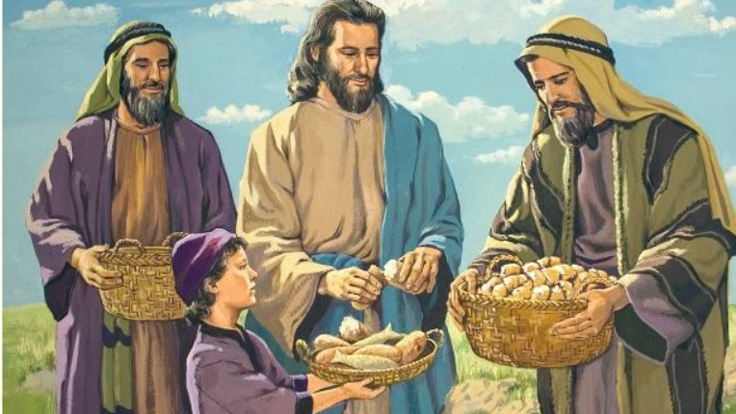
“There is a lad here who has five barley loaves and two small fish, but what are they among so many?” (John 6:9)

Slide 2
Blaming Oneself
Part 1
The Sin of Blame (Part 3)

Slide 3

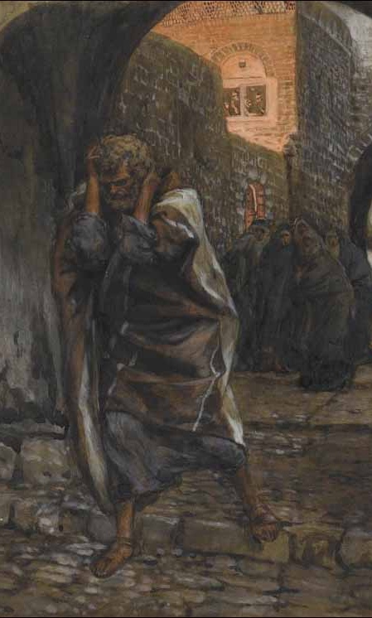
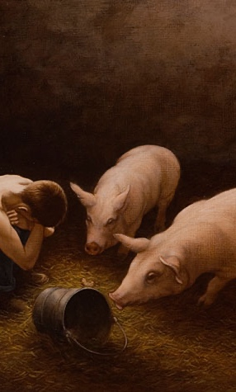
Healthy Self-Blame (Godly Sorrow)
"For godly sorrow produces repentance leading to salvation, not to be regretted; but the sorrow of the world produces death." (2 Cor. 7:10).
Example: The Prodigal Son (Luke 15:11-32)
Example: St. Peter vs. Judas

Slide 4
Healthy Self-Blame (Godly Sorrow)
"It is not sin that is grievous, but persisting in sin. For even if you have sinned, do not despair, but have recourse to repentance, for the Master is merciful and accepts repentance."
(St. John Chrysostom)
“Sorrow that does not lead to repentance is from the devil, for it darkens the soul and hinders prayer. True repentance brings hope, while the sorrow of the world brings despair."
(St. Basil the Great)

Slide 5
Destructive Self-Blame (Satanic Condemnation)
It is often fueled by the devil, who is called the Accuser,
"Then I heard a loud voice saying in heaven, 'Now salvation, and strength, and the kingdom of our God, and the power of His Christ have come, for the accuser of our brethren, who accused them before our God day and night, has been cast down.'" (Revelation 12:10).
"Despondency is a paralysis of the soul, an anticipation of hell." (St. John Climacus)
"He who thinks he is beyond forgiveness has already given himself over to the enemy.” (St. John Climacus)

Slide 6

Why Do We Blame Ourselves?

Slide 7
Pride in Disguise
Symptom: “I can’t believe I fell into this sin.”
"Do not despair of yourself because of your failings, but without ceasing, approach repentance. If you fall daily, rise daily." (St. Basil the Great)

Slide 8
Excessive focus on my weaknesses and failures
Symptom: “I cannot forgive myself.”
“But with me it is a very small thing that I should be judged by you or by a human court. In fact, I do not even judge myself. For I know of nothing against myself, yet I am not justified by this; but He who judges me is the Lord.” (1 Cor. 4:3-4)
“If we confess our sins, He is faithful and just to forgive us our sins and to cleanse us from all unrighteousness.” (1 Jn. 1:9)

Slide 9
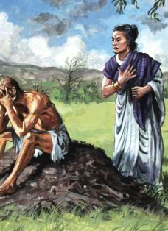
Influence of the Enemy
Satan accuses us before God, while also trying to drive us to despair.
EX: Job and his wife
"Does Job fear God for nothing? 10 Have You not made a hedge around him, around his household, and around all that he has on every side?...stretch out Your hand and touch all that he has, and he will surely curse You to Your face!" (Job 1:9-10,11)
“The devil rejoices when he sees a man despairing and saying: ‘There is no salvation for me.’” (St. Macarius the Great)

Slide 10

Childhood Wounds and Unresolved Guilt
Constant blaming and faulting children can lead them develop poor self-esteem and sense of failure, and self-condemnation.
How can parents distinguish between blaming a child vs teaching them responsibility and accountability for their choices and actions?

Slide 11
Distinguish between blaming a child vs teaching them responsibility and accountability
“And you, fathers, do not provoke your children to wrath, but bring them up in the training and admonition of the Lord.” (Ephesians 6:4)
"He who spares his rod hates his son, but he who loves him disciplines him promptly." (Proverbs 13:24)
"Do not withhold correction from a child, for if you beat him with a rod, he will not die. You shall beat him with a rod, and deliver his soul from hell." (Proverbs 23:13-14)

Slide 12
Distinguish between blaming a child vs teaching them responsibility and accountability
Focus on correction
Offer a solution vs just point our faults
Acknowledging progress despite repetitive infractions
Avoid “always” and “never” accusations
Show love and hope

Slide 13
The Dangers and Sinfulness of Excessive Self-Blame
Can lead us to despair
Despair leads to Spiritual Sickness
It hinders our repentance
How can we distinguish between health and destructive self-blame?

