Slide 1
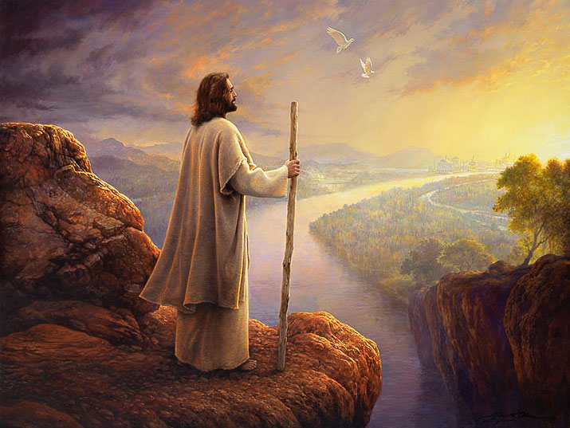
“…and will leave Me alone”
John 16:32

Slide 2
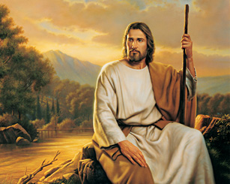
How and when do we leave Him alone?

Slide 3
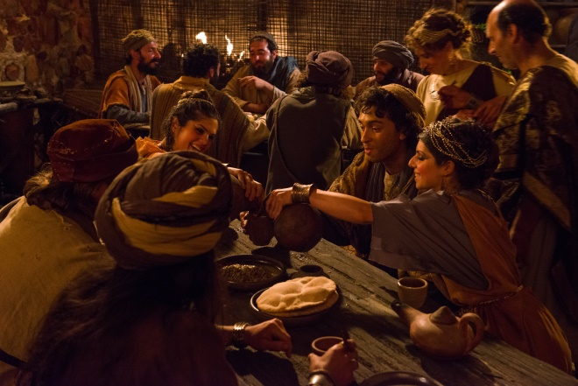
1. When we pursue a false freedom
This was the choice of the lost son
It is the choice of those who assume happiness through indulgence in worldly pleasures
The outcome is always the same: loneness, starvation, and serving the swine

Slide 4
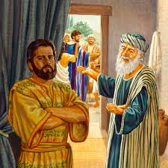
2. When we depart from love towards our brethren (1)
This was the choice of the older brother in the Parable of the Lost Son: “…But he was angry and would not go in” Luke 15:28
We cannot love the Father while we hate His children

Slide 5
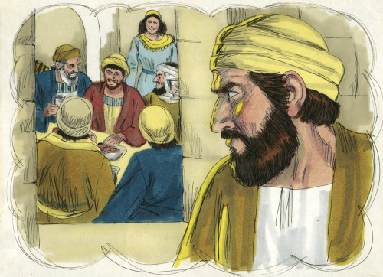
2. When we depart from love towards our brethren (2)
How many times did anger, grudges, and bitterness cause many to depart from the house of the Father?
“The gates of hell are locked on the inside” C.S. Lewis

Slide 6
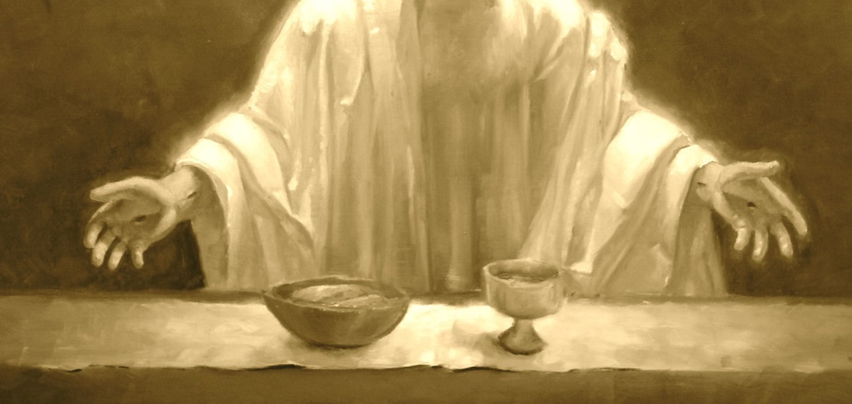
3. When we are too busy for Him! (1)
This was the case with those invited to the King’s banquet:
“But they made light of it and went their ways, one to his own farm, another to his
business” Matthew 22:5

Slide 7

3. When we are too busy for Him! (2)
Paying attention to the personal invitation and understanding the consequences of making light of it: “The wedding is ready, but those who were invited were not worthy” Matthew 22:8

Slide 8
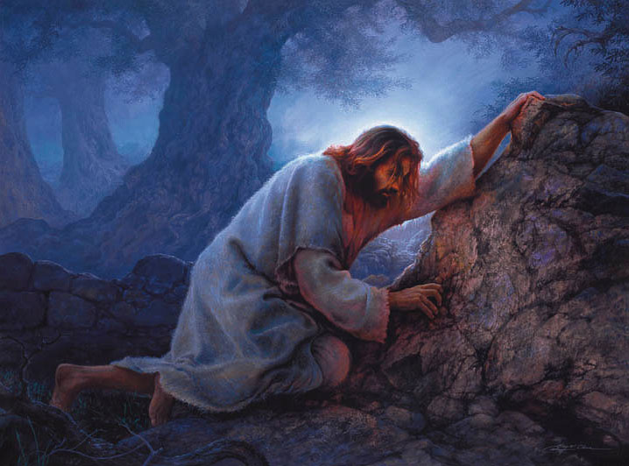
4. When we are overtaken with slackness! (1)
This is what happened in Gethsemane when the disciples could not stay awake with Him: “What! Could you not watch with Me one hour?” Matthew 26:40

Slide 9
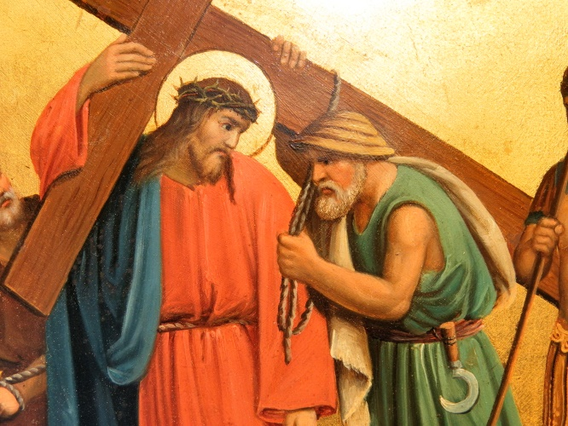
4. When we are overtaken with slackness! (2)
We pray, fast, attend vigils like Apocalypse, and all other
spiritual practices because we want to be with Him

Slide 10
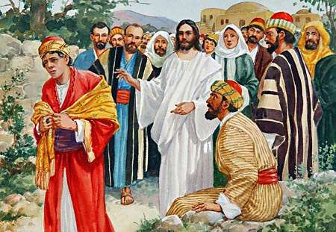
5. When we are taken with a loved sin
This was what made the young rich ruler turn away from the Lord Jesus: “But when the young man heard that saying, he went away sorrowful, for he had great possessions” Matthew 19:22

Slide 11
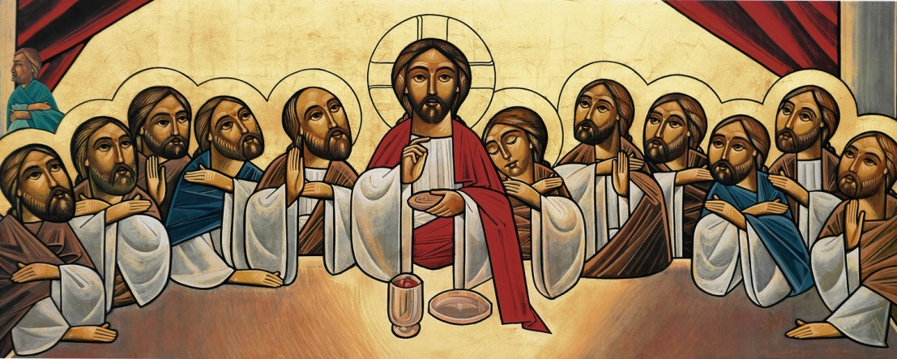
6. When we cannot raise our minds to accept the Faith (1)
This is what some of the disciples did when they stumbled at the doctrine of the Eucharist: “ From that time many of His disciples went back and walked with Him no more” John 6:66

Slide 12
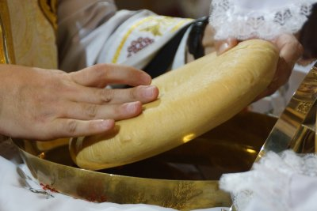
6. When we cannot raise our minds to accept the Faith (2)
Inventing new religion that can be approved by man’s mind led many to depart from following the Lord Jesus
Emptying Christianity of its doctrines and turning it into a code of conduct!

Slide 13
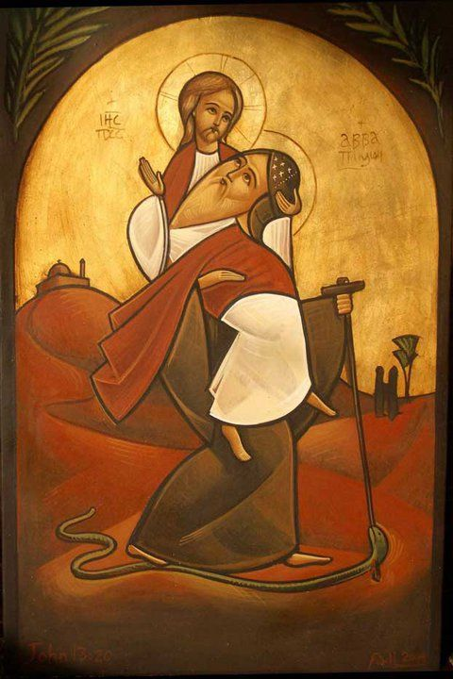
7. When we refrain from serving His brethren the needy
“ …inasmuch as you did not do it to one of the least of these, you did not do it to Me”
Matthew 25:45
The story of Abba Bishoy and the old man who wanted to climb the mountain

Slide 14

8. When we avoid the Cross (1)
This is what most of the disciples did at the time of the Crucifixion
Avoiding the Cross will lead us to depart from the Lord Jesus Himself

Slide 15
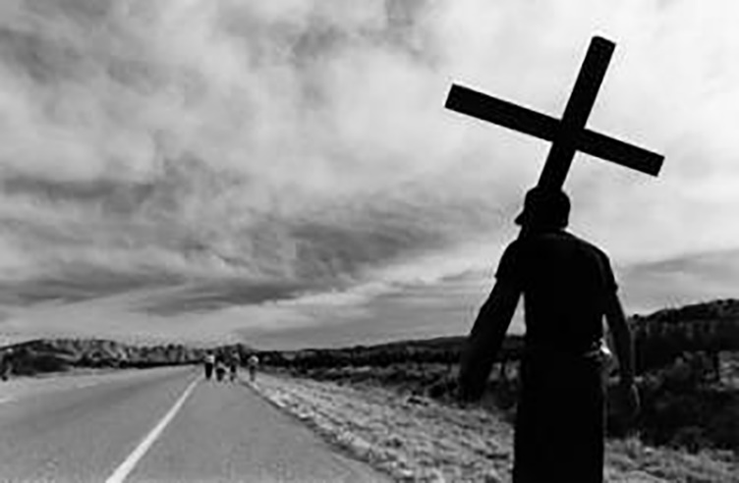
8. When we avoid the Cross (2)
“Whoever runs from tribulations escapes from God”
St. Paul the Simple

