Slide 1
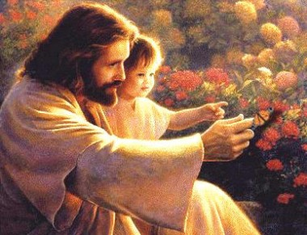
“…unless you are converted and become as little children, you will by no means enter the kingdom of heaven”
Matthew 18:3

Slide 2

How to “undo the heavy burden”
Isaiah 58:6

Slide 3
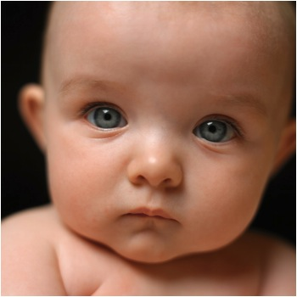
Highlights
The Challenge
The Answer
The Plan

Slide 4

The Challenge (1)
What to do with a bad habit?
How to regain purity for a mind that lost it with exposure to impure images and meditating on unclean thoughts?

Slide 5
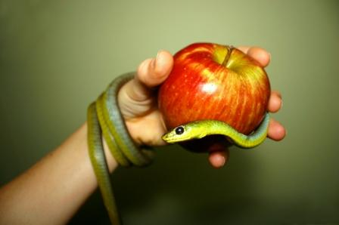
The Challenge (2)
How would simplicity be restored to a heart that has been exposed to what is evil?
Repentance will undo the penalty, but cannot cancel the experience of the unlawful

Slide 6
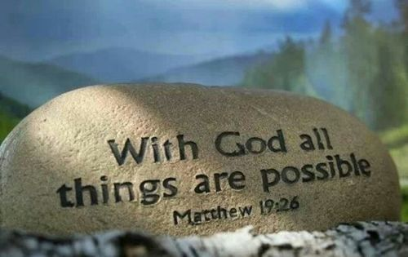
The Answer
God knows what is evil yet “God cannot be tempted by evil” James 1:13
“With men this is impossible, but with God all things are possible.” Matthew 19:26

Slide 7
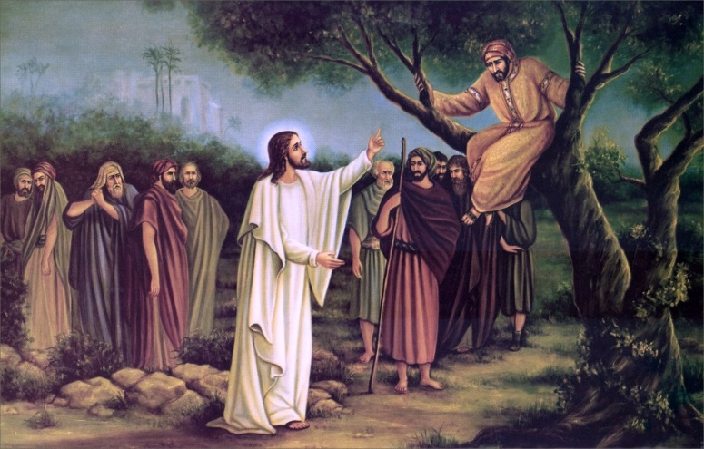
The Plan (1)
Be discontent with the distorted image and the heart that is defiled
- St. Moses and his search for the Creator
- Zacchaeus and his desire to meet with the Lord Jesus

Slide 8

The Plan (2)
God who created us is the One who can fix the image
- Pray always
- Trust that He can do what is beyond our ability

Slide 9
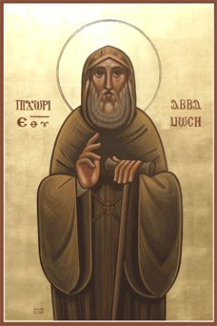
The Plan (3)
Discern between what you can and what you cannot do, what is your part and what is God’s
- St. Moses’ frequent confessions
- St. Moses serving others

Slide 10
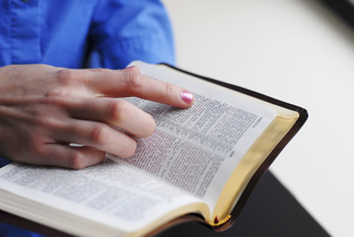
The Plan (4)
Change the exposure and the atmosphere
Undo practices:
- Fasting
- Readings
- Long prayers
- Abstain from sensual stimulation

Slide 11
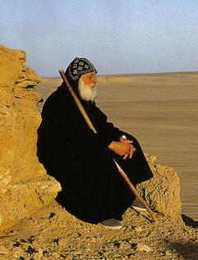
The Plan (5)
Put away childish things:
“When I was a child,
I spoke as a child,
I understood as a child,
I thought as a child;
but when I became a man,
I put away childish things”
1 Corinthians 13:11

Slide 12
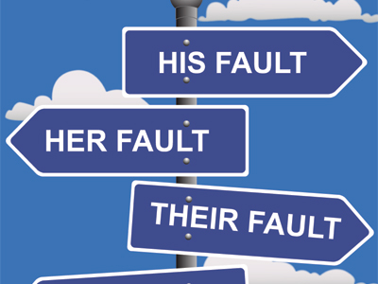
The Plan (6)
Put away childish things: (cont.)
- Stop blaming others
- Accept the consequences of one’s actions
- Stop self-pity

