Slide 1
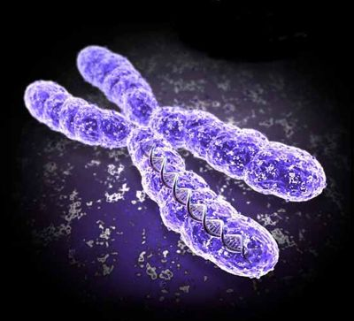

It’s Genetic…

Slide 2
Homosexuality: Outline
Biblical Context
Social Context
Scientific Context
Response in Current Social Context
Response to Individuals

Slide 3
Biblical Context
The Bible is unambiguous on God’s view of homosexuality
“You shall not lie with a male as with a woman. It is an abomination. Nor shall you mate with any animal, to defile yourself with it. Nor shall any woman stand before an animal to mate with it. It is perversion.”
(Leviticus 18:22 – 23)
Commandment

Slide 4
Biblical Context
“Do you not know that the unrighteous will not inherit the kingdom of God? Do not be deceived. Neither fornicators, nor idolaters, nor adulterers, nor homosexuals, nor sodomites, nor thieves, nor covetous, nor drunkards, nor revilers, nor extortioners will inherit the kingdom of God.”
(Corinthians 6:9-10)
FACT

Slide 5
Biblical Context
“For this reason God gave them up to vile passions. For even their women exchanged the natural use for what is against nature. Likewise also the men, leaving the natural use of the woman, burned in their lust for one another, men with men committing what is shameful, and receiving in themselves the penalty of their error which was due.”
(Romans 1:26 – 27)
FACT

Slide 6

Social Context
Accepting homosexuality is equated with tolerance. Being unsupportive of efforts to normalize homosexuality, even on the basis of sincerely held religious beliefs, is labeled ‘intolerant’.

Slide 7
Social Context
Protected classes:
Involuntary | Voluntary
Race | Religion
Color | Pregnancy
National Origin | Citizenship
Age | Familial Status
Gender | Veteran Status
Disability
Genetic Information

Slide 8

Scientific Context
Is homosexuality genetic?
Is homosexuality epigenetic?
Is homosexuality a choice?
Dr. NE Whitehead
Ph.D. biochemistry
Reviewed over 10,000 papers during over 20 yrs.

Slide 9
Scientific Context
Genes
Twins
Fetal Development
Psychology
Change
Behavior

Slide 10
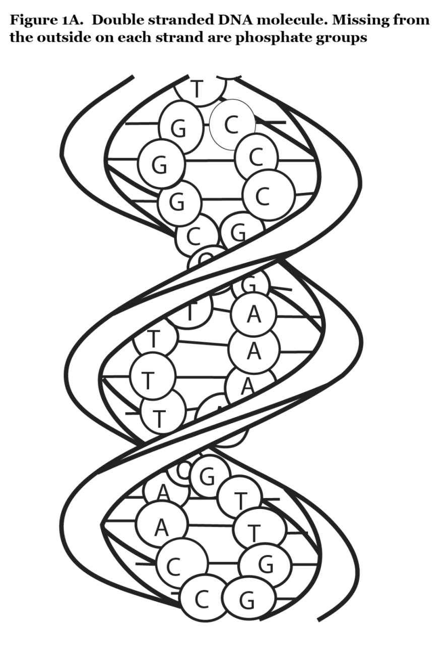
Scientific Context – Genes
Genes are lengths of DNA that encode the formation of proteins.
Human genome consists of over 3 billion base pairs.
~0.1% difference between the genes of two individual humans.
Loosely speaking, genes are responsible for the chemistry of our bodies.

Slide 11
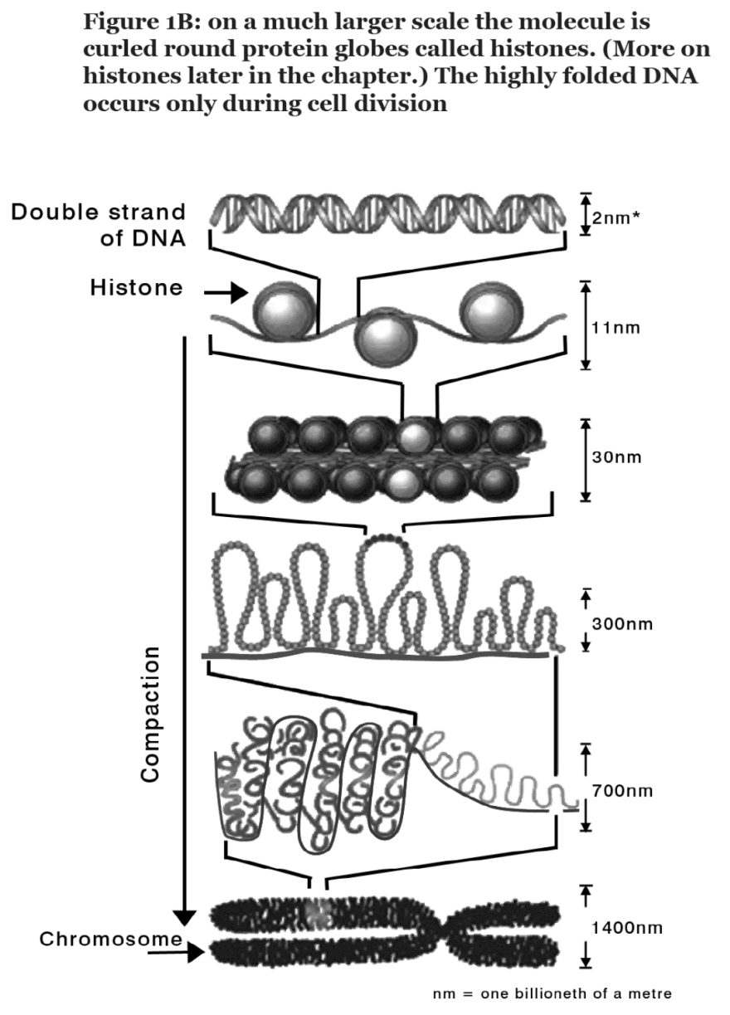
Scientific Context – Genes
There is no plausible way that genes could dictate behavior
Even simple traits are typically attributed to multiple genes
A genetically dominated SSA caused by multiple genes would not likely skip a generation

Slide 12
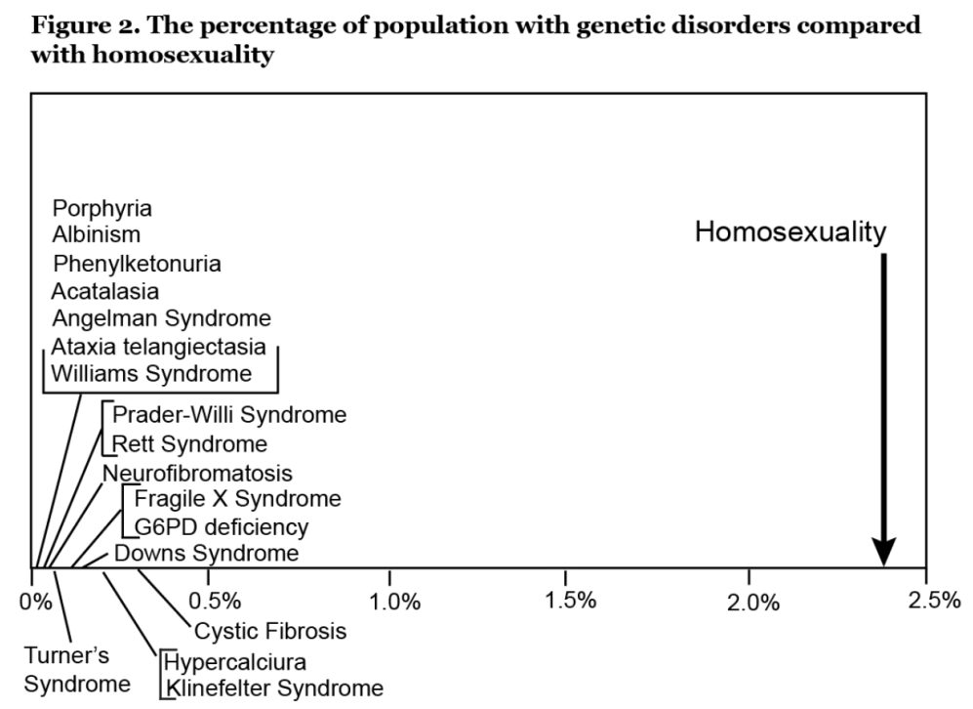
Scientific Context – Genes
Homosexuality occurs too frequently to be caused by a mutation of a single gene
(90x too high)

Slide 13

Scientific Context – Twins
Identical twins have the same genes.
If homosexuality is genetic, identical twins would both be homosexual.
However, co-twins of homosexuals are only 11-14% concordant.

Slide 14
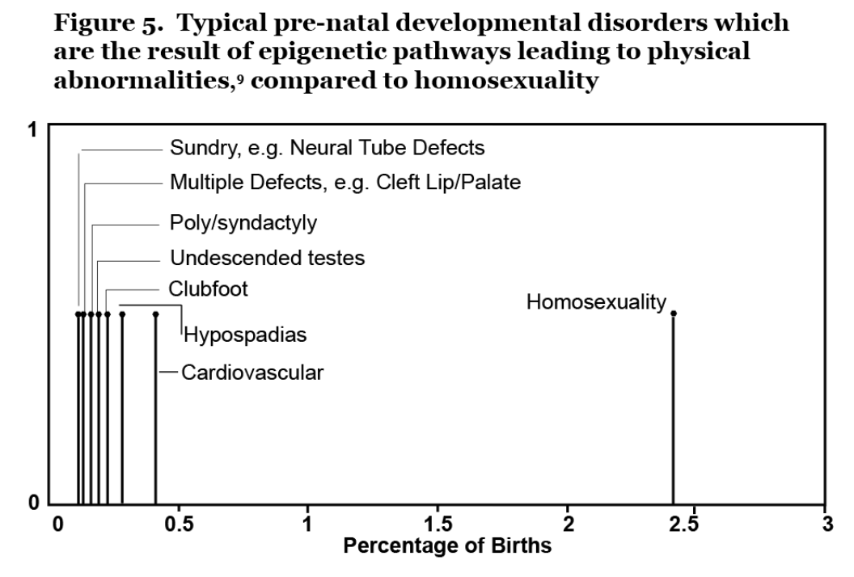
Scientific Context – Fetal Development
Homosexuality occurs too frequently to be caused by a fetal development error (epigenetic)
Homosexuality is not a physical abnormality like other epigenetic abnormalities.

Slide 15
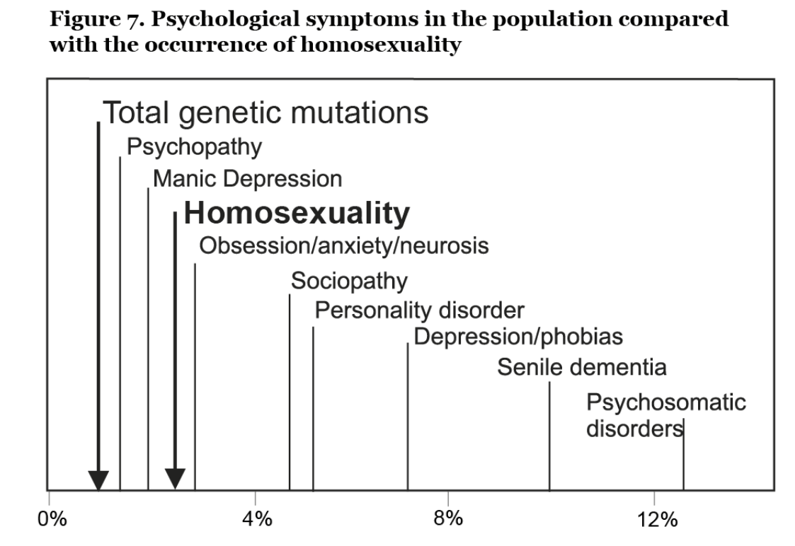
Scientific Context – Psychology
From 1952 – 1974 homosexuality was listed in the DSM as a sociopathic personality disorder.
Occurrences of homosexuality are more consistent with psychological disorders.

Slide 16
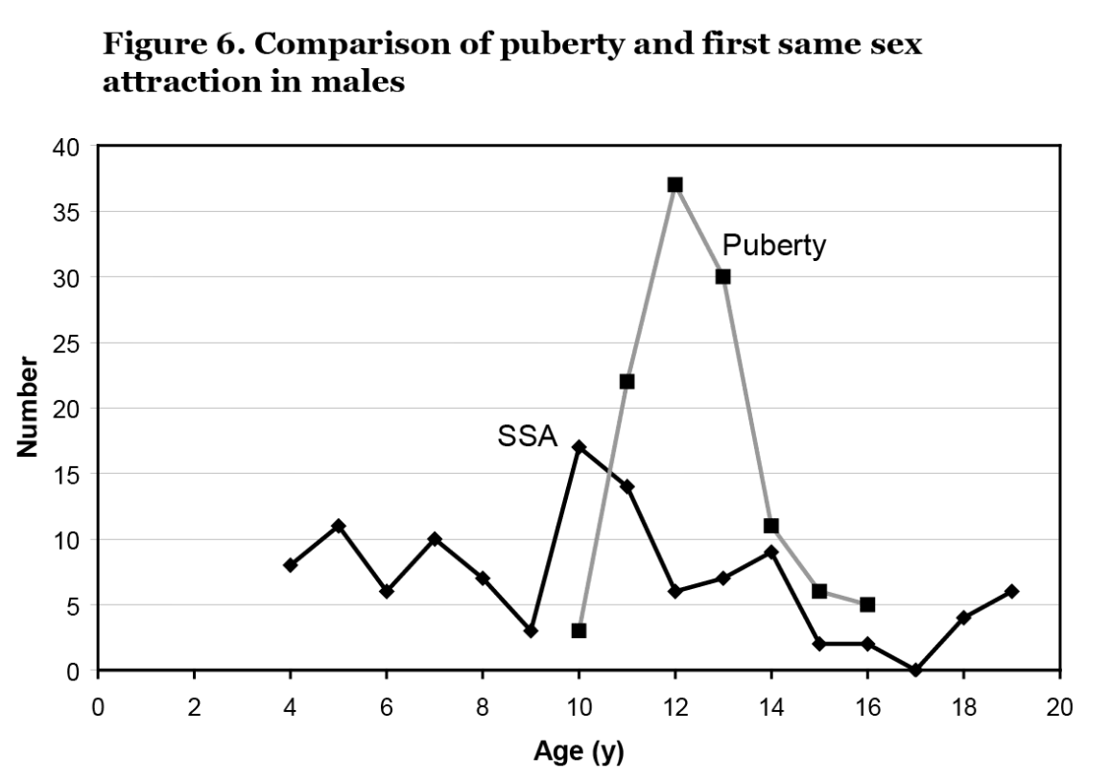
Scientific Context – Change
SSA is more erratic than genetically influenced events or sequences of events.

Slide 17
Scientific Context – Change
About ½ of adults who once had exclusive SSA moved to heterosexuality
Ex-gays outnumber actual gays
Exclusive OSA is more stable than exclusive SSA (17x for men, 30x for women)
Teens overwhelmingly shift from SSA to OSA (particularly from age 16 – 17)

Slide 18
Scientific Context – Behavior
The genetic influence of homosexuality is only about 10% (similar to other behaviors)
Environmental factors play a much stronger role in development of SSA
Homosexuality is a complex behavior that cannot be attributed to a single factor (genetic, hormonal, social, developmental, environmental etc.)
It can be changed (with or without therapy).

Slide 19
Response in Current Social Context
As Christians, is there a limitation on our tolerance of the weaknesses of others?
And even as they did not like to retain God in their knowledge, God gave them over to a debased mind, to do those things which are not fitting;…who, knowing the righteous judgment of God, that those who practice such things are deserving of death, not only do the same but also approve of those who practice them.
(Romans 1:28, 32)

Slide 20
Response in Current Social Context
So, as the Christian owner of a bakery, should I sell cookies or cupcakes to a same-sex couple?
Should I sell a wedding cake to a same-sex couple?

Slide 21
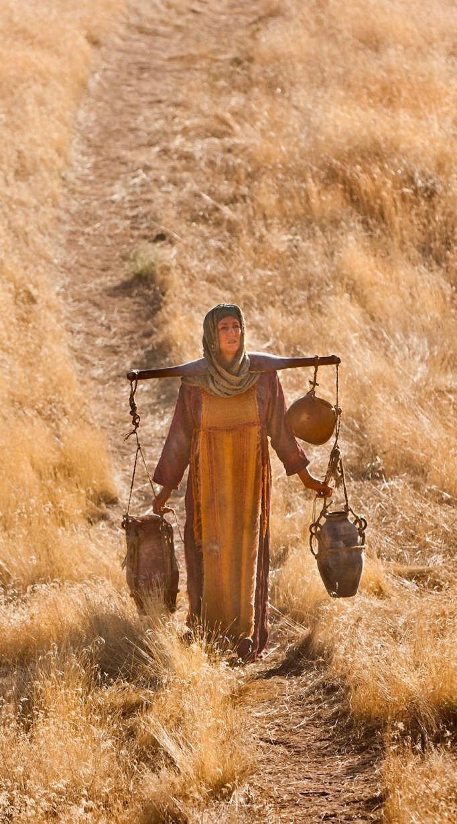
Response to Individuals
As Christians, we represent Christ to those who do not know Him.
First and foremost, Christ is love.
The pinnacle of love is to bring people to Christ.
For someone who is hurting & wounded by the attack of Satan, condemnation will not bring them to Christ. (Samaritan Woman)
However, accepting sin is not a loving response either.

Slide 22
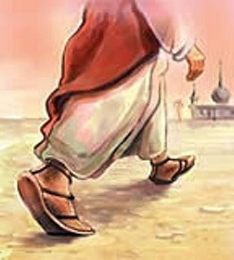
Response to Individuals
Whatever city you enter, and they receive you, eat such things as are set before you. And heal the sick there, and say to them, ‘The kingdom of God has come near to you.’ But whatever city you enter, and they do not receive you, go out into its streets and say, ‘The very dust of your city which clings to us we wipe off against you. (Luke 10:8-11)

Slide 23
Summary
Homosexuality is unambiguously an abomination to God
Society is pushing broad acceptance of homosexuality
The scientific evidence suggests that the genetic influence on homosexuality is minimal
We are not called to condemn others, but we must not compromise God’s value system
To those that are hurt, we must show them love by bringing them to Christ
To those who refuse, they have chosen their own condemnation

