Slide 1

Tolerance and the Evolution of Truth

Slide 2

Evolution of Truth

Slide 3
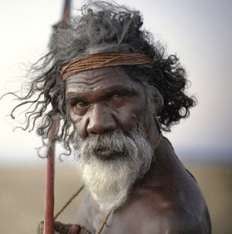
Premodern Era (Before 1750)
Culturally coherent
No social diversity
Minimal social change
Pre-scientific
Little exposure to outsiders
Religious and superstitious
I believe because it’s the only thing I know

Slide 4
Modern Era (1750-1900)
Protestant Reformation
Enlightenment
Questioning Divine revelation
The goal of Enlightenment was to: “free humanity from superstition and found a philosophy and civilization on rational inquiry, empirical evidence and scientific discovery.”
Science and rationality were the only tools to discover truth

Slide 5
Modern Era
Early modernists attempted to retain objective moral values
Later modernists are moral relativists
Religion seen as irrational
I believe because I can prove it

Slide 6
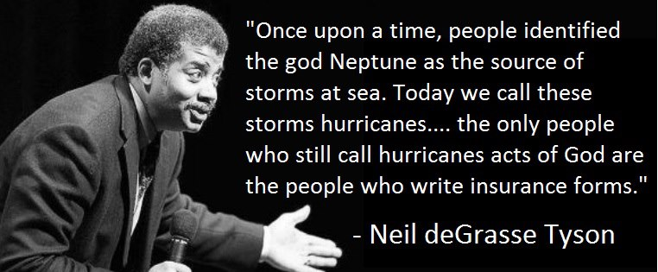
Scientism
An outgrowth of modernism
All truth must be scientifically proven
Science defines the limits of knowledge
Progress is inevitable through science

Slide 7
Postmodern Era (1900+)
Common with Modernism:
  Largely atheistic or agnostic
  Denies the supernatural – naturalistic
  Postmodernism is modernism carried to it’s logical conclusion
Rejects scientism
Rejects rationalism
Truth is an empty, but powerful political tool

Slide 8
Postmodern Era
Science is domineering, oppressive, and unable to discern truth
“Progress” only serves the interests of the dominant culture
“truth is what one's peers let one get away with” –Rorty
The idea that truth is objective is abandoned

Slide 9
Postmodern Era
Truth is not over and above us, something that can be conveyed across cultures and over time.
It is inseparable from our cultural conditioning, our psychology, our race and our gender.
Truth is simply what we, as individuals and as communities, make it to be-and nothing more.

Slide 10
Postmodern Era
The end of theism brought with it the end of objective value, meaning and significance
Altruism had no basis in a universal moral law
Walter Truett Anderson observes, we find in these postmodern times "a strange and unfamiliar kind of ideological conflict: not merely conflict between beliefs, but conflict about belief itself."'
I believe whatever I want to believe

Slide 11
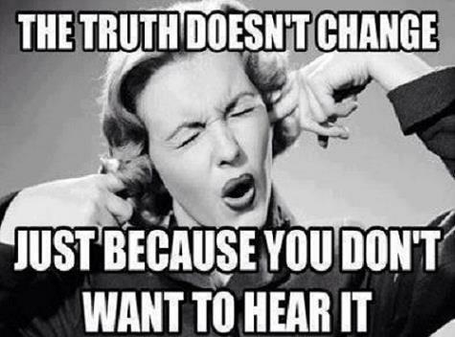
Theories of Truth

Slide 12

Correspondence Theory
Aquinas: "A judgment is said to be true when it conforms to the external reality."
Coherence is necessary, but not sufficient

Slide 13
Correspondence Theory
1 Corinthians 15:14-15
And if Christ is not risen, then our preaching is empty and your faith is also empty. Yes, and we are found false witnesses of God, because we have testified of God that He raised up Christ, whom He did not raise up—if in fact the dead do not rise.

Slide 14
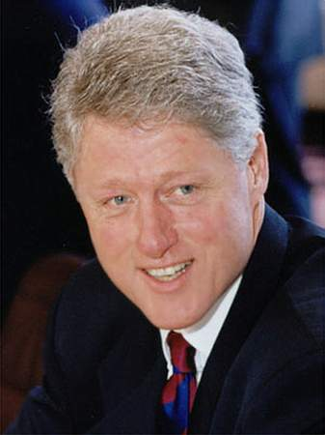
Coherence Theory
If a set of statements is consistent with another, that is enough to make it true.

Slide 15
Clinton and Lewinsky
Statement: "there's nothing going on between us."
Explanation: "It depends on what the meaning of the word 'is' is. If 'is' means is and never has been…that is one thing. If it means there is none, that was a completely true statement....Now, if someone had asked me on that day, are you having any kind of sexual relations with Ms. Lewinsky, that is, asked me a question in the present tense, I would have said no. And it would have been completely true.“

Slide 16
Pragmatic Theory
“Truth” is what is useful
It is useful to believe that my spouse is faithful
VS
It is true that my spouse is faithful

Slide 17
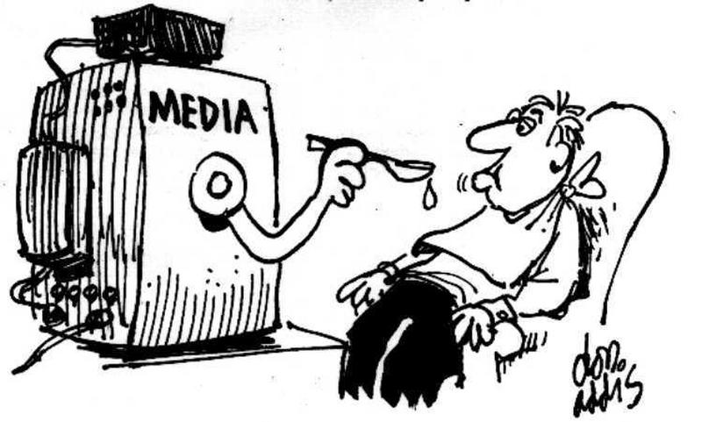
Role of the Media

Slide 18

Premodern
Word of mouth
No methodology for discerning true from false

Slide 19
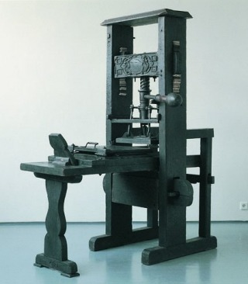
Modern
Written words: Printing press
Written word easily distributed
Knowledge and information transfer
Easier to assess the truth value of a statement

Slide 20
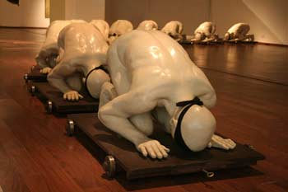
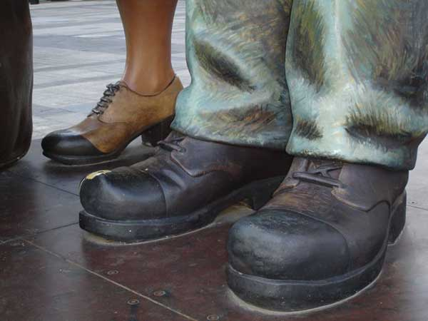
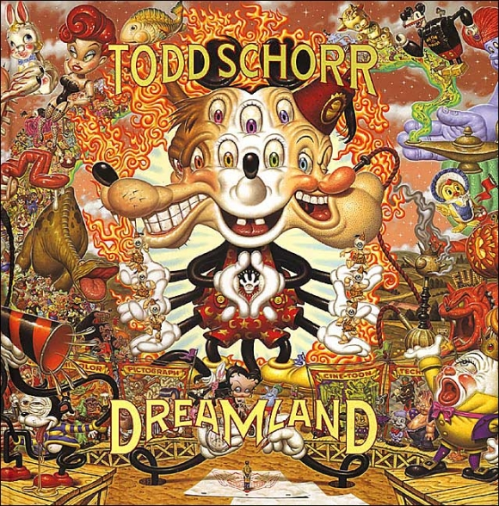
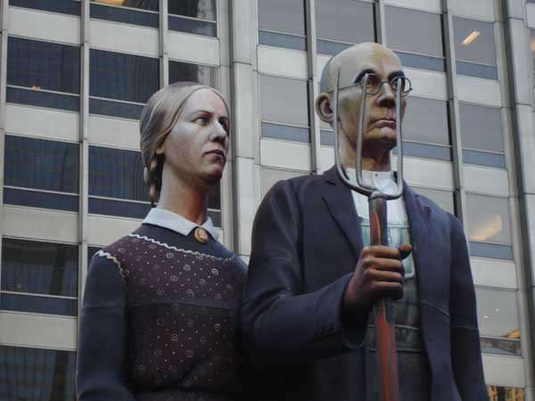

Postmodern

Slide 21
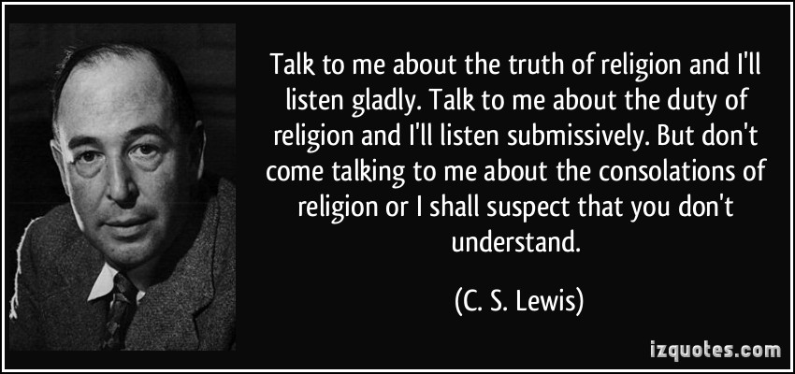
Truth and Religion

Slide 22
Morality without religion?
Morality is grounded in religion
Modernism denied religion, but most still maintained morality based on that religious foundation
Postmodernism turned morality into a relative concept – created by cultures, and not by God
If there is no standard to judge one's beliefs against reality, why change a set of beliefs, except for some self-serving purpose?
“God is dead”

Slide 23
Friedrich Nietzsche
Nietzsche poetically described the results of God's demise in a series of arresting questions uttered by an atheistic prophet:
Who gave us the sponge to wipe away the entire horizon? What did we do when we unchained this earth from its sun? Where is it moving now? Where are we moving now? Away from all suns? Are we not plunging continually? Backward, sideward, forward, in all directions? Is there any up or down left? Are we not straying as through an infinite nothing? Do we not feel the breath of empty space? Has it not become colder? Is not night and more night coming on all the while?

Slide 24
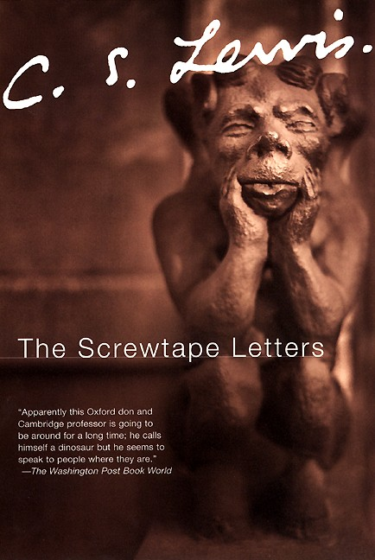
Screwtape Letters
Your man has been accustomed, ever since he was a boy, to have a dozen incompatible philosophies dancing about together inside his head. He doesn't think of doctrines as primarily "true" or "false," but as "academic" or "practical," "outworn" or "contemporary," "conventional" or "ruthless." Jargon, not argument, is your best ally in keeping him from the Church.

Slide 25
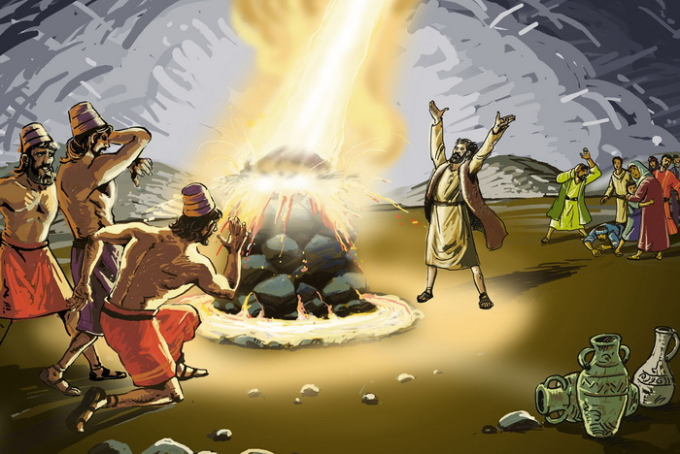
Christianity is based on absolutes
1 Kings 18:21
And Elijah came to all the people, and said, “How long will you falter between two opinions? If the Lord is God, follow Him; but if Baal, follow him.” But the people answered him not a word.

Slide 26
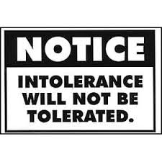
Postmodern Tolerance

Slide 27
What tolerance is NOT
Not remaining silent towards behavior you disagree with
  I believe abortion is wrong, but I will not rebuke or condemn anyone who does it
Not changing your mind that a certain action is wrong
  I used to believe that abortion is wrong, but now I see that is acceptable

Slide 28
What tolerance IS
Not claiming any belief you hold corresponds with reality
  Abortion is a personal choice, and there is no right answer
Not claiming that a belief is better than any other belief
  The belief that abortion is wrong is not better than the belief that it’s right and vice-versa
Not condemning any belief you don’t share
  Abortion is not wrong. I might not think it’s right for me, but it might be ok for you
Not holding any exclusive beliefs
  Murders will not inherit the Kingdom of God

Slide 29
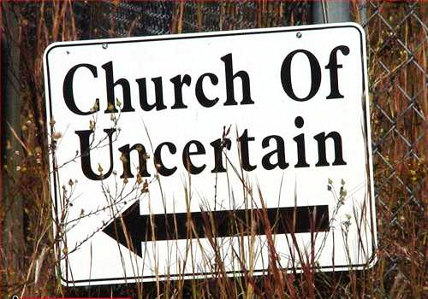
Postmodern Christianity
Experience over reason
Subjectivity over objectivity
Spirituality over religion
Images over words
Outward over inward
Bible not absolute source of truth

Slide 30

Orthodoxy

Slide 31
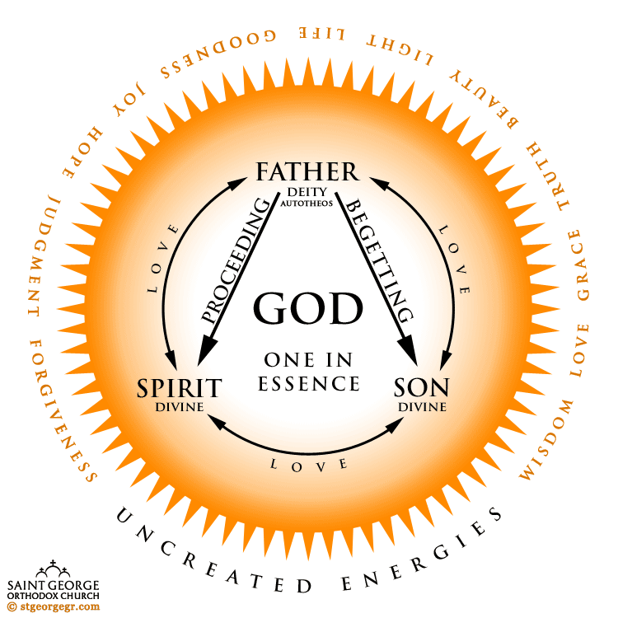
Premodern
Some things we do not question, even if there is no scientific “proof”
  God’s existence
  The nature of the Trinity
  The existence of heaven
  Sacraments

Slide 32

Modern
There are absolute truths, even if we can’t always discover them
There is evidence for God:
  Psalm 18: The heavens declare the glory of God; and the firmament proclaims the work of His hands. Day to day utters speech, and night to night proclaims knowledge.

Slide 33

Modern
Christ is the Logos (rational)
We can rationalize many things:
  The fall and the need for resurrection
  Atoning death of Christ
  The empty tomb
  The creation had to have a source

Slide 34
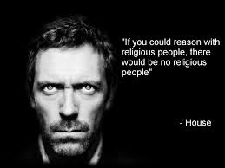
Postmodern
We reject scientism and rationalism

Slide 35
Glory be to GOD forever

