Slide 1
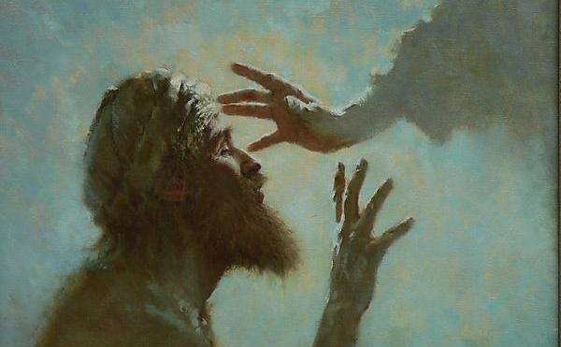
Unchanged Hearts
Parents of the Man Born Blind

Slide 2
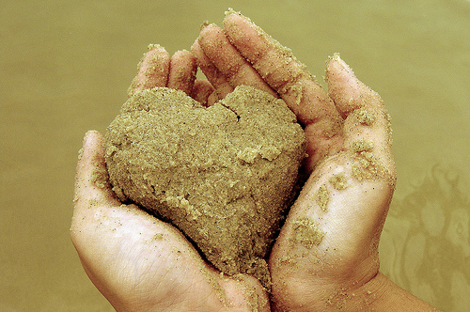
What changes a heart?
For this is the covenant that I will make with the house of Israel after those days, says the Lord: I will put My laws in their mind and write them on their hearts; and I will be their God, and they shall be My people. (Hebrews 8:10)

Slide 3
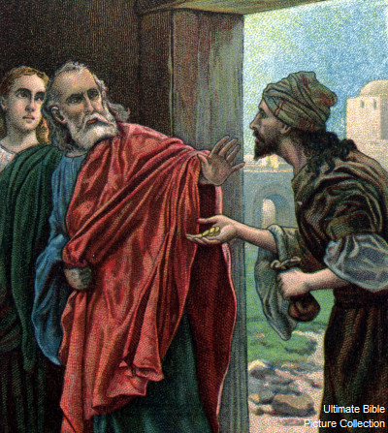
Miracles?
Acts 8:13, 18-19
Then Simon himself also believed; and when he was baptized he continued with Philip, and was amazed, seeing the miracles and signs which were done...And when Simon saw that through the laying on of the apostles’ hands the Holy Spirit was given, he offered them money, saying, “Give me this power also, that anyone on whom I lay hands may receive the Holy Spirit.”

Slide 4
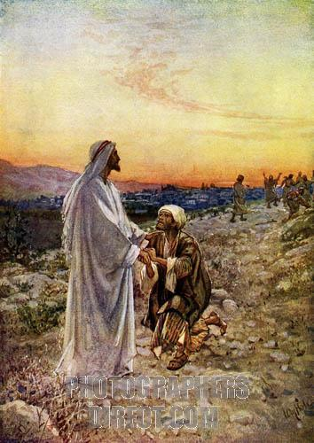
Healing?
Luke 17:17-19
So Jesus answered and said, “Were there not ten cleansed? But where are the nine? Were there not any found who returned to give glory to God except this foreigner?” And He said to him, “Arise, go your way. Your faith has made you well.”

Slide 5
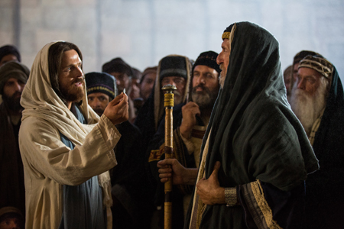
Rebuke?
Matthew 23:13
“But woe to you, scribes and Pharisees, hypocrites! For you shut up the kingdom of heaven against men; for you neither go in yourselves, nor do you allow those who are entering to go in.

Slide 6
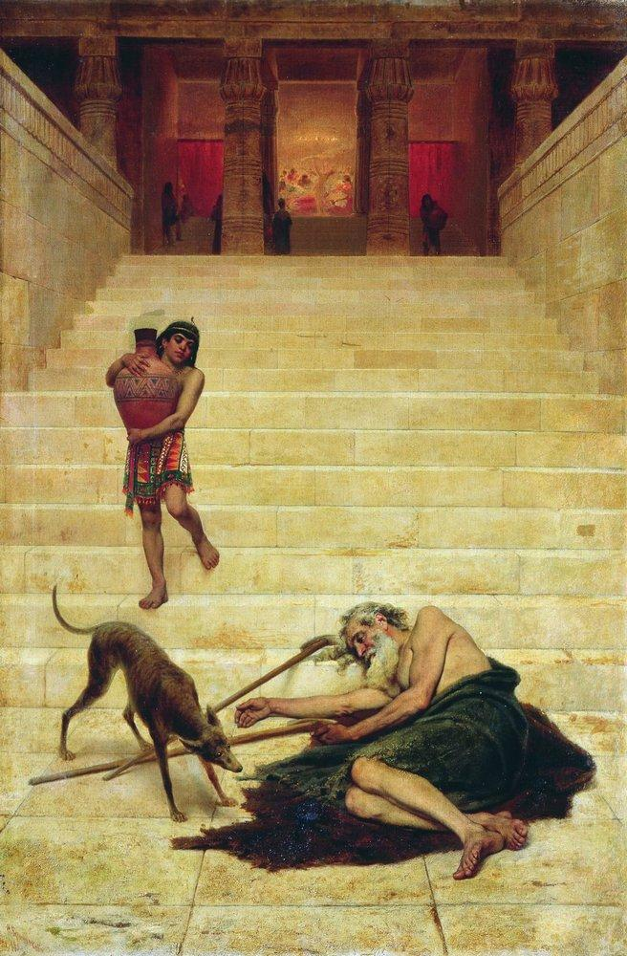
Raising the Dead?
Luke 16:27-31
“Then he said, ‘I beg you therefore, father, that you would send him to my father’s house, for I have five brothers, that he may testify to them, lest they also come to this place of torment.’ Abraham said to him, ‘They have Moses and the prophets; let them hear them.’ And he said, ‘No, father Abraham; but if one goes to them from the dead, they will repent.’ But he said to him, ‘If they do not hear Moses and the prophets, neither will they be persuaded though one rise from the dead.’”

Slide 7
Man Born Blind
John 9:1, 4-11
Now as Jesus passed by, He saw a man who was blind from birth... I must work the works of Him who sent Me while it is day; the night is coming when no one can work. As long as I am in the world, I am the light of the world.” When He had said these things, He spat on the ground and made clay with the saliva; and He anointed the eyes of the blind man with the clay. And He said to him, “Go, wash in the pool of Siloam” (which is translated, Sent). So he went and washed, and came back seeing. Therefore the neighbors and those who previously had seen that he was blind said, “Is not this he who sat and begged?” Some said, “This is he.” Others said, “He is like him.” He said, “I am he.” Therefore they said to him, “How were your eyes opened?” He answered and said, “A Man called Jesus made clay and anointed my eyes and said to me, ‘Go to the pool of Siloam and wash.’ So I went and washed, and I received sight.”

Slide 8
The Man’s Response
John 9:24-38
So they again called the man who was blind, and said to him, “Give God the glory! We know that this Man is a sinner.” He answered and said, “Whether He is a sinner or not I do not know. One thing I know: that though I was blind, now I see.” Then they said to him again, “What did He do to you? How did He open your eyes?” He answered them, “I told you already, and you did not listen. Why do you want to hear it again? Do you also want to become His disciples?” Then they reviled him and said, “You are His disciple, but we are Moses’ disciples. We know that God spoke to Moses; as for this fellow, we do not know where He is from.” The man answered and said to them, “Why, this is a marvelous thing, that you do not know where He is from; yet He has opened my eyes!

Slide 9
The Man’s Response
Now we know that God does not hear sinners; but if anyone is a worshiper of God and does His will, He hears him. Since the world began it has been unheard of that anyone opened the eyes of one who was born blind. If this Man were not from God, He could do nothing.” They answered and said to him, “You were completely born in sins, and are you teaching us?” And they cast him out. Jesus heard that they had cast him out; and when He had found him, He said to him, “Do you believe in the Son of God?” He answered and said, “Who is He, Lord, that I may believe in Him?” And Jesus said to him, “You have both seen Him and it is He who is talking with you.” Then he said, “Lord, I believe!” And he worshiped Him.

Slide 10
Parent’s Response
John 9:18-23
But the Jews did not believe concerning him, that he had been blind and received his sight, until they called the parents of him who had received his sight. And they asked them, saying, “Is this your son, who you say was born blind? How then does he now see?” His parents answered them and said, “We know that this is our son, and that he was born blind; but by what means he now sees we do not know, or who opened his eyes we do not know. He is of age; ask him. He will speak for himself.” His parents said these things because they feared the Jews, for the Jews had agreed already that if anyone confessed that He was Christ, he would be put out of the synagogue. Therefore his parents said, “He is of age; ask him.”

Slide 11
Magnitude of the Miracle
No small miracle - “Since the world began it has been unheard of that anyone opened the eyes of one who was born blind.”
Why did the parent’s not believe?
  Fear or rejection or losing their place
  They were happy with the miracle, but did not want the “inconvenience” that came with it
  They were more interested in physical comfort rather than seeking the truth
  They rationalized that this would pass and things would return to “normal”
  They were afraid of what a new life might look like

Slide 12

1. Fear of losing
They did not doubt the miracle, but were afraid of admitting it
Pharisees hated Christ for the same reason:
  John 11:47-48
  Then the chief priests and the Pharisees gathered a council and said, “What shall we do? For this Man works many signs. If we let Him alone like this, everyone will believe in Him, and the Romans will come and take away both our place and nation.”
Christ’s presence tears apart the established social order. Are we afraid of losing our place?
  The rich is no longer better than the poor
  The wise no longer wiser than the simple
  The first becomes last, and the last first

Slide 13
1. Fear of losing
What are we afraid to lose?
Death is the loss of all earthly things
We are asked to give up the world willingly, so that it is not taken from us unwillingly
Romans 6:21 - What fruit did you have then in the things of which you are now ashamed? For the end of those things is death.
Are we clinging to temporary things that we think will last forever? Are we afraid of losing our lifestyle for the sake of following God? Do we try to both live a godly life and a godless life at the same time?

Slide 14
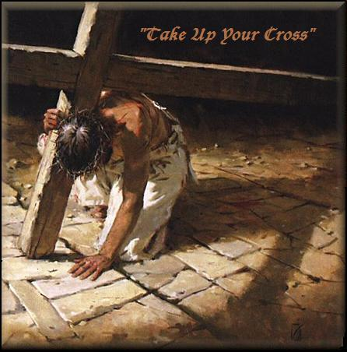
2. Inconvenience
How often had the parents prayed to God?
How joyful were they when he was healed?
Rich young ruler - “One thing you lack: Go your way, sell whatever you have and give to the poor, and you will have treasure in heaven; and come, take up the cross, and follow Me.” Is this what we are looking for?
It’s easy to talk about “loving your neighbor” or “following the commandments.”
Are we just looking for the blessings of God?

Slide 15
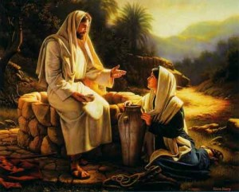
3. Physical Comfort vs. Truth
Who seeks the truth?
Why didn’t the parents willingly abandon the synagogue and go after Him?
He freed them from the burden of caring for their blind son
Were they ever worshiping God in truth or just their culture?

Slide 16

3. Physical Comfort vs. Truth
Should we question the truth? Should we question the Church?
No questioning → Superficial faith
Parents found excuses and didn’t want to acknowledge that the truth required of them to abandon their old way of life and pursue a new path.
Have we invested too much into our old way of life?
Philippians 3:8 - Yet indeed I also count all things loss for the excellence of the knowledge of Christ Jesus my Lord, for whom I have suffered the loss of all things, and count them as rubbish, that I may gain Christ

Slide 17
4. Desire for Normalcy
Things will just go back to normal and we can forget this ever happened
  Exodus 16:3 - And the children of Israel said to them, “Oh, that we had died by the hand of the Lord in the land of Egypt, when we sat by the pots of meat and when we ate bread to the full! For you have brought us out into this wilderness to kill this whole assembly with hunger.”
Change or accommodate?
Did the parents feel that they could just go on attending the synagogue? What about their son? What about their friends? How can we return to the way we were after we realize the truth?
Once we understand the reality of God, we must change

Slide 18
5. The Unknown
How will I live, who will my friends be, how will I spend my time?
No detailed plan when calling the disciples. Many left family.
They followed because they trusted Him, not because they understood where He was leading them
Ultra-rational modern age
God does not call us to a life of control, but one of faith, submission, and trust.
Perhaps the parents were too afraid of the life ahead
What will our life look like with God?
What will we give up, how will we spend our time? We ask the same thing about heaven…

Slide 19
Conclusion
Miracles don’t change the heart. If God knows they will help you, He’ll give them.
Seek God and the truth
Be willing to sacrifice everything to be conformed to the truth
Living what you know is more important than gaining more knowledge
Jeremiah 29:13 - And you will seek Me and find Me, when you search for Me with all your heart.

