Slide 1
Cast Down but Unconquered

Slide 2
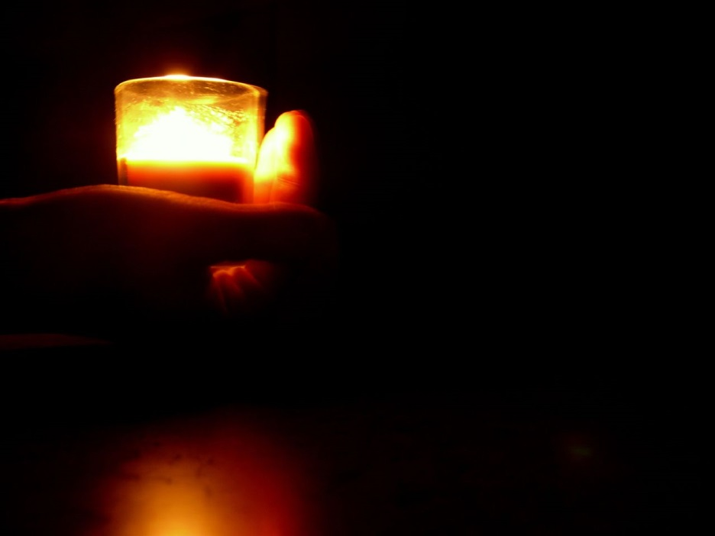
Light to shine out of darkness
2 Corinthians 4:6
For it is the God who commanded light to shine out of darkness, who has shone in our hearts to give the light of the knowledge of the glory of God in the face of Jesus Christ.

Slide 3
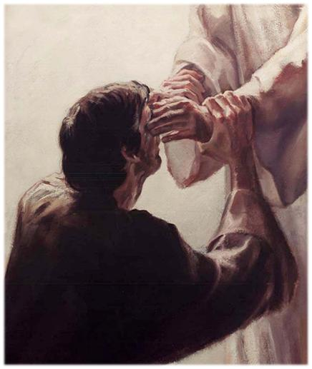
Light to shine out of darkness
God created light from darkness
He creates from nothing (eyes of the blind man)
He compares the darkness in our hearts to the darkness before creation

Slide 4
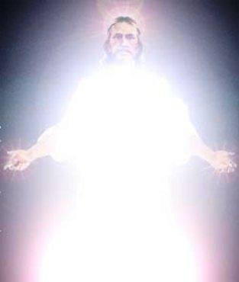
God is light
How does the light shine?
1 John 1:5 - This is the message which we have heard from Him and declare to you, that God is light and in Him is no darkness at all.

Slide 5
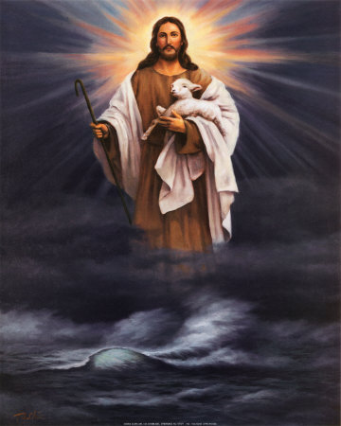
God is light
God’s light does not shine on us unless we know Him
John 14:7 - “If you had known Me, you would have known My Father also; and from now on you know Him and have seen Him.”

Slide 6
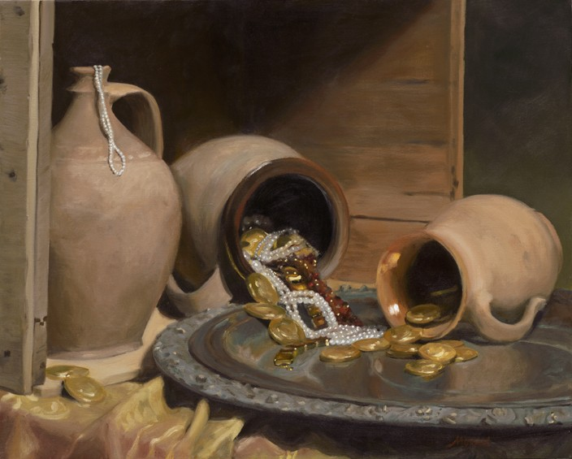
Treasure in Earthen Vessels
2 Corinthians 4:7
But we have this treasure in earthen vessels, that the excellence of the power may be of God and not of us.

Slide 7
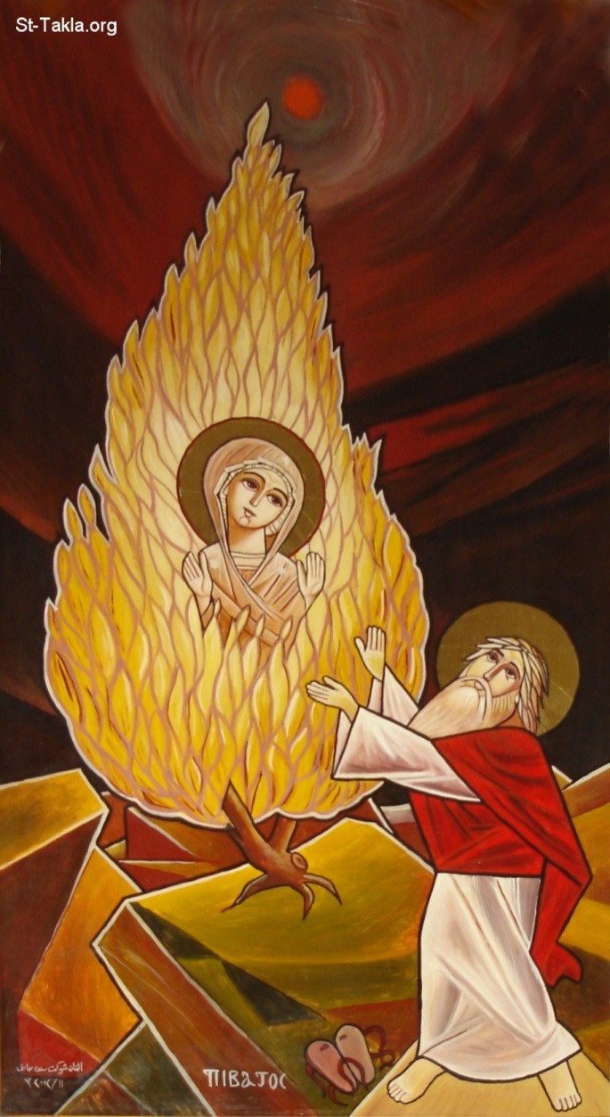
Treasure in Earthen Vessels
Our flesh (earthen vessels) contains the treasure of the light of God.
How can flesh contain spirit? Through the mysteries of the Church.
St. Mary carrying Christ in her womb

Slide 8
Hard-pressed
2 Corinthians 4:8-9
We are hard-pressed on every side, yet not crushed; we are perplexed, but not in despair; persecuted, but not forsaken; struck down, but not destroyed—

Slide 9
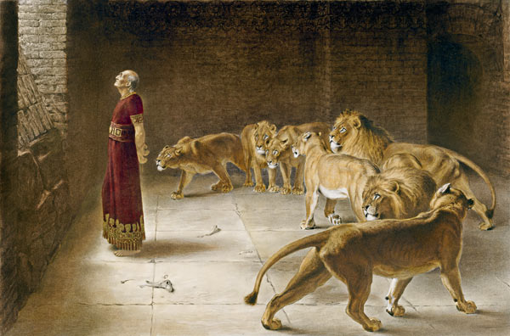
Suffering
We will suffer hardship and persecution. How do we in the USA suffer persecution?
Suffering → God does not exist?
Endurance → God DOES exist

Slide 10
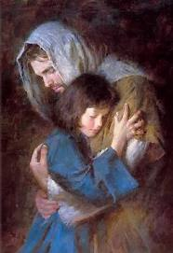
Suffering
What prevents us from falling into despair? Secular means or spiritual ones?
Why didn’t Job commit suicide?
The light of God is the treasure that lives in us.

Slide 11
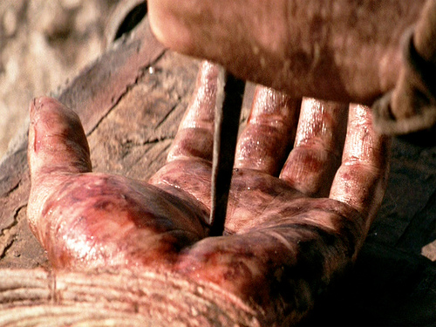
Carrying about the death of the Lord
2 Corinthians 4:10-11
always carrying about in the body the dying of the Lord Jesus, that the life of Jesus also may be manifested in our body. For we who live are always delivered to death for Jesus’ sake, that the life of Jesus also may be manifested in our mortal flesh.

Slide 12
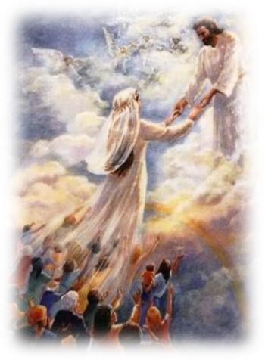
Resurrection
We carry about the death of the Lord through the sufferings we endure for His sake
Romans 6:8 - Now if we died with Christ, we believe that we shall also live with Him

Slide 13
How to die/live with Him?
To increase the capacity of our earthen vessels to carry the light of God:
  Spiritual practices
  Estrangement from the world
  Purity in the midst of temptation
  Forgiving our enemies

Slide 14
Renewal
2 Corinthians 4:16
Therefore we do not lose heart. Even though our outward man is perishing, yet the inward man is being renewed day by day.
Our external aspects are perishing, but our interior is being built up as a container for the spirit of God.
How does the inner man get renewed day by day?

Slide 15
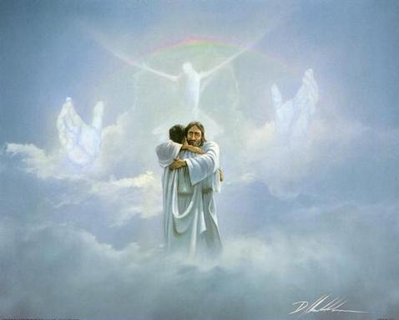
Eternal Glory
2 Corinthians 4:17
For our light affliction, which is but for a moment, is working for us a far more exceeding and eternal weight of glory,
Thinking this way requires an eternal perspective.
How does temporary suffering result in eternal glory?

Slide 16
Do not focus on the visible
2 Corinthians 4:18
while we do not look at the things which are seen, but at the things which are not seen. For the things which are seen are temporary, but the things which are not seen are eternal.
Much easier to focus on visible things
What is unseen is the most powerful

Slide 17
Gehazi
2 Kings 6:15-17
And when the servant of the man of God arose early and went out, there was an army, surrounding the city with horses and chariots. And his servant said to him, “Alas, my master! What shall we do?” So he answered, “Do not fear, for those who are with us are more than those who are with them.” And Elisha prayed, and said, “Lord, I pray, open his eyes that he may see.” Then the Lord opened the eyes of the young man, and he saw. And behold, the mountain was full of horses and chariots of fire all around Elisha.

Slide 18
Conclusion
God is light
God commanded that light shine to cast out our inner darkness
We are earthen vessels that hold the light of God
We experience suffering and persecution in the world just as Christ did.
These experiences are design to help us turn to God.

