Slide 1
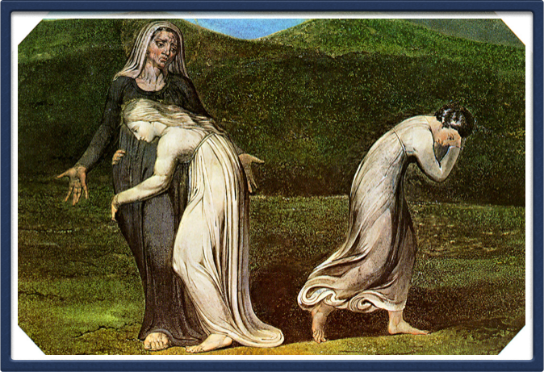
Ruth: A Model for Service
11.17.13

Slide 2

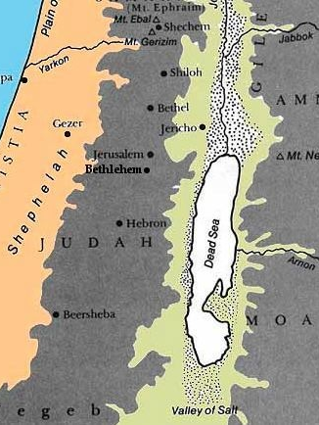

Chapter 1
“in the days when judges ruled”
Time of famine in Israel
Elimelech + Naomi = Mahlon & Chilion
Moved to Moab
Husband dies
Sons marry Moabite women
After 10 years and no children Naomi’s sons die

Slide 3
Chapter 1
Naomi pleads for her daughters-in-law to return to Moab
Ruth 1:16-17 — Entreat me not to leave you, Or to turn back from following after you; For wherever you go, I will go; And wherever you lodge, I will lodge; Your people shall be my people, And your God, my God. Where you die, I will die, And there will I be buried. The Lord do so to me, and more also, If anything but death parts you and me.
They return to Bethlehem at the time of harvest

Slide 4

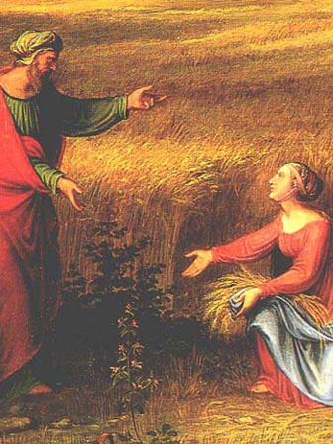
Chapter 2
Introduces Boaz as Naomi’s wealth relative
Ruth gleans in Boaz’s field
Boaz allows her to glean, hears of her loyalty, and commends her for it
Ruth 2:12 — The Lord repay your work, and a full reward be given you by the Lord God of Israel, under whose wings you have come for refuge.
Boaz asks that Ruth stay close

Slide 5
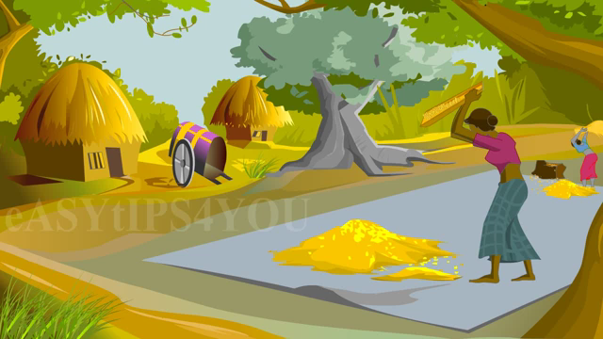
Chapter 3
Ruth 3:2 — “Now Boaz, whose young women you were with, is he not our relative? In fact, he is winnowing barley tonight at the threshing floor.”
Public place
Grain must be guarded
at night

Slide 6
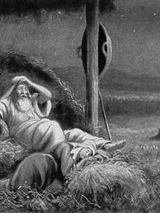
Chapter 3
Ruth asks Boaz for protection and security
Ruth 3:9 — And he said, “Who are you?” So she answered, “I am Ruth, your maidservant. Take your maidservant under your wing, for you are a close relative.
Ruth makes marriage proposal
  Desires to keep the Law
Must check with nearest of kin

Slide 7

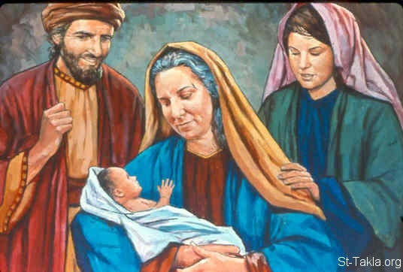
Chapter 4
Boaz checks with relative
Boaz marries Ruth
People bless Ruth and Boaz
Ruth gives birth to Obed
Who are Boaz’s parents?
  Salmon + Rahab

Slide 8
Types of Service
Serving Needs (Chapter 1)
Service of the Word (Chapter 2)
Prayer (Chapter 3)
Heavenly Service (Chapter 4)

Slide 9
Serving Needs
We often think of “service” as Sunday School
There are many other services, but the same Spirit
Matt. 10:41 — He who receives a prophet in the name of a prophet shall receive a prophet's reward. And he who receives a righteous man in the name of a righteous man shall receive a righteous man's reward.
  “receive” = serves
  Their reward is similar to the prophet
EX: St. Paul says to the Philippians: “…just as it is right for me to think this of you all, because I have you in my heart, inasmuch as both in my chains and in the defense and confirmation of the gospel, you all are partakers with me of grace.” (Phil. 1:7)

Slide 10
Serving Needs
Those who assist the servants will not lose their reward
  Matt. 10:42 — And whoever gives one of these little ones only a cup of cold water in the name of a disciple, assuredly, I say to you, he shall by no means lose his reward.
Sometimes the form of our service may change

Slide 11
Serving Needs: Negative Example
Elimelech
  Took a decision to go to Moab during famine, although they were not permitted to go
  He justified himself
  This lead to the destruction of his children
  Parents establish the economy of the house, as do coordinators and servants in their classes

Slide 12
Serving Needs: Positive Example
Ruth
  Chose to serve Naomi rather than remarry in Moab
  Justifications
    Serve mother-in-law?!
    Go to Bethlehem?
    She is still young — “…you did not go after young men, whether port or rich.” (Ruth 3:10)
    She was likely beautiful (Jer. 48:16-17)
    Highly probable that she will not remarry in Israel

Slide 13
Serving Needs: Positive Example
Ruth (cont’d)
  She had no benefit from this service
We rarely find this type of service even in the era of grace
Mother-in-law relationship is one of the most volatile
  How do I handle the volatile relationships in my life?

Slide 14

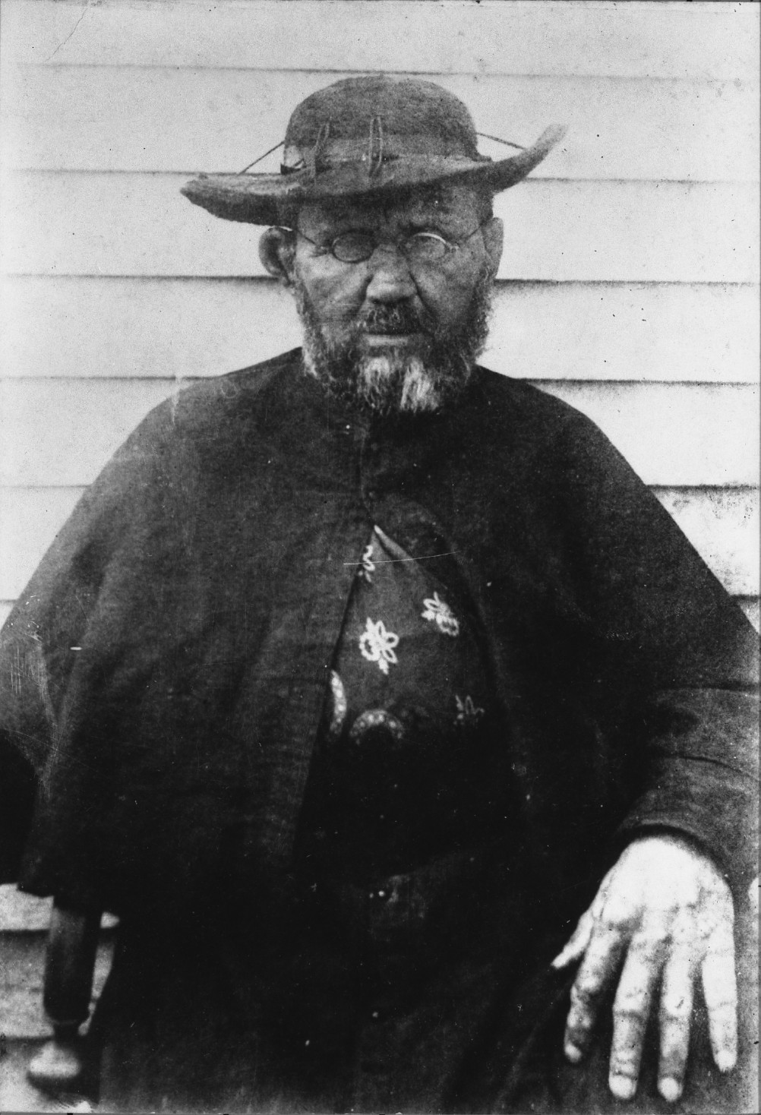
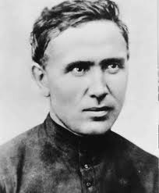
Serving without benefit
Fr. Damien of Molokai

Slide 15
Service of the Word
Boaz returns from Bethlehem, notices Ruth, and asks, “Whose young woman is this?”
Ruth 2:6-7 — “So the servant who was in charge of the reapers answered and said, “It is the young Moabite woman who came back with Naomi from the country of Moab. And she said, ‘Please let me glean and gather after the reapers among the sheaves. ’ So she came and has continued from morning until now, though she rested a little in the house.”

Slide 16
Service of the Word
Ruth 2:8-9 — Then Boaz said to Ruth, “You will listen, my daughter, will you not? Do not go to glean in another field, nor go from here, but stay close by my young women. Let your eyes be on the field which they reap, and go after them. Have I not commanded the young men not to touch you? And when you are thirsty, go to the vessels and drink from what the young men have drawn.
Notes:
Ruth stayed in the field to glean all day with his young women.
1. To gather from them the words of life
2. Like the one who gathers words of life – from scripture, spiritual books, experiences of others, sermons, etc…
3. She spent all day, only resting a little

Slide 17
Service of the Word
Ruth 2:17-18 — So she gleaned in the field until evening, and beat out what she had gleaned, and it was about an ephah of barley. Then she took it up and went into the city, and her mother- in- law saw what she had gleaned. So she brought out and gave to her what she had kept back after she had been satisfied.”
The servant of the words offers others while being satisfied
Notes:
What do I offer in my lessons?
i. Prepare the morning of or night before
ii. There is spiritual famine in the church
iii. There is information – all aspects of lesson are present – spirit?

Slide 18


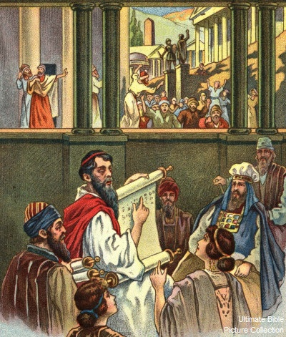
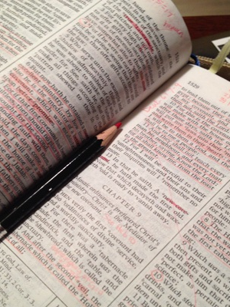
Thessalonica vs Berea
Acts 17:11 — These were more fair- minded than those in Thessalonica, in that they received the word with all readiness, and searched the Scriptures daily to find out whether these things were so.
Notes:
i. The people were thirsty
ii. The servant of the word should be happy spending time in God

Slide 19
Prayer
Is ministering the Word and to those in need costly?
What do we do when I get exhausted in service?
  Abouna!
What did Ruth do?
  Went to the feet of Boaz — Prayer
Is prayer a service?
Notes:
Costly
i. Physical health – eyes, back, etc.
ii. Money – buying books
iii. Time
Abouna!

Slide 20
Servant Plowing the Field
Luke 17:7-8 — And which of you, having a servant plowing or tending sheep, will say to him when he has come in from the field, “Come at once and sit down to eat’? But will he not rather say to him, “Prepare something for my supper, and gird yourself and serve me till I have eaten and drunk, and afterward you will eat and drink.’
Notes:
Christ speaking about faith and duty, but…
Consider that the Lord asks to be fed first
1. His food is communing (prayers) with us
2. EX: Samaritan woman – ““My food is to do the will of Him who sent Me, and to finish His work.” (Jn. 4:34)
3. What food can I offer the Lord?
a. Prayer
b. Praise
c. Thanksgiving

Slide 21

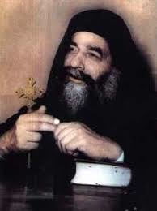
Story of a famous preacher
Notes:
i. At time of Pope Kyrillos, there was a priest famous for his sermons
ii. He complained about the Pope because he cannot give sermons
iii. It came to the Pope’s ear, and he called this priest
iv. The pope ask him to come to cathedral for a revival to give it more life
v. He came and gave sermon after sermon
vi. Then he came one Wednesday and found no one there except the pope.
vii. “Did you pray Vespers?”
viii. “No one is here.”
ix. There prayed together and the pope asked him to give his sermon
x. For 20 minutes he gave the sermon with tears rolling down his cheeks…he learned his lesson.

Slide 22

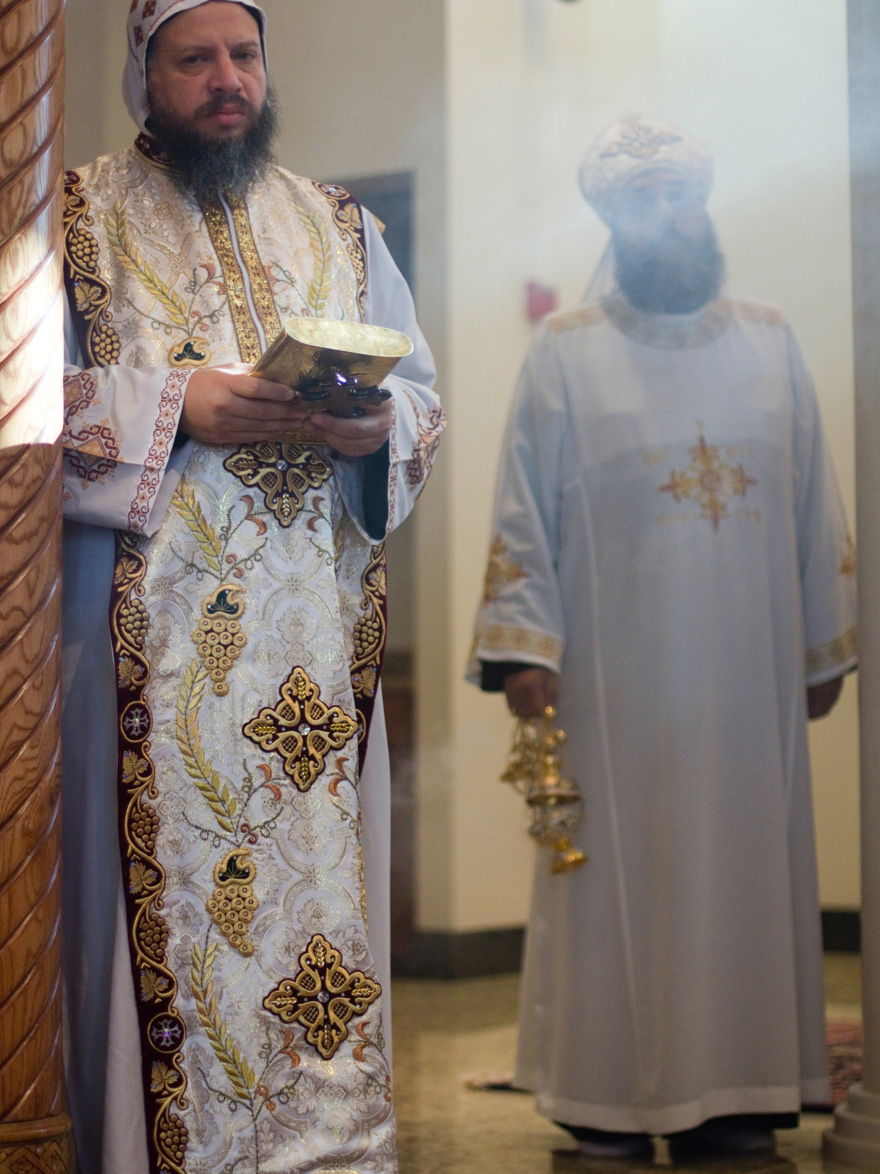
Prayer
Service of the Word without being supported by prayers will not be fruitful
“May we be made worthy to hear Your Holy Gospels, and may we keep Your precepts and commandments and bring forth fruit therein, a hundredfold, sixtyfold, and thirtyfold, in Christ Jesus our Lord.” (Liturgy of St. Basil)

Slide 23

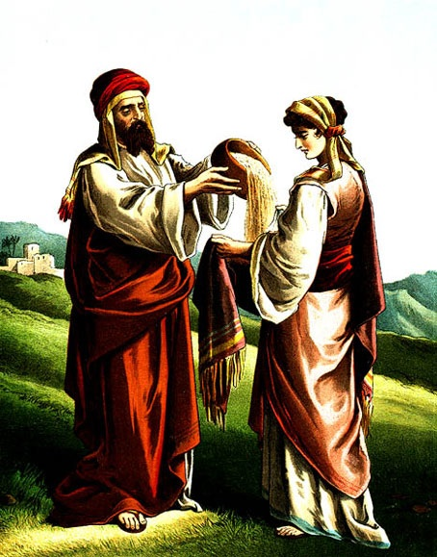
Heavenly Service
Ruth marries Boaz and abides in his house permanently
The soul living with Christ

Slide 24
Heavenly Service
The blessings of the people
Ruth 4:11 — And all the people who were at the gate, and the elders, said, “ We are witnesses. The Lord make the woman who is coming to your house like Rachel and Leah, the two who built the house of Israel…
Through the aforementioned services we help others live with the Lord
Notes:
i. They will be our witness before the Lord

Slide 25


