Slide 1

Analytical Listening

Slide 2

What is effective Listening?
‘Speak, Lord, for Your servant hears.’ (1 Sam 3)

Slide 3

Ineffective Listening
About 10,600 results

Slide 4

Listening
How?
"A good leader encourages followers to tell him what he needs to know, not what he wants to hear." John Maxwell.
Poor leaders are unwilling to listen to others.

Slide 5

Listening
To whom?
Keeping in contact with the people they are leading is a priority for good leaders
The success of the leader is not only determined by his ability to listen to followers, but is very closely related to how keenly he listens to his mentor.

Slide 6
King Rehoboam
1 Kings 12
Then Jeroboam and the whole assembly of Israel came and spoke to Rehoboam, saying, ⁴ “Your father made our yoke heavy; now therefore, lighten the burdensome service of your father, and his heavy yoke which he put on us, and we will serve you.”
⁵ So he said to them, “Depart for three days, then come back to me.” And the people departed.

Slide 7
King Rehoboam
1 Kings 12
⁶ Then King Rehoboam consulted the elders who stood before his father Solomon while he still lived, and he said, “How do you advise me to answer these people?”
⁷ And they spoke to him, saying, “If you will be a servant to these people today, and serve them, and answer them, and speak good words to them, then they will be your servants forever.”

Slide 8
King Rehoboam
1 Kings 12
⁸ But he rejected the advice which the elders had given him, and consulted the young men who had grown up with him, who stood before him. ⁹ And he said to them, “What advice do you give? How should we answer this people who have spoken to me, saying, ‘Lighten the yoke which your father put on us’?”

Slide 9
King Rehoboam
1 Kings 12
¹⁰ Then the young men who had grown up with him spoke to him, saying, “Thus you should speak to this people who have spoken to you, saying, ‘Your father made our yoke heavy, but you make it lighter on us’—thus you shall say to them: ‘My little finger shall be thicker than my father’s waist! ¹¹ And now, whereas my father put a heavy yoke on you, I will add to your yoke; my father chastised you with whips, but I will chastise you with scourges!’”

Slide 10
King Rehoboam
1 Kings 12
¹⁶ Now when all Israel saw that the king did not listen to them, the people answered the king, saying:
“What share have we in David?
We have no inheritance in the son of Jesse.
To your tents, O Israel!
Now, see to your own house, O David!”
So Israel departed to their tents.

Slide 11
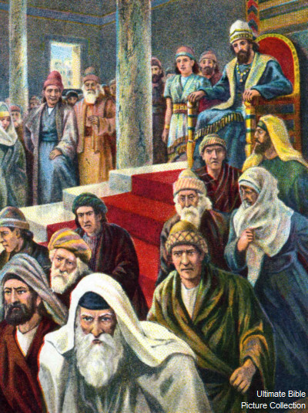
How did Rehoboam fail?
He did not pay attention to the people who promised to serve him if he lightened their load.
He rejected the wise counsel of the elders, as it did not meet his desires.
He promised to make life tougher for his people ignoring their complaints.

Slide 12

Funny Story…

Slide 13
Observations…
Speaker | Listener

Slide 14
Analytical Listening Technique
Analytical Listening Technique
Listen to
the end
Analyze & Connect

Slide 15
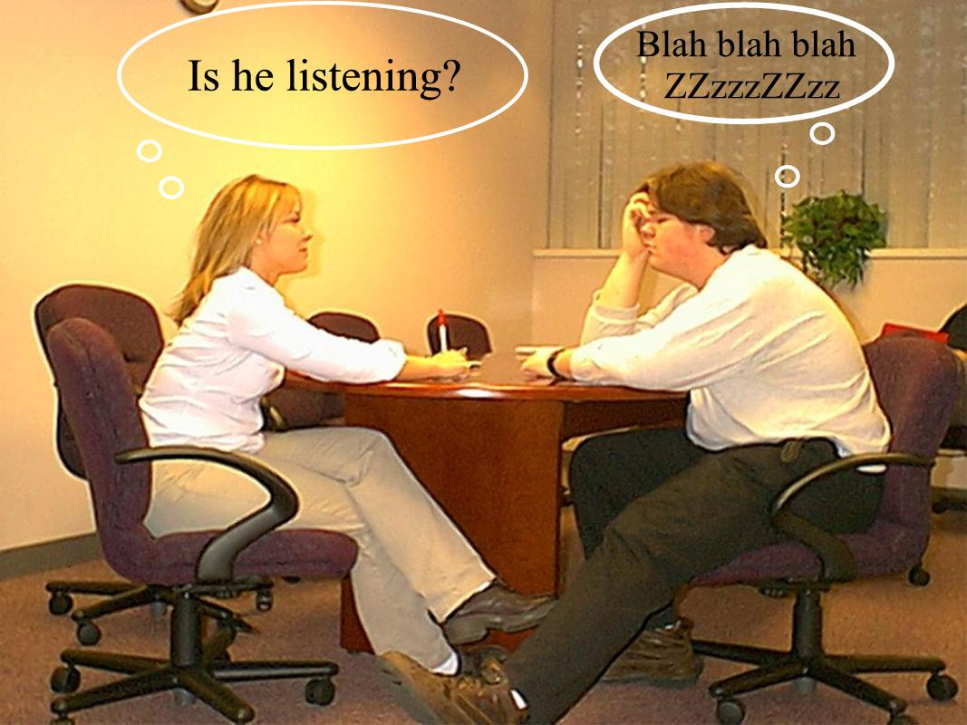
Listen to the end
Without distraction
Do not pretend you are listening while you stopped in the middle

Slide 16

Analyze & Connect
Analyze what your have heard logically
Connect it with your own experiences
If you have a comment, say it, if not, don’t!
Just listen! Sometimes listening is enough
  Job’s friends:
  “You are miserable comforters,
  all of you!” (Job 16)
Compare Job’s three friends
with Elihu

Slide 17

Listening Filter
F (Filter)
F: Feelings
F: Facts

Slide 18
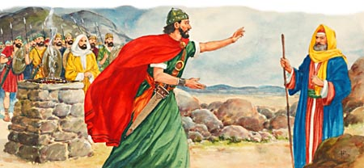
Listening Filter
Facts or Feelings?
Saul said, “When I saw that the people were scattered from me, and that you did not come within the days appointed, and that the Philistines gathered together at Michmash, then I said, ‘The Philistines will now come down on me at Gilgal, and I have not made supplication to the Lord.’ Therefore I felt compelled, and offered a burnt offering.” (1Sam 13)

Slide 19
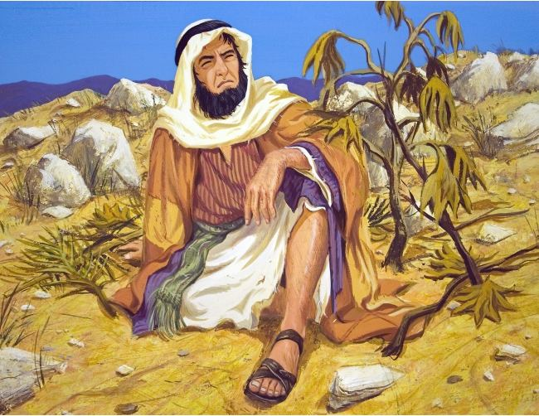
Listening Filter
Facts or Feelings?
“Ah, Lord, was not this what I said when I was still in my country? Therefore I fled previously to Tarshish; for I know that You are a gracious and merciful God, slow to anger and abundant in lovingkindness, One who relents from doing harm. ³ Therefore now, O Lord, please take my life from me, for it is better for me to die than to live!”

Slide 20
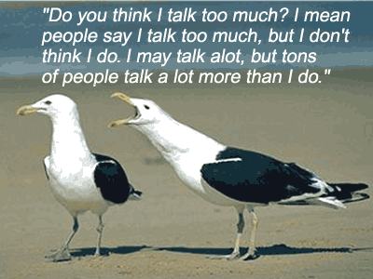
Listening Filter
Facts or Feelings?
“On Monday, I went to meet my friend
for lunch. Mondays are always bad,
because I have Microbiology class with Dr. Adam, and Dr. Adam always gives us difficult pop quizzes and I get stressed out, and on that Monday there was no quiz, but I was already stressed out fearing the quiz because I did not study for it, because on Sunday I went to the Servants Meeting and it was too long and I went to bed late. When I met my friend, she was talking to this guy that I like, and I was jealous and when she greeted me, I started yelling at her and we got into a big fight. Abouna, please read me the absolution!”

Slide 21
Mark 12:28-34
²⁸ Then one of the scribes came, and having heard them reasoning together, perceiving that He had answered them well, asked Him, “Which is the first commandment of all?”
²⁹ Jesus answered him, “The first of all the commandments is: ‘Hear, O Israel, the Lord our God, the Lord is one. ³⁰ And you shall love the Lord your God with all your heart, with all your soul, with all your mind, and with all your strength.’ This is the first commandment.

Slide 22
Mark 12:28-34
³¹ And the second, like it, is this: ‘You shall love your neighbor as yourself.’ There is no other commandment greater than these.”
³² So the scribe said to Him, “Well said, Teacher. You have spoken the truth, for there is one God, and there is no other but He. ³³ And to love Him with all the heart, with all the understanding, with all the soul, and with all the strength, and to love one’s neighbor as oneself, is more than all the whole burnt offerings and sacrifices.”

Slide 23
Mark 12:28-34
³⁴ Now when Jesus saw that he answered wisely, He said to him, “You are not far from the kingdom of God.”

Slide 24
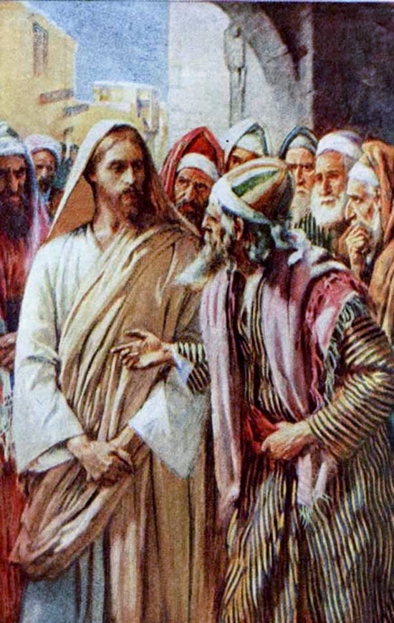
Apply the Analytical Listening Technique
Mark 12:28-34

Slide 25
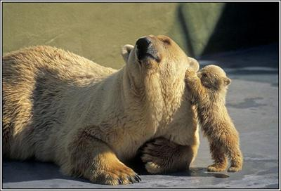
Analytical Listening
Listen to followers and mentors
Encourage followers to tell you what you need to know
Analytical Listening Technique:
  Listen to the end
  Analyze & Connect
F (Filter)
  F: Feelings
  F: Facts

