Slide 1
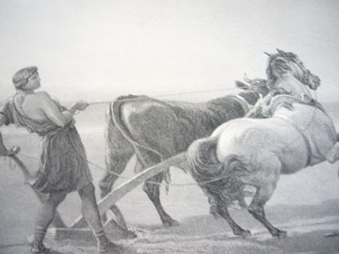
Worthless Labor

Slide 2
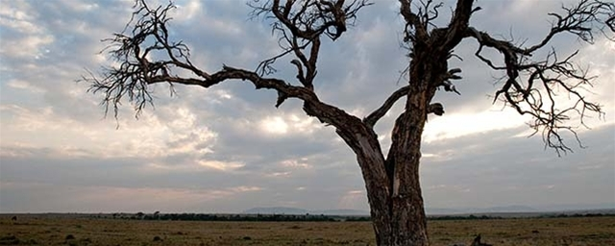
Not every labor is fruitful
Or receives a reward;
Some are
Worthless!!

Slide 3

1. Labor that does not continue unto the end (1)
“But when a righteous man turns away from his righteousness and commits iniquity, and does according to all the abominations that the wicked man does, shall he live? All the righteousness which he has done shall not be remembered; because of the unfaithfulness of which he is guilty and the sin which he has committed, because of them he shall die” Ezekiel 18:24

Slide 4
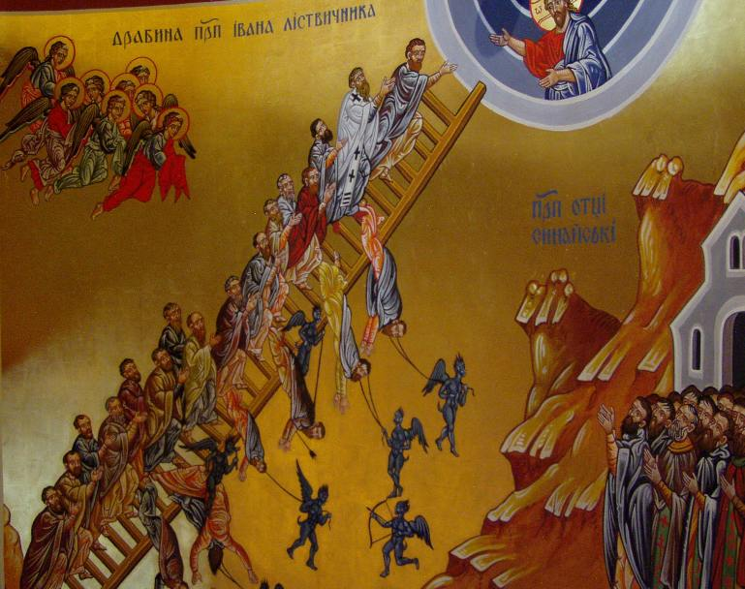
1. Labor that doesn’t continue to the end (2)
“…for Demas has forsaken me, having loved this present world” 2 Timothy 4:10
Saul the king
St. Macarius and his watchfulness until he entered the gate of heaven

Slide 5
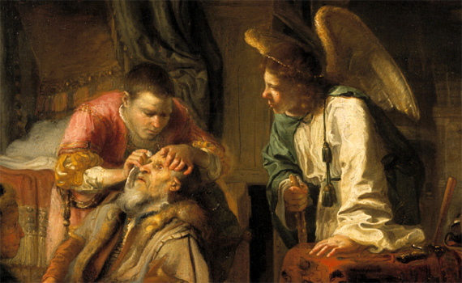
2. Loving and serving only those who love us
“For if you love those who love you, what reward have you? Do not even the tax collectors do the same?” Matthew 5:46
The excellence of the service of Tobit, the father who cared for the dead of his people

Slide 6

3. Serving without love (1)
“And though I bestow all my goods to feed the poor, and though I give my body to be burned, but have not love, it profits me nothing”
1 Corinthians 13:3
God desires mercy, not a sacrifice. The example of the priest and the Levite in the parable of the Good Samaritan

Slide 7

3. Serving without love (2)
“I know your works, your labor, your patience, and that you cannot bear those who are evil. And you have tested those who say they are apostles and are not, and have found them liars; and you have persevered and have patience, and have labored for My name’s sake and have not become weary. Nevertheless I have this against you, that you have left your first love” Revelation 2:2-4

Slide 8

3. Serving without love (3)
“‘Why have we fasted,’ they say, ‘and You have not seen?
Why have we afflicted our souls, and You take no notice?’ …Indeed you fast for strife and debate, And to strike with the fist of wickedness”
Isaiah 58:3-4

Slide 9
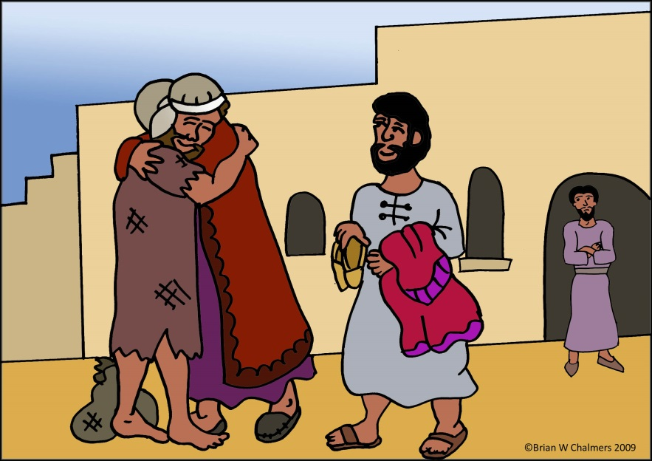
3. Serving without love (4)
The example of the older brother: “Lo, these many years I have been serving you; I never transgressed your commandment at any time; and yet you never gave me a young goat, that I might make merry with my friends. But as soon as this son of yours came, who has devoured your livelihood with harlots, you killed the fatted calf for him.”
Luke 15:29-30

Slide 10
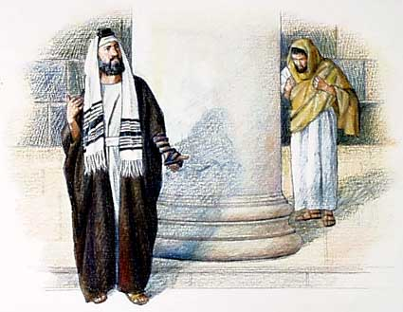
4. A labor stolen by the ego
The example of the Publican: “God, I thank You that I am not like other men—extortioners, unjust, adulterers, or even as this tax collector. I fast twice a week; I give tithes of all that I possess”
Luke 18: 11-12
“Take heed that you do not do your charitable deeds before men, to be seen by them. Otherwise you have no reward from your Father in heaven”
Matthew 6:1

Slide 11
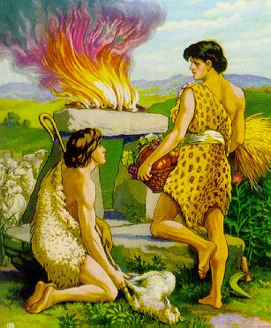
5. A labor not according to the rules
“And also if anyone competes in athletics, he is not crowned, unless he competes according to the rules” 2 Timothy 2:5
The offering of Cain
The doctrine of Salvation

Slide 12

6. A labor without wisdom
Without the blessing of God’s presence: “Unless the Lord builds the house, they labor in vain who build it; Unless the Lord guards the city, the watchman stays awake in vain”
Psalm 127:1
Without observing God’s commandments: “Bring no more futile sacrifices; Incense is an abomination to Me” Isaiah 1:13

