Slide 1
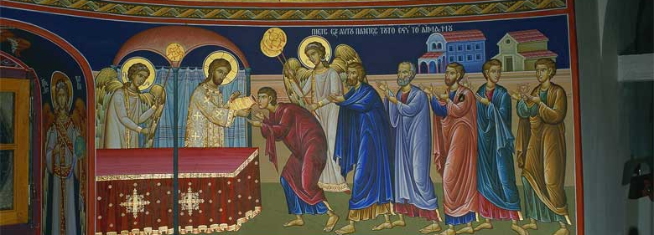
Talents
“…to each according to his own ability” (Matt 25)

Slide 2
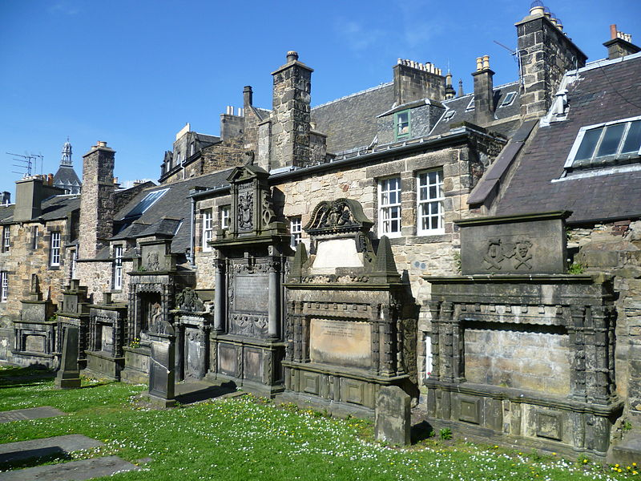
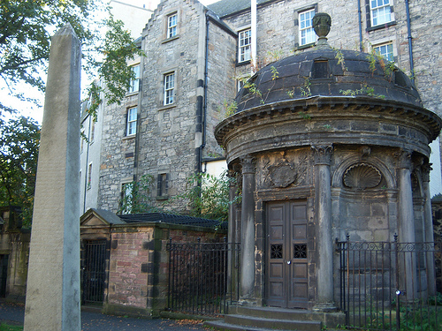
Greyfriars Kirkyard,
Edinburgh, Scotland
James Douglas, 4th Earl of Morton (d.1581), Regent of Scotland
George Buchanan (d.1582), historian and reformer
Alexander Henderson (d.1646), churchman and statesman
Sir George Mackenzie (1636–1691), Lord Advocate
Notes:
Mackenzie imprisoned 1,200 Covenanters in a field next to Greyfriars Kirkyard.^{[7]} Some were executed, and hundreds died of maltreatment. His treatment of Covenanters gained him the nickname of "Bloody Mackenzie".

Slide 3
Matthew 25: 14-19
¹⁴ “For the kingdom of heaven is like a man traveling to a far country, who called his own servants and delivered his goods to them. ¹⁵ And to one he gave five talents, to another two, and to another one, to each according to his own ability; and immediately he went on a journey. ¹⁶ Then he who had received the five talents went and traded with them, and made another five talents. ¹⁷ And likewise he who had received two gained two more also. ¹⁸ But he who had received one went and dug in the ground, and hid his lord’s money. ¹⁹ After a long time the lord of those servants came and settled accounts with them.

Slide 4
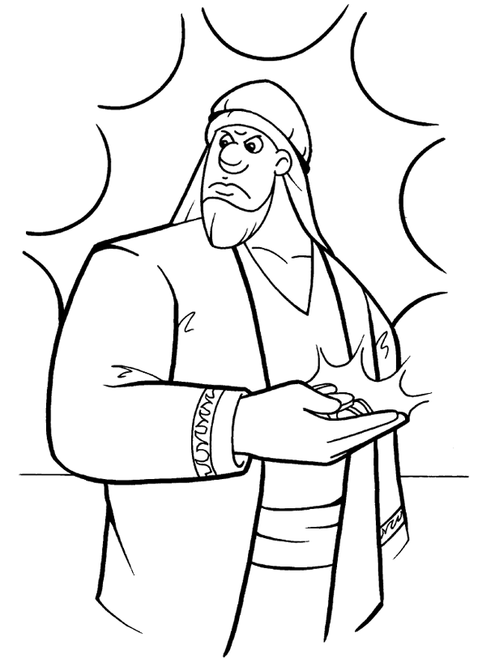
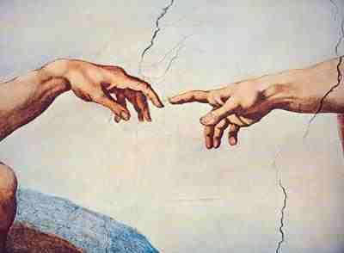
Kinds of Talents
Mind
Conscience
Senses
Heart
Leadership
Responsibility

Slide 5
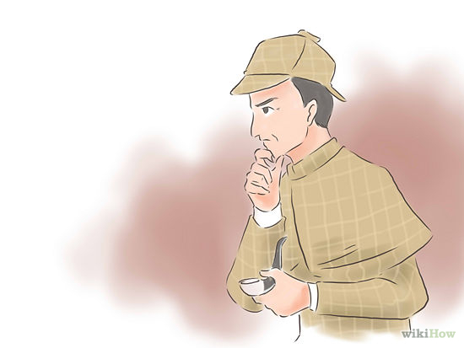
Talent of the Mind
Who has put wisdom in the mind?
Or who has given understanding to the heart? (Job 38:36)
God gave us a mind,
we must nourish it:
  Thinking
  Understanding
  Deduction
  Memory
We must exercise and strengthen our minds
We invest this talent and gain other talents

Slide 6

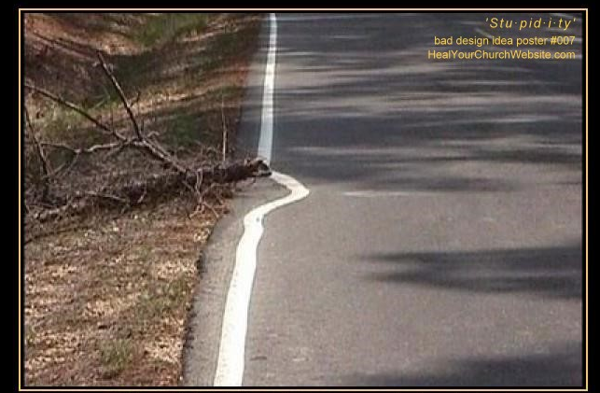
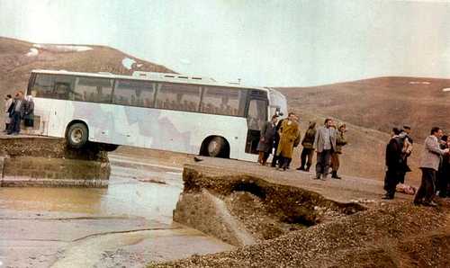
Talent of the Mind
Some people do not care / use their mind
“use your head”
“I can’t”
“I don’t want to”
“But he who had received one went and dug in the ground, and hid his lord’s money.” (Matt 25: 18)

Slide 7
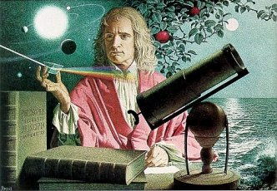
How to Strengthen the Mind
Studying, Reading, Solving
Science and Math
  Algebra, Chemistry, Geometry, Trigonometry
  What are we going to use these for in life?
    Strengthen our mind and exercise our thinking process
  Isaac Newton formulated (Fluxionary) Calculus to solve a problem presented to him!
  We may never use these studies
  later, but the benefits of how
  to use and exercise our mind
  remains.
    Help solve and evaluate problems

Slide 8
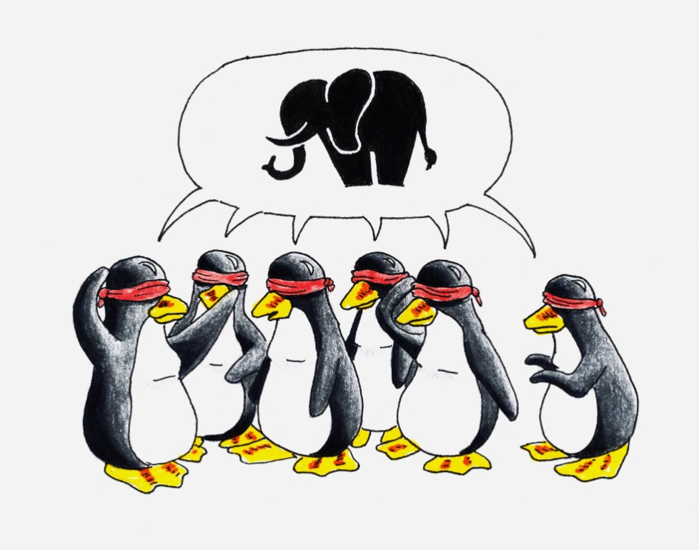
Types of Understanding
Rapid understanding
  Some understand the issue early from the beginning: “yes, I get it!”
  Others…
Correct understanding
  No misunderstanding
Accurate understanding
  Understanding the exact issue
  Not being confused by trivial details

Slide 9

Strengthening the Mind
Holistic / Complete:
  Think of all sides of the issue
  Discernment
    Right vs. wrong
    Acceptable vs. unacceptable
    “Folly is joy to him who is destitute of discernment, But a man of understanding walks uprightly.” (Prov 15:21)
  Learn about new topics, expand knowledge
  If giving a presentation on a topic, read more about it and related topics
  Be prepared to answer questions quickly and accurately

Slide 10
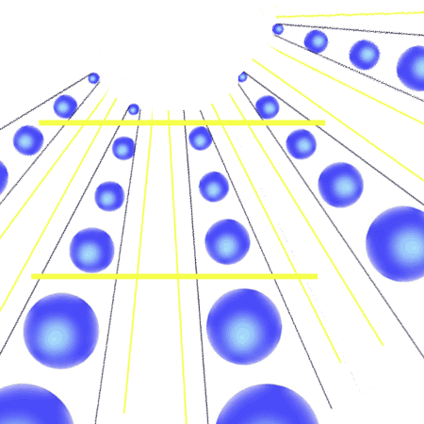
Strengthening the Mind
Depth:
  From shallow to deep thinking
  What are all the consequences,
  factors, inputs, outputs
  Remedies
  What if…
  “For which of you, intending to build a tower, does not sit down first and count the cost, whether he has enough to finish it— lest, after he has laid the foundation, and is not able to finish, all who see it begin to mock him…” (Lk 14:28-29)

Slide 11
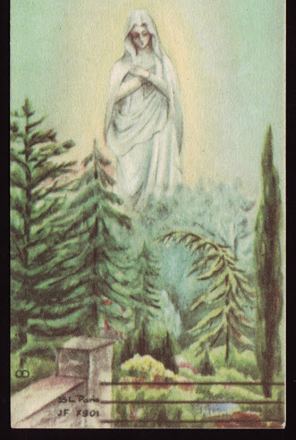
Strengthening the Mind
Purity:
  Test/discern the thoughts
  Do not continue in every thought
  Set guards: thoughts, senses, feelings…
    Not an open doorway.
    “A garden enclosed Is my sister, my spouse,
    A spring shut up, A fountain sealed.” (Song 4:12)
    “Praise the Lord, O Jerusalem! Praise your God, O Zion!
    For He has strengthened the bars of your gates” (Ps 147)
    You cannot prevent the birds of sorrow from flying over your head, but you can prevent them from building nests in your hair. (Chinese Proverb)
  Do not be a parrot!
    Story: parrot and old lady

Slide 12

Strengthening the Mind
Decisiveness
  Be able to made decisions
  Let me first ask: mom, dad, my guide, my wife…
  Maturity – accept the consequences of bad decisions

Slide 13
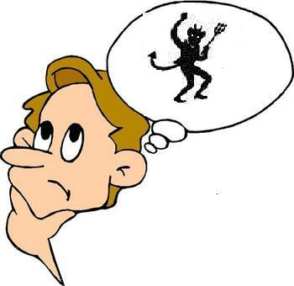
Strengthening the Mind
Righteousness
  Some use their mind in evil ways:
    deceit, guile, dishonesty, contention, fraud, …
    “Obamacare”
  “Oh, let the wickedness of the wicked come to an end, But establish the just; For the righteous God tests the hearts and minds.” (Ps 7:9)

Slide 14
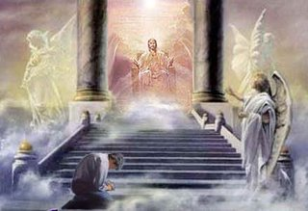
Investing the Mind Talent
‘Lord, you delivered to me the talent of Mind; look, I have gained more talents besides it:
  Success in life: spiritual, family, personal
  Honesty: at work, home, church
  Understanding: of spirituality, practicality, service
  Discernment: avoiding satanic traps
  Depth: in Your commandments
  Contemplations: on your Words
‘Well done, good and faithful servant; you have been faithful over a few things, I will make you ruler over many things. Enter into the joy of your lord.’

Slide 15

Talent of the Conscience
Using the conscience in a righteous way
Not: “strains out a gnat
and swallows a camel!”
Makes righteous decisions and judgments
  “This being so, I myself always strive to have a conscience without offense toward God and men.” (Acts 24:16)
  “…who show the work of the law written in their hearts, their conscience also bearing witness, and between themselves their thoughts accusing or else excusing them” (Rom 2:15)

Slide 16
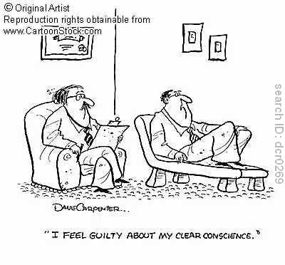
Strengthening the Conscience
Spiritual readings: Bible, Hagiography
Purification: from external factors
  Social traditions, habits
  People pleasing
  Controlling desires

Slide 17

Strengthening the Conscience
Execute according to your conscience
  “The conscience is a just judge, but it is not the executioner” (Pope Shenouda)
  Your actions should be aligned with your conscience
  Conscience should lead and control:
  actions, thoughts, feelings
  Do not flatter yourself or others
  Do not be flattered by praise
  If you see a friend’s misconduct, your conscience should judge that this is unacceptable, and this should guide your will and actions

Slide 18
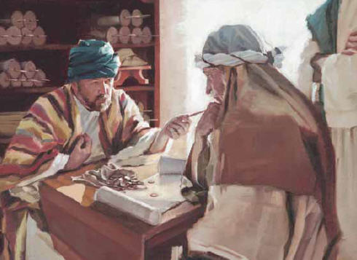
Talent of Responsibility
Granted to leaders, guides, mentors, ministers, servants
Should be used for the good of the people
We are but stewards of this talent
  “Who then is that faithful and wise steward, whom his master will make
  ruler over his household,
  to give them their portion
  of food in due season?”
  (Lk 12)

Slide 19
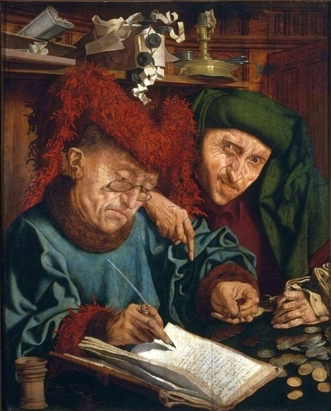
Talent of Responsibility
Should not Procrastinate the responsibility
  “Do not withhold good from those to whom it is due, When it is in the power of your hand to do so.” (Prov 3)
  Do not say to your neighbor, “Go, and come back, And tomorrow I will give it,”
  When you have it with you.” (Prov 3)
  A good steward finds a solution to
  every problem; a difficult steward
  find a problem to every solution!

Slide 20
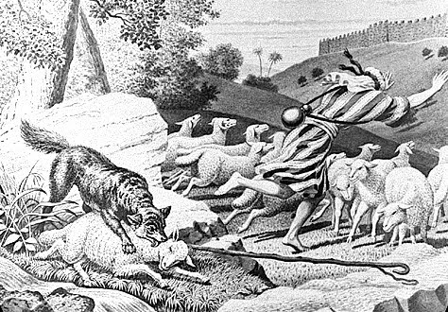
Talent of Responsibility
Responsibility to teach, to feed
  “ If you instruct the brethren in these things, you will be a good minister of Jesus Christ” (1Tim 4)
  “Woe to the shepherds of Israel who feed themselves! Should not the shepherds feed the flocks?” (Ezk 34)
  “Behold, I am against the shepherds, and I will require My flock at their hand…” (Ezk 34)
  Before becoming servants,
  we were responsible for ourselves,
  now we are responsible for all
  those we serve!
    I will require My flock at their hand

Slide 21

Talent of Responsibility
Responsibility to admonish, correct
  When I say to the wicked, ‘You shall surely die,’ and you give him no warning, nor speak to warn the wicked from his wicked way, to save his life, that same wicked man shall die in his iniquity; but his blood I will require at your hand. ¹⁹ Yet, if you warn the wicked, and he does not turn from his wickedness, nor from his wicked way, he shall die in his iniquity; but you have delivered your soul. (Ezk 3)

Slide 22
Talents
Mind
  Strengthen your mind: holistic, depth,
  purity, decisiveness, righteousness
  Invest it to gain more talents
Conscience
  Conscience should lead and control:
  actions, thoughts, feelings
Responsibility
  We are stewards
  Do not procrastinate your responsibility
  Teach, feed, admonish, correct
“to each according to his own ability…”

