Slide 1
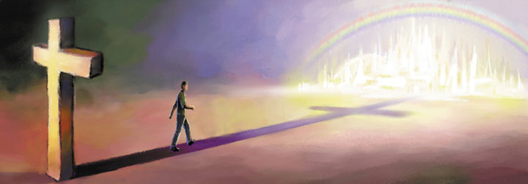
City of God
Saint Augustine

Slide 2
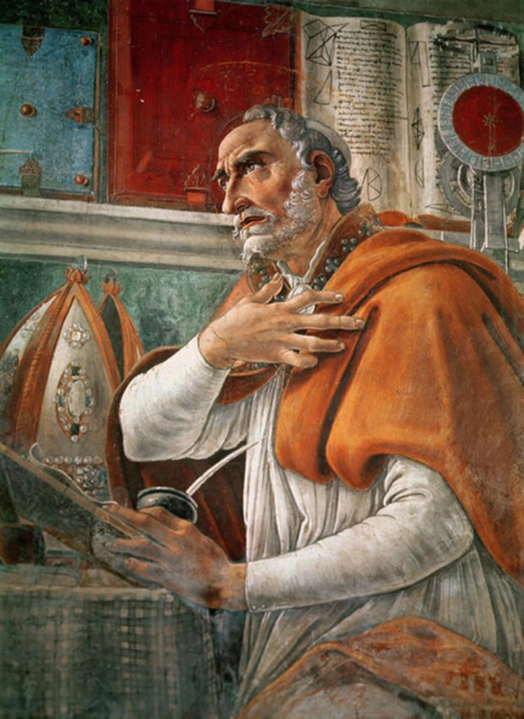
City of God
Twenty two books
(each about 20 – 30 chapters)
Collectively 500 pages
(one volume of Nicene & Post-Nicene Fathers)
“I have undertaken its defence against those who prefer their own gods to the Founder of this city, - a city surpassingly glorious, whether we view it as it still lives by faith in this fleeting course of time,…,or as it shall dwell in the fixed stability of its eternal seat…”

Slide 3
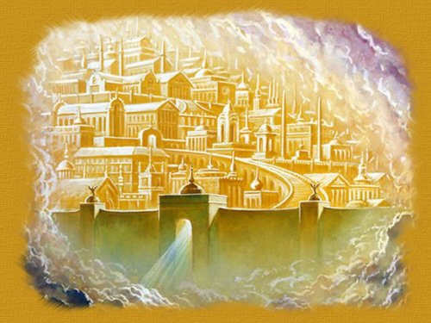
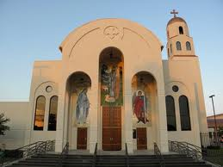
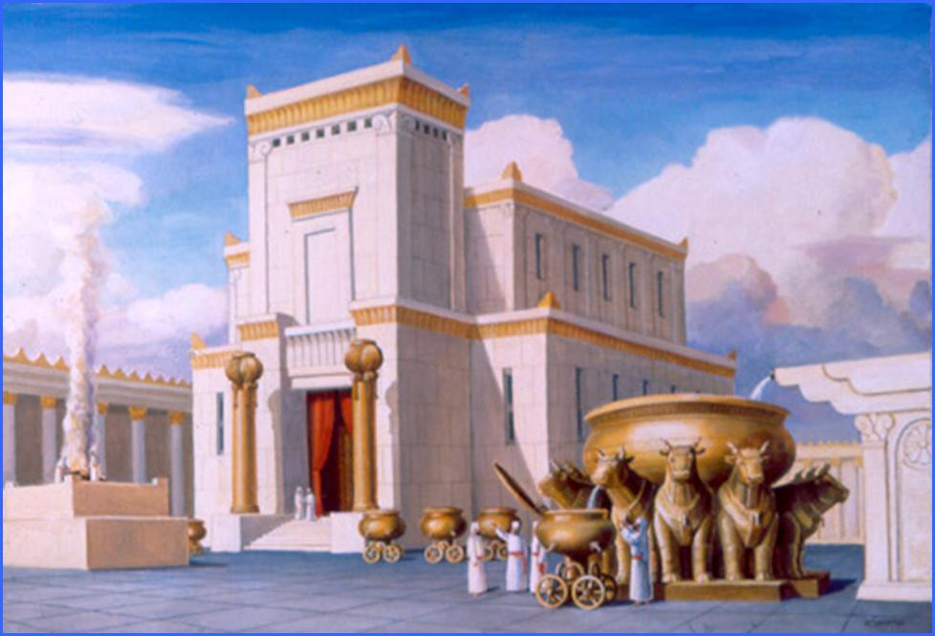
City of God
It is the heavenly city that was founded by Christ Himself
It is also the Church which is the City of God in this temporary place “… as it still lives by faith in this fleeting course of time”
It is prefigured by the earthly Jerusalem in the Old Testament.

Slide 4
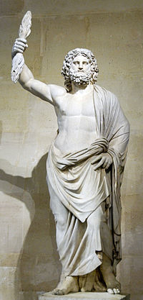
City of God
Books I through X
Direct response to the Roman theology and philosophies (Socrates, Plato, etc.)
Books XI through XIV & XIX
Introduction to some concepts in Christian theology (creation, origin of evil, Adam’s sin, punishment etc.)
Books XV through XVIII
Parallel progress of the heavenly and earthly cities through the Old Testament
Books XX through XXII
Judgment, and eternal punishment & happiness

Slide 5
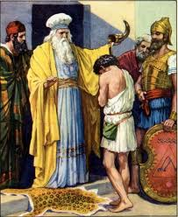
Book XVII – Prophets to Christ
St. Augustine presents a summary of the progress of the City of God from the time of the kings and prophets (Samuel, David, Solomon) even to Christ.
Some interpretations of the prophecies are interpreted and attributed to Christ and the Church

Slide 6
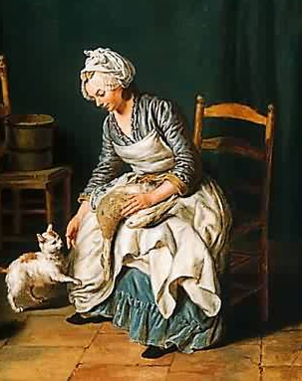
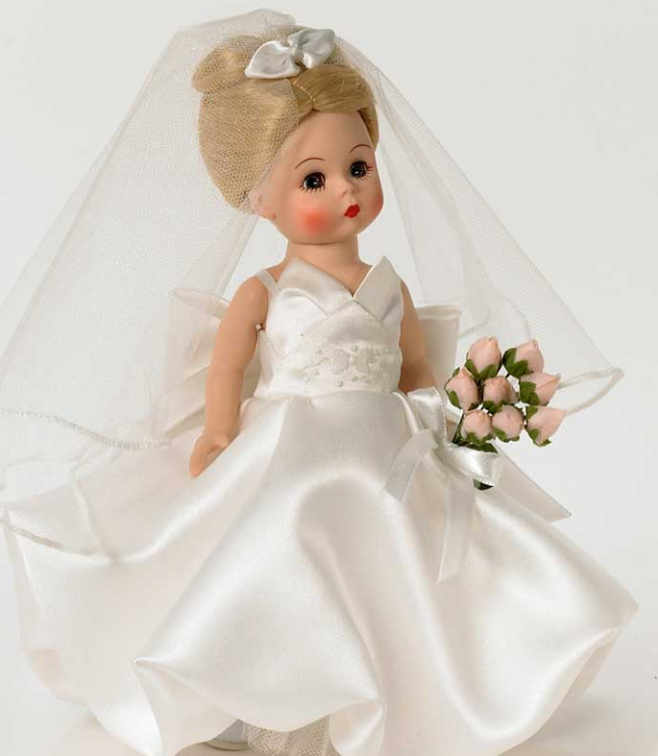
Two promises to Abraham
Earthly Promise:
His seed will fill the earth
Earthly Jerusalem:
The bond woman
Heavenly Promise:
Coming of the Messiah
Heavenly City of God:
The free woman

Slide 7
The Symbolism
When Eli was removed as the priest of God, Samuel simultaneously fulfilled the office of judge and priest.
The old priesthood (Eli) and old kingdom (Saul) were overthrown in favor of a new priesthood (Samuel) and a new kingdom (David).
Christ came and brought with Him a new priesthood & kingdom.

Slide 8
Hannah’s Prayer
“My heart rejoices in the Lord;
My horn is exalted in the Lord.
I smile at my enemies,
Because I rejoice in Your salvation.
² “No one is holy like the Lord,
For there is none besides You,
Nor is there any rock like our God.
³ “Talk no more so very proudly;
Let no arrogance come from your mouth,
For the Lord is the God of knowledge;
And by Him actions are weighed.

Slide 9
Hannah’s Prayer
But what about this…
⁴ “The bows of the mighty men are broken,
And those who stumbled are girded with strength.
⁵ Those who were full have hired themselves out for bread, And the hungry have ceased to hunger.
Even the barren has borne seven,
And she who has many children has become feeble.

Slide 10
Hannah’s Prayer
But what about this…
⁴ “The bows of the mighty men are broken,
And those who stumbled are girded with strength.
⁵ Those who were full have hired themselves out for bread, And the hungry have ceased to hunger.
Even the barren has borne seven,
And she who has many children has become feeble.
Did Hannah bear seven?

Slide 11
Hannah’s Prayer
“Wisdom has built her house, She has hewn out her seven pillars” (Proverbs 9:1)
The City of God was childless until Christ.
The earthly Jerusalem became feeble since all her fruitful children became citizens of the heavenly Jerusalem at His coming.
Here Hannah also prophecies about the end of the Aaronic priesthood and the beginning of the Christian priesthood.

Slide 12
Hannah’s Prayer
“Even the barren has borne seven…The Lord kills and makes alive; He brings down to the grave and brings up… He brings low and lifts up. He raises the poor from the dust…And make them inherit the throne of glory…The Lord will judge the ends of the earth.
“Who for us men and our salvation came down from Heaven…and became man…He was crucified for us…suffered and was buried…on the third day He rose from the dead. He ascended into the heavens…He is coming again in His glory to judge the living and the dead.”

Slide 13
Prophecy against Eli
“Thus says the Lord: ‘Did I not clearly reveal Myself to the house of your father when they were in Egypt in Pharaoh’s house? Did I not choose him out of all the tribes of Israel to be My priest, to offer upon My altar, to burn incense, and to wear an ephod before Me?…Now this shall be a sign to you that will come upon your two sons, on Hophni and Phinehas: in one day they shall die, both of them. Then I will raise up for Myself a faithful priest who shall do according to what is in My heart and in My mind. I will build him a sure house, and he shall walk before My anointed forever. And it shall come to pass that everyone who is left in your house will come and bow down to him for a piece of silver and a morsel of bread, and say, “Please, put me in one of the priestly positions, that I may eat a piece of bread.”’”

Slide 14
Prophecy against Eli
“Thus says the Lord: ‘Did I not clearly reveal Myself to the house of your father when they were in Egypt in Pharaoh’s house? Did I not choose him out of all the tribes of Israel to be My priest, to offer upon My altar, to burn incense, and to wear an ephod before Me?…Now this shall be a sign to you that will come upon your two sons, on Hophni and Phinehas: in one day they shall die, both of them. Then I will raise up for Myself a faithful priest who shall do according to what is in My heart and in My mind. I will build him a sure house, and he shall walk before My anointed forever. And it shall come to pass that everyone who is left in your house will come and bow down to him for a piece of silver and a morsel of bread, and say, “Please, put me in one of the priestly positions, that I may eat a piece of bread.”’”

Slide 15
Prophecy against Eli
In the temporal kingdom:
Hophni and Phineas the sons of Eli (and Aaron) died and were replaced by Samuel (an Ephraimite)
In the eternal kingdom:
The Aaronic priesthood was replaced by the Christian priesthood

Slide 16
Promise to David
“When your days are fulfilled and you rest with your fathers, I will set up your seed after you, who will come from your body, and I will establish his kingdom. He shall build a house for My name, and I will establish the throne of his kingdom forever. I will be his Father, and he shall be My son. If he commits iniquity, I will chasten him with the rod of men and with the blows of the sons of men. But My mercy shall not depart from him, as I took it from Saul, whom I removed from before you. And your house and your kingdom shall be established forever before you. Your throne shall be established forever.”’”

Slide 17
Promise to David
“When your days are fulfilled and you rest with your fathers, I will set up your seed after you, who will come from your body, and I will establish his kingdom. He shall build a house for My name, and I will establish the throne of his kingdom forever. I will be his Father, and he shall be My son. If he commits iniquity, I will chasten him with the rod of men and with the blows of the sons of men. But My mercy shall not depart from him, as I took it from Saul, whom I removed from before you. And your house and your kingdom shall be established forever before you. Your throne shall be established forever.”’”

