Slide 1
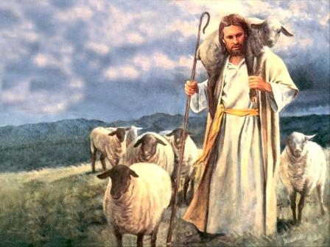
Pastoral Care
Who comforts us in all our tribulation, that we may be able to comfort those who are in any trouble, with the comfort with which we ourselves are comforted by God. (2 Corinthians 1:4)

Slide 2
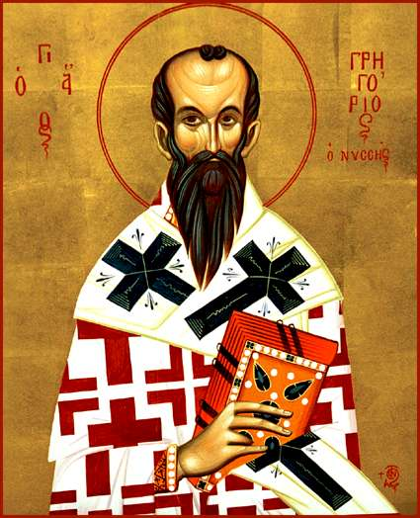
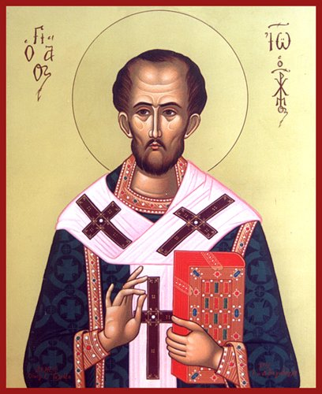
Major Sources
St. Gregory Nazianzen
In Defense of His Flight to Pontus, and His Return, After His Ordination to the Priesthood, with an Exposition of the Character of the Priestly Office.
St. John Chrysostom
On The Priesthood

Slide 3
Overview
Purpose
Internal aspects
  Self-Knowledge
  Spiritual Warfare
  Praise
  Criticism
  Balance
  Good works
External aspects
  Responsibility
  Public Life
  Discernment
  Dealing with lost sheep
  Caring for the unfortunate
  Impartiality
  Preaching
  Love
Mercy of God

Slide 4
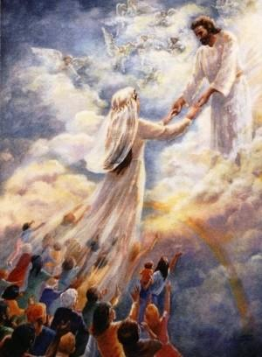
Purpose
“But the scope of our art is to provide the soul with wings, to rescue it from the world and give it to God, and to watch over that which is in His image, if it abides, to take it by the hand, if it is in danger, or restore it, if ruined, to make Christ to dwell in the heart by the Spirit: and, in short, to deify, and bestow heavenly bliss upon, one who belongs to the heavenly host.” (St. Gregory)

Slide 5
Internal Aspects

Slide 6
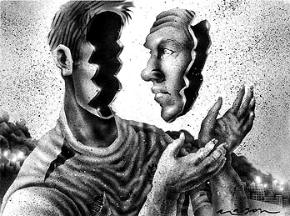
Self-Knowledge
“who readily accept what is offered them, without having first acquired a knowledge of their own souls…being blinded by inexperience, overwhelm with innumerable evils the people who have been committed to their care.” (St. John)

Slide 7
Self-Knowledge
To know our weakness and need for salvation
“Therefore most gladly I will rather boast in my infirmities, that the power of Christ may rest upon me.” (2 Corinthians 12:9)
To request forgiveness and healing from the Great Physician
To empathize with others’ weaknesses
To comfort, and not judge others
To gain experience in order to advise others

Slide 8
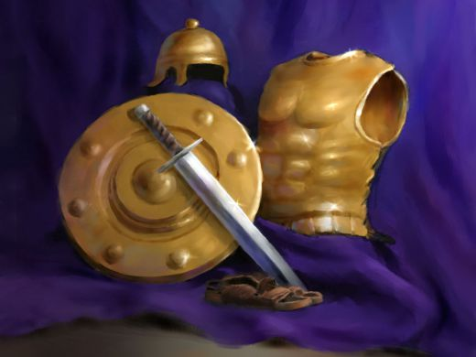
Spiritual Warfare
“They are wrath, despondency, envy, strife, slanders, accusations, falsehood, hypocrisy, intrigues, anger against those who have done no harm, pleasure at the indecorous acts of fellow ministers, sorrow at their prosperity, love of praise, desire of honor…doctrines devised to please, servile flatteries…” (St. John)

Slide 9
Spiritual Warfare
Hypocrisy – preaching, but not living the truth
Envy – comparing with others
Anger against others for no reason
Pleasure at the failure of other servants
Sorrow for their success
Seeking to win praise at all costs

Slide 10
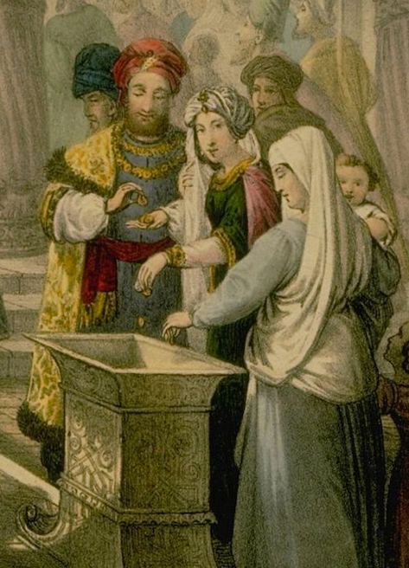
Praise
“For I know not whether any man ever succeeded in the effort not to be pleased when he is praised, and the man who is pleased at this is likely also to desire to enjoy it, and the man who desires to enjoy it will, of necessity, be altogether vexed and beside himself whenever he misses it.” (St. John)

Slide 11
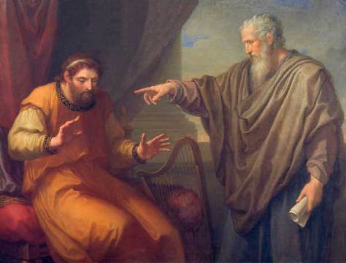
Criticism
“For to be indifferent to food and drink and a soft bed, we see is to many no hard task…but insult, and abuse, and coarse language, and gibes from inferiors…is what few can bear, in fact only one or two here and there…who are strong in the former exercises, [are] so completely upset by these things, as to become more furious than the most savage beasts.” (St. John)

Slide 12

Balance
“This, however, I take to be generally admitted—that just as it is not safe for those who walk on a lofty tight rope to lean to either side, for even though the inclination seems slight, it has no slight consequences, but their safety depends upon their perfect balance: so in the case of one of us, if he leans to either side, whether from vice or ignorance, no slight danger of a fall into sin is incurred, both for himself and those who are led by him.” (St. Gregory)

Slide 13
External Aspects

Slide 14
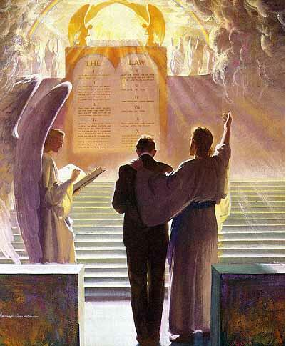
Responsibility
“Our condition here, indeed, is such as thou hast heard. But our condition hereafter how shall we endure, when we are compelled to give our account for each of those who have been entrusted to us? For our penalty is not limited to shame, but everlasting chastisement awaits us as well.” (St. John)

Slide 15
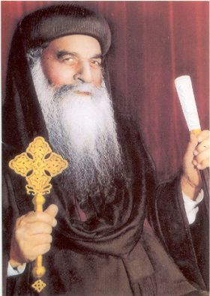
Public Life
“For I know many men who have exercised perpetual restraint upon themselves, and consumed themselves with fastings, who, as long as they were suffered to be alone, and attend to their own concerns, have been acceptable to God, and day by day have made no small addition to this kind of learning; but as soon as they entered public life, and were compelled to correct the ignorance of the multitude, have, some of them, proved from the outset incompetent for so great a task.” (St. John)

Slide 16
St. Anthony
“One day, while St. Antony was sitting with a certain Abba, a virgin came up and said to the Elder: ‘Abba, I fast six days of the week and I repeat by heart portions of the Old and New Testament daily. To which the Elder replied: ‘Does poverty mean the same to you as abundance?’ ‘No’, she answered. ‘Or dishonor the same as praise?’ ‘No, Abba.’ ‘Are your enemies the same for you as your friends?’ ‘No’, she replied. At that the wise Elder said to her: ‘Go, get to work; you have accomplished nothing’”

Slide 17
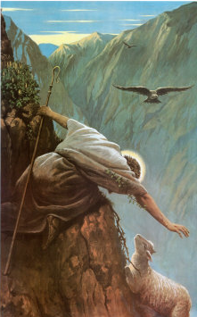
Dealing with lost sheep
“For the pastor of sheep has his flock following him, wherever he may lead them: and if any should stray out of the straight path, and, deserting the good pasture, feed in unproductive or rugged places, a loud shout suffices to collect them and bring back to the fold those who have been parted from it: but if a human being wanders away from the right faith, great exertion, perseverance and patience are required; for he cannot be dragged back by force, nor constrained by fear, but must be led back by persuasion to the truth from which he originally swerved.” (St. John)

Slide 18
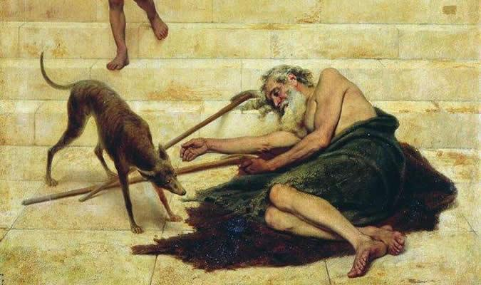
Caring for the unfortunate
“Now the superintendent should endure all these things in a generous spirit, and not be provoked either by their unreasonable annoyance or their unreasonable complaints. For this class of persons deserve to be pitied for their misfortunes, not to be insulted; and to trample upon their calamities, and add the pain of insult to that which poverty brings, would be an act of extreme brutality.” (St. John)

Slide 19
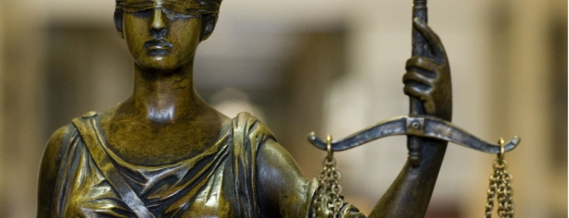
Impartiality
“For the public rigorously criticize their simplest actions, taking note of the tone of their voice, the cast of their countenance, and the degree of their laughter. He laughed heartily to such a man, one will say, and accosted him with a beaming face, and a clear voice, whereas to me he addressed only a slight and passing remark.” (St. John)

Slide 20
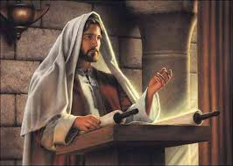
Preaching
“For if it has occurred to any preacher to weave into his sermons any part of other men’s works, he is exposed to greater disgrace than those who steal money. Nay, often where he has not even borrowed anything from any one, but is only suspected, he has suffered the fate of a thief…For the public are accustomed to listen not for profit, but for pleasure, sitting like critics of tragedies, and of musical entertainments” (St. John)

Slide 21
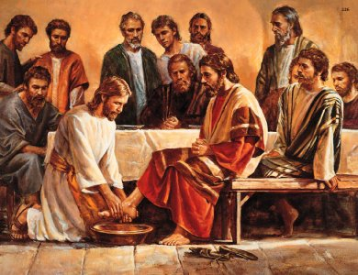
Love
“Do you know how great the power of love is? For omitting all the miracles which were to be wrought by the apostles, Christ said, ‘Hereby shall men know that you are my disciples if you love one another’” (St. John)

Slide 22
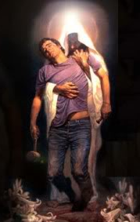
Mercy of God
“Yet these monstrous evils are borne with by Him who wills not the death of a sinner, that he may be converted and live. And how can one sufficiently marvel at His loving-kindness, and be amazed at His mercy? They who belong to Christ destroy the property of Christ more than enemies and adversaries, yet the good Lord still deals gently with them, and calls them to repentance.” (St. John)

Slide 23

Conclusion
Basil: “What excuse I should make on thy behalf to those who find fault with thee; but you send me back after putting another case in the place of that I had. For I am no longer concerned about the excuses I shall give them on thy behalf, but what excuse I shall make to God for myself and my own faults.”

