Slide 1
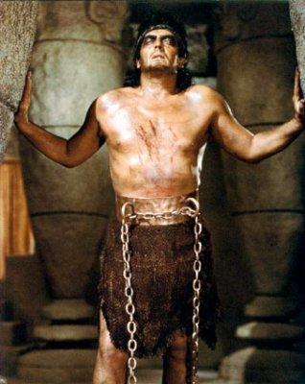
Samson: A hero of faith

Slide 2
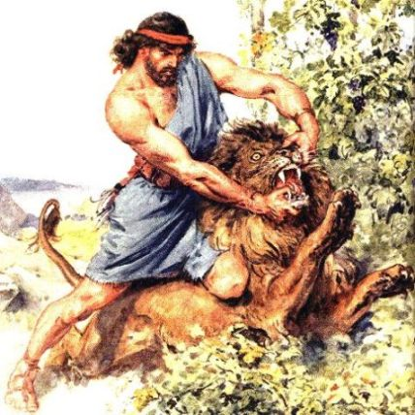
He was a judge over Israel and a symbol of the Lord Christ, but was forced to grind corn like a beast of burden and play to his enemies like a clown!!!
He was strong before men, but weak before women.

Slide 3
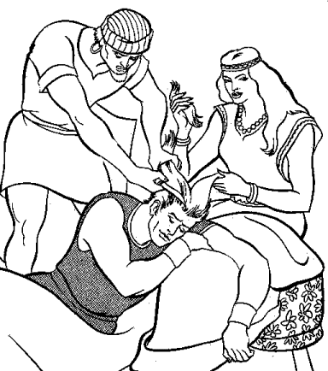
He fought the Lord's battles by day, but broke the Lord's commandments by night.
He fell and was humiliated by his sin, but He is counted as a hero of faith in the hall of fame in Hebrews 11.

Slide 4
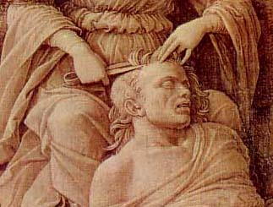
The law of a Nazarite
Not to drink wine: Be always in control
Not to touch a dead body: Separate from all defilement
Let his hair grow unshaven:
The Lord Christ rules over him (“But I want you to know that the head of every man is Christ”
-- 1 Corinthians 11:3)

Slide 5
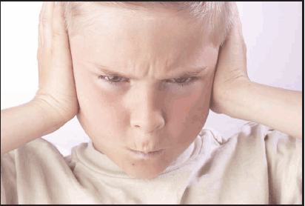
Samson’s downfall (1)
Dishonored his parents and forsook their advice:
“Then his father and mother said to him, ‘Is there no woman among the daughters of your brethren, or among all my people, that you must go and get a wife from the uncircumcised Philistines?’” (Judges 14:3)

Slide 6
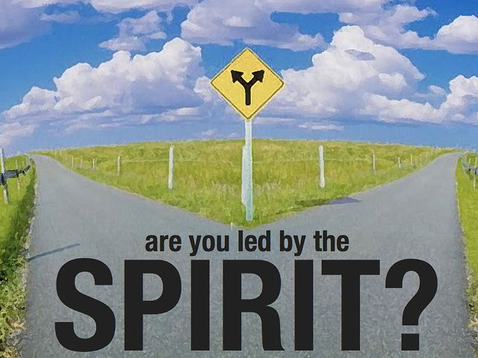
Samson’s downfall (2)
He was led by what makes him feel good:
“And Samson said to his father, ‘Get her for me, for she pleases me well’” Judges 14:3
- An undisciplined life is the cause of all tragedy and heartache around us.

Slide 7
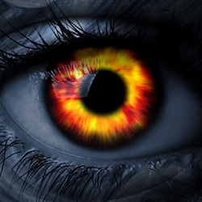
Samson’s downfall (3)
- His eyes did not see that he was breaking his vow by associating with unbelievers and marrying from among them.
- He focused on the external, not the internal.
- He did not see the traps designed for him. He underestimated his enemies.

Slide 8
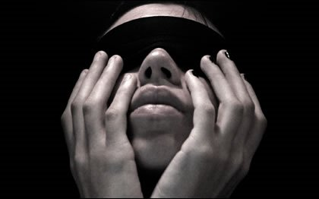
Samson’s downfall (4)
- He did not see that God was not pleased with what he was doing. God’s continuous support of him made him believe that he is doing OK!
- He did not realize that God departed from him: “‘I will go out as before, at other times, and shake myself free!’ But he did not know that the Lord had departed from him” Judges 16:20

Slide 9
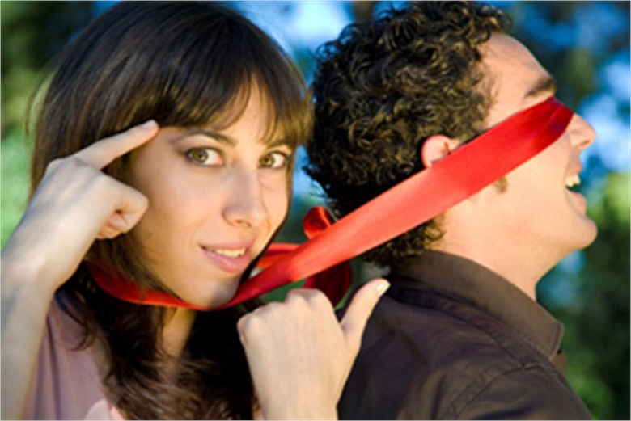
Samson’s downfall (5)
He allowed himself to be subjected to manipulation:
* Stressing emotions: Affects our feelings
- “Then Samson’s wife wept on him, and said, ‘You only hate me! You do not love me! You have posed a riddle to the sons of my people, but you have not explained it to me’” Judges 14:16
- “Then she said to him, ‘How can you say, “I love you,” when your heart is not with me’” Judges 16:15

Slide 10

Samson’s downfall (6)
* Nagging: Affects our nerves
- “Now she had wept on him the seven
days while their feast lasted. And it
happened on the seventh day that he
told her, because she pressed him so
much.” Judges 14:17
- Delilah’s strategy
* Flattery: Affects our pride
* Guilt: Affects our consciences
* Distraction: Affects our minds

Slide 11
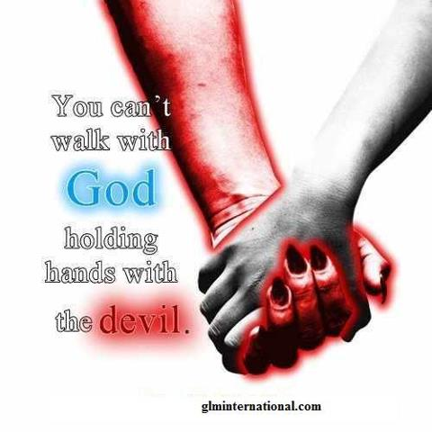
Samson’s downfall (7)
He flirted with a deadly temptation:
- Pleasure-related sins such as lust and addictions bind our wills every time we are exposed to them. These kinds of sins will not maintain a constant level of control in a person’s life, but will always increase.

Slide 12
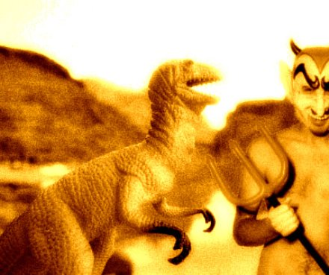
Samson’s downfall (8)
- St. James says: “But every man is tempted, when he is drawn away of his own lust, and enticed. Then when lust hath conceived, it brings forth sin: and sin, when it is finished, brings forth death.” (1:14-15)
When a woman conceives, it means she has become pregnant with a child. But, she did not become pregnant by herself. There is romance, an engagement, and then a wedding. In other words, mutual cooperation on the part of both participants.

Slide 13
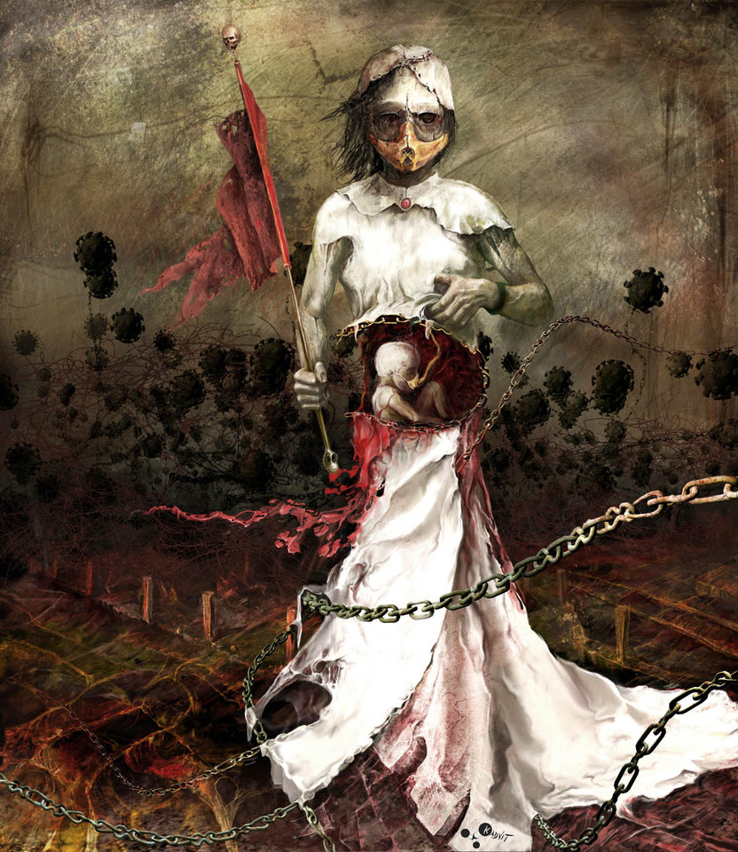
Samson’s downfall (9)
- When lust impregnates the human soul, it carries within its seed the programming for an entire, full-blown, out-of-control operation of sin that will take over a person’s emotions and attempt to keep that person from returning to God until the sin is finished and brings forth death.

Slide 14

Samson’s downfall (10)
- One of Satan’s strongest delusions concerning sin is to deceive a person into thinking he is getting away with it, or convincing him that he will be able to stop TOMORROW.

Slide 15

Samson’s faith (1)
He failed, but did not lose himself to despair:
With no eyes, no strength, no one to help him, being mocked and humiliated, still he never blamed God or lost trust in God’s acceptance when he would repent.

Slide 16

Samson’s faith (2)
- The critical issue for us is not whether we fail, but how we fail. There is such a thing as failing forward – learning from what we have done wrong: laying hold of the forgiveness of God. OR we can wallow in guilt and remorse and be overwhelmed by our failure.

Slide 17
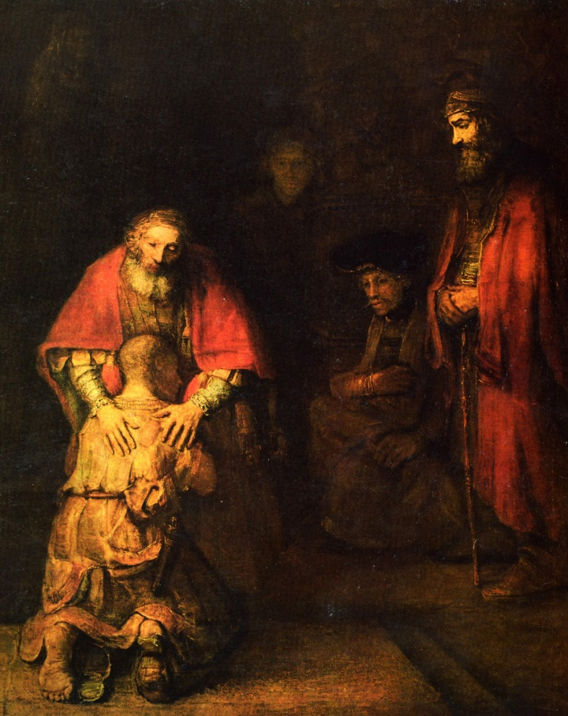
Samson’s faith (3)
He accepted the consequences:
- “Before I was afflicted I went astray, but now I keep Your word. It is good for me that I have been afflicted, that I may learn Your statutes” (Psalm 119:67,71)

Slide 18

Samson’s faith (4)
He was able to pray and ask for help once more.
He realized God’s will through repentance and returning to God.
He gave his life to avenge his enemies: A symbol of the Lord Christ. His death was a victory, not a defeat.

Slide 19
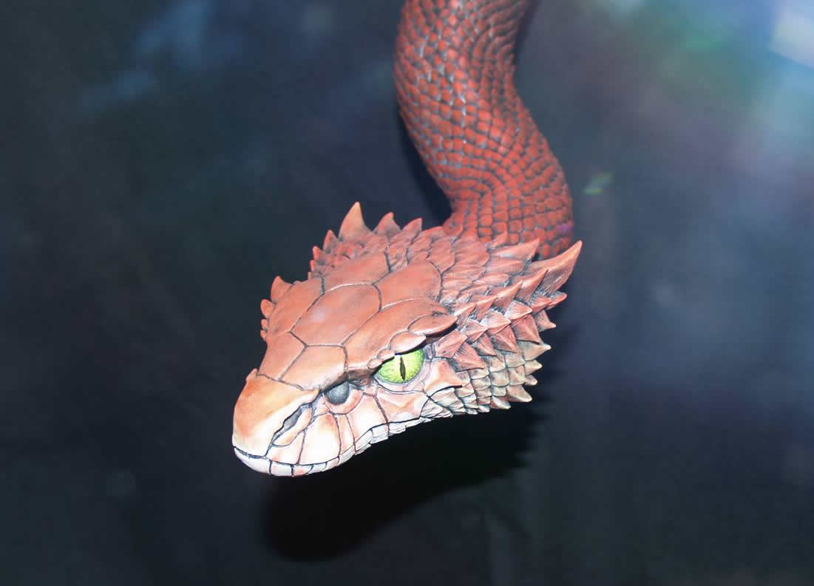
Satan’s role (1)
The common presentations: a lion, a crowd of enemies and the old serpent.
Simplifying the sin and magnifying man’s power over it.
Sin Thrills...then it Kills
Sin Fascinates...then it Assassinates.
Belittling the danger around him.

Slide 20
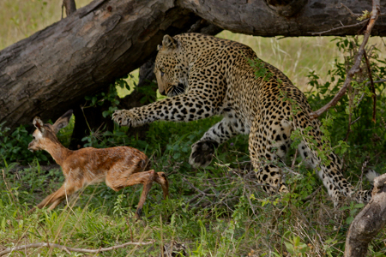
Satan’s role (2)
Watching carefully to know and destroy our source of power.
Discovering the pattern of our weakness and providing the desired bait.
Humiliation and making an example of our fall.

Slide 21
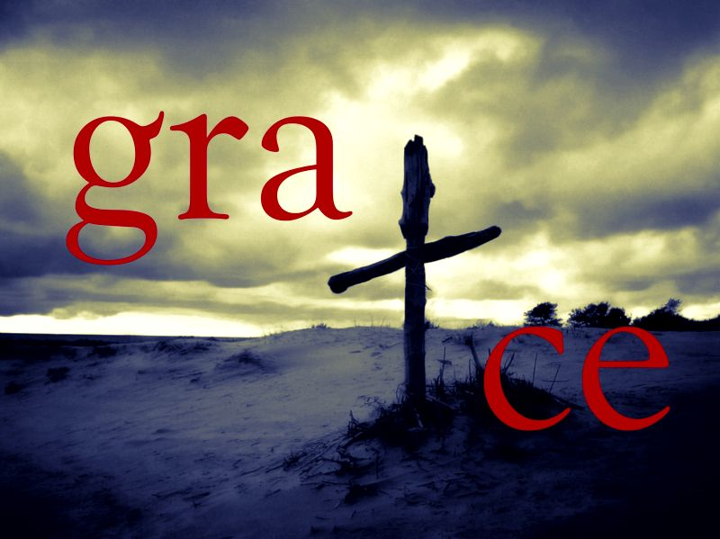
God’s restoring grace (1)
He covered Samson’s wrongs in Gaza when the Philistines tried to kill him.
He allowed him to suffer so that He can save him. When we suffer, we cease to sin.
He permitted Samson to lose his sight so that he can come to himself and see clearly.

Slide 22
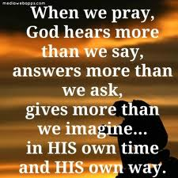
God’s restoring grace (2)
He allowed him to regain his strength when he repented.
He answered his prayers at the end.
He brought deliverance once more through a blind, broken, forgiven sinner!

