Slide 1
The Filioque Controversy
Servants’ Meeting
June 23, 2013
Feast of the Pentecost

Slide 2
Overview
Definition of Terms
Trinitarian Theology
Formulation of Creed
Some History
Effect of Words
Catholic Point of View
Orthodox Point of View
Most Recent Attempt at Reconciliation

Slide 3
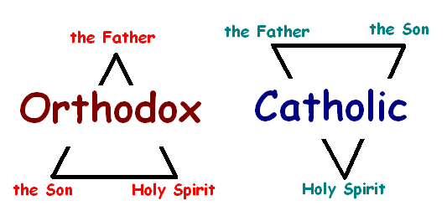
Meaning
“and from the Son” or simply “and the Son”
This phrase was added to the Creed regarding the Procession of the Holy Spirit:
  “Yes, we believe in the Holy Spirit, the Lord, the Giver of Life, who proceeds from the Father [and the Son]…”

Slide 4

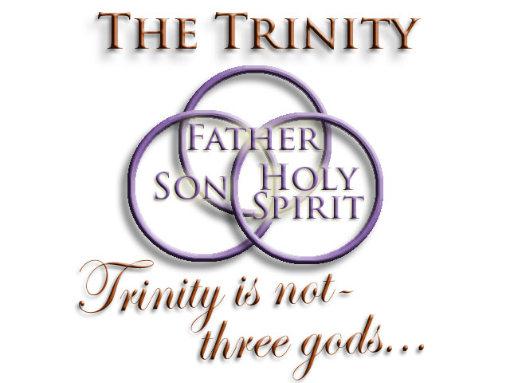
Some Terms
Hypostasis: “Existence” (East) or “Person” (West)
Homoousios: same substance (“hallmark of Orthodoxy”)
Ousia: being, substance, essence

Slide 5
Understanding the Trinity
The Trinity:
  God is three persons
  Each person is divine
  There is only one God
Each of the three persons is completely divine in nature, though each is not the totality of the Godhead.
Each of the three persons is not the other two persons.
Each of the three persons is related to the other two, but are distinct from them.

Slide 6
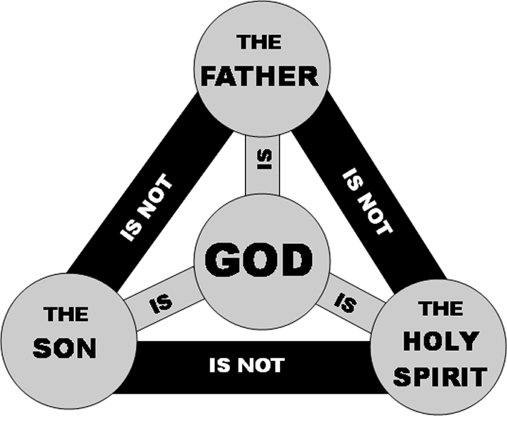

Slide 7
Understanding the Trinity
Is there Subordination?
  Yes, but only in order/roles and not in essence (“ousia”)
  King and servant
Roles
  The ____ is not begotten, but the ____ is.
    “And the Word became flesh and dwelt among us, and we beheld His glory, the glory as of the only begotten of the Father, full of grace and truth.” (John 1:14)
  The ____ proceeds from the ____.
    “But when the Helper comes, whom I shall send to you from the Father, the Spirit of truth who proceeds from the Father, He will testify of Me.” (John 15:26)

Slide 8
Understanding the Trinity
Roles
  The ____ sent the ____.
    “Jesus said to them, "My food is to do the will of Him who sent Me, and to finish His work.” (John 4:34)
  The ____ and the ____ send the ____.
    “But the Helper, the Holy Spirit, whom the Father will send in My name…” (John 14:26)
    “But when the Helper comes, whom I shall send to you from the Father…” (John 15:26)
  The ____ creates, the ____ redeems, and the ____ sanctifies.

Slide 9
Understanding the Trinity
Can we be more precise?
After Baptism, we receive God in Chrismation.
God saved us by dying on the cross for us.
God will judge us on the Last Day.
  “For the Father judges no one, but has committed all judgment to the Son…” (John 5:22)
God alone knows when the End of the Age will be.
  “But of that day and hour no one knows, not even the angels of heaven, but My Father only.” (Matthew 24:36)
God came upon the disciples as tongues of fire.
No one has ever seen God.

Slide 10
Formulation of Creed
Nicea (325) | Constantinople (381)
We believe in one God, the Father Almighty, Maker of all things visible and invisible. | We believe in one God, the Father Almighty, Maker of heaven and earth, and of all things visible and invisible.
And in one Lord Jesus Christ, the Son of God, begotten of the Father [the only-begotten; that is, of the essence of the Father, God of God], Light of Light, very God of very God, begotten, not made, being of one substance with the Father; | And in one Lord Jesus Christ, the only-begotten Son of God, begotten of the Father before all worlds, Light of Light, very God of very God, begotten, not made, being of one substance with the Father;
By whom all things were made [both in heaven and on earth]; | by whom all things were made;

Slide 11
Formulation of Creed
Nicea (325) | Constantinople (381)
Who for us men, and for our salvation, came down and was incarnate and was made man; | who for us men, and for our salvation, came down from heaven, and was incarnate by the Holy Spirit of the Virgin Mary, and was made man;
He suffered, and the third day he rose again, ascended into heaven; | he was crucified for us under Pontius Pilate, and suffered, and was buried, and the third day he rose again, according to the Scriptures, and ascended into heaven, and sits on the right hand of the Father;
From thence he shall come to judge the living and the dead. | from thence he shall come again, with glory, to judge the living and the dead;

Slide 12
Formulation of Creed
Nicea (325) | Constantinople (381)
 | whose kingdom shall have no end.
And in the Holy Spirit. | And in the Holy Spirit, the Lord and Giver of life, who proceeds from the Father, who with the Father and the Son together is worshiped and glorified, who spoke by the prophets.
 | In one holy catholic and apostolic Church; we acknowledge one baptism for the remission of sins; we look for the resurrection of the dead, and the life of the world to come. Amen.

Slide 13
Formulation of Creed
Nicea (325) | Constantinople (381)
[But those who say: ‘There was a time when he was not;’ and ‘He was not before he was made;’ and ‘He was made out of nothing,’ or ‘He is of another substance’ or ‘essence,’ or ‘The Son of God is created,’ or ‘changeable,’ or ‘alterable’—they are condemned by the holy catholic and apostolic Church.]

Slide 14
Some History
Earliest mention may have been at a local council, Council of Seleucia-Ctesiphon in Persia in about 410.
A dogmatic epistle of Pope Leo I to a Spanish bishop in 446-47.
Was not initially considered heretical by the Eastern churches.
In the local Council of Toledo (Spain) in 589, was inserted into the Creed.
First opposition by Patriarch Paul II of Constantinople (642-653) who accused Roman Patriarch for using the expression

Slide 15
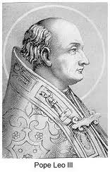
Some history
Pope Leo III of Rome:
  Initially approved the Filioque doctrine at the
  request of Emperor Charlemagne
  In 810, opposed its addition to the Creed
  Had two heavy silver tablets made and placed in
  St. Peter’s Basilica in Rome
  Engraved the original Creed of 381 in both Greek
  and Latin without the Filioque
  “I, Leo, have placed these for love and protection of the Orthodox faith.”
  Because the clause had always been rejected by the Eastern churches, Leo, in the interest of peace with the Greeks, urged that the creed should not be chanted in the public liturgy.

Slide 16
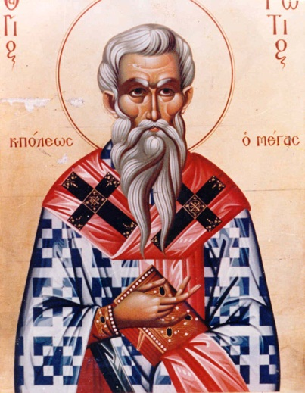
Some history
In 867, Patriarch Photios of Constantinople
  Wrote letter to rest of Eastern patriarchs
  Expressed concern for growing political and
  ecclesiastical tensions between
  Constantinople and Rome
  Proclaimed addition of Filioque to be
  blasphemous
  Presented strong theological argument against the view of the Trinity caused by the Filioque
  Detracted from the distinctive character of each Person of the Trinity
  Stated that it creates two origins, sources, or causes
  Confuses relationships between Persons of the Trinity

Slide 17
Some History
Filioque was taught in Rome, but was added to the Creed officially until 1014.
Great Schism of 1054 divided East (Eastern Orthodox) and West (Catholic Church):
  Theological disputes (papal supremacy):
    Iconoclasm: Emperor Leo III, early 8th century
    Filioque
  Jurisdictional disputes: Papal supremacy
  Governance disputes: role of Emperor
  Canonical
    Some liturgical practices: unleavened bread
    Celibacy among priests
  Language and Culture
  Decline of three patriarchies

Slide 18
Effect of Words
Early Church Fathers widely use the formula of procession of the Holy Spirit “from the Father through the Son”
Greek word for proceeds (“ekporeuomenon”) has the implication of “from a source”
Latin word for proceeds (“procedere”) does not
Some early fathers used the Filioque expression
  What was context? Hypostasis or ousia?

Slide 19
Catholic Point of View
Many early church fathers used this expression in their writings
The addition of “and the Son” was used to combat Arian heresy challenging the divinity of the Lord Jesus Christ
Understanding of the word for “proceeds” in Latin
Of the 150 bishops at Constantinople, none were from the West: Pope Damasus I

Slide 20
Orthodox Point of View
Changes understanding of the Holy Trinity
Creates two sources, whereas the Father is understood to be the source: creates a double procession
Lessens the Holy Spirit in the Trinity by making Him subordinate to the Father and Son
Creed was formulated by two ecumenical councils (Nicea and Constantinople)
Specific wording of Scripture
Difference between “proceeds” and “sends”

Slide 21
Most Recent Attempt at Reconciliation
North American Orthodox-Catholic Theological Consultation
  Committee on Ecumenical and Interreligious Affairs of the United States Conference of Catholic Bishops
  Standing Conference of the Canonical Orthodox Bishops in the Americas (SCOBA)
Issued an agreed statement, The Filioque: A Church-Dividing Issue?

Slide 22
Most Recent Attempt at Reconciliation
That all involved in such dialogue expressly recognize the limitations of our ability to make definitive assertions about the inner life of God.
That, in the future, because of the progress in mutual understanding that has come about in recent decades, Orthodox and Catholics refrain from labeling as heretical the traditions of the other side on the subject of the procession of the Holy Spirit.
That Orthodox and Catholic theologians distinguish more clearly between the divinity and hypostatic identity of the Holy Spirit (which is a received dogma of our Churches) and the manner of the Spirit's origin, which still awaits full and final ecumenical resolution.

Slide 23
Most Recent Attempt at Reconciliation
That those engaged in dialogue on this issue distinguish, as far as possible, the theological issues of the origin of the Holy Spirit from the ecclesiological issues of primacy and doctrinal authority in the Church, even as we pursue both questions seriously, together.
That the theological dialogue between our Churches also give careful consideration to the status of later councils held in both our Churches after those seven generally received as ecumenical.
That the Catholic Church, as a consequence of the normative and irrevocable dogmatic value of the Creed of 381, use the original Greek text alone in making translations of that Creed for catechetical and liturgical use.

Slide 24
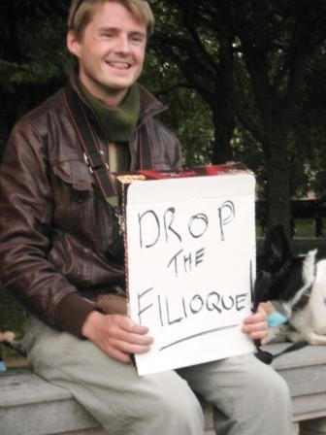
Most Recent Attempt at Reconciliation
That the Catholic Church, following a growing theological consensus, and in particular the statements made by Pope Paul VI, declare that the condemnation made at the Second Council of Lyons (1274) of those “who presume to deny that the Holy Spirit proceeds eternally from the Father and the Son” is no longer applicable.

Slide 25
Review
Definition of Terms
Trinitarian Theology
Formulation of the Creed
Some History
Effect of Words
Catholic Point of View
Orthodox Point of View
Most Recent Attempt at Reconciliation

