Slide 1
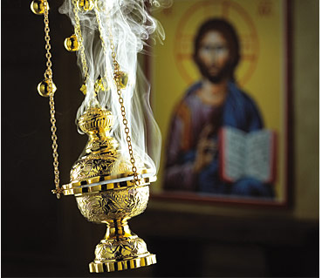
Holy Tradition (Part 3)
“…being seen by them during forty days and speaking of the things pertaining to the kingdom of God.” (Acts 1:3)

Slide 2
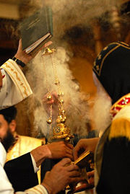
Holy Tradition (Part 1)
Handing down… from generation to generation
Holy Tradition in the Old Testament
  Before and after the laws were written
Holy Tradition in the New Testament
  Christ taught the Apostles who taught their disciples
Orthodox Tradition
  The whole system of doctrine, church government, worship and art.
  Tradition lives in the church
The Outward Forms of Holy Tradition
  The Bible

Slide 3
Holy Tradition (Part 2)
Ecumenical Councils
  The Oriental Orthodox Churches recognize three.
    Nicaea (325 AD)
    Constantinople (381 AD)
    Ephesus (431 AD)
  The Eastern Orthodox Churches recognize seven.
Infallibility of Ecumenical Councils
  Solemn definitions of ecumenical councils, which concern faith or morals, and to which the whole Church must adhere are infallible.
Local Councils
  Coptic Holy Synod

Slide 4
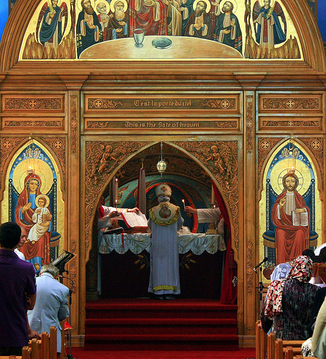
The Outward Forms of Holy Tradition
The Bible
The Ecumenical Councils
Local Councils
Patristics: The Fathers
The Liturgy
Canon Law
Church Rites
Icons

Slide 5
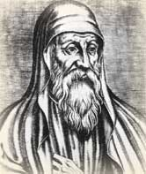
Patristics: The Fathers
Patristics or Patrology
  Greek patḗr (father)
  Study of Early Christian writers (Church Fathers).
The Patristic period:
  From the Apostolic Age (c. AD 100)
  to either AD 451 (Council of Chalcedon) (OO)
  or to the 8th century (2nd Council of Nicaea (EO)
Studied in the wider context of the Fathers:
  Scriptural interpretations
  Canons of Councils

Slide 6
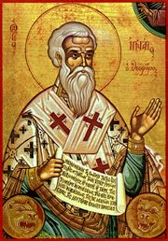
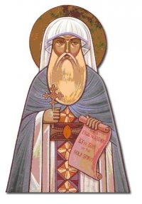
Patristics: Key Writers
Ignatius of Antioch (c. 35-c.108) – 7 letters
Clement of Rome (c.1st century AD-c.101),
Justin Martyr (c.100-c.165) – 8 Apologies
Irenaeus of Lyons (c.120-c.202),
Clement of Alexandria (c.150-c.215),
Tertullian (c.160-c.225) – 31 works
Origen (c.185-c.254) – 6000 works
Cyprian of Carthage (d. 258),
St. Athanasius (c.296-c.373) – over 90 works
St. Gregory of Nazianzus (329-389),
St. Basil of Caesarea (c.330-379),
St. Gregory of Nyssa (c.330-c.395)
St. Augustine of Hippo (354-430),
St. Cyril of Alexandria (d.444)

Slide 7

Eras of the Church Fathers
Ante-Nicene Fathers, those who lived and wrote before the Council of Nicaea (325)
Nicene and Post-Nicene Fathers, those who lived and wrote after 325.
38 volumes

Slide 8
Patristics: Languages and Locations
Greek writers
  Justin Martyr, John Chrysostom, Cyril of Alexandria.
Latin writers
  Tertullian, Cyprian, Jerome, Ambrose of Milan, Gregory the Great and Augustine of Hippo.
The major locations of the early Church fathers were Rome, Constantinople, Alexandria, Antioch, and the area of western north Africa around Carthage.

Slide 9
Patristics: Discernment
The Church is selective in adopting the teachings of the Fathers
  Individual writers have at times fallen into error
    Origin: pre-existence of the soul
    Tertullian: Misogyny (dislike of women)
  At times writers contradicted one another
  "Patristic wheat" needs to be distinguished from "Patristic chaff“
To acquire a "Patristic mind", an orthodox needs to enter into the spirit of the fathers
  The Fathers are NOT treated as relics of the past
  They are living witnesses and contemporaries

Slide 10
The Didache
The Teaching of the Twelve Apostles
  Didachē means "Teaching”
  A brief early Christian treatise, dated to the late first or early 2nd century.
  Oldest surviving written catechism
  Three main sections:
    Christian ethics, rituals (baptism and Eucharist), and Church organization
The first section (Chapters 1-6) begins:
  "There are two ways, one of life and one of death, and there is a great difference between these two ways."

Slide 11
The Didache
The second part (chapters 7 to 10)
  Begins with an instruction on baptism, which is to be conferred "in the Name of the Father, and of the Son and of the Holy Spirit" in “living water”.
  Chapter 8 suggests that fasts are not to be on Monday and Thursday "with the hypocrites" - but on Wednesday and Friday.
Ends (Ch 16) with an “apocalypse”:
  And then shall appear the signs of the truth: first the sign of opening in heaven; then the sign of the voice of the trumpet; and the third, the resurrection of the dead. Not, however, of all, but as was said, "The Lord shall come, and all the saints with him.” Then shall the world see the Lord coming upon the clouds of heaven.

Slide 12
Didascalia Apostolorum
“Teaching of the Apostles”
  “Didascalia, that is, the teaching of the twelve Apostles and the holy disciples of our Lord”
It presents itself as being written by the Twelve Apostles at the time of the Council of Jerusalem
  Scholars agree that it was actually a composition of the 3rd century, modeled on the Didache.
Main focus: liturgical practice and church organization.

Slide 13
Didascalia: Contents
Admonitions about Christian life, prayer, orphans, martyrdom (chapters 1-3, 13, 17, 19-20)
Rules about bishops' qualifications, conduct, duties, alms (chapters 4-11, 18)
Rules about male and female deacons and widows (chapters 14-16)
Liturgical rules about the proper place in the church-building and about fasting (chapters 12, 21)
The education of children and the denouncement of heresy (chapters 22-23)
The claim of the composition of the treatise by the Twelve Apostles and the refuse of the Jewish ritual practices (chapter 24-26)

Slide 14
Didascalia: Excerpt
“Each one therefore of the laity is to render an account of his own sins; and a man is not hurt by reason of� the sins of others. For neither did Judas harm us at all when he was praying with us, but he alone perished.� And in the ark, Noah and his two sons who were saved alive, they were blessed; but Ham, his other son, was not blessed, but his seed was cursed; [Gen 9.25] and the animals that went in, animals they came forth.”
  (CHAPTER VI, Concerning transgressors, and concerning those who repent.

Slide 15
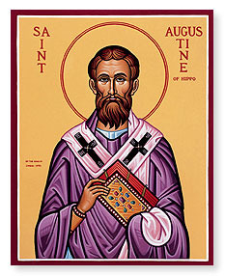
St. Augustine
Volume I. Prolegomena: St. Augustine's
Life and Work, Confessions, Letters
Volume II. The City of God, Christian Doctrine
Volume III. On the Holy Trinity, Doctrinal Treatises, Moral Treatises
Volume IV. The Anti-Manichaean Writings, The Anti-Donatist Writings
Volume V. Anti-Pelagian Writings
Volume VI. Sermon on the Mount, Harmony of the Gospels, Homilies on the Gospels
Volume VII. Homilies on the Gospel of John, Homilies on the First Epistle of John, Soliloquies
Volume VIII. Expositions on the Psalms

Slide 16
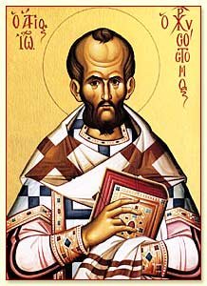
St. John Chrysostom
Volume IX. On the Priesthood, Ascetic Treatises, Select Homilies and Letters, Homilies on the Statutes
Volume X. Homilies on the Gospel of St. Matthew
Volume XI. Homilies on the Acts of the Apostles and the Epistle to the Romans
Volume XII. Homilies on First and Second Corinthians
Volume XIII. Homilies on the Epistles to the Galatians, Ephesians, Philippians, Colossians, Thessalonians, Timothy, Titus, and Philemon
Volume XIV. Homilies on the Gospel of St. John and the Epistle to the Hebrews

Slide 17
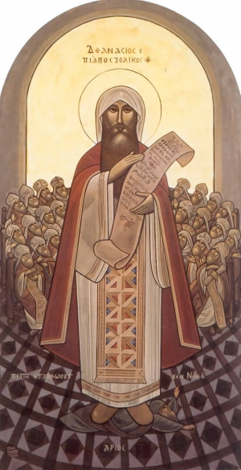
St. Athanasius
Over 90 works:
  Deposition of Arius
  On the Incarnation of the Word
  Festal Letters [written annually at Easter]
  On the Council of Nicaea
  Life of Anthony
  Commentary on the Psalms
  Many Homilies

Slide 18
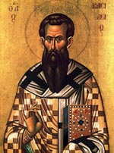
Patristics: The Fathers
The age of the fathers did NOT end in the fifth century
  Many later writers are also "Fathers"
    Habib Girgis, Pope Shenouda III
  The age of the Fathers is continuous
  To say that there can be no more Fathers is to suggest that the Holy Spirit has stopped working in the Church.

Slide 19
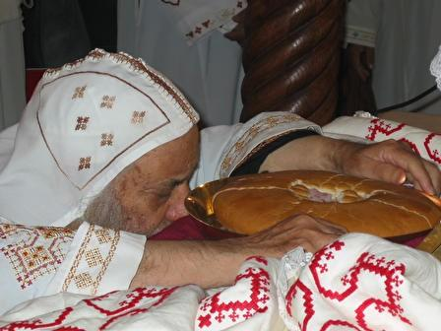
The Liturgy
Not all doctrines are formally documented in a form of a "creed"
Many doctrines are contained mainly in the prayers and hymns used at Orthodox services:
  The Eucharist
  The Theotokos (Mother of God)
  The Saints
  The faithful departed

Slide 20
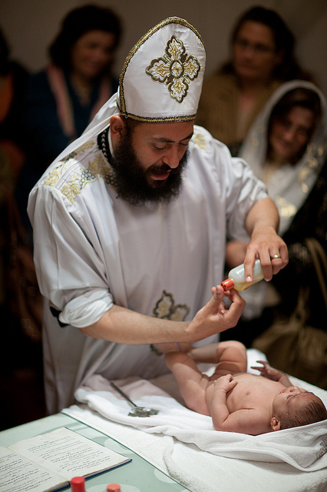
The Liturgy
Many doctrines are contained in various gestures and activities:
  Immersion in the waters of Baptism
  The different anointing with oil
  The sign of the Cross
  Raising of incense

Slide 21
Holy Tradition
The primary elements of Orthodox Tradition:
  Scripture, Councils, Fathers Liturgy, Canons, Icons
Each can only be understood in light of the rest
Doctrine cannot be understood unless it is prayed : “A Theologian is one who knows how to pray...” (Evagrius)
Doctrine if prayed, must also be lived
  “Theology without action (deeds) is the theology of demons” (Maximus)
  “You believe that there is one God. You do well. Even the demons believe—and tremble!” (Jam 2:19)

