Slide 1
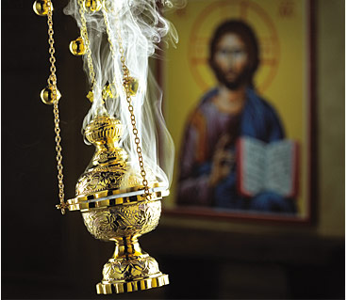
Holy Tradition (Part 2)
“…being seen by them during forty days and speaking of the things pertaining to the kingdom of God.” (Acts 1:3)

Slide 2
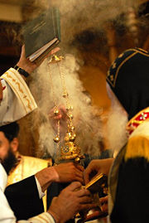
Holy Tradition (Part 1)
Handing down… from generation to generation
Holy Tradition in the Old Testament
  Before and after the laws were written
Holy Tradition in the New Testament
  Christ taught the Apostles who taught their disciples
Orthodox Tradition
  The whole system of doctrine, church government, worship and art.
  Tradition lives in the church
The Outward Forms of Holy Tradition
  The Bible

Slide 3
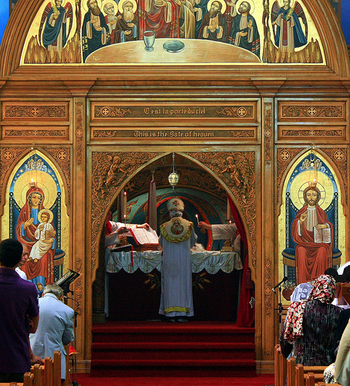
The Outward Forms of Holy Tradition
The Bible
The Ecumenical Councils
Local Councils
Patristic: The Fathers
The Liturgy
Canon Law
Church Rites
Icons

Slide 4
The Ecumenical Councils
“A conference of ecclesiastical dignitaries and theological experts convened to discuss and settle matters of Church doctrine and practice in which those entitled to vote are convoked from the whole world (oikoumene)”
Acceptance of councils as ecumenical and authoritative varies between different Christian denominations.
Disputes over Christological and other questions have led certain churches to reject some councils that others accept.

Slide 5
The Ecumenical Councils
The Oriental Orthodox Churches recognize three Ecumenical Councils
Both the Eastern Orthodox Church and Roman Catholic Church recognize seven.
The Roman Catholic Church continues to hold general councils of those bishops in full communion with the Pope, reckoning them as ecumenical.
  Roman Catholics recognize twenty-one Councils.
Anglicans and confessional Protestants, accept either the first seven or the first four as Ecumenical councils.

Slide 6
Infallibility of Ecumenical Councils
Doctrine of the infallibility of ecumenical councils:
  Solemn definitions of ecumenical councils, which concern faith or morals, and to which the whole Church must adhere are infallible.
  Such decrees are often labeled as 'Canons' and they often have an attached anathema, a penalty of excommunication, against those who refuse to believe the teaching.
  The doctrine does not claim that every aspect of every ecumenical council is infallible.
  The doctrinal decisions cannot be revised or corrected, but must be accepted "in toto" (totally)
  The most important Ecumenical statements of faith is the "Nicene-Constantinopolian Creed".

Slide 7
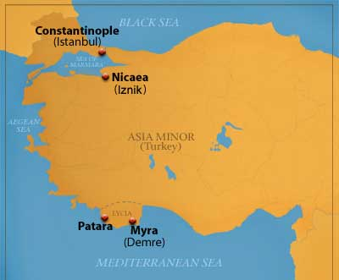
Council of Nicaea (325 AD)
Canons(20)
Major Canons:
  Repudiated Arianism, declared that Christ is "homoousios with the Father"
  (of the same substance as the Father)
  Adopted the original Nicene Creed
  Fixed Easter date
  Recognized primacy of the sees of Rome, Alexandria and Antioch
  Granted the See of Jerusalem a position of honor.

Slide 8
Council of Constantinople (381 AD)
Canons (7)
Major Canons:
  Condemnation of all shades of Arianism, and also of Macedonianism and Apollinarianism.
  Declared that Christ is "born of the Father before all time“
  Added to the Nicene Creed in regard to the Holy Spirit.
  Granted the Bishop of Constantinople the prerogative of honor after the Bishop of Rome because Constantinople is ‘New Rome’.
    Demoted the patriarchs of Antioch and Alexandria

Slide 9
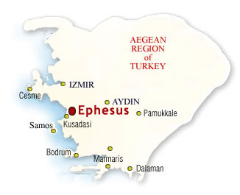
Council of Ephesus (431 AD)
Canons (8)
Major Canons:
  Denounced Nestorius' teaching as erroneous and decreed that Jesus was one person, not two separate people: complete God and complete man, with a rational soul and body.
  The Virgin Mary was to be called Theotokos, a Greek word that means "God-bearer" (the one who gave birth to God).
    Nestorius suggested the title Christotokos ("Christ-bearer“)

Slide 10

Council of Chalcedon (451 AD)
Repudiated the Eutychian doctrine of monophysitism, adopted the Chalcedonian Creed, which described the hypostatic union of the two natures of Christ, human and divine.
Reinstated those deposed in Second Council of Ephesus (449) and deposed Dioscorus of Alexandria.
Elevation of the bishoprics of Constantinople and Jerusalem to the status of patriarchates.
First Major Schism of the Church:
  Chalcedonian: Rome, Constontiniple
  Non-Chalcedonian: Alexandria, Antioch, Jerusalem

Slide 11
Last Three Councils
Second Council of Constantinople (553) repudiated the “Three Chapters” as Nestorian, condemned Origen of Alexandria, decreed the Theopaschite Formula (Christology which was both Chalcedonian and Cyrillian).
Third Council of Constantinople (680–681) repudiated Monothelitism and Monoenergism.
Second Council of Nicaea (787) restored the veneration of icons (condemned at the Council of Hieria, 754) and repudiated iconoclasm (destruction of Icons).

Slide 12
Local/Provincial Councils
There are two other ways that the church expressed doctrine
  Definitions by Local Councils
  Letters or statements of faith put out by individual bishops
While doctrinal decisions of Ecumenical Councils are infallible, decisions by local councils are liable to error
If these decisions are accepted in the rest of the Church, they acquire Ecumenical authority
Local Council decisions are often revised before being accepted by the Ecumenical Church
The Church in general has been selective in adopting Local Council decisions

Slide 13
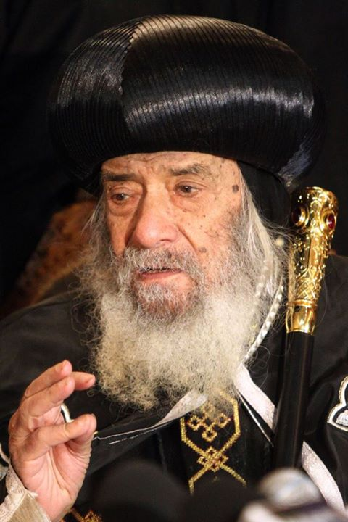
Local/Provincial Councils
Council of Laodicea (363)
  Maintaining order among clergy and laypeople
  Outlawing the keeping of the Jewish Sabbath
Council of Carthage (397)
  Specifying a Biblical canon
Coptic Synod (1986)
  Unified statement of Christology:"We believe that our Lord, God and Savior Jesus Christ, the Incarnate - Logos is perfect in His Divinity and perfect in His Humanity. He made His humanity One with His Divinity without Mixture, nor Mingling, nor Confusion. His Divinity was not separated from His Humanity even for a moment or twinkling of an eye. At the same time, we anathematize the Doctrines of both Nestorius and Eutyches".
Notes:
Pope Gabriel II (1131–1145)
Allowed the reading of the scriptures in Arabic after Coptic

Slide 14
Holy Synod of the Coptic Orthodox Church
The Holy Synod of the Coptic Orthodox Church of Alexandria is the highest authority in the Church of Alexandria and it formulates the rules and regulations regarding matters of church's organization, faith, service's order.
The Synod is chaired by the Patriarch of Alexandria and the members are all the Bishopric ranks, including General Bishops, Chorbishops, as well as all the Monastic Abbots, and the Patriarchal vicar (deputies)
Chair and members of the Synod (107)

Slide 15
The Outward Forms of Holy Tradition
The Bible
The Ecumenical Councils
Local Councils
Patristic: The Fathers
The Liturgy
Canon Law
Church Rites
Icons

