Slide 1
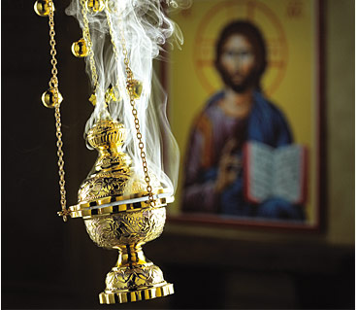
Holy Tradition (Part 1)
“…being seen by them during forty days and speaking of the things pertaining to the kingdom of God.” (Acts 1:3)

Slide 2
What is Tradition?
“The handing down orally of customs, beliefs, stories, etc… from generation to generation” (Webster’s New World Dictionary).
Tradition means an experience, an entire life – not simply a series of teachings.
The living out of the revelation of God by His people.

Slide 3
Holy Tradition
Holy Tradition in the Old Testament
Holy Tradition in the New Testament
Orthodox Tradition
The Outward Forms of Holy Tradition

Slide 4
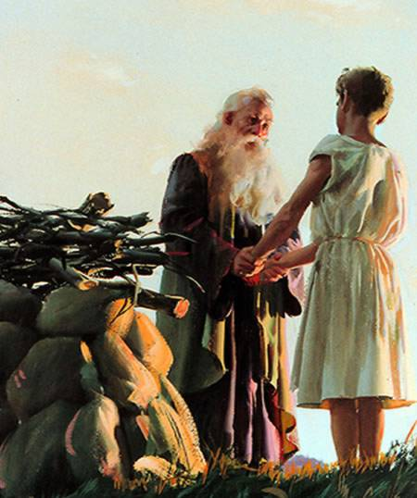
Holy Tradition in the Old Testament
2000 years between Adam and Moses.
  What was the source of knowledge about God and His commandments?
The life of the people was the tradition and others followed:
  Abel, Enoch, Methuselah, Noah, Abraham, Sarah, Melchizedek, Lot, Isaac, Rebecca, Jacob, Rachel, etc… (Heb 11:1-29; 1 Pet 3:1-6)

Slide 5
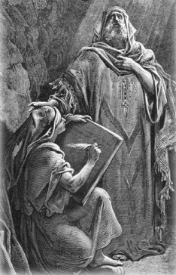
Holy Tradition in the Old Testament
Even after the writing of the laws:
  “Only be careful, and watch yourselves closely so that you do not forget the things your eyes have seen or let them fade from your heart as long as you live. Teach them to your
  children and to their children after them.”
  (Deut 4:9)
  “We have heard with our ears, O God,
  our fathers have told us, what deeds
  You did in their days, in days of old.”
  (Ps 66:1)

Slide 6
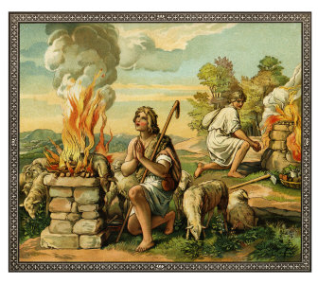
Examples
Offering sacrifices:
  Abel, Noah, Abraham, Isaac, Jacob, Job
  They knew the offering of animal sacrifices and building altars through Holy Tradition before the Written Law.
Priesthood
  Melchizedek the priest of God; Abraham giving him the tithe.
  How did they know about the Priesthood and the commandment of giving the Tithe?
  Jacob said to God, “and all You give me I will surely give a tenth to You.” (Gen 28:22)

Slide 7
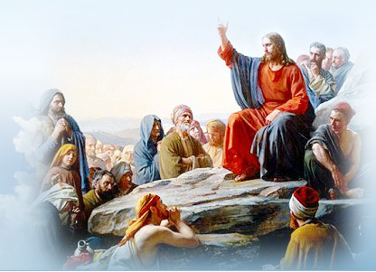
Holy Tradition in the New Testament
Our Lord Jesus Christ did not write a book,
He chose His disciples who accompanied Him day and night.
  They absorbed His teachings and learned directly from Him.
  He sent them to teach the whole world and to make disciples of all nations:
    “Go therefore and make disciples
    of all nations.” (Mt 28:19)

Slide 8
Holy Tradition in the New Testament
“Hold fast the pattern of sound words which you have heard from me.” (1 Tim 1:13)
“Brethren, join in following my example, and note those who so walk, as you have us as a pattern” (Phil 3:17)
“Having many things to write to you, I did not wish to do so with paper and ink; but I hope to come to you and speak face to face, that our joy may be full.” (2 Jn 12)
And there are also many other things that Jesus did, which if they were written one by one, I suppose that even the world itself could not contain the books that would be written.” (Jn 21:25)

Slide 9
Examples
St. Matthew quoted a prophecy that was not written in any of The Old Testament Holy Books but was transmitted through Tradition.
  “And he went and lived in a town called Nazareth. So was fulfilled what was said through the prophets, that he would be called a Nazarene.” (Matt 2:23)
St. Paul mentioned the names of the two Egyptian magicians who resisted Moses. These names are not mentioned in the Old Testament but were known by Holy Tradition.
  “Just as Jannes and Jambres opposed Moses…” (2Tim 3:8)

Slide 10
Examples
St. Jude mentioned the dispute between Archangel Michael and Satan regarding the body of Moses the Prophet.
  None of this was mentioned in the Old Testament but again was known through Holy Tradition. (Jude 9)
St. Jude mentioned a prophecy by Enoch not written in the Old Testament but known by Holy Tradition.
  ¹⁴ Now Enoch, the seventh from Adam, prophesied about these men also, saying, “Behold, the Lord comes with ten thousands of His saints, ¹⁵ to execute judgment on all, to convict all who are ungodly among them of all their ungodly deeds which they have committed in an ungodly way, and of all the harsh things which ungodly sinners have spoken against Him.” (Jude 14-15)

Slide 11
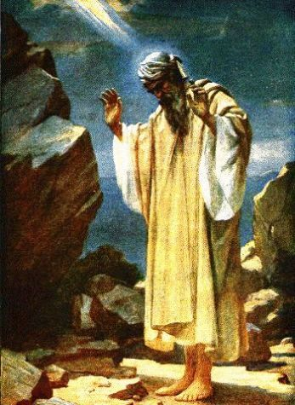
Examples
St. Paul described how the people received the Law and how the mountain was blazing with fire: “Moses said, I am exceedingly afraid and trembling” (Heb 12:21).
  These words ascribed to Moses the
  Prophet are not mentioned in the
  Old Testament.

Slide 12
Orthodox Tradition
To an Orthodox Christian, Tradition means:
  The Bible
  The Creed
  The decrees of the Ecumenical Councils
  The writings of the Fathers
  The Canons
  The Service books
  The Holy Icons
It means the whole system of doctrine, church government, worship and art.
Tradition is not only kept by the church
  it lives in the church

Slide 13
Orthodox Tradition
Tradition is not static (fixed) but dynamic (active)
  It is not a dead acceptance of the past
  (1 Pet 2:9-10)
  It is a living experience of the Holy Spirit in the present
    “…as it has now been revealed by the Spirit to His holy apostles and prophets” (Eph 3:4-5)
Tradition is inwardly changeless
  God does not change (Heb 13:8)
  But Tradition is constantly assuming new forms, which supplement the old without superseding them. (Matt 5:17)
    Example: Day the liturgy is celebrated

Slide 14
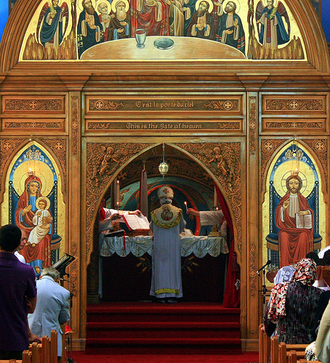
The Outward Forms of Holy Tradition
The Bible
The Ecumenical Councils
Local Councils
Patristic: The Fathers
The Liturgy
Canon Law
Church Rites
Icons

Slide 15
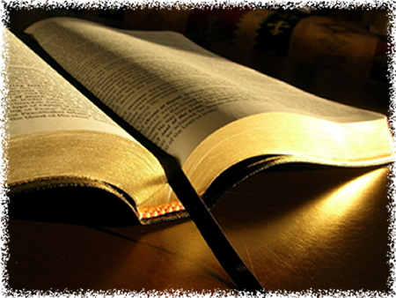
The Bible
The Bible and the Church
  The Orthodox Church is a Scriptural Church
  The Bible is the supreme expression of God's revelation to man.
  The Bible is NOT regarded as something set up OVER the Church, but rather something that lives and is understood WITHIN the Church.

Slide 16
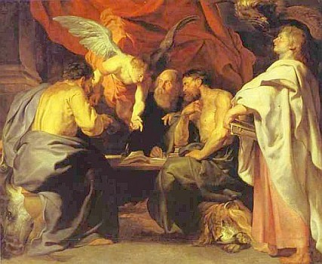
The Bible and the Church
It is from the Church that the Bible derives its authority.
  It was the church that originally decided which books form the Holy Scripture.
    Biblical canon:
    The Council of Laodicea (A.D. 363)
    The Council of Hippo (A.D. 393)
    The Council of Carthage (A.D. 397)

Slide 17
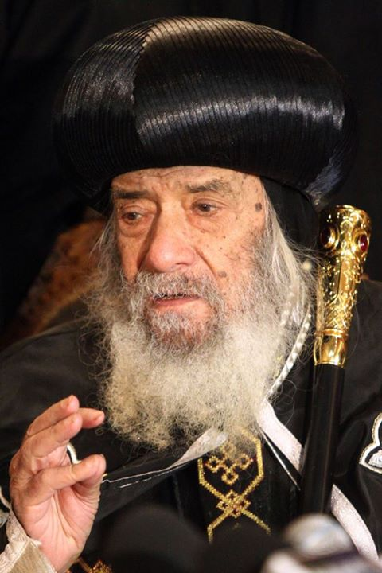
The Bible and the Church
It is from the Church that the Bible derives its authority.
  The Church alone can interpret Holy Scripture WITH AUTHORITY.
    "So Philip ran to him, and heard him reading the prophet Isaiah, and said, "Do you understand what you reading?" And he said, "How can I, unless someone guides me?" (Acts 8:30-31).
    “If you do not know, O fairest among women, Follow in the footsteps of the flock, And feed your little goats Beside the shepherds’ tents.” (Song 1:8)

Slide 18
Biblical Criticism
The Text of the Bible:
The Orthodox Church has the same Bible as the rest of Christendom.
The AUTHORITATIVE text for the Old Testament is the old Greek translation, the Septuagint.
When the Septuagint differs from the original Hebrew text, Orthodox believe that the "changes" in the Septuagint were made under the inspiration of the Holy Spirit, and are to be accepted as part of God's continuing revelation.

Slide 19
Biblical Criticism
Example: Isaiah 7:14:
  Hebrew: "A YOUNG WOMAN shall conceive and bear a son"
  Septuagint: "A VIRGIN shall conceive."
The Hebrew version contains only 39 books; the Septuagint contains also the other ten "Deuterocanonical" Books.
  Tobit, Judith, 1&2 Maccabees, Wisdom, Baruch, Sirach, Additions to Esther, Additions to Daniel,
  Prayer of Manasseh, Psalm 151
  Canons of various Christian traditions

Slide 20
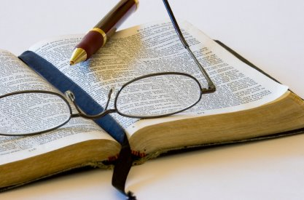
The Bible
Orthodoxy, while regarding the Church as the authoritative interpreter of Scripture, does NOT forbid the critical and historical study of the Bible.

Slide 21
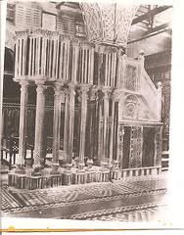
The Bible in Worship
The Holy Scripture is read constantly in Orthodox services:
In the Coptic Orthodox Church:
  During Vespers and Matins Raising of Incense:
    A Psalm and Gospel
  In the Liturgy:
    A Pauline Epistle
    A Catholic Epistle
    The Praxis (Acts of the Apostles)
    A Psalm
    A Gospel
  Read from the pulpit

Slide 22
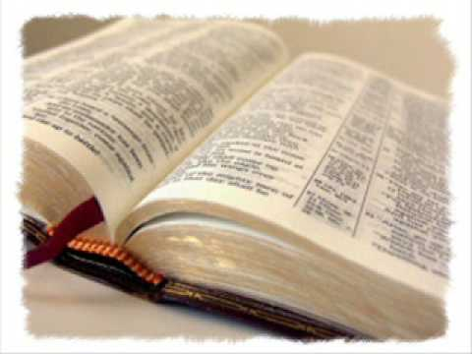
The Bible in Worship
During the Fast of Ninevah,
Great Fast and Holy Pascha Week:
  Readings from the Prophecies
During Holy Pascha Week:
  The entire Gospels of
  Matthew, Mark, Luke and John are read
On Joyous Saturday: The Book of Revelations in its entirety is read
Readings in every service:
  Baptisms, Funerals, Crowning Ceremonies, Ordinations, Consecrations

Slide 23
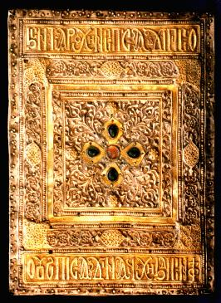
The Bible: Verbal Icon of Christ
The Gospel Book has a place of honor on the Altar.
It is carried in processions at the Liturgy and on feasts.
Placed visibly during the Liturgy
of the Word
  Concealed during the
  Liturgy of the Eucharist
  Different manifestations of Christ

Slide 24
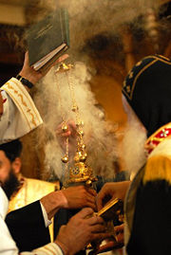
Holy Tradition
Handing down… from generation to generation
Holy Tradition in the Old Testament
  Before and after the laws were written
Holy Tradition in the New Testament
  Christ taught the Apostles who taught their disciples
Orthodox Tradition
  The whole system of doctrine, church government, worship and art.
  Tradition lives in the church
The Outward Forms of Holy Tradition
  The Bible

