Slide 1
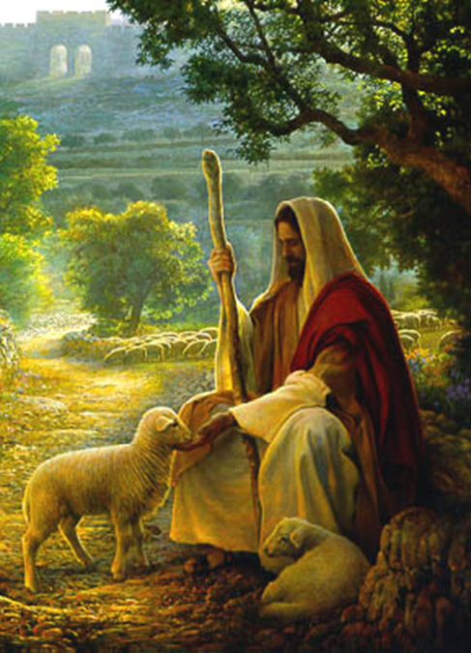
Joy in Forgiveness of Israel’s sins
Psalm 106

Slide 2
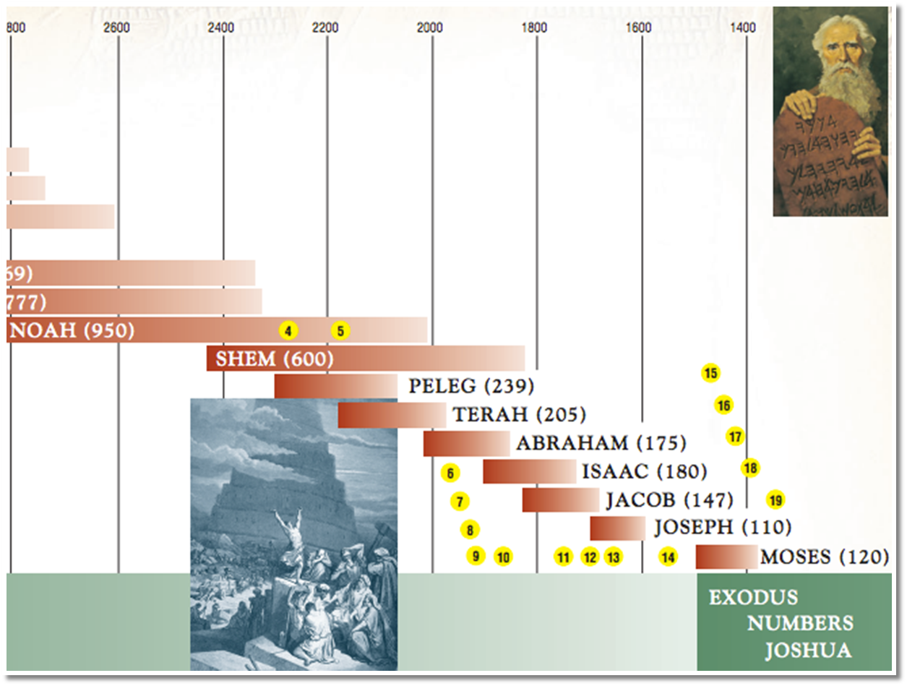
Psalm 105 we see God's faithfulness in keeping His covenant.
Psalm 106 we see the unfaithfulness of Israel.
Notes:
(Gen. 22:17) “Blessing I will bless you, and multiplying I will multiply your descendants as the stars of the heaven and as the sand which is on the seashore, and your descendants shall possess the gate of their enemies.”
Psalm 105 we see God’s faithfulness in keeping His covenant from the time of Abraham till the 10 plagues.
Psalm 106 we see the unfaithfulness of Israel from the time of crossing the Red Sea to the time of the Judges.
The two Psalms together provide a recount of Israel’s history and a clear contrast between the character of God and the character of man (represented in the people of Israel).

Slide 3
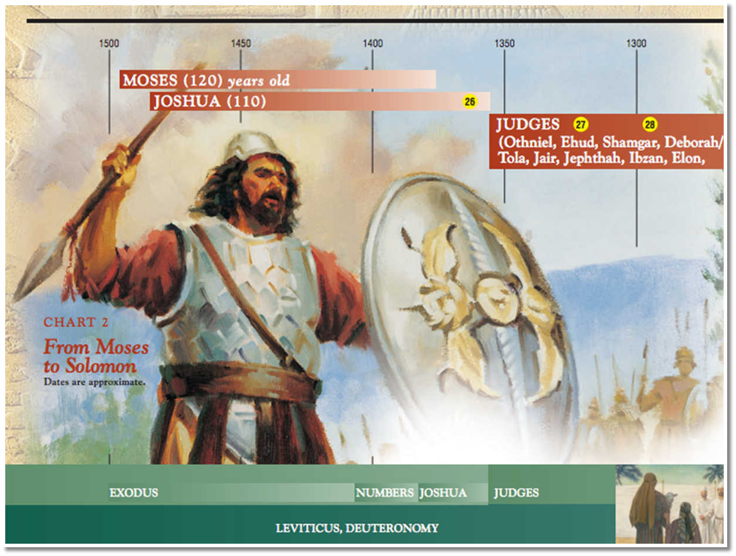

Slide 4
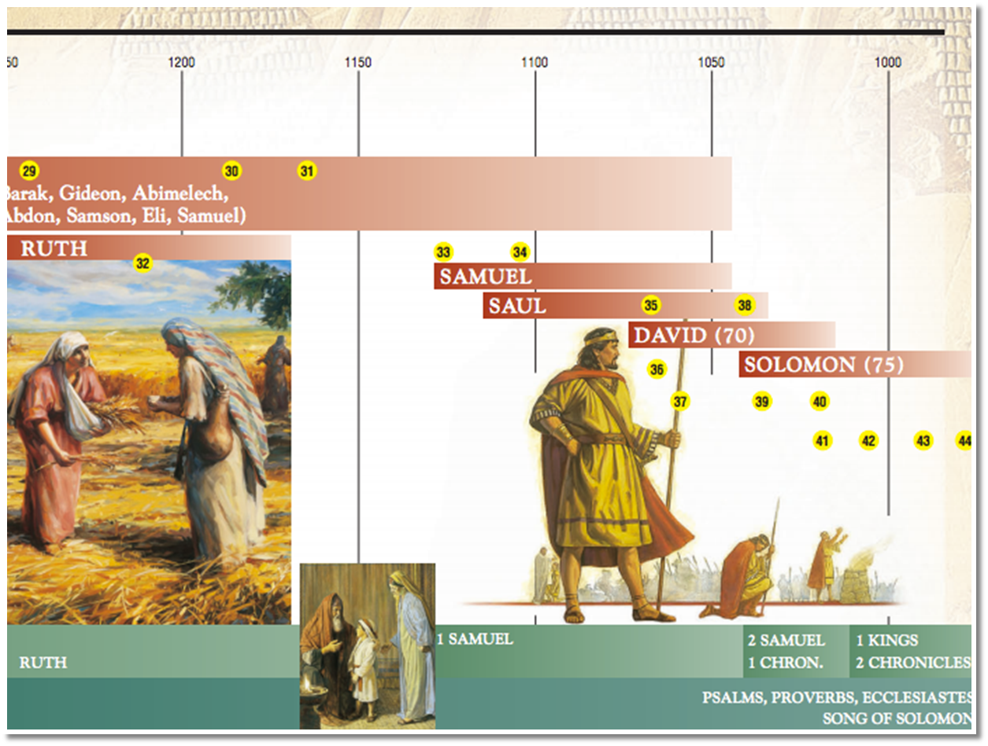

Slide 5
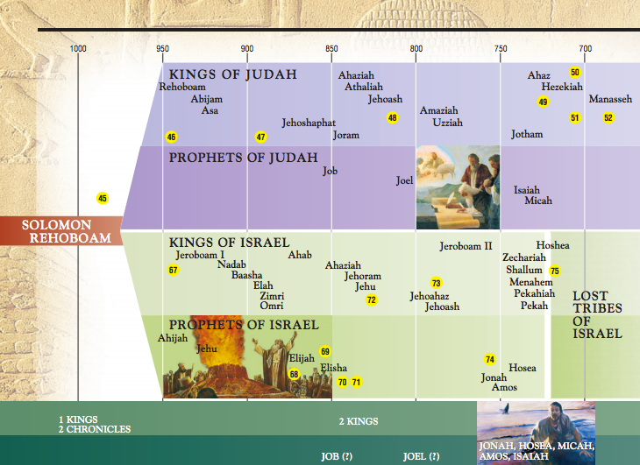

Slide 6
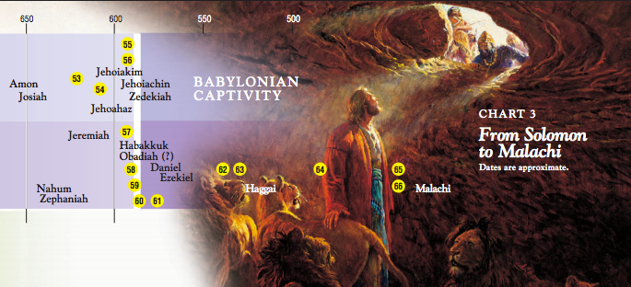

Slide 7
Psalm 106 begins and ends with hallelujah “Praise the Lord”. The space between two praises is filled with the details of Israel's sin and the extraordinary patience of God; and we do well to praise the Lord when the theme is sin of man and Grace of the Lord.
– – Charles Spurgeon
Notes:
The two Psalms provide a recount of Israel's history and a
clear contrast between the character of God and the character of man.

Slide 8
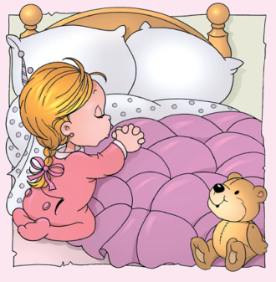
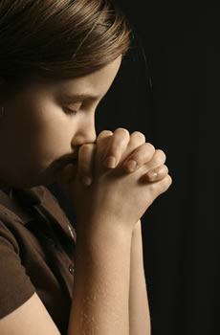
Psalm 106
  Opening prayer and praises.
  Story of the nation's sins
  with confessions.
  Closing prayer and praises.
Notes:
One of the nice contemplations of our fathers is that we feel happy before we go to confess as we are preparing to cleans ourselves, later on after the confession we feed happy because we are cleaned after Abuna has read the absolution for us, remember some Moses!

Slide 9

^{(Ps 106:1)} Praise the Lord oh, give thanks to the Lord, for He is good for His mercy endures forever.
Why Israel (people) do not praise the Lord?
sometimes people do not realize the blessings the Lord provide.
easy to acknowledge earthly signs
difficult to acknowledge the goodness in suffering when the Lord visits offenders with the rod of correction.
Notes:
Praising the Lord is not only in the Vespers and praises on Saturday, we can praise the Lord all the days of the week whether we are at work, home, anywhere.
If you give me a goodie I would say thank you, if you do not give me a goodie I will not save, if you give me a goodie and I do not remember or forgot that you gave me a goodie I will not say thank you

Slide 10
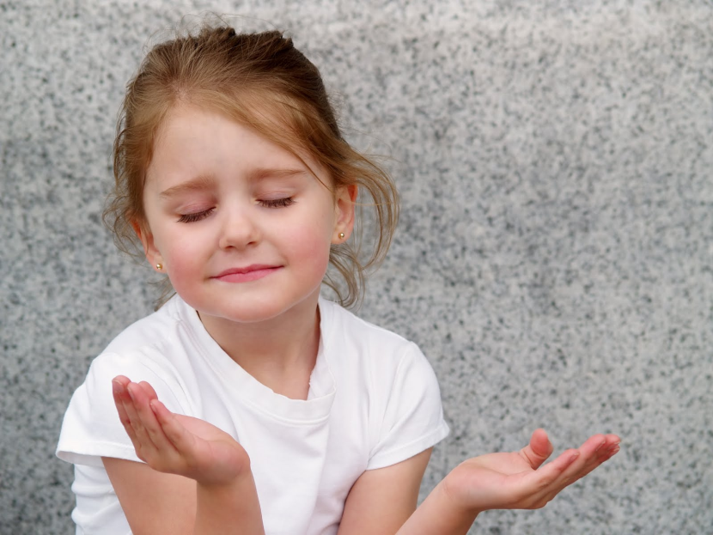
^{(Ps 106:1)} Praise the Lord oh, give thanks to the Lord, for He is good for His mercy endures forever.
Why Israel (people) praise(s) the Lord?
for all people.
Praises are free from any requests
our job in heaven?
man never stops to sin;
God never stops to be merciful.
^{(Ps 67:3)} “Let the peoples praise You, O God; Let all the peoples praise You.”
Notes:
However God is also just as He is merciful, He will stay patient with us until we do not show any signs of repentance than he will use the rod for correcting just to bring us back to His grace
Where did the Jews refuse the teachings of St. Paul which caused him to start preaching to the Gentiles?

Slide 11
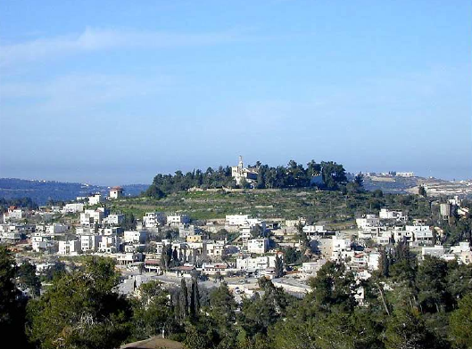
^{(1 Chronicles 16:34)} Oh, give thanks to the LORD, for He is good! For His mercy endures forever.
The Ark of covenant was captured by the Philistines and Shiloh was destroyed.
When God brought the Ark back, it was kept in Kiriath Jearim for 20 years.
Notes:
(1 Chronicles 16:34) “Oh, give thanks to the LORD, for He is good! For His mercy endures forever.”
The first and two last verses of this psalm form a part of that psalm which David delivered into the hand of Asaph and his brethren, to be sung before the ark of the covenant, after it was brought from the house of Obed-Edom to Mount Zion.

Slide 12
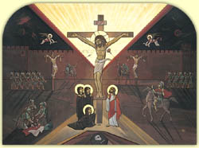
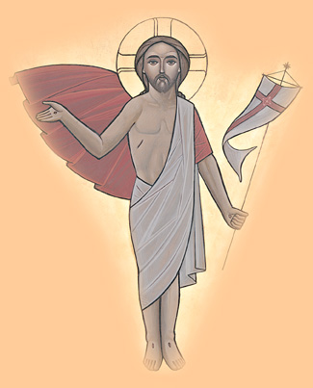
^{(Psalm 106:4)} “Remember me, O Lord, with the favor You have toward Your people. Oh, visit me with your salvation.”
Good-ashamed-repent
Bad-trials-remember-repent,
regardless of His wise ways to bring us
back, He always seeks after our salvation.
^{(Luke 23:42)} “Then he said to Jesus, "Lord, remember me when You come into Your kingdom“
Notes:
Beautiful words in the resurrection happy days and as we have just came out from the passion week, it tells us that He is using any small excuses to save us.
This is why we need to learn in these days and throughout the year not to judge but to forgive, NOT to think of anyone that he or she will go to Hades as we do not know that with our limited knowledge, we may go to heaven and see people we never thought they would be there.
(Luke 23:43) ⁴³ And Jesus said to him, "Assuredly, I say to you, today you will be with Me in Paradise."
⁵ That I may see the benefit of Your chosen ones, That I may rejoice in the gladness of Your nation, That I may glory with Your inheritance.

Slide 13
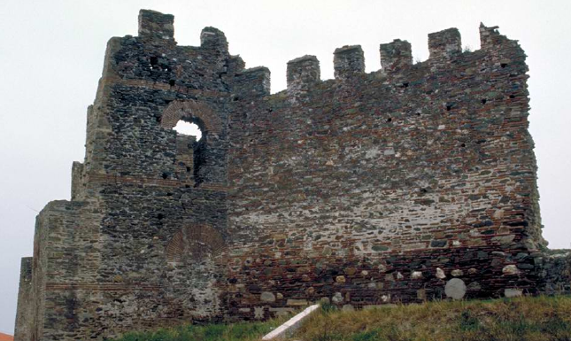
^{(Joshua 2:11)} “For the LORD your God, He is God in heaven above and on earth beneath.”
Any idea who said that?
Rahab the harlot who saved the two spies
Notes:
Hebrews 11:31 (NKJV)
³¹ By faith the harlot Rahab did not perish with those who did not believe, when she had received the spies with peace.
James 2:24-26 (NKJV)
²⁴ You see then that a man is justified by works, and not by faith only.
²⁵ Likewise, was not Rahab the harlot also justified by works when she received the messengers and sent them out another way?
²⁶ For as the body without the spirit is dead, so faith without works is dead also.
Because of Rahab‘s faith in the power and ability of the God of Israel she was saved and became a mother of Boaz who is the grandfather of King David. And we all know that Jesus Christ came from the descendants of King David (Matthew 1:5, Hebrews 11:31, James 2:25).
As if God is sending a message to the people of Israel and the Gentiles together, Old or New Testament saying you are still My sons and daughters: (Mt 11:28) “Come to Me, all you who labor and are heavy laden, and I will give you rest.”
Out of all the population of Jericho, only she reached out to the living God and He in turn saved her.
This teaches us that it is not enough to be good because probably there where good people in Jericho at least better than Rahab however they did not reach out to the Lord as she did

Slide 14
^{(Psalm 106:6)} “We have sinned with our fathers, we have committed iniquity, we have done wickedly.”
Here begins a confession
national confession?
they shared national privileges, therefore they shared national guilt.
Notes:
The confession is repeated three times, in token of the sincerity and heartiness of it.

Slide 15
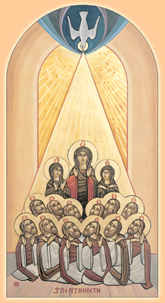
^{(Psalm 106:8)} "nevertheless He saved them for His name's sake, that He might make His mighty power known."
When He could find no other reason for His mercy He
found it in His
own Glory and seized the opportunity to display His
power.

Slide 16
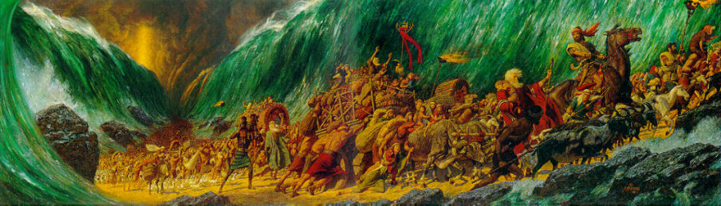
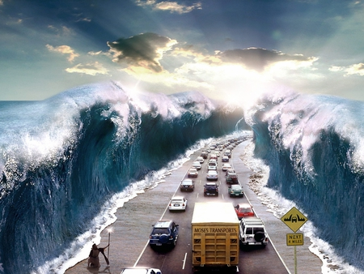
^{(Psalm 106:9)} "He rebuked the Red Sea also, and it dried up; so He led them through the depths, as through the wilderness."
Notes:
A word did it. The sea heard his voice and obeyed. How many rebukes of God are lost upon us! Are we more unmanageable than the ocean?

Slide 17
^{(Psalm 106:12-13)} “¹² Then they believed His words; they sang His praise. ¹³ they soon forgot His works; they did not wait for His counsel.”
Peace
Sin
Suffer
Repent
The Spiritual Cycle of the people of Israel in Judges
Story of the man in a storm.
Notes:
Between Israel singing and Israel sinning there was a small step.

Slide 18
^{(Psalm 106:14-15)} “¹⁴ But lusted exceedingly in the wilderness, and tested God in the desert. ¹⁵ and He gave them their request, but sent leanness into their soul.”
A prayer
  may be answered in anger
  may be denied in love
Notes:
For a meal of meat they were ready to curse their God and the promised land.
When wealth grows with a man his worldly estate is fatter, but his soul's state is leaner.
To gain silver and lose gold is a poor increase; but to win for the body and lose for the soul is far worse.
Numbers 11:31-33 (NKJV)
³¹ Now a wind went out from the LORD, and it brought quail from the sea and left them fluttering near the camp, about a day's journey on this side and about a day's journey on the other side, all around the camp, and about two cubits above the surface of the ground.
³² And the people stayed up all that day, all night, and all the next day, and gathered the quail (he who gathered least gathered ten homers); and they spread them out for themselves all around the camp.
³³ But while the meat was still between their teeth, before it was chewed, the wrath of the LORD was aroused against the people, and the LORD struck the people with a very great plague.

Slide 19
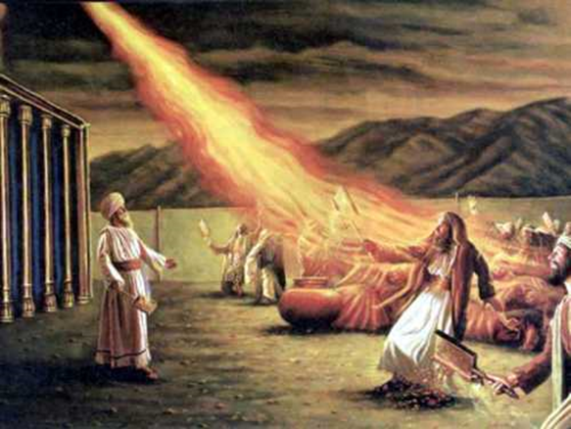
^{(Psalm 106:16-18)} “¹⁶ When they envied Moses in the camp, and Aaron the saint of the Lord, ¹⁷ the earth opened up and swallowed Dathan, and covered the faction of Abiram. ¹⁸ a fire was kindled in their company; the flame burned up the wicked.
(Zechariah 2:8) For he who touches you touches the apple of His eye.
Notes:
The Book of Numbers 16:41-50
Moses was the one man in all the camp who labored hardest and always prayed and pleaded to God to save his people. They should have sympathized with him.
By divine choice Aaron was set apart to be holy unto the Lord, instead of thanking God that he had favored them with a high priest by whose intercession their prayers would be presented, they envied and quarreled with the man who was to offer sacrifice for them.
It is a mark of bad men who are envious of the good.
(Zechariah 2:8) For thus says the LORD of hosts: "He sent Me after glory, to the nations which plunder you; for he who touches you touches the apple of His eye.

Slide 20
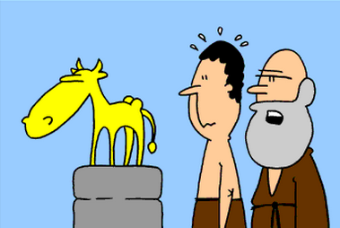
^{(Psalm 106:19)} “¹⁹ They made a calf in Horeb, and worshiped the molded image.
Should we judge the people of Israel?
Story of the monk.
Notes:
In the very place where they had pledged themselves to obey the Lord they broke the second, if not the first, of his commandments, and set up the Egyptian symbol of the ox, and bowed before it.
Before we start going into the judgment mode about how Israel forgot about the cloud, the pillar of fire, the split of the Red Sea, the water gushing out of the rock how many of us in the same day of Sunday liturgy where we took communion had a fight or did things which are not appropriate with the fact that we have received the body and blood of our Lord Jesus Christ in the morning.
If the answer is yes then we have no right to judge because the only one who can judge is the One with no sin and since none of us is with no sin then we cannot judge, it is only He who can judge.

Slide 21
^{(Psalm 106:28)} “²⁸ They joined themselves also to Baal of Peor, and ate sacrifices made to the dead."
Numbers 25:1-3
1 Now Israel remained in Acacia Grove, and the people began to commit harlotry with the women of Moab.
2 They invited the people to the sacrifices of their gods, and the people ate and bowed down to their gods.
3 So Israel was joined to Baal of Peor, and the anger of the LORD was aroused against Israel.
Notes:
This abomination of the Moabites was an idol in whose worship women gave up their bodies to the most shameless lust.
In the orgies with which the Baalites celebrated their detestable worship Israel joined, partaking even in their sacrifices as earnest inner court worshippers, though the gods were but dead idols.
basically they were imitating the worshiping of strange gods at the time like in Egypt and in the promised land, this is why God asked them to wipe them up when they enter the promised land, not to leave anybody, definitely not to marry from them which they did especially in places like in Samaria which is why God allowed the captivity first in the north kingdom by the Assyrians then in the south kingdom by the Babylonians.

Slide 22
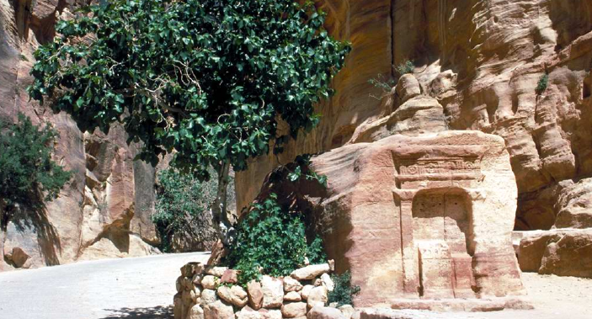
Description of the problem
^{(Psalm 106:34-35)} “³⁴ They did not destroy the peoples, concerning whom the Lord had commanded them, ³⁵ but they mingled with the Gentiles and learned their works.”

Slide 23
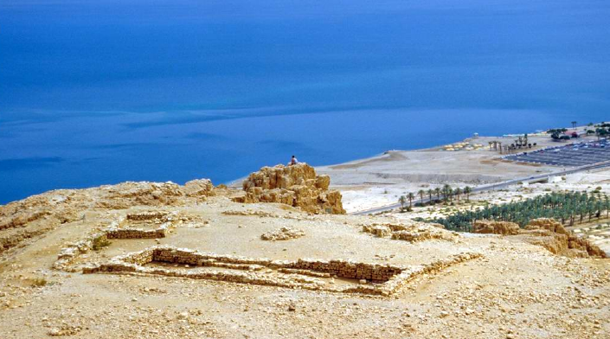
Description of the problem ²
^{(Psalm 106:36-38)} “³⁶ They served their idols, which became a snare to them. ³⁷ they even sacrificed their sons and their daughters to demons, ³⁸ and shed innocent blood, the blood of their sons and daughters whom they sacrificed to the idols of Canaan; and the land was polluted with blood.”

Slide 24
Consequences
^{(Psalm 106:40)} “⁴⁰ Therefore the wrath of the Lord was kindled against His people, so that He abhorred his own inheritance."

Slide 25
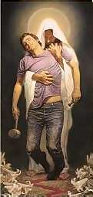
^{(Psalm 106:41…46)}
“⁴¹ Nevertheless He regarded their affliction, when He heard their cry……
⁴⁶He also made them to be pitied by all those who carried them away captive."

Slide 26
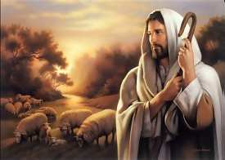
^{(Psalm 106:48)} “⁴⁸ Blessed be the Lord God of Israel from everlasting to everlasting and let all the people say Amen Praise the Lord."

Slide 27
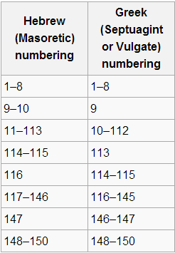
Book of Psalms
“tehillim”
Hebr. hillil “to praise”
hellil ; hallelujah
Poetry peculiarities:
Rhyme (unknown in Hebrew)
Alliteration
Parallelism
Notes:
The book of Psalms is the first and main book of the third part of the Hebrew Bible, of the "writings" (hebr. ketubim). The reference in Luke 24:44 "psalms" probably means the whole third part of the OT. The Hebrew title is "tehillim" (hebr. hillil, which means "to praise"; compare hallelujah) and signifies "praises". The name "psalm" for a singular praise originates from the Greek and means "singing with instrumental accompaniment" or "playing a stringed instrument".

Slide 28
Instructions for the conquest of Canaan:
(Num 33:50-54) ⁵⁰Now the Lord spoke to Moses in the plains of Moab by the Jordan, across from Jericho, saying ⁵¹“Speak to the children of Israel, and say to them: when you have crossed the Jordan into the land of Canaan, ⁵²then you shall drive out all the inhabitants of the land from before you, destroy all their engraved stones, destroy all their molded images, and demolish all their high places, ⁵³you shall dispossess the inhabitants of the land and dwell in it for I have given you the land to possess. ⁵⁴and you shall divide the land by lot as an inheritance
among your families…
Pagan Shrine in Juda

Slide 29
(Num 33:55-56) “⁵⁵but if you do not drive out the inhabitants of the land from before you, then it shall be that those whom you let remain shall be irritants in your eyes and thorns in your sides, and they shall harass you in the land where you dwell. ⁵⁶Moreover it shall be that I would do to you as I thought to do to them.”
Pagan temples from the 4th century B.C.

