Slide 1
Isaiah 59 – Separated from God
“The Redeemer will come to Zion and to those who turn from transgression in Jacob” (Isaiah 59:20)

Slide 2
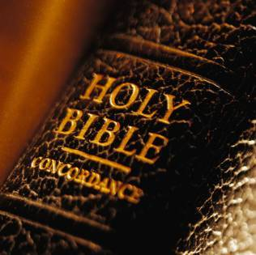
Two Parallel Stories
Mankind’s salvation
My personal salvation
Summarized in Isaiah 59

Slide 3
Summary
Separated from God (59:1-8)
Effects of sin (59:9-11)
Sins confessed (59:12-15)
The Redeemer (59:16-20)
The Covenant (59:21)

Slide 4
Separated from God
“Behold, the Lord’s hand is not shortened, That it cannot save; Nor His ear heavy, That it cannot hear. But your iniquities have separated you from your God; And your sins have hidden His face from you, so that He will not hear.” (59:1-2)

Slide 5
Separated from God
“Behold, the Lord’s hand is not shortened, That it cannot save; Nor His ear heavy, That it cannot hear. But your iniquities have separated you from your God; And your sins have hidden His face from you, so that He will not hear.” (59:1-2)
Our sins do not limit God, nor do they limit His ability to forgive them.

Slide 6
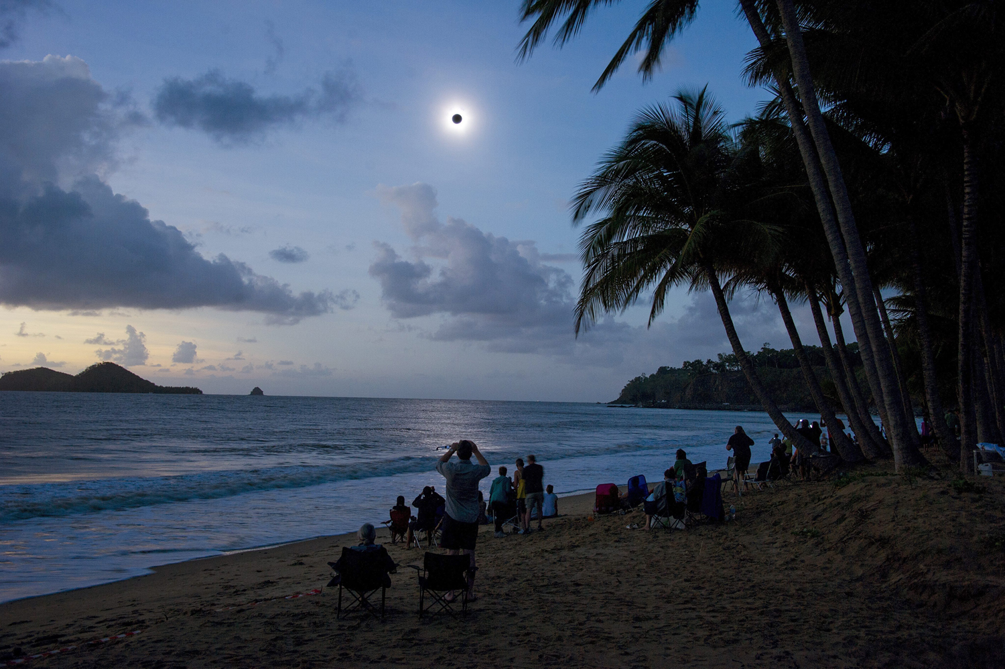
Separated from God

Slide 7
Separated from God
“Behold, the Lord’s hand is not shortened, That it cannot save; Nor His ear heavy, That it cannot hear. But your iniquities have separated you from your God; And your sins have hidden His face from you, so that He will not hear.” (59:1-2)
Toddler example
“…with whom is no variableness, neither shadow of turning.” (James 1:17)

Slide 8
Effects of Sin
(Consequences of Separation)
Depravation of coming close to God
“…justice is far from us” (vs. 9)
Being in darkness
“We look for light, but there is darkness” (vs. 9)
Loss of insight and lack of alert spiritual leadership
“We grope for the wall like the blind…we stumble at noonday as at twilight” (vs. 10)

Slide 9
Effects of Sin
(Consequences of Separation)
Crying out with no avail
“We all growl like bears and moan sadly like doves” (vs. 11)
“My God, My God, why have You foresaken me?” (Psalm 22:1, Matthew 27:46)

Slide 10
Confession of Sin
“For our transgressions are multiplied before you, And our sins testify against us; For our transgressions are with us, And as for our iniquities, we know them” (vs. 12)

Slide 11
Confession of Sin
“For our transgressions are multiplied before you, And our sins testify against us; For our transgressions are with us, And as for our iniquities, we know them:(vs. 12)
“… for I was hungry and you gave Me no food; I was thirsty and you gave Me no drink… Assuredly, I say to you, inasmuch as you did not do it to one of the least of these, you did not do it to Me. (Matthew 25:41-46)

Slide 12
The Redeemer
“Then the Lord saw it, and it displeased Him
That there was no justice. He saw that there was no man, And wondered that there was no intercessor;
Therefore His own arm brought salvation for Him;
And His own righteousness, it sustained Him.”
(vs. 15-16)
Because of that separation, the Intercessor was sent to uproot the sin out of the world, through which we were separated from Him as enemies, to get reconciled with Him, and to turn from enemies into children (St. Augustine)

Slide 13
The Redeemer
“Then the Lord saw it, and it displeased Him
That there was no justice. He saw that there was no man, And wondered that there was no intercessor;
Therefore His own arm brought salvation for Him;
And His own righteousness, it sustained Him.”
(vs. 15-16)
Because of that separation, the Intercessor was sent to uproot the sin out of the world, through which we were separated from Him as enemies, to get reconciled with Him, and to turn from enemies into children (St. Augustine)

Slide 14
The Role of the Redeemer
He led his people in the battle against the enemy
“For He put on righteousness as a breastplate,
And a helmet of salvation on His head;” (vs. 17)
“For we do not wrestle against flesh and blood, but against principalities, against powers, against the rulers of the darkness of this age, against spiritual hosts of wickedness in the heavenly places. Therefore take up the whole armor of God…” (Ephesians 6:12-13)

Slide 15
The Role of the Redeemer
He established his church as a center for repentance.
“The Redeemer will come to Zion and to those who turn from transgression in Jacob” (vs. 20)

Slide 16
The Covenant
“this is My covenant with them: My Spirit who is upon you, and My words which I have put in your mouth, shall not depart from your mouth, nor from the mouth of your descendants, nor from the mouth of your descendants’ descendants,” (vs. 21)
Second part of the covenant?

Slide 17
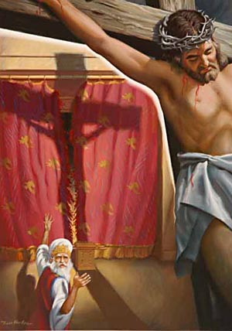
Glory be to God forever, Amen.

