Slide 1

Gerontology Ministry

Slide 2
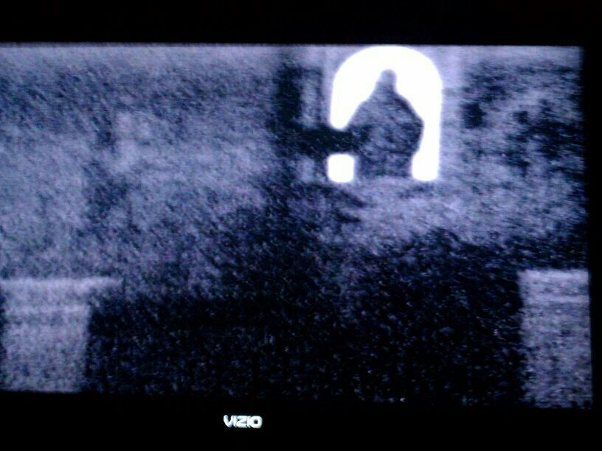
Gerontology Ministry
Unless the Lord guards the city, the watchmen have watched in vain.
(Psalm 126:1)

Slide 3
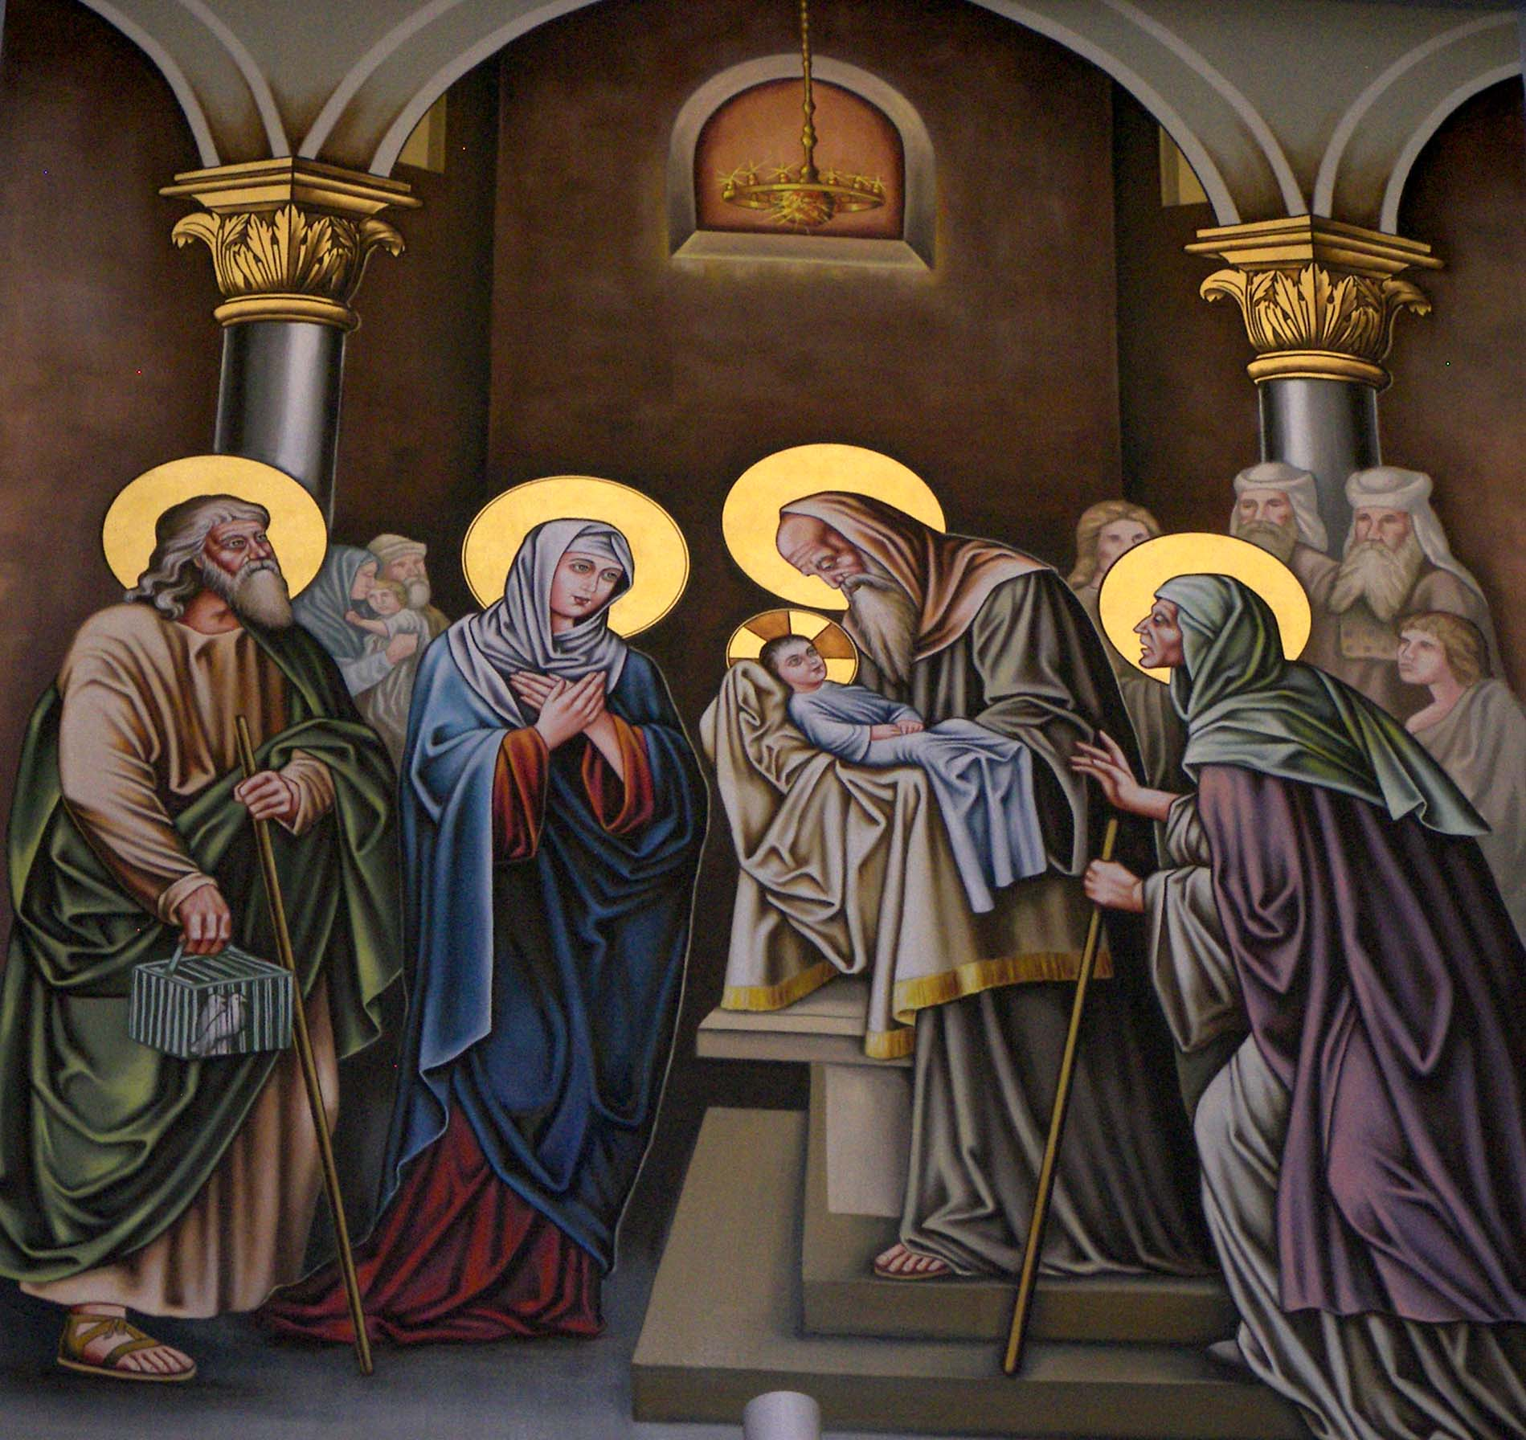
Gerontology Ministry

Slide 4
Some Facts
Your life expectancy in the US today if you are
  65y → 17Y → 82Y
  75y → 11y → 86y
  85y → 6y → 91y
In 1996 65y-74y increased 8 fold over 1900. 75y-84y by 16 fold and ≥ 85y by 31 fold
Percentage of Americans over 65y tripled since the 1900’s from 4.1% of the population to 12.8%
In 2000 and in 2010 the population grew by 9% while seniors population grew by 15%
1 of every 8 in the US is a senior adult
By the year 2025, people over 65Y will increase by 100% in the US, 136% in Japan & 200% in Canada

Slide 5
Physical Changes ≥ 65y
Loss in brain cells 1% per year
Age associated memory loss
Problems with balance, coordination, reaction time
Risk of Alzheimer’s, Parkinson’s & stroke
Bones / Osteoporosis (shrinking or breaking)
Looks / Aging spots / bags / shakes
Hearing / vision
Internal organs (food absorption, constipation, less blood flow, liver & kidneys weaker, incontinence…etc.)

Slide 6
Social/Psychological Changes LOSS!
Retirement (Loss of work, something to occupy time & mind)
Loss of sleep (less deep sleep, more awakenings, even though still need 7-8 hrs.)
Loss of mobility
Loss of family members, friends & loved ones
Loss of purpose
Loss of people who care about you, check on you, see if you want to do something together… “it’s like dying before dying!”
Loss of independence/dignity as people (relatives or strangers) must help you bathe or use the bathroom, or more.
Loss of time left
“I don’t fear death but I fear dying”
Personality traits become more accentuated
Obviously increased risk of depression and sadness (Remember the category of people with highest suicide risk?)

Slide 7
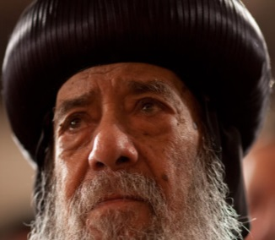
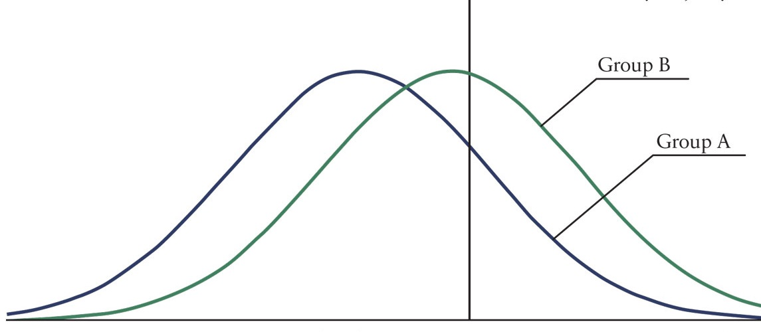
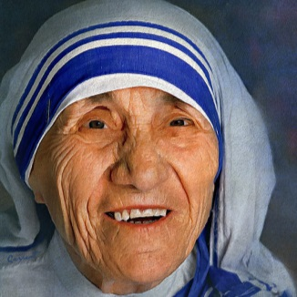
Physical & Emotional Independence
Group A= Physical independence
Group B = Emotional independence
Note how intellectual capability is not a bell curve

Slide 8
The World’s view of Seniors1
Slow
Ugly
In the way
A nuisance
Sucking the resources from the rest of us
All they do is complain
  About their ailments
  About inflation
  About politicians
  About the rest of us
“They lived their life, it’s time for them to go and let us live ours!”

Slide 9
The World’s view of Seniors2
Euthanasia (The Marketing of Evil Continues!):
Used to be in situations only when a patient is clinically dead
In 2002 Netherlands legalized euthanasia (also 1st in Europe to legalize marijuana & same-sex marriage) followed by Belgium and Luxemburg followed by Sweden and Switzerland
After a long fight against euthanasia because of the Nazis using mass euthanasia Germany now allows passive euthanasia which is removal of feeding tubes and such
Even in strongly Catholic countries like Italy, Spain and Poland, even though it is not legalized, Federal prosecutors said they will not legally prosecute doctors for assisting in suicide
And in countries that fully accepted it and legalized it, the seeds of debates about allowing it for “poor” quality of life!
What’s next? with increased number of seniors & the financial burden on the country depleting SS & Medicare?

Slide 10
God’s View of Seniors
Exodus 20:12: Honor your father and mother that your days may be long upon the land which the Lord your God is giving you.
Prov. 20:20: Whoever curses his father or his mother, his lamp will be put out in deep darkness.
Lev 19:32: You shall rise before the gray headed and honor the presence of an old man, and fear your God: I am the Lord”
Job 12:12: Wisdom is with aged men and with length of days, understanding
Psalm 92:14: They shall still bear fruit in old age; they shall be fresh and flourishing
2 Kings 2:24: [When the youth made fun of Elisha…]
So he turned around and looked at them, and pronounced a curse on them in the name of the Lord. And two female bears came out of the woods and mauled forty-two of the youths.

Slide 11
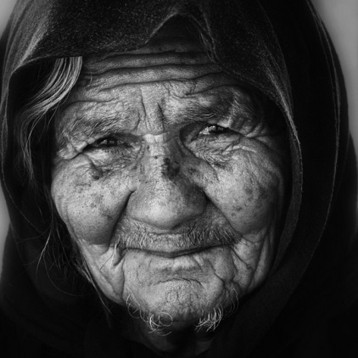
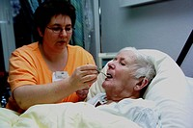
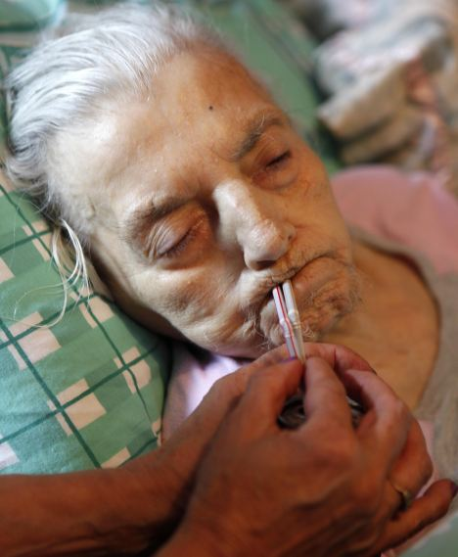
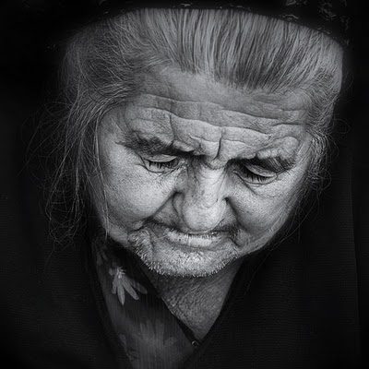
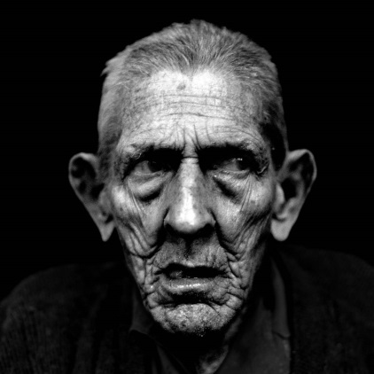
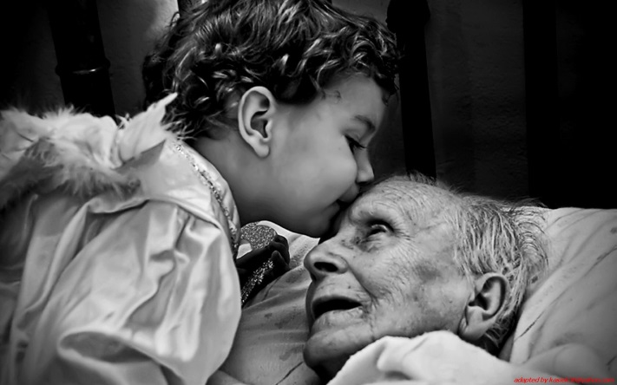
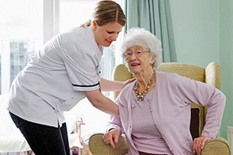
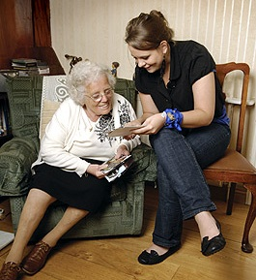
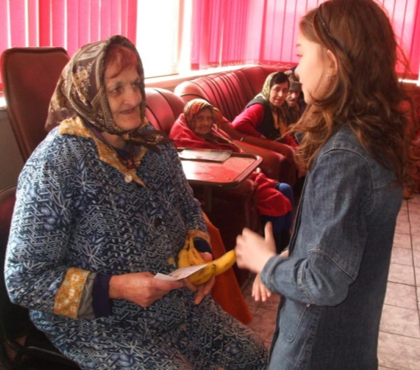
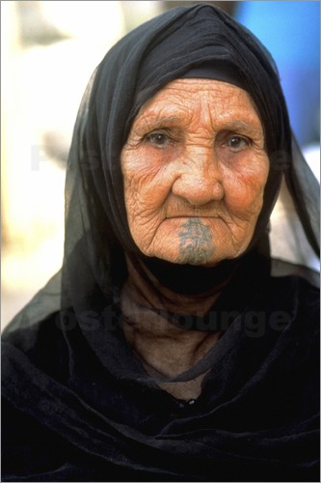
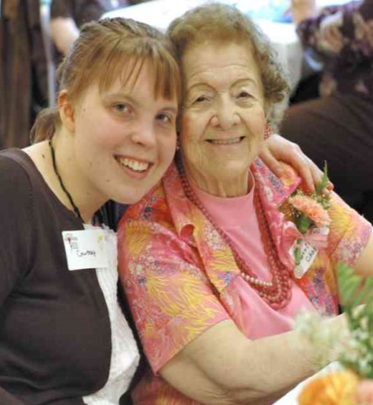
What God Wants Us to Do
Proverbs 18:24: There is a friend who sticks closer than a brother” … Let’s be that friend!
James 1:27: Pure and undefiled religion before God and the Father is this:
to visit orphans and widows in their trouble, and to keep oneself unspotted from the world.
Matthew 25: ‘Come, you blessed of My Father, inherit the kingdom prepared for you from the foundation of the world:
for I was hungry, thirsty, a stranger, naked, sick in prison and you gave Me food, drink, took Me in, clothed Me, visited Me, came to Me…‘Assuredly, I say to you, inasmuch as you did it to one of the least of these My brethren, you did it to Me.’

Slide 12
Some Simple Practical things We Can Do1
Calls
Visitations
  Don’t just ask “how are you doing?” Be more specific
  Give them the chance to complain and vent about life, physical ailments, their loneliness and how no one checks on them… Simply Listen, Interact, Validate & Empathize.
  Tell them about your daily life issues, share with them. You’d be surprised, you may benefit from their life wisdom and experience
  Asking them for advice/opinions is a great gift; makes them feel like they still have something to offer / have some value.

Slide 13
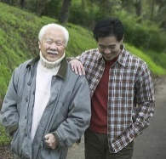
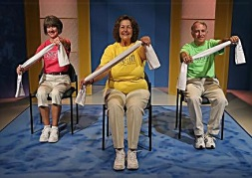
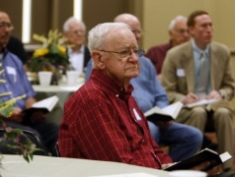
Some Simple Practical things We Can Do2
Help them have routines in their week (give them something to look forward to)
  Walks / Exercising / Visits / Senior Bible studies
Isaiah 40:31: They shall mount up with wings like eagles, They shall run and not be weary, They shall walk and not faint. (Getting them connected to spiritual resources can be their lifeline)
Find opportunities / venues for them to serve (huge!)
It is better to give than to receive (Acts 20:35).
“Happiness is a very mysterious thing… you cannot find it no matter how hard you search for it. But once you start providing it to others, happiness & joy hunt you down and you cannot escape them”
Remind them gently and lovingly that “the simple fact they are still here on earth means that God is not yet done with the purposes for which He created them”
Patience. Especially with the ones that live with us. Dementia: 5% of ≥65y → sever, 15%→mild. 20% of ≥80y→ sever. Unfortunately for us, to many of them we’re still kids

Slide 14
What are Basic Human Needs?
For all of us
A true relationship with God
Food
Shelter
Clothing
Healthcare
To be loved
To be cared for
To be of value / purpose for family, friends, church & society
For seniors / elders
A true relationship with God
Food
Shelter
Clothing
Healthcare
To be loved
To be cared for
To be of value / purpose for family, friends, church & society
It’s possible that the reason God is keeping them alive is to give us an opportunity to serve Him! Remember Matt 25
Let us not be like the rich man who ignored Lazarus!

Slide 15
