Slide 1
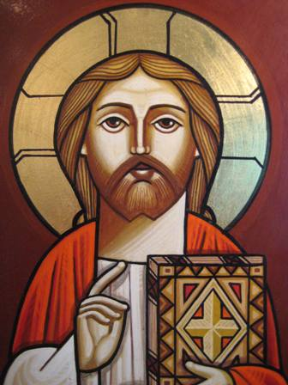
Definition
&
Role
THE CHURCH

Slide 2
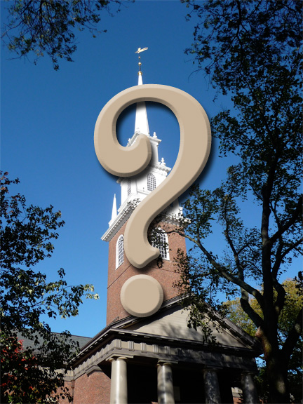
How people define the Church and its role?
“The assembly of the followers of Christ”
“A sign that points to God”
“A place for Christian worship”
“He who is near the church is often far from God”
“That church teaches us that we can make God happy by being miserable ourselves”

Slide 3
How Does the Bible
Define
The Church

Slide 4
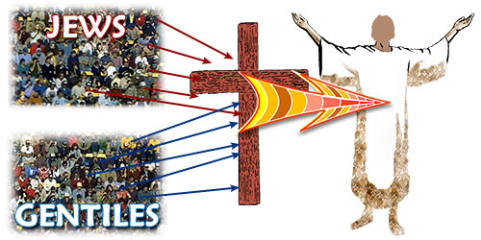
The Body of Christ
“And He put all things under His feet, and gave Him to be head over all things to the church, which is His body” Ephesians 1:22 -23
“For we are members of His body, of His flesh and of His bones”
Ephesians 5:30

Slide 5
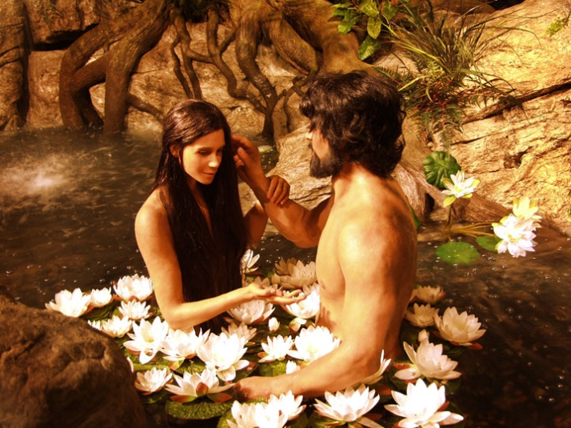
Between Adam and Christ (1)
The creation of Adam reveals God’s purpose for humanity; to be always united.
Adam understood this purpose at the beginning: “And Adam said: “This is now bone of my bones
And flesh of my flesh” Genesis 2:23

Slide 6
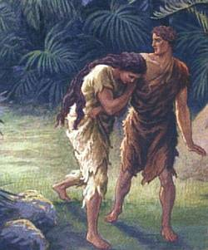
Between Adam and Christ (2)
With the introduction of sin to the human nature, division started to find its way to us: “The woman whom You gave to be with me, she gave me of the tree, and I ate” Genesis 3:12
The scattering of the human race reached its ultimate at the tower of Babel

Slide 7
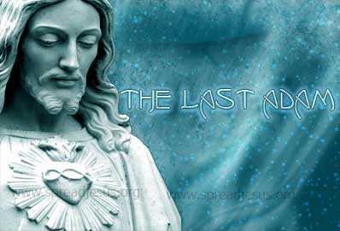
Between Adam and Christ (3)
Christ is the second Adam, in whom humanity is restored once more to oneness: “The first man Adam became a living being.” The last Adam became a life-giving spirit”
1 Corinthians 15:45
This fact explains clearly the Christian faith and what God intended for the Church to be.

Slide 8
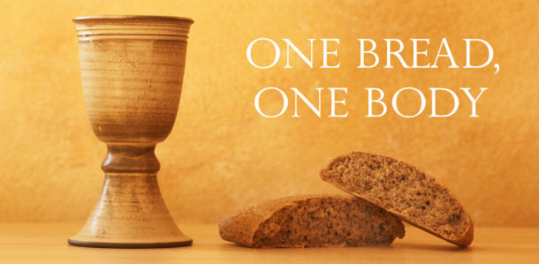
Between Adam and Christ (4)
“so we, being many, are one body in Christ, and individually members of one another” Romans 12:5
“For we, though many, are one bread and one body; for we all partake of that one bread” 1 Corinthians 10:17
“For by one Spirit we were all baptized into one body” 1 Corinthians 12:3

Slide 9
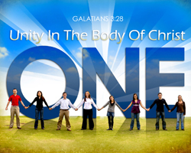
Between Adam and Christ (5)
“and that He might reconcile them both to God in one body through the cross, thereby putting to death the enmity” Ephesians 2:16
“And let the peace of God rule in your hearts, to which also you were called in one body” Colossians 3:15
“If anyone does not abide in Me, he is cast out as a branch and is withered; and they gather them and throw them into the fire” John 15:6

Slide 10
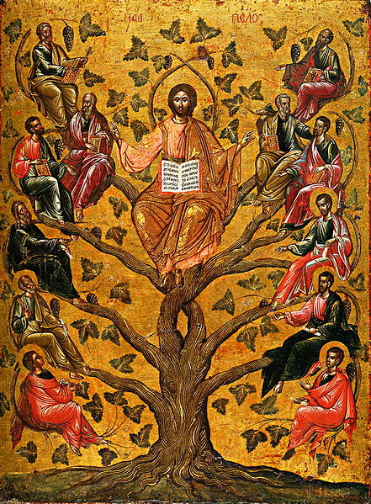
Between Adam and Christ (6)
“Most assuredly, I say to you, unless you eat the flesh of the Son of Man and drink His blood, you have no life in you…. He who eats My flesh and drinks My blood abides in Me, and I in him.” John 6:53, 56
“But we have the mind of Christ”
1 Corinthians 2:16

Slide 11

Between Adam and Christ (7)
That is why “Love” is the greatest virtue.
“Pursue peace with all people, and holiness, without which no one will see the Lord”
Hebrews 12:14

Slide 12
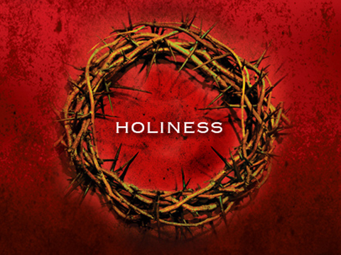
Between Adam and Christ (8)
“Do you not know that your bodies are members of Christ? Shall I then take the members of Christ and make them members of a harlot? Certainly not! Or do you not know that he who is joined to a harlot is one body with her? For “the two,” He says, “shall become one flesh.” But he who is joined to the Lord is one spirit with Him” 1 Corinthians 6:15 -17

Slide 13
Between Adam and Christ (9)
That also explains why the spirits of the righteous are waiting in Paradise and did not enter the kingdom yet: “…that they should not be made perfect apart from us” Hebrews 11:39

Slide 14
Between Adam and Christ (10)
This brings us to the question: How can we all members in One Body (that is the Church) and we have thousands of churches with conflicting believes???
“We believe that all religions are basically the same--
at least the one that we read was.
They all believe in love and goodness.
They only differ on matters of
creation, sin, heaven, hell, God, and salvation”

Slide 15
The Pillar and the Ground of the TRUTH
“but if I am delayed, I write so that you may know how you ought to conduct yourself in the house of God, which is the church of the living God, the pillar and ground of the truth”
1 Timothy 3:15

Slide 16
The Biblical view of Truth (1)
Truth is revealed by a personal and moral God who makes himself known. Truth is not invented or constructed by individuals or communities.
- Those who suppressed this revealed truth crafted idols for themselves: “they exchanged the truth of God for a lie” Romans 1:25
Truth Decay: by Douglas Groothuis

Slide 17
The Biblical view of Truth (2)
Objective truth exists and is knowable. It is not dependent on any creature’s subjective feelings, desires or beliefs.
- “God’s truth is not dependent upon any individual’s or group’s experiences or interpretations, however strongly felt or culturally entrenched they may be”
Truth Decay: by Douglas Groothuis

Slide 18
The Biblical view of Truth (3)
Truth is absolute in nature: God’s truth is true without exception or exemption.
- A classic text is the Lord’s statement: “ I am the Way, the Truth, and the Life. No one comes to the Father except through Me” John 14:6
- “The truth of the gospel is not subject to any human veto or democratic procedure”
Truth Decay: by Douglas Groothuis

Slide 19
The Biblical view of Truth (4)
Truth is universal; it applies everywhere. The gospel message and the moral law are not circumscribed or restricted by cultural conditions. “…for there is no other name under heaven given to people by which we must be saved”
Acts 4:12
Truth Decay: by Douglas Groothuis

Slide 20
The Biblical view of Truth (5)
The truth of God is eternally engaging and crucial, not trendy or superficial.
- “Religion is little more than a hobby, something with which to amuse oneself, a kind of curiosity for when the mood strikes but not something to take all that seriously, especially in matters of legality” Stephen Carten: How American Law and Politics Trivialize religious Devotion (1993)
Truth Decay: by Douglas Groothuis

Slide 21
The Biblical view of Truth (6)
Accordingly, this truth should transform us: “I have hidden your word in my heart that I might not sin against you” Ps 119:11
Truth Decay: by Douglas Groothuis

Slide 22
The Biblical view of Truth (7)
Truth is exclusive, specific and antithetical (directly contrasted).
- “Truth is exact and precise, and the slightest departure from the truth is the substitution of falsity for truth”
R.J. Rushdoony
- The logic of the truth is the logic of the law of non-contradiction.
- It is also the law of excluded middle.
Truth Decay: by Douglas Groothuis

Slide 23
The Biblical view of Truth (8)
Truth is systematic and unified. Something cannot be true in religion and false in science (or vice versa), or true in philosophy but false in theology (or vice versa).
- “There is only one world, God’s world; it is a uni-verse, not a multi-verse)
Truth Decay: by Douglas Groothuis

Slide 24
The Biblical view of Truth (9)
Christian truth is an end, not a means to any other end. It should be desired and obtained for its own value.
- “There is no subtler perversion of Christian Faith than to treat it as a mere means to a wordly end, however admirable that end in itself may be. The Christian Faith is important because it is true. What it happens to achieve, in ourselves or in others, is another and, strictly speaking, secondary matter”
Blamires, Christian Mind, P.104
Truth Decay: by Douglas Groothuis

Slide 25
In conclusion…
The CHURCH, being the pillar and the ground of the Truth should be the legitimate reference when issues about the “faith which was once for all delivered to the saints” arise.
But …Which Church??

Slide 26
The desired Church should be…
ONE
APOSTOLIC
UNIVERSAL
HOLY

Slide 27
431
451
381
325
33
Oriental Orthodox Church (Coptic, Ethiopian, Antioch, Armenian, Indian,…)
1054
Pentecost
Nicea
Constantinople
Ephesus
Chalcedon
Eastern Orthodox Churches (Constantinople, Greece, Russia,…)
Chalcedonic
Catholics (Rome)
Protestants (Lutheran, Baptist,…)
Jehovah's Witness
Filioque
Adventist
1521
Mormons
Reformation
1538
Church of England
(Anglican, Episcopal, United,…)
Catholics
Cults
Fig. (1): Time Line History of Church Denominations

