Slide 1

Marketing the Narrow Path

Slide 2
Honest Question #1
When presenting our Church to others, what things do we lead with and emphasize the most?

Slide 3
Honest Question #2
What things do we avoid talking about? Are there some things we try to hide?

Slide 4
Honest Question #3
Do we believe that Orthodoxy is attainable and understandable to our audience?

Slide 5
Honest Question #4
How do we present and introduce the practices of our Church that are foreign to most people?
Example: Fasting, kissing icons, length of the Liturgy, the style of the hymns, praying for the dead, intercession of saints, etc?

Slide 6
Honest Question #5
How can we market the narrow path? What would make people WANT to come to our church?

Slide 7
Honest Question #6
Are we embarrassed by our faith or do we proclaim it boldly?

Slide 8
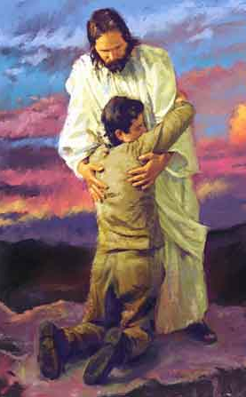
Submission
The Church does not offer a put-it-in-your-pocket form of Christianity.
We cannot wrap our minds around it, and we cannot control it.
We are called to surrender to it, and to the process of sanctification.

Slide 9

Levels
In athletics, the amateurs look up to and follow the experts
Why not in the Church?

Slide 10

Fullness
Pascha week – 3 prayers a day
Covenant Thursday – 7 hours
Good Friday – 9 hours
Bright Saturday – 8 hours
Resurrection Feast – 5 hours

Slide 11

Training
Aspiring medical student shadowing a doctor performing a life-saving surgery.
Can the undergrad student do what the doctor is doing???
NO…not yet, but by being in that environment it motivates him to work hard to reach that goal.

Slide 12
Is Christianity a goal for us?
Narrow path is valuable BECAUSE it is narrow.
Fasting, standing, praying, etc are all mastered one step at a time with help from your personal trainer (father of confession) who tailors the experience to what you can handle all the while motivating you to reach higher levels.

Slide 13

Evangelism
Evangelism is leading people to the narrow path and walking with them on it.
Evangelism is NOT downplaying the importance of the narrow path or leading them to a different more presentable path, “for wide is the gate and broad is the way that leads to destruction”

Slide 14
Evangelism
Evangelism is accepting the sinner with the understanding that they are going to walk this path.
A man who comes to the hospital, but does not want to be treated is a loiterer, not patient.
The church is open for patients that admit their need for treatment, but those who do not admit their sickness only infect the rest of the patients.

Slide 15
Come Alongside
What if I have not attained the fullness?
Instead of presenting these things to the as a problem with our church, it should be presented as the Church giving us an opportunity to grow gradually
I am struggling to learn these things along with you.
It’s truthful, compassionate, attractive, and real.

Slide 16
Conclusion
Understand your faith
Understand the importance of the narrow path
See it’s life-giving value
Then you will be able to present it to others as such

