Slide 1
Coptic Lessons
Introduction: Coptic Alphabet 1: Letters Similar to English (1) a b e z 2: Letters Similar to English (2) i k m n 3: Letters Similar to English (3) o c t w 4: Letters pronounced differently 3 x r 5: Three New Coptic Letters (1) j d l 6: Three New Coptic Letters (2) p h g 7: Three New Coptic Letters (3) 2 0 f 8: Three New Coptic Letters (4) y 4 5 9: Three New Coptic Letters (5) 6 7 v 10: Last Two Coptic Letters q s 11: The Rule of the JINKIM Coptic Alphabet 12: The Lord’s Prayer 13: The Coptic Numbers | 14: Words for Common Conversation 1 15: Words for Common Conversation 2 16: Articles 17: The Holy Bible 18: The Preposition ‘of’ 19: Abbreviations 20: Personal Pronouns and Verb ‘be’ 21: Coptic Months 22: Plural Nouns that change form 23: Possessive Adjectives 24: The Church (1) 25: Church Feasts 26: Demonstrative Pronouns 27: The Church (2) 28: The Church (3)
Notes:
Welcome
Happy Coptic New Year 1737 - Happy Nayroz Feast The Feast of Nayrouz marks the beginning of the era of martyrdom in the Coptic Church, which began with the reign of Emperor Diocletian (284 AD), the most vicious persecutor of the Church. Our Coptic word for this week is "Nofri Shai", meaning "Happy Feast" ... we can use this to greet each other during any feast.

Slide 2
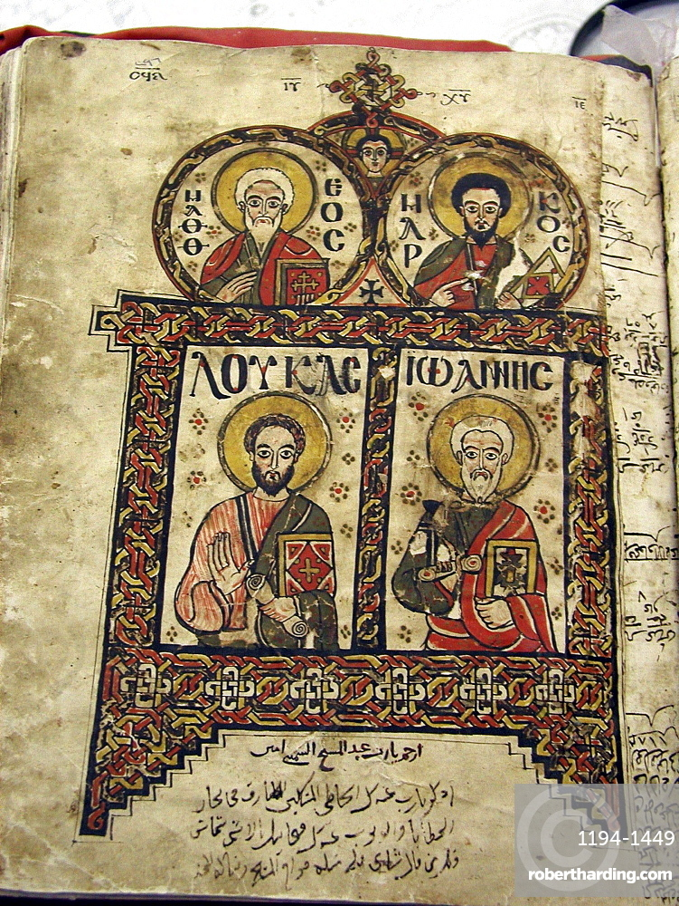
Why Learn Coptic?
To read hymns and prayers
To understand better
To connect to our heritage
It’s cool ☺
Notes:
Mix of Coptic and Greek:
Pope Cyril I – translated many prayers to Greek to benefit the non-Coptic speakers
90% of deacon responses are Greek
10% of Priest prayers are Greek
50% of Congregation Hymns are Greek

Slide 3
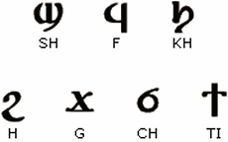
Introduction: Coptic Alphabet
There are 32 letters in the Coptic alphabet.
The first 25 are derived from the Greek letters that have their origin in the Egyptian Hieroglyphic script
The last 7 letters are directly derived from the Egyptian Demotic Script.

Slide 4
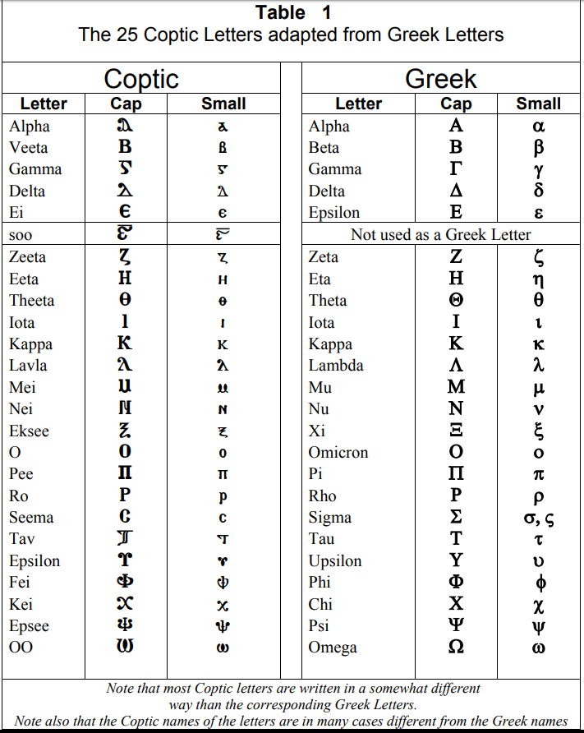

Slide 5
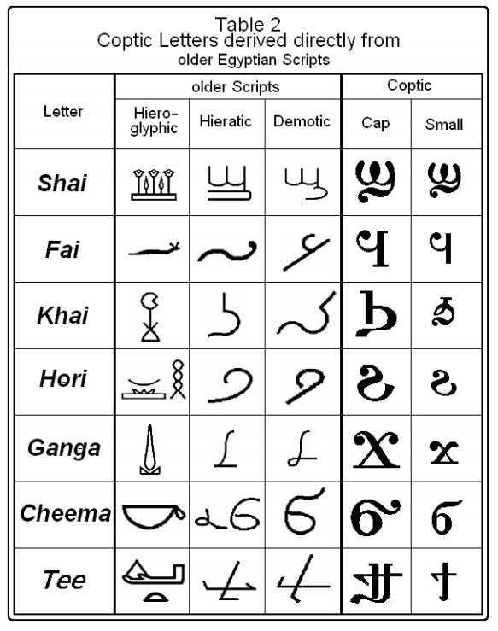

Slide 6
Coptic Letters that are similar to English (1)
Lesson 1
a b e z

Slide 7
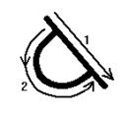

Letter | Shape | Pron | Example | How to write it
Alpha | A a | A (as in ART) | an (an = not)

Slide 8
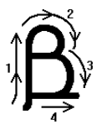
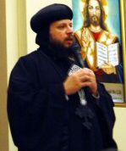
Letter | Shape | Pron | Example | How to write it
Vita | B b | V (if followed by a vowel) (as in VALVE) B (as in BELL) | abba (ava=father)

Slide 9
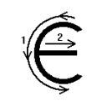
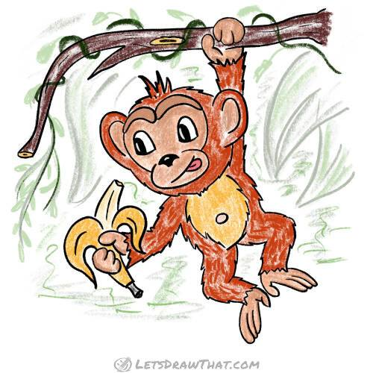
Letter | Shape | Pron | Example | How to write it
Ei | E e | E (as in PEN) | en (en = monkey)

Slide 10


Letter | Shape | Pron | Example | How to write it
Zeta | Z z | Z (as in ZOO) | zenzen (zen-zen = lizard)

Slide 11

Let's read some easy words using these letters

Slide 12
Ava
Word | Pronunciation | Meaning
Abba |  | Ava, father (bishop)

Slide 13
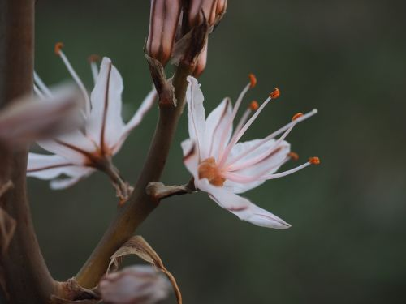
zaz
Word | Pronunciation | Meaning
Zaz |  | Asphodel (a plant)

Slide 14
Zen-zen
Word | Pronunciation | Meaning
Zen/zen |  | Lizard

Slide 15
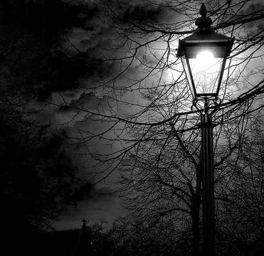
Ev-i
Word | Pronunciation | Meaning
Ebi |  | Darkness

Slide 16
Review of Lesson 1
Letter | Shape | Pronunciation | Example
Alpha | A a | A | ART
Vita | B b | V B | VALVE BELL
Ei | E e | E | PEN
Zeta | Z z | Z | ZOO

Slide 17


Coptic Word of the Week
Nofri Sai
Nofri Shai
Happy Feast (“Kol sana we enta tayeb”)

Slide 18
Coptic Letters that are similar to English (2)
Lesson 2
i k m n

Slide 19
Review of Lesson 1
Letter | Shape | Pronunciation | Example
Alpha | A a | A | ART
Vita | B b | V B | VALVE BELL
Ei | E e | E | PEN
Zeta | Z z | Z | ZOO

Slide 20
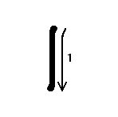
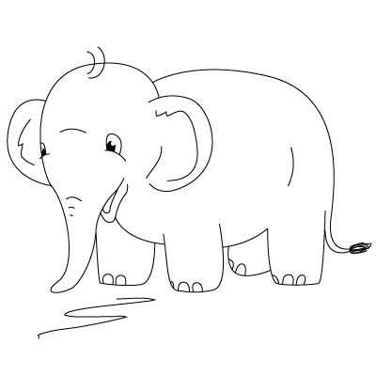
Letter | Shape | Pron | Example | How to write it
Yota | I i | I or Y (as in SIT) | iab (yab= elephant)

Slide 21


Letter | Shape | Pron | Example | How to write it
Kappa | K k | K (as in KITE) | kakia (kakia = evil)

Slide 22

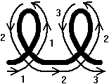
Letter | Shape | Pron | Example | How to write it
Mey | M m | M (as in MOON) | ma (ma= place)

Slide 23

Letter | Shape | Pron | Example | How to write it
Ney | N n | N (as in NEAR) | an (an = not)

Slide 24
Let's read some easy words using these letters

Slide 25

nan
Word | Pronunciation | Meaning
nan |  | Us

Slide 26
Zen-zen
Word | Pronunciation | Meaning
Zen/zen |  | Lizard

Slide 27
ma
Word | Pronunciation | Meaning
ma |  | place

Slide 28
yab
Word | Pronunciation | Meaning
iab |  | elephant

Slide 29

Kim
Word | Pronunciation | Meaning
kim |  | To move

Slide 30
Review of Lesson 2
Letter | Shape | Pronunciation | Example
Yota | I i | I | SIT
Kappa | K k | K | LIKE
Mey | M m | M | MOON
Ney | N n | N | NEAR

Slide 31
Coptic Word of the Week
Nofr
Nofri
Hello (Happy)

Slide 32
Coptic Letters that are similar to English (3)
Lesson 3
o c t w

Slide 33
Review of Lesson 1
Letter | Shape | Pronunciation | Example
Alpha | A a | A | ART
Vita | B b | V B | VALVE BELL
Ei | E e | E | PEN
Zeta | Z z | Z | ZOO

Slide 34
Review of Lesson 2
Letter | Shape | Pronunciation | Example
Yota | I i | I | SIT
Kappa | K k | K | LIKE
Mey | M m | M | MOON
Ney | N n | N | NEAR

Slide 35
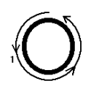
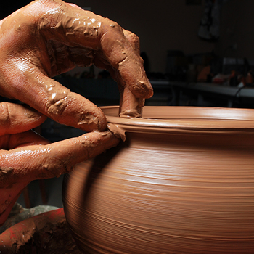
Letter | Shape | Pron | Example | How to write it
O | O o | Short O (as in NOT) | omi (omy= clay)

Slide 36
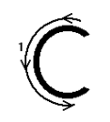

Letter | Shape | Pron | Example | How to write it
Sima | C c | S (as in CITY) | cabe (Sa-vey =wise person)

Slide 37
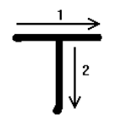

Letter | Shape | Pron | Example | How to write it
Tav | T t | T (as in TEST) | tai (tai= this)

Slide 38
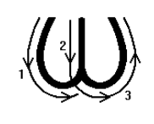

Letter | Shape | Pron | Example | How to write it
Oou | W w | Long O (as in BOARD) | wb (oa-b= lettuce)

Slide 39
Let's read some easy words using these letters

Slide 40
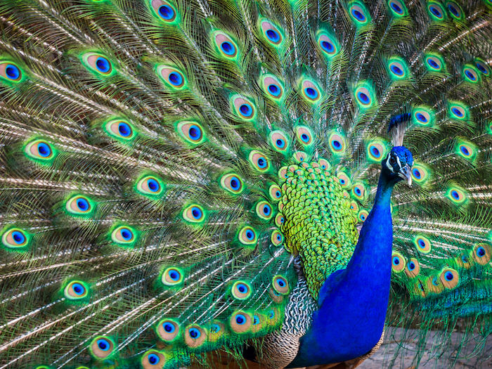
Ta-os
Word | Pronunciation | Meaning
Taoc |  | Peacock (Arabic: Ta-oos)

Slide 41
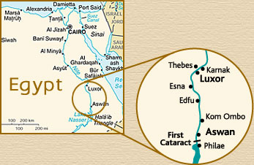
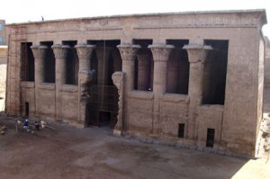
Es-ne
Word | Pronunciation | Meaning
~ Cne |  | Esna, City in Egypt

Slide 42

Soak
Word | Pronunciation | Meaning
Cwk |  | Close (Arabic: "sok")

Slide 43
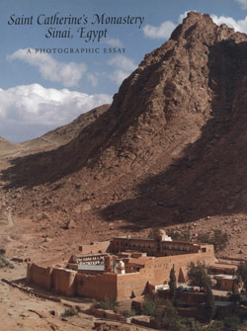
Si-na
Word | Pronunciation | Meaning
Cina |  | Sinai, City in Egypt

Slide 44
Let’s Read More Words
Word | Word Meaning
Nem | And (Coptic)
Ke | And (Greek)
Tai | This
Amwini | Come
Nai nan | Have mercy on us
Baki | City
Zwon | Animal
Manna | Manna
Ock | To be Late

Slide 45
Review of Lesson 3
Letter | Shape | Pronunciation | Example
O | O o | O | NOT
Sima | C c | S | CITY
Tav | T t | T | TEST
Oou | W w | Oa | Board

Slide 46

Coptic Word of the Week
Oujai
Oo-gai
Goodbye (Farewell)

Slide 47
Lesson 4
3 x r
Coptic Letters that look like English letters but are pronounced differently

Slide 48
Review of Lesson 1
Letter | Shape | Pronunciation | Example
Alpha | A a | A | ART
Vita | B b | V B | VALVE BELL
Ei | E e | E | PEN
Zeta | Z z | Z | ZOO

Slide 49
Review of Lesson 2
Letter | Shape | Pronunciation | Example
Yota | I i | I | SIT
Kappa | K k | K | LIKE
Mey | M m | M | MOON
Ney | N n | N | NEAR

Slide 50
Review of Lesson 3
Letter | Shape | Pronunciation | Example
O | O o | O | NOT
Sima | C c | S | CITY
Tav | T t | T | TEST
Oou | W w | Oa | Board

Slide 51


Letter | Shape | Pron | Example | How to write it
Eeta | # 3 | EE (or I-I) (as in FEET) | 3i (ee-y= house)

Slide 52
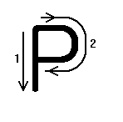
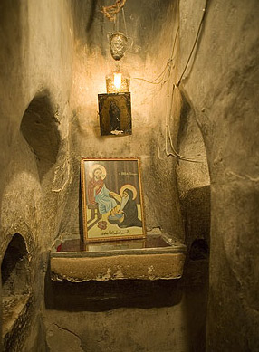
Letter | Shape | Pron | Example | How to write it
Ro | R r | R (as in ROAD) | ri (ry= cell/ room)

Slide 53

Letter | Shape | Pron | Example | How to write it
Key | X x | K (Kin) in some Greek words: SH (Show) KH "Khiar" | x3mi (keemi = Egypt) xere (shere = hail) xr3ctoc (Khristos = Christ)

Slide 54
Let's read some easy words using these letters

Slide 55
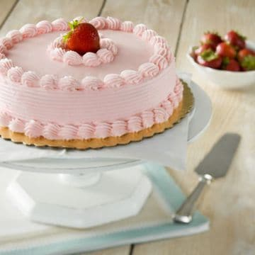
Keek
Word | Pronunciation | Meaning
K3k |  | Cake

Slide 56
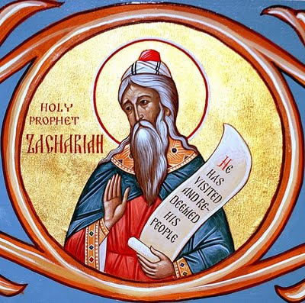
Za-ka-raia
Word | Pronunciation | Meaning
Za/xa/ria |  | Zachariah

Slide 57
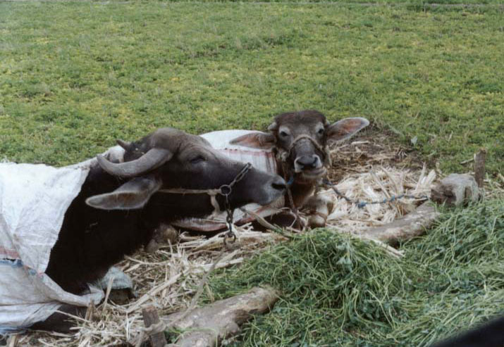
Ver-sim
Word | Pronunciation | Meaning
Ber/cim |  | Berseem (Egyptian clover)

Slide 58
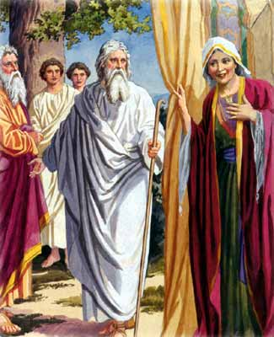
Sa-ra
Word | Pronunciation | Meaning
Carra |  | Sarah

Slide 59
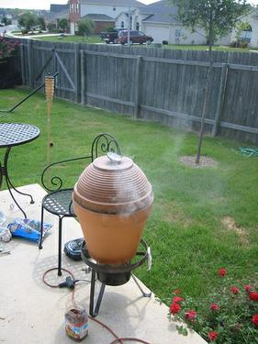
Sir
Word | Pronunciation | Meaning
Cir |  | Clay well (Arabic: Zeer)

Slide 60
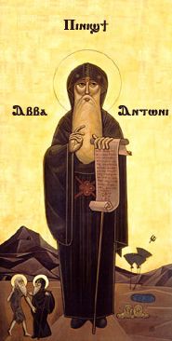
An-ton-ious
Word | Pronunciation | Meaning
An/twn/ioc |  | Anthony

Slide 61
Review of Lesson 4
Letter | Shape | Pronunciation | Example
Eeta | # 3 | EE | FEET
Ro | R r | R | ROAD
Key | X x | K in some Greek words: SH KH | Kin SHOW "KHIAR" (ARABIC: Cucumber)

Slide 62

Coptic Word of the Week
Seph~mot
Shep-eh-mot
Thank you

Slide 63
Lesson 5 j d l

Slide 64
Review of Lesson 1
Letter | Shape | Pronunciation | Example
Alpha | A a | A | ART
Vita | B b | V B | VALVE BELL
Ei | E e | E | PEN
Zeta | Z z | Z | ZOO

Slide 65
Review of Lesson 2
Letter | Shape | Pronunciation | Example
Yota | I i | I | SIT
Kappa | K k | K | LIKE
Mey | M m | M | MOON
Ney | N n | N | NEAR

Slide 66
Review of Lesson 3
Letter | Shape | Pronunciation | Example
O | O o | O | NOT
Sima | C c | S | CITY
Tav | T t | T | TEST
Oou | W w | Oa | Board

Slide 67
Review of Lesson 4
Letter | Shape | Pronunciation | Example
Eeta | # 3 | EE | FEET
Ro | R r | R | ROAD
Key | X x | K in some Greek words: SH KH | Kin SHOW "KHIAR" (ARABIC: Cucumber)

Slide 68

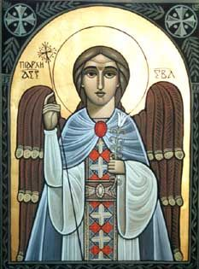
Letter | Shape | Pronunciation | Example | How to write it
Ghamma | J j | Gh غ (as in Oghnia (Arabic: Song)) G (as in Good) NG (as in Angel) | Jabri3l (Ghav-riel = Gabriel) Ajioc (A-gios = Holy) Ajjeloc (Angelos = Angel)

Slide 69
Ghamma is normally pronounced GH (Arabic letter Ghen غ) as in Jabri3l (Ghav-riel = Gabriel) It is pronounced G as in Ajioc (A-gios = Holy) if followed by any of the vowels: e.i.3.v It is pronounced N as in ajjeloc (Angelos = Angel) if followed by g, k, x, , jj: the first is pronounced N, and the second is G

Slide 70
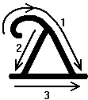

Letter | Shape | Pronunciation | Example | How to write it
Delta | D d | Soft TH (as in Then) D (as in David) | Dw-ron (thoa-ron = gift)
Delta is normally pronounced TH as in dwron (thoa-ron = gift) It is pronounced D in a person's name as in Dan (Dan)

Slide 71
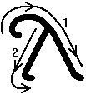

Letter | Shape | Pronunciation | Example | How to write it
Lola (Lavla) | L l | L (as in Lamb) | alla (al-la= but, how-ever)

Slide 72
Let's read some easy words using these letters

Slide 73
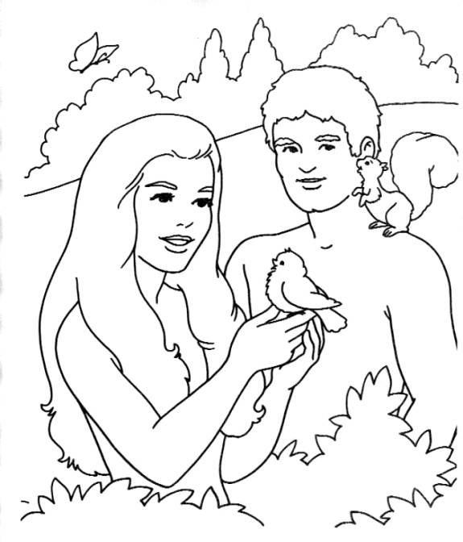
A/dam |  | Adam
A-dam

Slide 74
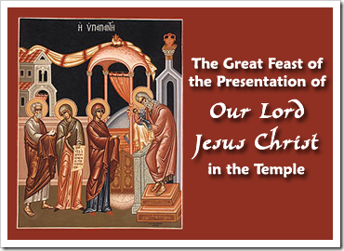
Me/xir |  | The Coptic month of Amshir
Me-sheer

Slide 75
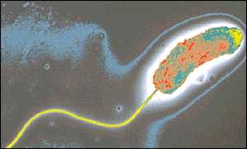
Xo/l3/ra |  | Cholera (disease)
Ko-lee-ra

Slide 76
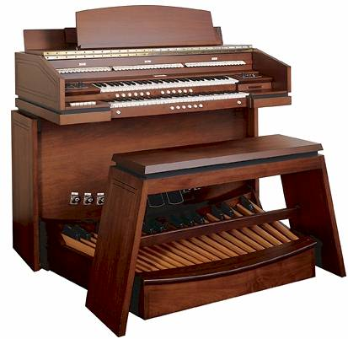
Or/ja/non |  | Organ (musical instrument)
Or-gha-non

Slide 77
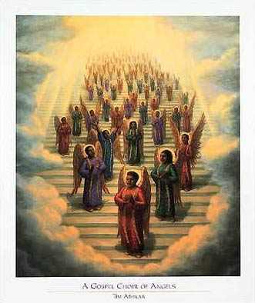
A-gios
Ajioc |  | Holy

Slide 78
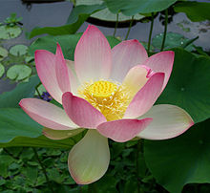
Lo-tos
Lo/toc |  | Lotus (flower)

Slide 79
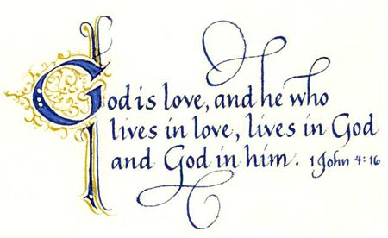
A-gh-api
A/ja/pi |  | Love

Slide 80
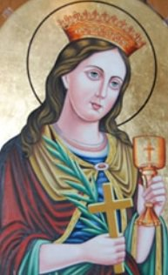
Bar/bara |  | Barbara
Bar-ba-ra

Slide 81
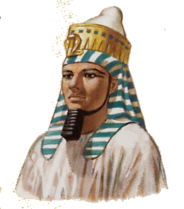
Ra-msis
Ram/cic |  | Ramsis

Slide 82
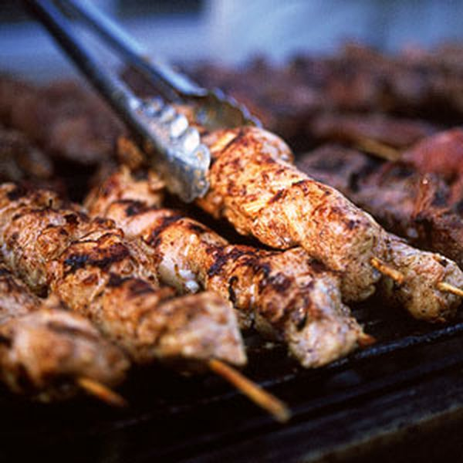
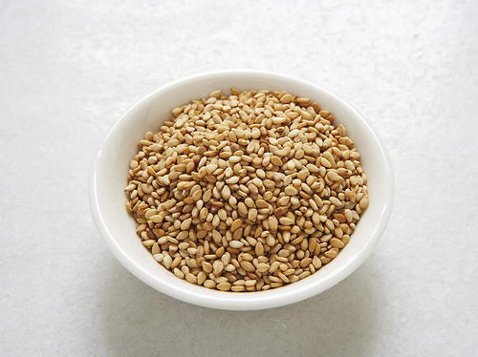
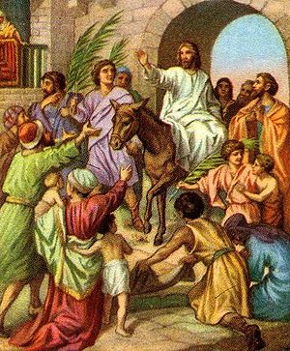
Let’s Read More Words
Kw/bab | “Shish Kabab”
Ca/mit | Pretzel
Ca/xar | Sugar
Cim/cim | Sesame
A/moi | "I wish"
Xa/ki | Darkness
Wcanna | Hosanna
Ba/ci/li | King
Ced/rak | Sedrak

Slide 83
Review of Lesson 5
Letter | Shape | Pronunciation | Example
Ghamma | J j | G Gh غ NG | Ajioc Jabri3l Ajjeloc
Delta | D d | ZTH D | dwron dan
Lola (Lavla) | L l | L | alla

Slide 84

Coptic Word of the Week
~Mmon h~li
emmon- eh-ly
You are welcome (it is nothing)

Slide 85
Lesson 6 p h g

Slide 86
Review of Lesson 1
Letter | Shape | Pronunciation | Example
Alpha | A a | A | ART
Vita | B b | V B | VALVE BELL
Ei | E e | E | PEN
Zeta | Z z | Z | ZOO

Slide 87
Review of Lesson 2
Letter | Shape | Pronunciation | Example
Yota | I i | I | SIT
Kappa | K k | K | LIKE
Mey | M m | M | MOON
Ney | N n | N | NEAR

Slide 88
Review of Lesson 3
Letter | Shape | Pronunciation | Example
O | O o | O | NOT
Sima | C c | S | CITY
Tav | T t | T | TEST
Oou | W w | Oa | Board

Slide 89
Review of Lesson 4
Letter | Shape | Pronunciation | Example
Eeta | # 3 | EE | FEET
Ro | R r | R | ROAD
Key | X x | K in some Greek words: SH, KH | Kin SHOW "KHIAR"

Slide 90
Review of Lesson 5
Letter | Shape | Pronunciation | Example
Ghamma | J j | G Gh غ NG | Ajioc Jabri3l Ajjeloc
Delta | D d | ZTH D | dwron dan
Lola (Lavla) | L l | L | alla

Slide 91

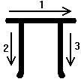
Letter | Shape | Pronun-ciation | Example | How to write it
Pee | P p | P (as in Paul) | paiwt (pa-iot = my father)

Slide 92
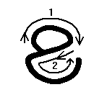

Letter | Shape | Pronun-ciation | Example | How to write it
Horee | H h | H (as in House) | nahren ( (nah-ren = before)

Slide 93
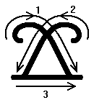

Letter | Shape | Pronun-ciation | Example | How to write it
Jenja (Ganga) | G g | G (as in Go) J (as in Joy), if followed by e i 3 | agp (Agp = hour) ge (Je = For)

Slide 94
Let's read some easy words using these letters

Slide 95
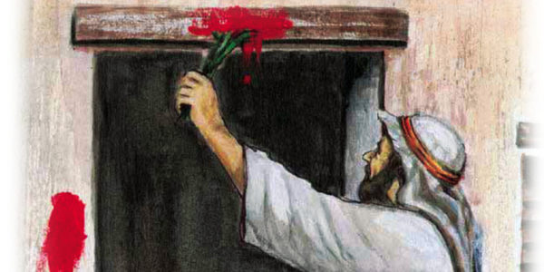
Pac/xa |  | Passover
Pas-kha

Slide 96

He/la/hwb |  | "Let's Go" (Egyptian expression)
He-la-hope

Slide 97

Pa/rak/l3t |  | The Comforter
Pa-rak-leet

Slide 98

Epip |  | The Coptic month of Epip (Abib)
E-pip
Martyrdom of Sts. Peter and Paul, the Apostles.
5 Epip

Slide 99

sok-heat
Cok/h3t |  | Hiccup (cok = close) (Arabic: zo-ghota)
Notes:
zo-ghota
Closing of the vocal cords which makes the hiccup sound

Slide 100

`T/ra/peza |  | Table (Arabic: Tarabeza)
Et-ra-pe-za

Slide 101

Abba Ha/did |  | St. Ava Hadid
Ava Ha-deed

Slide 102

Apa Kir
Apa Kir |  | St. Apakir
Notes:
City of Abu-Kir in Egypt is named after Apa Kir

Slide 103

Agpia |  | The book of the Hours (Agpia)
Ag-pia

Slide 104



Let’s Read More Words
Ic/ra/3l | Israel
Agp | Hour
Kor/ban | Holy Bread
Ha/lak | Earring
@3p/23p | Slippers
Gwm | Book
Pi/`hmot | The grace
Han/m32 | Many
Papa | Pope

Slide 105
Review of Lesson 6
Letter | Shape |  | Pronunciation | Example
Pee | P p | P (as in Paul) |  | paiwt (pa-iot = my father)
Horee | H h | H (as in House) |  | nahren ((nah-ren = before)
Jenja (Ganga) | G g | G (as in Go) J (as in Joy), if followed by e i 3 |  | agp (Agp = hour) ge (Je = For)

Slide 106

Coptic Word of the Week
Ce
Se
Yes

Slide 107
Lesson 7
2 0 f

Slide 108
Review of Lesson 1
Letter | Shape | Pronunciation | Example
Alpha | A a | A | ART
Vita | B b | V B | VALVE BELL
Ei | E e | E | PEN
Zeta | Z z | Z | ZOO

Slide 109
Review of Lesson 2
Letter | Shape | Pronunciation | Example
Yota | I i | I | SIT
Kappa | K k | K | LIKE
Mey | M m | M | MOON
Ney | N n | N | NEAR

Slide 110
Review of Lesson 3
Letter | Shape | Pronunciation | Example
O | O o | O | NOT
Sima | C c | S | CITY
Tav | T t | T | TEST
Oou | W w | Oa | Board

Slide 111
Review of Lesson 4
Letter | Shape | Pronunciation | Example
Eeta | # 3 | EE | FEET
Ro | R r | R | ROAD
Key | X x | K in some Greek words: SH, KH | Kin SHOW "KHIAR"

Slide 112
Review of Lesson 5
Letter | Shape | Pronunciation | Example
Ghamma | J j | G Gh غ NG | Ajioc Jabri3l Ajjeloc
Delta | D d | ZTH D | dwron dan
Lola (Lavla) | L l | L | alla

Slide 113
Review of Lesson 6
Letter | Shape |  | Pronunciation | Example
Pee | P p | P (as in Paul) |  | paiwt (pa-iot = my father)
Horee | H h | H (as in House) |  | nahren ((nah-ren = before)
Jenja (Ganga) | G g | G (as in Go) J (as in Joy), if followed by e i 3 |  | agp (Agp = hour) ge (Je = For)

Slide 114

Letter | Shape | Pronun-ciation | Example | How to write it
Shy | @ 2 | Sh (as in Shake) | 2ai (shai =feast)

Slide 115


Letter | Shape | Pronun-ciation | Example | How to write it
Theta | ) 0 | TH (as in Think) T (as in Tree) if it follows: v.t.m.c | 0ai (Thai = this) Acpa-zec0e (As-pa-zes-te = Greet)

Slide 116


Letter | Shape | Pronun-ciation | Example | How to write it
Fee | F f | PH (as in Phone) | feri (phe-ri = new)

Slide 117
Let's read some easy words using these letters

Slide 118

Pa/2onc
Pa-shons
The Coptic month of Pashons
Entry of the Lord Christ to Egypt
24 Pashons

Slide 119

@op/ra
Shop-ra
Shobra, Egypt

Slide 120

A0a/nac/ioc
Atha-nas-ios
Athanasius

Slide 121

Jol/jo/0a
Ghol-gho-tha
Golgotha
“place of the skull”

Slide 122

Ce/ra/fim
Se-ra-pheem
Seraphim

Slide 123

Fa/la/fel
Fa-la-fel
Falafel
(“full of beans”)

Slide 124

Fi/lip/poc
Phi-lip-pos
Philip

Slide 125

Lebt
Le-vt
Beets

Slide 126

Lak/an3
La-ka-nee
Lakkan (Liturgy of the Waters)

Slide 127



Let’s Read More Words
`Fiwt | The Father
11`P23ri | The Son
`Triac | Trinity
X<ere | Hail (to…)
Ek`k/l3/ci`a | The Church
`P3i | The house
Par/0e/noc | Virgin
Etac/mec | Who bore
Pen/cw/t3r | Our Savior

Slide 128
Review of Lesson 7
Letter | Shape | Pronunciation | Example
Shy | @ 2 | Sh (as in Shake) | 2ai (shai =feast)
Theta | ) 0 | TH (as in Think) T (as in Tree) if it follows: v.t.m.c | 0ai (Thai = this) acpazec0e (As-pa-zes-te = Greet)
Fee | F f | PH (as in Phone) | feri (phe-ri = new)

Slide 129

Coptic Word of the Week
~Mmon
emmon
No!

Slide 130
Lesson 8 y 4 5

Slide 131
Review of Lesson 1
Letter | Shape | Pronunciation | Example
Alpha | A a | A | ART
Vita | B b | V B | VALVE BELL
Ei | E e | E | PEN
Zeta | Z z | Z | ZOO

Slide 132
Review of Lesson 2
Letter | Shape | Pronunciation | Example
Yota | I i | I | SIT
Kappa | K k | K | LIKE
Mey | M m | M | MOON
Ney | N n | N | NEAR

Slide 133
Review of Lesson 3
Letter | Shape | Pronunciation | Example
O | O o | O | NOT
Sima | C c | S | CITY
Tav | T t | T | TEST
Oou | W w | Oa | Board

Slide 134
Review of Lesson 4
Letter | Shape | Pronunciation | Example
Eeta | # 3 | EE | FEET
Ro | R r | R | ROAD
Key | X x | K in some Greek words: SH, KH | Kin SHOW "KHIAR"

Slide 135
Review of Lesson 5
Letter | Shape | Pronunciation | Example
Ghamma | J j | G Gh غ NG | Ajioc Jabri3l Ajjeloc
Delta | D d | ZTH D | dwron dan
Lola (Lavla) | L l | L | alla

Slide 136
Review of Lesson 6
Letter | Shape |  | Pronunciation | Example
Pee | P p | P (as in Paul) |  | paiwt (pa-iot = my father)
Horee | H h | H (as in House) |  | nahren ((nah-ren = before)
Jenja (Ganga) | G g | G (as in Go) J (as in Joy), if followed by e i 3 |  | agp (Agp = hour) ge (Je = For)

Slide 137
Review of Lesson 7
Letter | Shape | Pronunciation | Example
Shy | @ 2 | Sh (as in Shake) | 2ai (shai =feast)
Theta | ) 0 | TH (as in Think) T (as in Tree) if it follows: v.t.m.c | 0ai (Thai = this) acpazec0e (As-pa-zes-te = Greet)
Fee | F f | PH (as in Phone) | feri (phe-ri = new)

Slide 138


Letter | Shape | Pronun-ciation | Example | How to write it
Epsi | Y y | PS (as in Psalmody) | yalmoc (psal-mos = psalm)

Slide 139


Letter | Shape | Pronun-ciation | Example | How to write it
Fai | $ 4 | F (as in Fish) | 4wi (foi= hair)

Slide 140


Letter | Shape | Pronun-ciation | Example | How to write it
Tee | % 5 | Ti or tee (as in teepee) | cw5 (so-tee= save)

Slide 141
Let's read some easy words using these letters

Slide 142

Yal/mo/dia
Psal-mo-dia
Psalmody

Slide 143

Ya/li
Psa-li
Psali (song)

Slide 144

Yal/moc
Psal-mos
Psalm

Slide 145

$w5
Fo-tee
Towel

Slide 146

$ent
Fent
Worm

Slide 147

$or/4er
For-fer
To fall down

Slide 148

%/bla
Ti-vla
Drum

Slide 149

%/e/pic/to/l3
Ti-epes-tolee
Epistle

Slide 150

Met/re4/5
Met-ref-tee
Generosity

Slide 151



Let’s Read More Words
Pet/eh/nak | Thy will
Mare4/2wpi | Be done
Pen/wik | Our bread
`nte rac5 | Of tomorrow
`m`f/r35 hwn | as we
Yal/t3/rion | Psaltery
Ten/5/ho | We ask
@l3l | Pray
Ir3n3 paci | Peace be with all

Slide 152

Coptic Word of the Week
Nane a~tooui
Nane at-o-oo-y
Good Morning

Slide 153
Review of Lesson 8
Letter | Shape | Pronunciation | Example
Epsi | Y y | PS (as in Psalmody) | yalmoc (psal-mos = psalm)
Fai | $ 4 | F (as in Fish) | 4wi (foi= hair)
Tee | % 5 | Ti or tee (as in teepee) | cw5 (so-tee= save)

Slide 154
Lesson 9
6 7 v

Slide 155
Review of Lesson 1
Letter | Shape | Pronunciation | Example
Alpha | A a | A | ART
Vita | B b | V B | VALVE BELL
Ei | E e | E | PEN
Zeta | Z z | Z | ZOO

Slide 156
Review of Lesson 2
Letter | Shape | Pronunciation | Example
Yota | I i | I | SIT
Kappa | K k | K | LIKE
Mey | M m | M | MOON
Ney | N n | N | NEAR

Slide 157
Review of Lesson 3
Letter | Shape | Pronunciation | Example
O | O o | O | NOT
Sima | C c | S | CITY
Tav | T t | T | TEST
Oou | W w | Oa | Board

Slide 158
Review of Lesson 4
Letter | Shape | Pronunciation | Example
Eeta | # 3 | EE | FEET
Ro | R r | R | ROAD
Key | X x | K in some Greek words: SH, KH | Kin SHOW "KHIAR"

Slide 159
Review of Lesson 5
Letter | Shape | Pronunciation | Example
Ghamma | J j | G Gh غ NG | Ajioc Jabri3l Ajjeloc
Delta | D d | ZTH D | dwron dan
Lola (Lavla) | L l | L | alla

Slide 160
Review of Lesson 6
Letter | Shape |  | Pronunciation | Example
Pee | P p | P (as in Paul) |  | paiwt (pa-iot = my father)
Horee | H h | H (as in House) |  | nahren ((nah-ren = before)
Jenja (Ganga) | G g | G (as in Go) J (as in Joy), if followed by e i 3 |  | agp (Agp = hour) ge (Je = For)

Slide 161
Review of Lesson 7
Letter | Shape | Pronunciation | Example
Shy | @ 2 | Sh (as in Shake) | 2ai (shai =feast)
Theta | ) 0 | TH (as in Think) T (as in Tree) if it follows: v.t.m.c | 0ai (Thai = this) acpazec0e (As-pa-zes-te = Greet)
Fee | F f | PH (as in Phone) | feri (phe-ri = new)

Slide 162
Review of Lesson 8
Letter | Shape | Pronunciation | Example
Epsi | Y y | PS (as in Psalmody) | yalmoc (psal-mos = psalm)
Fai | $ 4 | F (as in Fish) | 4wi (foi= hair)
Tee | % 5 | Ti or tee (as in teepee) | cw5 (so-tee= save)

Slide 163

Letter | Shape | Pronun-ciation | Example | How to write it
Soo | ^ 6 | So-oo | pi6 `ntenh (Pi-So-oo en-tenh= six wings)
The only use of this letter is the number 6; it always has a bar over it. A bar indicates that it is a number

Slide 164

Letter | Shape | Pronun-ciation | Example | How to write it
Exsi | & 7 | x (as in fix) | Or0odo-7wn (ortho-zthoxon = orthodox)

Slide 165

Letter | Shape | Pronun-ciation | Example | How to write it
Epsilon | V v | V (as in nave) Long closed O (as in broom) E (as in hero) | ctavroc (stav-ros = cross) Iwannov (you-an-no = John) Kvrie (Ke-riee = Lord)

Slide 166
If v follows a or e it is pronounced V: If v follows o it is pronounced O: Otherwise v is pronounced E: | av = av ; ev= ev ov = oo v= e

Slide 167
Let's read some easy words using these letters

Slide 168

Agp ^
Agp soo
Sixth hour

Slide 169
Do/7o/lo/jia
Zoxo-lo-gia
Doxology (praise)

Slide 170

Eva
Eva
Eve

Slide 171

`Cnav
Es-nav
Two

Slide 172

Man/lav
Man-lav
Malawy, Egypt

Slide 173

Al/l3/lov/ia
Al-lee-loo-ia
Alleluia

Slide 174

Nan/novc
Nan-noos
Doll

Slide 175

Kv/0a/ra
Kee-tha-ra
Harp

Slide 176

A7ioc
A-xios
Worthy

Slide 177

Coptic Word of the Week
Nane rouhi
Nane roo-hy
Good Evening

Slide 178
Review of Lesson 9
Letter | Shape | Pronunciation | Example
Soo | ^ 6 | So-oo | pi6 `ntenh (Pi-So-oo en-tenh= six wings)
Exsi | & 7 | x (as in fix) | or0odo7wn (ortho-zthox-on = orthodox)
Epsilon | V v | V (as in nave) Long O (as in no) E (as in hero) | ctavroc (stav-ros = cross) Iwannov (you-an-no = John) kvrie (Ke-riee = Lord)

Slide 179
Lesson 10 q s

Slide 180
Review of Lesson 1
Letter | Shape | Pronunciation | Example
Alpha | A a | A | ART
Vita | B b | V B | VALVE BELL
Ei | E e | E | PEN
Zeta | Z z | Z | ZOO

Slide 181
Review of Lesson 2
Letter | Shape | Pronunciation | Example
Yota | I i | I | SIT
Kappa | K k | K | LIKE
Mey | M m | M | MOON
Ney | N n | N | NEAR

Slide 182
Review of Lesson 3
Letter | Shape | Pronunciation | Example
O | O o | O | NOT
Sima | C c | S | CITY
Tav | T t | T | TEST
Oou | W w | Oa | Board

Slide 183
Review of Lesson 4
Letter | Shape | Pronunciation | Example
Eeta | # 3 | EE | FEET
Ro | R r | R | ROAD
Key | X x | K in some Greek words: SH, KH | Kin SHOW "KHIAR"

Slide 184
Review of Lesson 5
Letter | Shape | Pronunciation | Example
Ghamma | J j | G Gh غ NG | Ajioc Jabri3l Ajjeloc
Delta | D d | ZTH D | dwron dan
Lola (Lavla) | L l | L | alla

Slide 185
Review of Lesson 6
Letter | Shape |  | Pronunciation | Example
Pee | P p | P (as in Paul) |  | paiwt (pa-iot = my father)
Horee | H h | H (as in House) |  | nahren ((nah-ren = before)
Jenja (Ganga) | G g | G (as in Go) J (as in Joy), if followed by e i 3 |  | agp (Agp = hour) ge (Je = For)

Slide 186
Review of Lesson 7
Letter | Shape | Pronunciation | Example
Shy | @ 2 | Sh (as in Shake) | 2ai (shai =feast)
Theta | ) 0 | TH (as in Think) T (as in Tree) if it follows: v.t.m.c | 0ai (Thai = this) acpazec0e (As-pa-zes-te = Greet)
Fee | F f | PH (as in Phone) | feri (phe-ri = new)

Slide 187
Review of Lesson 8
Letter | Shape | Pronunciation | Example
Epsi | Y y | PS (as in Psalmody) | yalmoc (psal-mos = psalm)
Fai | $ 4 | F (as in Fish) | 4wi (foi= hair)
Tee | % 5 | Ti or tee (as in teepee) | cw5 (so-tee= save)

Slide 188
Review of Lesson 9
Letter | Shape | Pronunciation | Example
Soo | ^ 6 | So-oo | pi6 `ntenh (Pi-So-oo en-tenh= six wings)
Exsi | & 7 | x (as in fix) | or0odo7wn (ortho-zthox-on = orthodox)
Epsilon | V v | V (as in nave) Long O (as in no) E (as in hero) | ctavroc (stav-ros = cross) Iwannov (you-an-no = John) kvrie (Ke-riee = Lord)

Slide 189

Letter | Shape | Pronun-ciation | Example | How to write it
Khai | Q q | Kh خ - The Arabic KH sound, like خمسة Kham-sa= number 5 | qen (khen= with/in)

Slide 190

Letter | Shape | Pronun-ciation | Example | How to write it
Cheema | S s | ch (as in church) | soic (chois= lord)

Slide 191
Let's read some easy words using these letters

Slide 192

Pi/iq
Pe-ekh
The Ghost

Slide 193

Pa/qwm/ioc
Pa-khom-ios
St. Pachomios (Pachome)

Slide 194

Swm
`n/ni/cim
Shom En-ne-sem
"Garden of Green"
(Egyptian Feast of Spring)

Slide 195

`E/qovn
E-Khoon
Into

Slide 196

Qa/ron
Kha-ron
On us

Slide 197

Pi/ta/lso
Pi-ta-le-tcho
The healing

Slide 198

Ma/rov/sac4
Maroo-chasf
Let them exalt

Slide 199

As/ne
Achne
Without

Slide 200

si/wmc
tchi-oms
Baptized

Slide 201
Review of Lesson 10
Letter | Shape | Pronunciation | Example
Khai | Q q | Kh خ - The Arabic KH sound, like خمسة Kham-sa= number 5 | qen (khen= with/in)
Cheema | S s | ch (as in church) | soic (chois= lord)

Slide 202
Lesson 11
The Rule of the JINKIM { ` }

Slide 203
Review of Lesson 1
Letter | Shape | Pronunciation | Example
Alpha | A a | A | ART
Vita | B b | V B | VALVE BELL
Ei | E e | E | PEN
Zeta | Z z | Z | ZOO

Slide 204
Review of Lesson 2
Letter | Shape | Pronunciation | Example
Yota | I i | I | SIT
Kappa | K k | K | LIKE
Mey | M m | M | MOON
Ney | N n | N | NEAR

Slide 205
Review of Lesson 3
Letter | Shape | Pronunciation | Example
O | O o | O | NOT
Sima | C c | S | CITY
Tav | T t | T | TEST
Oou | W w | Oa | Board

Slide 206
Review of Lesson 4
Letter | Shape | Pronunciation | Example
Eeta | # 3 | EE | FEET
Ro | R r | R | ROAD
Key | X x | K in some Greek words: SH, KH | Kin SHOW "KHIAR"

Slide 207
Review of Lesson 5
Letter | Shape | Pronunciation | Example
Ghamma | J j | G Gh غ NG | Ajioc Jabri3l Ajjeloc
Delta | D d | ZTH D | dwron dan
Lola (Lavla) | L l | L | alla

Slide 208
Review of Lesson 6
Letter | Shape |  | Pronunciation | Example
Pee | P p | P (as in Paul) |  | paiwt (pa-iot = my father)
Horee | H h | H (as in House) |  | nahren ((nah-ren = before)
Jenja (Ganga) | G g | G (as in Go) J (as in Joy), if followed by e i 3 |  | agp (Agp = hour) ge (Je = For)

Slide 209
Review of Lesson 7
Letter | Shape | Pronunciation | Example
Shy | @ 2 | Sh (as in Shake) | 2ai (shai =feast)
Theta | ) 0 | TH (as in Think) T (as in Tree) if it follows: v.t.m.c | 0ai (Thai = this) acpazec0e (As-pa-zes-te = Greet)
Fee | F f | PH (as in Phone) | feri (phe-ri = new)

Slide 210
Review of Lesson 8
Letter | Shape | Pronunciation | Example
Epsi | Y y | PS (as in Psalmody) | yalmoc (psal-mos = psalm)
Fai | $ 4 | F (as in Fish) | 4wi (foi= hair)
Tee | % 5 | Ti or tee (as in teepee) | cw5 (so-tee= save)

Slide 211
Review of Lesson 9
Letter | Shape | Pronunciation | Example
Soo | ^ 6 | Soo | pi6 `ntenh (Pi-Soo en-tenh= six wings)
Exsi | & 7 | x (as in fix) | or0odo7wn (ortho-zthox-on = orthodox)
Epsilon | V v | V (as in nave) Long O (as in no) E (as in hero) | ctavroc (stav-ros = cross) Iwannov (you-an-no = John) kvrie (Ke-riee = Lord)

Slide 212
Review of Lesson 10
Letter | Shape | Pronunciation | Example
Khai | Q q | Kh خ - The Arabic KH sound, like خمسة Kham-sa= number 5 | qen (khen= with/in)
Cheema | S s | ch (as in church) | soic (chois= lord)

Slide 213
Assignment:
Now that you know all the Coptic Letters, you can write your name in Coptic
Markoc
Eve
Maria
Daniel
Ajapi

Slide 214
The Jinkim is the accent mark that is placed on Coptic letters to indicate pronunciation.
The Rule of the Jinkim:
When Jinkim comes over a vowel letter, it splits the word, because the letter must be pronounced by itself.

Slide 215
The Coptic vowel letters:
(English) | A | E | I | O | U
(Coptic) | a | e | 3 | i | o | v | w

Slide 216
Let's read some easy words

Slide 217

A/`a/ron
A-a-ron
Aaron

Slide 218

Mari`/a
Mari-a
Mary

Slide 219

`E/bol
E-vol
Of

Slide 220

Pek`/3/poc
Pek-ee-pos
Your garden

Slide 221
II. When Jinkim comes over a consonant letter, an e sound proceeds the letter.
For Example:
`t = et | `b = ev
`k = ek | `z = ez
`m = em | `q = ekh
`n = en | `s = etch
`d = ed | `r = er

Slide 222

` K/`c/ma/rw/ovt
Ek-es-maro-oot
Your are blessed

Slide 223

` N/novb
En-noub
The Gold

Slide 224
`m/Ma/riam
Em-Mariam
Of Mary

Slide 225
Let's read more words

Slide 226
A4`\i
He Came
)e`\o\to\koc
Mother of God
`E\ron
Unto us
Pi`\e\ho\ov
The day

Slide 227
Ei`\e\`i
I Come
`A\jioc
Holy (Greek)
`X\ov\ab
Holy (Coptic)
%`\t\riac
The Trinity

Slide 228
`N\te
Of
`P\rec\bv\te\roc
The presbyters (priests)
`F\ran
The name
@ep`\hmot
Thank you

Slide 229
`A\poc\to\loc
Apostle
`A\l3\0wc
Truly
Pi`\w\ov
The glory
`A\m3n
Amen

Slide 230
Coptic Alphabet

Slide 231
Alpha | A a | A (ART) | an (an = not)
Vita | B b | V (VALVE) | abba (ava=father)
 |  | B (BELL) | n3b (neeb = master)
Ghamma | J j | G (as in Good) | Ajioc (A-gios = Holy)
 |  | Gh غ (as in Oghnia) | Jabri3l (Ghav-riel = Gabiel)
 |  | NG (as in Angel) | ajjeloc (Angelos = Angel)
Delta | D d | ZTH (as in Then) | dwron (Ztho-roon = gift)
 |  | D (as in David) | Dan (Dan = Dan)
Ei | E e | E (PEN) | en (en = monkey)
Soo | ^ 6 | Soo | pi6 (Pi-Soo = the six)
Zeta | Z z | Z (ZOO) | zenzen (zen-zen = lizard)
Eeta | # 3 | EE (FEET) | 3rp (eerp = wine)
Theta | ) 0 | TH (as in Think) | 0ai (Thai = this)
 |  | T (as in Tree) | acpazec0e (As-pa-zes-te = Greet)
Yota | I i | I (SIT) Y (YET) | iab (yab= elephant)
Kappa | K k | K (LIKE) | k3k (keek = cake)
Lola (Lavla) | L l | L (as in Lamb) | alla (al-la= but)
Mey | M m | M (MOON) | ma (ma= place)
Ney | N n | N(NEAR) | an (an = not)
Eksi | & 7 | ks (as in thanks) | a7ioc (aksios= worthy)
O | O o | O (NOT) | oili (oily = ram)

Slide 232
Pee | P p | P (as in Paul) | paiwt (pa-iot = my father)
Ro | R r | R (ROAD) | rir (rir = pig)
Sima | C c | S (CITY) | cir (sir= well)
Tav | T t | T (TEST) | tebt (tevt= fish)
Epsilon | V v | V (as in nave) | Ctavroc (stav-ros = cross)
 |  | Long O (as in no) | Iwannov(you-an-no = John)
 |  | E (as in hero) | kvrie (Ke-riee = Lord)
Fee | F f | PH (as in Phone) | feri (phe-ri = new)
Key | X x | K (Kin) | x3me (keemi = Egypt)
 |  | SH (SHOW) | xere (shere = hail)
 |  | Arabic KH خ"KHIAR" (cucumber) | , `Xrictoc (ekhristos = Christ)
Epsi | Y y | PS (as in Psalmody) | yalmoc (psal-mos = psalm)
Oou | W w | Oa (Board) | 0wk (thoak =thine)
Shy | @ 2 | Sh (as in Shake) | 2ai (shai =feast)
Fai | $ 4 | F (as in Fish) | 4wi (foi= hair)
Khai | Q q | Arabic KH خ "KHIAR" (cucumber) | qen (khen= with/in)
Horee | H h | H (as in House) | nahren ((nah-ren = before)
Jenja (Ganga) | G g | G (as in Go) | Agp (Agp = hour)
 |  | J (as in Joy) | ge (Je = For)
Cheema | S s | ch (as in church) | soic (choice= lord)
Tee | %5 | Ti or tee (as in teepee) | cw5 (sotee= save)

Slide 233
Lesson 12
The Lord’s Prayer

Slide 234

Je Pen\iwt et qen ni\v/oui:
Our Father who art in heavens
maref\toubo n~je pek\ran:
hallowed be Thy name
mareci~ n~je tek\met\ouro:
Thy kingdom come,

Slide 235

pet\ehnak maref\swpi:
Thy will be done,
m~v~r/] qen t~ve
nem hijen pi\kahi.
on earth as it is in heaven.
Pen\wik n~te rac]
m/if nan m~voou:
Give us this day our daily bread;

Slide 236

ouoh ,a n/\e~te\ron nan e~bol:
and forgive us our trespasses,
m~v~r/] hwn n~ten\,w e~bol
as we forgive those
n~n/\e~te ouon
n~tan e~rwou:
who trespass against us;

Slide 237

ouoh m~per\enten e~qoun e~pi\racmoc
and lead us not into temptation,
alla nah\men
e~bol ha pi\pet\hwou.
but deliver us from the evil one.

Slide 238

Qen Pi\,~rictoc I/couc Pen\[oic:
In Christ Jesus our Lord,
je ywk te ]met\ouro
for Thine is the kingdom

Slide 239

nem ]jom nem pi\wou
and the power and the glory
sa eneh: a~m/n.
forever. Amen.

Slide 240
Lesson 13
The Coptic Numbers
Coptic numbers are written as letters with bars on top, and they follow the order of the Coptic alphabet.

Slide 241
Ones
Number | Coptic | Coptic name
1 | =a | Ovai
2 | =b | `Cnav
3 | =j | @omt
4 | =d | `$tov
5 | =e | `Tiov
6 | 6 | Coov
7 | =z | @a24
8 | =3 | `@m3n
9 | =0 | Yit
10 | =i | M3t
11 (combination of 10 + 1 ) | =i=a | M3t ovai

Slide 242
Tens
Number | Coptic | Coptic name
20 | =k | Govt
30 | =l | Map
40 | =m | `Hme
50 | =n | Tebi
60 | =7 | Ce
70 | =o | `@be
80 | =p | Qamne
90 | =4 | Pictav
100 | =r | @e
101 | =ra | @e { ovai
110 | =r=i | @e (m3t

Slide 243
Hundreds
Number | Coptic | Coptic name
200 | =c | `Cnav 2e(
300 | =t | @omt 2e
400 | =v | `$tov 2e
500 | =f | `Tiov 2e
600 | =x | Coov 2e
700 | =y | @a24 2e
800 | =w | `@m3n 2e
900 | =2 | Yit 2e
1000 | a | @o
2000 | b | `cnav 2o

Slide 244
Do these math exercises:
=a + =e = ?
=b + =3 = ?
=d + =0 = ?
=k - =z = ?
=j x =i = ?
=m ÷ =d = ?
=j x [ =n - ( =e x =z ) + =i3 ] = ?
6
=i
=ij
=ij
=l
=i
==40

Slide 245
Some numbers used in the church hymns:
=d | ``$tov | =d `nzwon `nacwmatoc | 4 incorporeal creatures
=z | @a24 | =z `narx3ajjeloc | 7 archangels
=ib | M3t `Cnav | =ib `napoctoloc | 12 apostles
=k=d | Gwt `$toov | =k=d `m`precbvteroc | 24 Priests
=m | Hme | =m `n`ehoov ne,m =m `n`egwrh | 40 days and 40 nights
=r=n | @e Tebi | =r=n `nte Kwctantinopolic | 150 at Constantinople
=c | `Cnav 2e | =c `nte Efecoc | 200 at Ephesus
=ji=3 | @omt 2e met`2m3n | =ji=3 etav0wov5 qen Nikie`a | 318 assembled at Nicaea
a=r==m=d | 2e `hme `4toov `n2o | a=r==m=d nipar0enoc | 144,000 virgins

Slide 246
Lesson 14
Words for Common Conversation 1

Slide 247


Here are some Coptic words that you can easily learn and use in common conversations.
Greetings
Ce | Yes
`Mmon | No
No4ri | “Hello”, “Hi” (Good / Happy)
Ovgai | "Goodbye" (farewell)
@ai | Feast
2ep`hmot | Thanks
`Mmon `hli | you're welcome (It’s nothing)
My Family
Paiwt | My father
Tamav | My mother
Pacon | My brother
Tacwni | My sister
Pa23ri | My son
Ta2eri | My daughter
Pahai | My husband
Ta`chimi | My wife

Slide 248
Try to read these simple sentences:
Ce pacwn `Ctefanoc | Yes, my brother Stephen
Ce Tamav | Yes, (my) mother
`Mmon ov2ep`hmot | No, thanks
No4ri tamav `mmenrit | Hello, my beloved mother
ovgai pahai `mmenrit | Goodbye, my beloved husband
No4ri 2ai | Happy Feast (“Kol sana we enta tayeb”)
%2ep`hmot Abba Iwc3f | Thank you, Ava (Anba) Youssef.
Mmon `hli Tacwni | You’re Welcome, sister
Ovagi peniwt Iwnac | Goodbye, Fr. Younan.
Ovagi qen Psoic | "farewell in the Lord" (Goodbye)
Am3n ec`e2wpi | Amen so be it

Slide 249

The Sign of the Cross
Qen v~ran m~v~iwt nem P~s/ri nem Pip~neuma eyouab ounou] n~ouwt: a~m/n. | In the name of the Father and the Son and the Holy Spirit, one God. Amen.

Slide 250
Lesson 15
Words for Common Conversation 2

Slide 251
Greetings
A2 pe pekran | What is your name? (M)
A2 pe peran | What is your name? (F)
Paran pe... | My name is …
Nane | Good, fine
Nane `atoovi | Good morning
Nane rovhi | Good evening
No4ri `ehoov | Good day
No4ri `egwrh | Good night
`Ir3n3 paci | Peace be with all
Agapi | “Hello” (Love)
@e `nrompi | (for) a hundred years
`N0ok 2omt 2e `nrompi | You (for) three hundred years
`Mpair35 an | Not like this
Ce `mpair35 | yes, like this
Mare `Fnov5 2wpi nemak | May God be with you(m)
Notes:
Why we say "shea enrompi":
For those who can't read Arabic:
100 years: greeting of blessing (May God bless you for 100 years) - based on 100 years of blessing that Abraham lived with God after he left Ur and followed God (Gen 12:1-4, 25:7), he begat Issac when he was 100 y.o.
300 years: response of blessing (May God bless you for 300 years) - based on 300 years of blessing that Enoch lived with God (Gen 5:21-24)

Slide 252
The Church Leaders
I3covc Pixrictoc | Jesus Christ
Pipatrairx3c | The Patriarch
Pimetropolitic | The Metropolitan
Piepickopoc | The Bishop
Penn3b | “Sayedna” (Our master)
Abba Iwc3f | Ava Youssef
`Precbvteroc | The Presbyter (Priest)
Peniwt | “Abouna” (Our father)
Apa Iwnac | Abba Jonah
Pidiakwn | The Deacon

Slide 253
Try to read these simple sentences:
Nane `toovi paiwt | Good Morning, father.
Nane rovhi tamav | Good evening, mother.
No4ri `egwrh tacwni `mmenrit | Good night, my beloved sister.
No4ri penn3b `mmenrit | Hello, our beloved bishop
Agapi penn3b | Hello, Sayedna (our master)
Agapi peniwt | Hello, Abouna (our father)
`Mpair35 an tacwni Maria | Not like this, my sister Maria
I3covc Pixrictoc ` mm3ni nemak | Jesus Christ is always with you.
%2ep`hmot `ntotk piepickopoc Iwc3f | Thank you, Bishop Youssef.
Nane toovi paiwt | Good Morning, (my) father.
Nane rovhi tamav | Good evening, (my) mother.

Slide 254
Lesson 16
Indefinite and Definite Articles

Slide 255
Gender | Indefinite Article (a, an) | Definite Article (the)
Masculine | ou | pi | p~ |  | v~
Feminine | ou | ] | t~ |  | y~
Plural | han | ni |  | nen
* If the noun start with one of the letters (b i l m n o r) `v or y~ is used. * If `n or `m is used on a 2nd noun, then nen is used : nens/ri m~piIcra/l
Mescaline Nouns | Noun | Meaning | Indefinite | Definite | Short Definite
 | ,ahi | Earth | ou,ahi | pi,ahi | p~,ahi
 | s/ri | Son | ous/ri | pis/ri | p~s/ri
 | iwt | Father | ouiwt | piiwt | v~iwt
 | con | Brother | oucon | picon | p~con
 | ran | Name | ouran | piran | v~ran
Feminine Nouns | ve | Heaven | ouve | ]ve | t~ve
 | seri | Daughter | ouseri | ]seri | t~seri
 | mau | Mother | oumau | ]mau | y~mau
 | cwni | Sister | oucwni | ]cwni | t~cwni
 | baki | City | oubaki | ]baki | y~baki

Slide 256
Gender | Indefinite Article (a, an) | Definite Article (the)
Masculine | ou | pi | p~ |  | v~
Feminine | ou | ] | t~ |  | y~
Plural | han | ni |  | nen
* If the noun start with one of the letters (b i l m n o r) `v or y~ is used. * If `n or `m is used on a 2nd noun, then nen is used : nens/ri m~piIcra/l
Plural Mescaline Nouns | Noun | Meaning | Indefinite | Definite | Definite multiple
 | nou] | God | hannou] | ninou] | nennou]
 | [oic | Lord | han[oic | ni[oic | nen[oic
 | p~neuma | Spirit | hanp~neuma | nip~neuma | nenp~neuma
 | aggeloc | Angel | hanaggeloc | niaggeloc | nenaggeloc
 | wik | Bread | hanwik | niwik | nenwik
Plural Feminine Nouns | jom | Power | hanjom | nijom | nenjom
 | bw | Tree | hanbw | nibw | nenbw
 | metouro | Kingdom | hanmetouro | nimetouro | nenmetouro
 | hiomi | Women | hanhiomi | nihiomi | nenhiomi
 | rompi | Year | hanrompi | nirompi | nenrompi

Slide 257



Slide 258
Lesson 17
The Holy Bible

Slide 259



Pigwm e0ovab The Holy Book (Bible)
is divided into two (=b) parts
%dia03k3 `n`apac %dia03k3 `mberi
The Old Testament The New Testament

Slide 260


%dia03k3 `n`apac | The Old Testament
5
12
5
5
12
Pentateuch
Historical
Poetic
Major Prophecies
Minor Prophecies
Protestant Canon
Orthodox Canon

Slide 261
%dia03k3 `n`apac | The Old Testament
Nigwm `nte Mwic3c =9e | The Books of Moses (5)
Nigwm `nhictor3k3 =ib | The Historical Books (12)
Nigwm `noi3t3c =9e | The Poetic Books (5)
Iwb | Job
Niyalmoc | The Psalms
Niparamoia | The Proverbs
Pek`kliciactic | Ecclesiastes
P igw `nte nigw | The Song of songs
Ni`prof3t3c | The Prophets
ni`prof3t3c nini25 =9e | Major Prophets (5)
#ca3ac | Isaiah
Ieremiac | Jeremiah
`)rinoi `nte Ieremiac | Lamentations of Jeremiah
Iezeki3l | Ezekiel
Dani3l | Daniel
ni`prof3t3c nikovgi =ib | Minor Prophets (12)

Slide 262

%dia03k3 `mberi | The New Testament
Nievajjelion kata : | The Gospels according to:
Mat0eon | Matthew
Markon | Mark
Lovkan | Luke
Iwann3n | John
Ni`pra7ic | Praxis (Acts)
Ni`epictol3 `nte | The Epistles of:
Pavloc =id | Paul (14)
Ka0ovl3kon | Catholic (epistles)
Iakwboc =a | James (Jacob)
Petroc =b | Peter
Iwann3n =j | John
Iovda =a | Jude
%apokalvyic | Revelation (Apocalypse)

Slide 263
Lesson 18
The Preposition ‘Of’

Slide 264
The preposition ‘of’ comes between two nouns to indicate:
  possession of the second to the first.
    “the book of Mark” → Mark owns the book
  ‘objective genitive’ (the direct object of the action is contained in another noun)
    “the love of God” (God doesn’t own the love. He is actually the loved one not the lover in this context)
  expressing quality or quantity
    “A man of action”, “a speed of 40 mph”
In Coptic, 8`nte serves the preposition:
  abba M/na n~te nivaiat : Abba Mena of (the) Bayad

Slide 265
Preposition Rules
`nte can be shortened to `n and attached to the beginning of the second noun.
  y~mau n~te I/couc → y~mau n~I/couc
If the second noun start with one of the letters (b y m p v ') `m is used.
  ~Ps/ri n~te V] → ~Ps/ri m~V]
If the first noun is plural, and `n or `m are used, the definite article of the first noun is changed from ni to nen
  nis/ri n~te nirwmi → nens/ri n~nirwmi

Slide 266
Examples
n~te | p~/i n~te niaggeloc | The house of the angels
 | P[oic n~te nijom | The Lord of the powers
 | p~jwm n~te ni'almoc | The book of the Psalms
 | ],wra n~te ,/mi | The land of Egypt
n~ | p~cuggen/c n~Emmanou/l | The kinsman of Emmanuel
 | y~mau n~I/couc Pi,rictoc | The mother of Jesus (the) Christ
 | t~seri n~Ciwn | The daughter of Zion
 | m~V] n~Iakwb | The God of Jacob
m~ | P~s/ri m~V~nou] | The Son of God
 | Qen v~ran m~Viwt | In the Name of the Father
 | Za,ariac p~s/ri m~Bara,iac | Zachariah, the son of Barachiah
 | p~cwjp m~peklaoc | The rest of Your people
nen | Nens/ri m~piIcra/l | The sons of Isreal
 | hiten nentwbh m~Mi,a/l | Through the prayers of Michael
 | etqen nenjij n~Aa~rwn piou/b | in the hands of Aaron the priest

Slide 267
Lesson 19
Coptic Abbreviations
Abbreviations are a form of short hand that was used mainly because of books were hand-inscribed.
Abbreviations were used for the most common words

Slide 268
Coptic Full Word | Abbreviation | Meaning
All/louia | A#l# | Alleluia
Eyouab | e#y#u# | Holy
~Vnou] | V} | God
Yeoc - Yeou | y#c# - y#u# | God (Gr)
Uioc – Uiou | u#c# - u#u# | Son
~P[oic - [oic | P% - % | (The) Lord
Kurioc - Kuriou - Kurion - Kurie | k#c# - k#u# - k#n# - k#e# | The Lord (Gr)
I/couc | I/#c# | Jesus
Pi,~rictoc - ,~rictoc | P,#c# - ,#c# | (The) Christ
Cwt/r | c#w#r# | Savior
~Pneuma | Pn#a# | Spirit
Marturoc | & | Martyr
~Ctauroc | * | Cross
Dauid | d#a#d# | David
Ieroucal/m | Il#/#m# | Jerusalem
Iwann/n - Iwann/c | Iw#a# | John
Sa e~bol | s#b#l# | To the end

Slide 269
Liturgical Examples
A#l#~ (All/louia): vai pe pie~hoou e~ta P% ( ~P[oic) yamiof | Alleluia. This is the day which the Lord has made
Fc~marwout n~je piPn#a# ( ~Pneuma) e#y#u# (eyouab) m~parakl/ton | Blessed be the Holy Spirit, the Paraclete
I/#c# (I/couc) P,#c# (Pi,~rictoc) ~Ps/ri m~V] ( ~Vnou]) etonq | Jesus Christ, the Son of the living God
Eulog/toc k#c# (Kurioc) I/#c# ,#c# u#c# (Uioc) y#c# (Yeoc) a~giacmoc Pn#a a~gion. Am/n | Blessed be the Lord Jesus Christ, the Son of God; the sanctification is by the Holy Spirit. Amen.
Pen% ouoh Pennou] ouoh penc#w#r# (Cwt/r) I/#c# P,#c# | our Lord, God, and Savior Jesus Christ
piaylovoroc m~& (marturoc): pa% p~ouro Gewrgioc | The struggle-mantled martyr, my Lord, King George
Afsenaf e~pec/t e~a~men] e~bol hiten pi* ( ~Ctauroc) | He descended into Hades through the Cross
qen t~,wra n~te n/etonq sa e~neh: qen Il#/#m# (Ieroucal/m) n~te t~ve | in the region of the living forever, in the heavenly Jerusalem
a~rih~mot nan n~tekhir/n/ s#b#l# (sa e~bol) | grant us Your peace unto the end

Slide 270
Lesson 20
Personal Pronouns and Verb ‘be’
Person |  | Pronoun | The Verb ‘be’
First | I (m) | Anok | pe | I am
 | I (f) | Anok | te | I am
 | We | Anon | ne | We are
Second | You (m) | n~yok | pe | You are
 | You (f) | n~yo | te | You are
 | You (pl) | n~ywten | ne | You are
Third | He | n~yof | pe | He is
 | She | n~yoc | te | She is
 | They | n~ywou | ne | They are
Note: when the object is indefinite, the verb ‘be’ comes at the end of the sentence.
V] ouagapi pe God is Love

Slide 271
Examples
Anok pe v~ouwini m~pikocmoc. | I am the light of the world. (Jn 8:12)
Anok pe ]anactacic nem piwnq | I Am the Resurrection and the Life (Jn 17:11)
Anok nim? ~Nyok nim? Anok pe (Petroc) | Who am I? Who are you? (m) I am (Peter)
~Nyo nim? Anok te (Maria~) | Who are you? (f) I am (Mary)
Nyok pe Pi,rictoc p~S/ri m~Vnou] | You are the Christ, the Son of God (Jn 11:27)
Icje n~yok pe ~Ps/ri m~V}… | If you are the Son of God… (Matt 4:3,6)
~N~yo te ]sour/ n~noub n~kayaroc | You are the censer of pure gold
~Nywten ne namenra] | You (pl) are my beloved
…n~yof pe ?liac eyn/ou | …he is Elijah who is to come (Matt 11:14)
~Nyoc nim? ~Nyoc te ]ref]c~bw | Who is she? She is the teacher
~Nyoc ouref]c~bw te | She is a teacher
~Nywou nim? ~Nywou ne nidiakwn | Who are they? They are deacons
M/ n~yok pe Petroc? ~Mmon. Anok pe Petroc an. Alla anok pe Senou] | Are you Peter? No. I’m not Peter, but, I am Shenouda

Slide 272
Lesson 21
Coptic Months
All Prayers and Rites in the Coptic church are based on the Coptic Calendar.
The Egyptian calendar preceded the church by thousands of years and is the only calendar that our church has ever used.
The Julian calendar is an adaptation of the Egyptian calendar that was introduced by Julius Caesar, with the aid of an Alexandrian astronomer, in 46 B.C.
The Gregorian calendar takes its name from Pope Gregory XIII of Rome, who adjusted and dropped 10 days from the Julian calendar in 1582 based on scientific findings.

Slide 273
Nia~b/t n~te ]rompi n~remn~,/mi – The months of the Coptic year
Egyptian Calendar |  |  |  | Gregorian Calendar
Yoout | Thoout | توت | Tout | September 11/12 – October 9/10
Pawpe | Paope | بابه | Babah | October 11/12 – November 9/10
Haywr | Hathor | هاتور | Hatour | November 10/11 – December 9/10
Koiahk | Koiahk | كيهك | Kiahk | December 10/11 – January 8/9
Twbe | Tobe | طوبه | Tubah | January 9/10 – February 7/8
Msir | Meshir | أمشير | Amshir | February 8/9 – March 9
Parmhotp | Paremhotep | برمهات | Baramhat | March 10/11 – April 8
Parmoute | Parmoute | برموده | Baramoudah | April 9 – May 8
Pasonc | Pashons | بشنس | Bashans | May 9 – June 7
Pawne | Paone | بؤونه | Baounah | June 8 – July 7
Ep/p | Epep | أبيب | Abib | July 8 – August 6
Mecor/ | Mesore | مسرى | Misra | August 7 – September 5
Kouji n~abot | Little Month | الشهر الصغير | Al-Nasi | September 6 – 10

Slide 274

Nia~b/t n~te ]rompi n~p~jinmici – The months of the year of the Birth (Gregorian)
Egyptian Calendar
Ianouarioc | January | يناير
Vebrouarioc | February | فبراير
Martioc | March | مارس
Aprillioc | April | أبريل
Maioc | May | مايو
Iounioc | June | يونيو
Ioulioc | July | يوليو
Augouctoc | August | أغسطس
Cebtembrioc | September | سبتمبر
Oktwbrioc | October | أكتوبر
Noembrioc | November | نوفمبر
Dekembrioc | December | ديسمبر

Slide 275
Reading Exercise: Jn 1:1-9
Qen t~a~r,/ ne piCaji pe ouoh piCaji n~af,/ qaten V} ouoh ne ouNou] pe piCaji. | In the beginning was the Word, and the Word was with God, and the Word was God.
Vai ena~r,/ icjen h/ qaten V}. | He was in the beginning with God.
Hwb niben auswpi ebol hitotf ouoh at[nouf m~pe h~li swpi qen v/ etafswpi | All things were made through Him, and without Him nothing was made that was made.
Ne p~wnq petenq/tf ouoh p~wnq nev~ouwini n~nirwmi pe. | In Him was life, and the life was the light of men.
Ouoh piouwini aferouwini qen pi,aki ouoh m~pe pi,aki tahof. | And the light shines in the darkness, and the darkness did not comprehend it.
Afswpi n~je ourwmi e~auouorpf e~bol hiten V} e~pefran pe Iwann/c. | There was a man sent from God, whose name was John.
Vai afi~ eumetmeyre hina n~tefermeyre qa piOuwini hina n~te ouon niben nah] e~bol hitotf. | This man came for a witness, to bear witness of the Light, that all through him might believe.
Ne n~yof an pe piOuwini alla hina n~tefermeyre qa piOuwini. | He was not that Light, but was sent to bear witness of that Light.
Nafsop n~je piOuwini n~tafm/i v/ ete~rouwini e~rwmi niben eyn/ou e~pikocmoc | That was the true Light which gives light to every man coming into the world.

Slide 276
Vocabulary
Ar,/ | Beginning / head
Caji | Word
Nou] – V] | God
Swpi | To make
Wnq | Life
Ouwini | Light
<aki | Darkness
Meyre | To witness / testify
Rwmi | Man
I | To come

Slide 277
Lesson 22
Plural Nouns that change form
The plural form of the noun is usually obtained by replacing the singular article with the plural article (]seri→ niseri).
There are some exceptions in which the form of the noun itself changes in the plural (iwt → io]).
The following list contains the popular exceptions that are commonly used in the liturgical prayers.

Slide 278
Singular define | Meaning | Plural definite | Plural indefinite
p~/i | The house | ni/ou | han/ou
v~iwt | The father | niio] | hanio]
p~con | The brother | nic~n/ou | hanc~n/ou
v~bwk | The slave | nie~biaik | hane~biaik
t~ve | The heaven | niv/oui~ | hanv/oui~
]c~himi | The woman | nihiomi | hanhiomi
v~iaro | The river | niiarwou | haniarwou
p~ouro | The king | niourwou | hanourwou
pialou | The boy | nialwoui~ | hanalwoui~
pihal/t | The bird | nihala] | hanhala]
pimenrit | The beloved | nimenra] | hanmenra]
piqello | The elder | niqelloi | hanqelloi
v~iom | The sea | niamaiou | hanamaiou
pihwb | The work | nih~b/oui~ | hanh~b/oui~
][aloj | The foot | ni[alauj | han[alauj
p~safe | The desert | nisafeu | hansafeu

Slide 279

Reading Exercise: Angelic Hosts
V/e~touo~hi e~ratou nahraf: n~je niaggeloc: nem niar,iaggeloc: niar,/: niexoucia: niy~ronoc: nimet[oic: nijom.
Before whom stand the angels, the archangels, the principalities, the authorities, the thrones, the dominions, and the powers.
N~yok gar pe e~touo~hi e~ratou m~pekkw]: n~je ni,eroubim eymeh m~bal: nem niceravim na picoou n~tenh: euerhumnoc qen oumoun e~bol n~at,arwou eujw m~moc
You are He around whom stand the cherubim full of eyes, and the seraphim with six wings, praising continuously, without ceasing, saying

Slide 280

Reading Exercise: Angelic Hosts
Sasf n~ar,iaggeloc: ceo~hi e~ratou euerhumnoc: m~pem~yo m~pipantokratwr: eusemsi m~muct/rion eth/p. | Seven archangels, / praising as they stand, / before the Pantocrator, / serving the hidden Mystery.
Mi,a/l pe pihouit: Gabri/l pe pimahc~nau: Rava/l pe pimahsomt: kata p~tupoc n~}t~riac. | Michael is the first, / Gabriel is the second, / Raphael is the third, / a symbol of the Trinity.
Couri/l Cedaki/l: Carayi/l nem Anani/l: nainis] n~referouwini eyouab: n/ettwbh m~mof e~h~r/i e~jen picwnt. | Suriel, Sedakiel, / Sarathiel, and Ananiel, / the great and holy luminaries, / entreating Him for the creation.

Slide 281



Reading Exercise: Angelic Hosts
<ere pif~tou n~zwon n~a~cwmatoc: etfai qa piharma n~te V]: ouho m~moui~ nem ouho m~maci: nem ouho n~rwmi nem ouho n~a~/~toc | Hail to the four incorporeal creatures: who carry the throne of God: a lion’s face and a calf’s face: and a man’s face and an eagle’s face.
Arip~recbeuin e~h~r/i e~jwn: w~ niou/b n~te ]meym/i: pijout f~tou m~p~recbuteroc: n~tef,a nennobi nan e~bol | Intercede on our behalf: O priests of the truth: the 24 presbyters: that He may forgive us our sins

Slide 282
Lesson 23
Possessive Adjectives
Possessive adjectives describe belonging or ownership:
  my, your, our, its, his, her, and their
In Coptic, possessive adjectives consist of two parts.
  The first part is one of the letters to tell whether the noun is singular masculine (P),
  singular feminine(T) or plural (N)
  The second part explains who possesses: e.g.
  a= first person singular, en= first person plural
  Paiwt = my father -- Peniwt = our father

Slide 283
Person | Adjec-tive | Masculine |  | Feminine |  | Plural
First | My | Paiwt | My father | Tacwni | My sister | Nakas | My pens
 | Our | Peniwt | Our father | Tencwni | Our sister | Nenkas | Our pens
Second | Your (m) | Pek-iwt | Your father | Tekcwni | Your sister | Nekkas | Your pens
 | Your (f) | Peiwt | Your father | Tecwni | Your sister | Nekas | Your pens
 | Your (pl) | Peten-iwt | Your father | Teten-cwni | Your sister | Neten-kas | Your pens
Third | His | Pefiwt | His father | Tefcwni | His sister | Nefkas | His pens
 | Her | Peciwt | Her father | Teccwni | Her sister | Neckas | Her pens
 | Their | Pouiwt | Their father | Toucwni | Their sister | Noukas | Their pens

Slide 284
Exercise: Try using the nouns with each of the valid possessive adjectives
Masculine
Nouns
God Lord Glory King Tongue |  | Nou] {oic Wou Ouro Lac
Adjective
My | Pa
Our | Pen
Your (m) | Pek
Your (f) | Pe
Your (pl) | Peten
His | Pef
Her | Pec
Their | Pou
Feminine
Nouns
Head Mother Woman City Pigeon |  | ~Ave Mau ~Chimi Baki {rompi
Adjective
My | Ta
Our | Ten
Your (m) | Tek
Your (f) | Te
Your (pl) | Teten
His | Tef
Her | Tec
Their | Tou
Plural
Nouns
Hand(s) Eye(s) Brother(s) Name(s) Book(s) |  | Jij Bal ~Cn/ou Ran Jwm
Adjective
My | Na
Our | Nen
Your (m) | Nek
Your (f) | Ne
Your (pl) | Neten
His | Nef
Her | Nec
Their | Nou

Slide 285
Reading Exercise:
The Introduction to the Creed
Ten\[ici m~mo y~mau m~piOuouwini n~tav~m/ | We exalt you, the Mother of the True Light
ten]wou ne w y/e#y#u# ouoh m~ma\cnou] | We glorify you O saint and Mother of God
je aremici nan m~p~c#w#r# m~pikocmoc t/rf | for you brought forth unto us the Savior of the whole world
Afi~ ouoh afcw] n~nen\'u,/ | He came and saved our souls
ouwou nak penn/b penouro P,#c# | Glory be to You, our Master, our King, Christ
p~sou\sou n~ni\apoctoloc pi,~lom n~te ni\mart/roc | the pride of the apostles, the crown of the martyrs,
p~yel/l n~ni\dikeoc p~tajro n~ni\ekk~l/cia p~,w ebol n~te ninobi. | the joy of the righteous, the firmness of the churches, the forgiveness of sins
Ten\hiwis n~]t~riac e#y#u# ecqen oumey\Nou] n~ouwt. | We proclaim the Holy Trinity in One Godhead.
Tenouwst m~moc ten]wou nac. | We worship Him. We glorify Him.

Slide 286

Lesson 24
The Church (1): Structure of the Church
}ekk~l/cia | The Church
Pic~tauroc | The Cross
}c~k/n/ | The Dome
}lu,nia~ | The Steeple
Pis~kelkil | The Bell
}pul/ / v~ro | The Gate / The Door
Ou,ay/ou | Window
Anabaymoc / }mouki | Stair / ladder
~Tve | The Heaven
Piervei | The Sanctuary
Pima\n~er\swousi | The Altar (The place of the sacrifice)
Pima\n~eu\aggelion | Mangalia / pulpit (The Place of the Gospel)

Slide 287

Reading Exercise: The Church
Ten]\ho e~rok penn/b: ari\v~meui~ P[oic n~]\hir/n/ n~te tekoui m~mauatc eyouab n~kayo\lik/ n~a~pocto\lik/ n~ekk~l/cia. | We ask You, O our Master, remember, O Lord, the peace of Your one, only, holy, catholic, and apostolic Church
Yai etak\j~voc nak e~bol\hiten pic~nof et\tai\/out n~te Pek\,rictoc… | this, which You have acquired to Yourself with the precious Blood of Your Christ…
Areh e~roc qen ouhir/n/: nem nie~pickopoc t/rou n~oryo\doxoc e~te n~q/tc. | keep her in peace, with all the orthodox bishops who are in her.

Slide 288

Reading Exercise: The Church
Nijaji n~te tek\ekk~l/cia eyouab P[oic: m~~v~r/] n~c/ou niben nem ]nou maye\biw~ou. | The enemies of Your holy Church, O Lord, as at all times, now also humiliate.
Kwrf n~nou\v~yonoc nou\e~pi\boul/ nou\man\kania nou\kak\ou\rgia nou\kata\la\lia e~tou\i~ri m~mwou qaron. | Bring to naught their envies, their intrigues, their madness, their wickedness, and their slanders, which they commit against us.

Slide 289

Reading Exercise: The Church
Twnk P[oic Vnou]: marou\jwr e~bol n~je nek\jaji t/rou: marou\vwt e~bol qat~h/ m~pekho n~je ouon niben eymoc] m~pekran eyouab. | Arise, O Lord God, let all Your enemies be scattered, and let all who hate Your holy name flee before Your face.
Pek\laoc de maref\swpi qen pic~mou e~han\anso n~so nem han\y~ba n~~y~ba eui~ri m~pekouws. | But let Your people be in blessing, thousands of thousands and ten thousand times ten thousand, doing Your will.

Slide 290
Lesson 25
Nisai n~te }ekk~l/cia Church Feasts
Nisai n~te P[oic | The Feasts of the Lord
Nisai n~te }yeotokoc | The Feasts of the Theotokos
Nisai n~te Nie#y#u# | The Feasts of the Saints
Nijinervmeui n~rompi | The yearly Commemorations: Nayrouz, Cross
Nijinervmeui n~abot | The monthly Commemorations: 12th(A. Michael), 21st(Theotokos), 29th (Annunciation, Nativity, Resurrection)
The feasts of the Lord are those feasts that commemorate important events that took place during the life of Christ.
There are fourteen feasts altogether, seven major and seven minor feasts.

Slide 291



Nisai n~nis] n~te P[oic
Major Feasts of the Lord
Pisai m~p~- | The Feast of the…
Hisennoufi | Annunciation
Jinmici | Nativity (Birth)
Jinwmc | Epiphany (Baptism)
Jinse e~qoun e~Il#/#m# | Entry into Jerusalem
Jintwnf / n~}anactacicic | Resurrection
Jinsenaf / n~}analum’ic | Ascension
Parakl/toc/n~}pent/koct/ | Pentecost

Slide 292



Nisai n~koji n~te P[oic
Minor Feasts of the Lord
Pisai m~p~- | The Feast of the…
Cebi | Circumcision
Jin[i,ereb | Transfiguration
Jinse e~qoun e~piervei | Entry into Temple
Jinse e~qoun et~,wra n~,/mi | Entry into Egypt
Hop n~t~Kana n~te ]Galilea | Wedding at Cana of Galilei
Eu,arict/riwn | Eucharist Thursday
Ouai n~Ywmac | Thomas’ Sunday

Slide 293

Reading Exercise: Final Canon
Tenws e~bol enjw m~moc: je w~ Pen[oic I/couc Pi,~rictoc… | We proclaim and say, O our Lord Jesus Christ…
V/e~tau\macf qen B/ylee~m: kata nic~m/ m~p~ro\v/\t/\kon | Who was born in Bethlehem, according to the prophetic voices.
Ps/ri m~V] afswp e~rof m~picebi | The Son of God accepted unto Him the circumcision.
V/e~taf\[iwmc qen Pi\iorda\n/c | Who was baptized in the Jordan
Ps/ri m~V] afc~mou e~nimwou afaitou n~/rp | The Son of God blessed the water and converted it to wine.
V/ e~taf[i\carx e~bol qen }par\yenoc | Who was incarnate of the Virgin.

Slide 294

Reading Exercise: Final Canon
Tenws e~bol enjw m~moc: je w~ Pen[oic I/couc Pi,~rictoc… | We proclaim and say, O our Lord Jesus Christ…
Ps/ri m~V]: afi~ e~qoun e~Il#/#m# | The Son of God, entered into Jerusalem.
V/e~tau\asf e~pic~tauroc eke~\qom\qem m~p~ca\ta\nac capec/t n~nen\[alauj | Who was crucified on the Cross conquer the devil under our feet
Pouro n~te p~w~ou af\twnf e~bol qen n/ey\mwout qen pie~hoou m~mah\somt | The King of Glory who rose from the dead on the third day.
Pouro n~te p~w~ou af\twnf e~bolqen n/ey\mwout ouoh afsenaf e~p~swi e~niv/oui afhemci caoui\nam m~Pefiwt | The King of Glory who rose from the dead and ascended into the Heavens and sat at the right-hand of His Father.
Ps/ri m~V]: afi~ e~qoun e~t~,wra n~,/mi | The Son of God, entered into the land of Egypt.
Ps/ri m~V]: afsobtf e~jen pitwou n~Yabwr | The Son of God, was transfigured on mount Tabor

Slide 295
Lesson 26
Demonstrative Pronouns
Demonstrative Pronouns: Pronouns that point to specific things: this, these
  as in “This is a man”
Gender | Pronoun (this) | Verb ‘be’ (is) | Determinative (this …)
Masculine | Vai | pe | Pai
Feminine | Yai | te | Tai
Plural | Nai | ne | Nai
If the noun is indefinite, the verb is after the noun:
Vai ourwmi pe | “This is a man”
If the noun is definite, the verb is before the noun:
Vai pe pirwmi | “This is the man”
Determinative definite noun are connected to the verb and abbreviated:
Pairwmi | “This man”

Slide 296
Exercise: Try using the nouns with each of the valid demonstrative pronouns
Masculine
Nouns
God Lord Chair King Tongue | Nou] {oic totc Ouro Lac
Feminine
Nouns
Head Mother Woman City Sister | ~Ave Mau ~Chimi Baki Cwni
Plural
Nouns
Hand(s) Eye(s) Brother(s) Name(s) Book(s) | Jij Bal ~Cn/ou Ran Jwm
Pronoun (this) | Vai
Verb (is) | pe
This is a … Vai ou… pe
This is the … Vai pe pi…
This … (determinative) Pai…
Pronoun (this) | Yai
Verb (is) | te
This is a … Yai ou… te
This is the … Yai te ]…
This … (determinative) Tai…
Pronoun(these) | Nai
Verb (are) | ne
These are … Nai han… ne
These are the … Nai ne ni…
These… (determinative) Nai…

Slide 297

Reading Exercise
A#l#: vai pe pie~hoou e~ta P[oic yamiof: maren\yel/l n~ten\ounof m~mon n~~q/tf: | Alleluia. This is the day which the Lord has made; let us rejoice and be glad in it.
Picwma nem pic~nof n~te Emma\nou/l Pennou] vai pe qen ou\mey\m/i: a~m/n. | The Body and the Blood of Immanuel our God; this is true. Amen.
Vai pe Pihi/b n~te V]: v/et\w~li m~v~nobi m~pi\kocmoc: v/\e~taf\ini n~ou\tap n~cw]… | This is the Lamb of God, who takes away the sin of the world, who brought a trumpet of salvation…
Vai pe qen oumeym/i: a~m/n | This is true. Amen.
Hiten nieu,/ n~te n/eyouab n~te paie~hoou piouai piouai kata pefran… | Through the prayers of the saints of this day, each one, according to his name…
Ouoh paiwik men n~tefaif n~cwma efouab n~tak. | And this bread make into Your holy Body.

Slide 298

Reading Exercise
A~m/n A~m/n A~m/n: ]nah] ]nah] ]nah] je yai te qen ou\mey\m/i: A~m/n. | Amen. Amen. Amen. I believe, I believe, I believe that this is true. Amen.
Yai etsop icjen aur/jc n~]oiko\men/ sa aur/jc... | This, which extends from one end of the world to the other…
P,#c# piLogoc n~te V~iwt: pi\mono\gen/c n~nou]: eke~] nan n~tekhir/n/: yai eymeh n~rasi niben. | O Christ, the Word of the Father: the Only Begotten God: give us Your peace: that is full of joy.
Atai paryenoc [i n~ou\taio m~voou a~tai selet [i n~ou\w~ou m~voou | Today, this Virgin has received honor. / Today, this bride has received glory.
}m/] c~nou] n~a~ret/ m~piP~neuma eyouab: etc~\q/out qen nig~rav/ eyouab e~te nai ne nouran… | The twelve virtues of the Holy Spirit which are written in the Holy Scriptures, these are their names…

Slide 299

Lesson 27
The Church (2)
Vessels of the Church (1)

Slide 300


Slide 302


Slide 303



Slide 305
Lesson 28
The Church (3)
Vessels of the Church (2)

Slide 306


Slide 308


Slide 309


