Slide 1
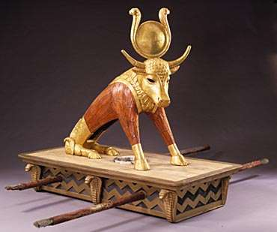
Idols in the Service

Slide 2
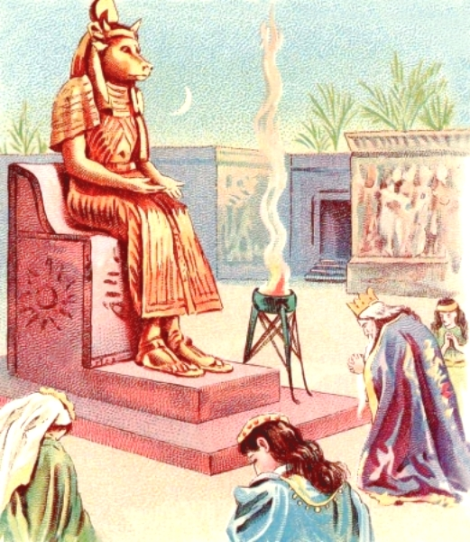
What is an Idol?
Not a real god
One that is made by the worshiper
Made in the image of the worshipper
  God created man in His image
  Man refuse to follow God’s image
    “…you will be like God,
    knowing good and evil” (Gen 3)
    “This is your god, O Israel, that
    brought you out of the land of
    Egypt!” (Exo 32:4)

Slide 3
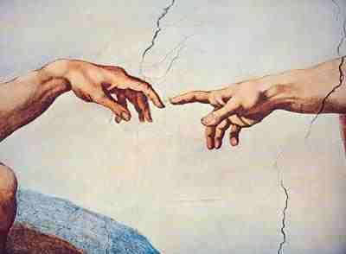
Idols of a Servant
Servant sets a curriculum and economy according to his own “image”
  understanding, belief, comfort, service
We set the path for God to follow us!
  Uphold my your steps in Your my paths... (Ps 17:4)
  Your my word is a lamp to my your feet… (Ps 119: 105)

Slide 4
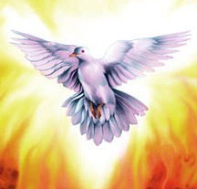
True Servants
“in which their voices are not heard. Their voice is gone out into all the earth, and their words to the ends of the world.” (Ps 19:4)
  12 disciples → the whole world
  12,000 servants → one class room?
  Why???
What’s different between us and St. Paul?
  St. Paul (dust) + Holy Spirit = fire!
  Me (dust) + nothing (no Holy Spirit) = dust!

Slide 5
Weak Servants
Hard truth: Perhaps if we stop serving, more people will be converted…
  “But woe to you, scribes and Pharisees, hypocrites! For you shut up the kingdom of heaven against men; for you neither go in yourselves, nor do you allow those who are entering to go in.” (Matt 27:13)

Slide 6
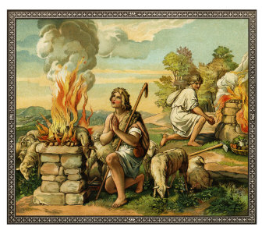
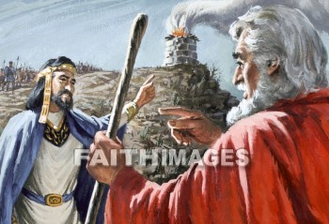
Idol (1): Servant's Will
Most difficult idol
  “Cain brought an offering of the fruit of the ground to the Lord.” (Gen 4:3)
  “¹¹ Saul said, “When I saw that the people were scattered from me, and that you did not come… I felt compelled, and offered a burnt offering.” (1Sam 13)

Slide 7
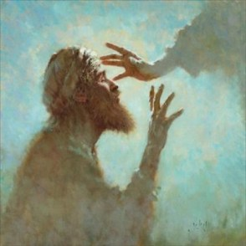
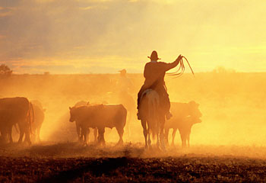
Idol (1): Servant's Will
Difficult to obey another (God)
  “I was like a beast before You.
  Nevertheless I am continually with You” (Ps 73)
  “Who is blind but My servant,
  Or deaf as My messenger whom I send?
  Who is blind as he who is perfect,
  And blind as the Lord’s servant?” (Isa 42:19)

Slide 8
Idol (1): Servant's Will
Difficult to give up my will, even in service
  “When you were younger, you girded yourself and walked where you wished; but when you are old, you will stretch out your hands, and another will gird you and carry you where you do not wish.” (Jn 21:18)
  “After they had come to Mysia, they tried to go into Bithynia, but the Spirit did not permit them.” (Act 16:7)
  “Now when they came up out of the water, the Spirit of the Lord caught Philip away, so that the eunuch saw him no more…. But Philip was found at Azotus.(Acts 8)

Slide 9
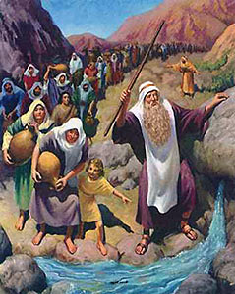
Idol (1): Servant's Will
“All who ever came before Me are thieves and robbers” (Jn 10:8)
  All??? Abraham? Moses? David?
  Abraham: stole God’s economy (Ishmael)
  Moses: stole God’s instructions (hit the rock)
  David: stole God’s decency (Bathsheba, Uriah)

Slide 10
Idol (1): Servant's Will
Solution: Ask the Holy Spirit to work
  God does not compel Himself on us, even in the service:
  “Behold, I stand at the door and knock. If anyone hears My voice and opens the door, I will come in to him and dine with him...” (Rev 3:20)
Compel God to work with you!
  But they constrained Him, saying, “Abide with us, for it is toward evening, and the day is far spent.” And He went in to stay with them. (Lk 24:29)
  “I will not let You go unless You bless me!” (Gen 32:26)
Lord: help me in the service!

Slide 11

Idol (2): Selfish Ambition
Most luxurious idol, Satan’s favorite (Pride)
Serving towards one’s account
  ^{“15} Some indeed preach Christ even from envy and strife, and some also from goodwill: ¹⁶ The former preach Christ from selfish ambition, not sincerely…” (Phil 1)
  “⁸ but to those who are self-seeking and do not obey the truth, but obey unrighteousness—indignation and wrath” (Rom 2)

Slide 12
Idol (2): Selfish Ambition
Imagine: someone donates land for new church
David and Nathan: 2Sam 7
  ² The king said to Nathan the prophet, “See now, I dwell in a house of cedar, but the ark of God dwells inside tent curtains.”
  ³ Then Nathan said to the king, “Go, do all that is in your heart, for the Lord is with you.”
  ⁴ But it happened that night that the word of the Lord came to Nathan, saying, ⁵ “Go and tell My servant David, ‘Thus says the Lord: “Would you build a house for Me to dwell in?
  ¹² “…I will set up your seed after you…¹³ He shall build a house for My name

Slide 13
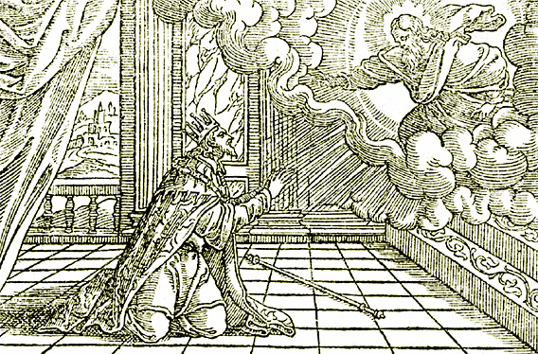
Idol (2): Selfish Ambition
David and Nathan: 2Sam 7
  What’s the problem???
  Selfish Ambition: The house/temple will glorify David and Nathan, not God
  God will choose the place, the time, the servant
Idol of being: first, head, valued, respected

Slide 14
Idol (2): Selfish Ambition
Most people’s reaction?
  Fine! I won’t build a house! See who’ll build it!
David’s reaction: Repentance, Thanksgiving!
  ¹⁸ “Who am I, O Lord God? And what is my house, that You have brought me this far?
  ²⁰ Now what more can David say to You? For You, Lord God, know Your servant. ²¹ For Your word’s sake, and according to Your own heart, You have done all these great things, to make Your servant know them.
  ²⁹ Now therefore, let it please You to bless the house of Your servant, that it may continue before You forever.”

Slide 15
Idol (2): Selfish Ambition
“He must increase, but I must decrease.”
(Jn 3:30)
Story: service in Youth meeting
Solution: When you serve, serve where God wants you to serve, in the service He choses for you, in the time he sets for you
  Position is not our concern: “on the road they had disputed among themselves who would be the greatest.”
  Instead: “If anyone desires to be first, he shall be last of all and servant of all.” (Mk 9)

Slide 16
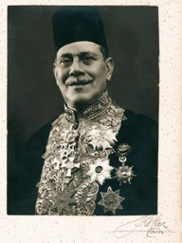

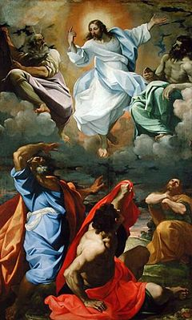
Idol (2): Selfish Ambition
The “Pasha” servant (chief surgeon)
The “Microphone” servant
Solution: The “Hidden” servant (Matt 17)
  “…let us make here three tabernacles:
  one for You, one for Moses, and one for Elijah.”
  Moses and Elijah like Christ???
  “This is My beloved Son, in whom I am well pleased. Hear Him!”
  When they had lifted up their eyes, they saw no one but Jesus only.
Story: The king built the church

Slide 17
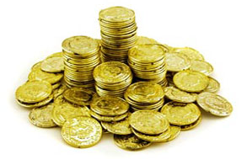
Idol (3): Dishonest Gain
Most profitable idol
  “Shepherd the flock of God which is among you, serving as overseers, not by compulsion but willingly, not for dishonest gain but eagerly” (1Pet 5:2)
In Service: gain is not on earth
  Assuredly, I say to you, they have
  their reward. (Matt 6)
Servant: خادم or خدام ?
  Bondservant: one who is bound to service without wages; one who is subservient to, and entirely at the disposal of, his master

Slide 18
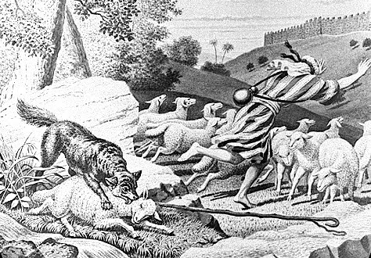
Idol (3): Dishonest Gain
Do some servants want gain?
Hireling! (Jn 10)
  But a hireling, he who is not the shepherd, one who does not own the sheep, sees the wolf coming and leaves the sheep and flees; The hireling flees because he is a hireling and does not care about
  the sheep.

Slide 19
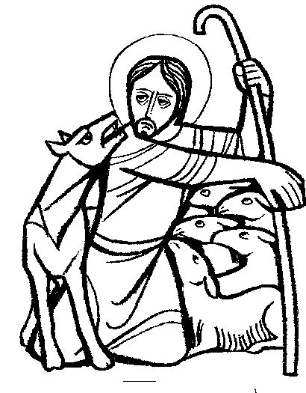
Idol (3): Dishonest Gain
Good Shepherd:
  Suffers for the sheep
  Protects the sheep
Not only, no gain, but the servant gives:
  Heart, love, time, effort, energy – for the service
  “I have come that they may have life, and that they may have it more abundantly.”
  (Jn 10: 10)

Slide 20
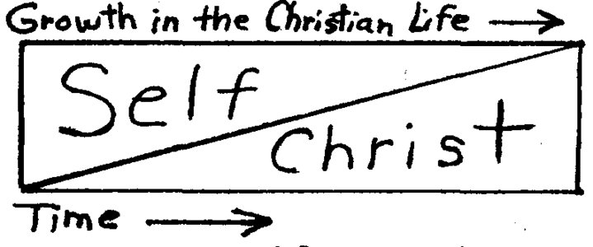
Idol (3): Dishonest Gain
Praise / Pride / Honor
  “Not unto us, O Lord, not unto us, But to Your name give glory” (Ps 115:1)
  “He must increase, but I must decrease.”
  (Jn 3:30)
  “The truly humble does not feel honor”
  (St. Macarius)
    He does not have any feeling towards it
    He does not fight it, because it is not even an issue

Slide 21
Idol (3): Dishonest Gain
Solution:
  “The Lord gave, and the Lord has taken away;
  Blessed be the name of the Lord.” (Job 1:20)
  “Where He lead me (to serve), I will follow”
    priesthood… deaconship… Sunday School… cleaning the floors… no service…
  “Freely you have received, freely give.” (Matt 10:8)
  “Take heed that you do not do your charitable deeds (service) before men, to be seen by them. Otherwise you have no reward from your Father in heaven.” (Matt 6)
  Hide your service!

Slide 22
Idols in the Service
Servant's Will
  Most difficult idol
  Solution: Ask the Holy Spirit to work
Selfish Ambition
  Most Luxurious idol
  Solution: When you serve, serve where God wants you to serve, in the service He choses for you, in the time he sets for you
Dishonest Gain
  Most profitable idol
  Solution: Hide your service!

Slide 23
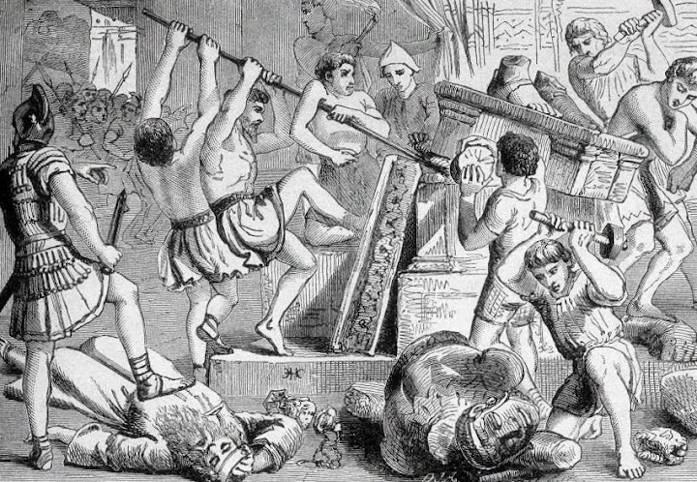
Let us break down these idols!

