Slide 1
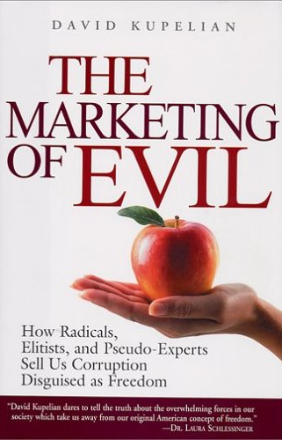

Slide 2
America has Degenerated
“Within the space of our lifetimes, much of what Americans once almost universally abhorred has been packaged, perfumed, gift wrap, and sold to us as though it had great value. By skillfully playing on our deeply felt natural values of fairness, generosity, and tolerance, these marketers have persuaded us to embrace as enlightened and noble that which all previous generations since America's founding regarded as grossly self-destructive – in a word, evil.”

Slide 3
Evil Has a Plan
“Marketing of evil is not a random series of events or just a natural degradation of morality, but a systematic tearing down of values with specific goals and techniques.”

Slide 4
Topics Covered
Week | Topics
Week 1 – January 13 | Selling “Gay Rights” to America Multiculturalism
Week 2 – January 20 | Campaign to Destroy Marriage Obsession with Sex
Week 3 – January 27 | Myth of Church-State Separation Abortion
Week 4 – February 3 | Maccabees Open Discussion

Slide 5
Selling “Gay Rights” To America

Slide 6
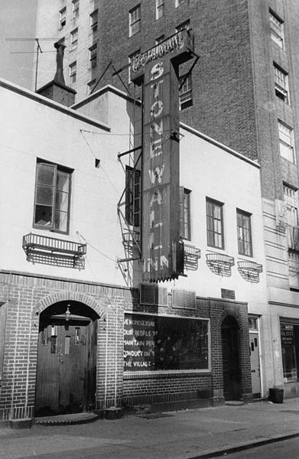
Stonewall Riot
Grew out of the sexual liberation movement of the 1960s
Stonewall Riot in 1969 NYC – group of homosexuals at Stonewall Inn resisted police – seen as the beginning of the gay rights movement

Slide 7
Public Outcry Against Homosexuals
GRID (gay-related immunodeficiency disease)
1978 - 43% of homosexuals had over 500 partners in their lifetime
High profile figures were dying
Non-gays were dying of blood transfusions.
Hatred toward homosexuals
“Keep your rosaries off my ovaries!”

Slide 8
“War” Conference
In 1988, 175 leading gay activists met in Warrenton, Virginia
Long-term marketing campaign
Marshall Kirk and Hunter Madsen formulated marketing plan
Kirk - Harvard-educated researcher in neuropsychiatry
Madsen – PhD in politics from Harvard and was an expert in social marketing
Goal: Capitalize on the AIDs epidemic and the treatment of gays to portray as victims

Slide 9
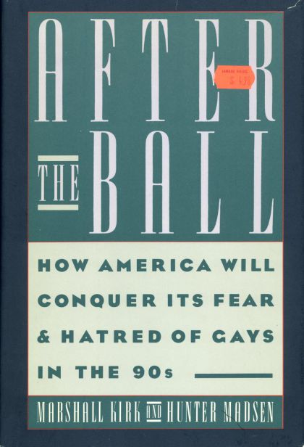

Slide 10
After the Ball: Condition or Problem
A problem has a solution. A condition doesn’t need to be fixed. It is simply an aspect of life that must be accommodated. It requires permanent tolerance and you must come to terms with it psychologically, practically, and morally. Must change public opinion, from problem to condition.

Slide 11
After the Ball: Perception
H don’t warrant or deserve much attention from straights.
Preferred: H are valuable part of American society; we should be familiar with their nature, culture, news and heroes.
H are few in number; I don’t know any H.
Preferred: H constitute a large minority of our society; and some of my friends/family are H.
H are easy to spot.
Preferred: They are not: most of them look just like anyone else.

Slide 12
After the Ball: Perception
H become H because of sin, insanity, seduction.
Preferred: Sexual feelings are not really chosen by anybody; H is just as healthy and natural for some persons as heterosexuality is for others.
H are sex addicts
Preferred: The sex and love lives of most H and straights today are both similar and conventional.
H are unproductive and untrustworthy
Preferred: H are hardworking, patriotic Americans.

Slide 13
After the Ball: Understand Prejudice
Prejudice is not logical. Cannot be overcome by facts and logic.
Prejudice is deep, automatic, prelogical, product of emotional conditioning unassailable by any appeal to the intellect. And so is homohatred impervious to argument.

Slide 14
After the Ball: Understand Prejudice
Tactics that won’t work to overcome prejudice:
  You can’t inform or argue it away,
  Not illness so it can’t be cured by therapy,
  Not a conspiracy by sick or wicked people.
  H parades where H looks extreme won’t work
  Storming the barricades or picketing won’t work

Slide 15
After the Ball: Reverse Prejudice
First you get your foot in the door, by being as similar as possible; then, and only then – when your one little difference is finally accepted – can you start dragging in your other peculiarities, one by one. You hammer in the wedge narrow end first.
As the saying goes, “Allow the camel’s nose beneath your tent, and his whole body will soon follow.”

Slide 16
After the Ball: Desensitization
To desensitize straights, inundate them with conscious flood of H related advertising, presented in the least offensive fashion. If straights can’t shut the shower off, they may at least eventually get used to being wet. (149)

Slide 17
After the Ball: Jamming
Insertion of incompatible emotion into the pre-existing system. Like sprinkling sand into a pocket watch.
All normal people feel shame when they perceive that they are not thinking, feeling, or acting like one of the pack. The trick is to get the bigot into the position of feeling a conflicting twinge of shame, along with his reward, whenever his homohatred surfaces, so that his reward will be diluted or spoiled. (151)

Slide 18
After the Ball: Jamming
Effect of Jamming, is achieved without reference to facts, logic or proof. Through repeated infralogical emotional conditioning, his bigotry can be alloyed in exactly the same way, whether he is conscious of the attack or not. Indeed, the more he is distracted by any incidental, even specious, surface arguments, the less conscious he’ll be of the true nature of the process – which is all to the good. (153)
In short, Jamming succeeds insofar as it inserts …doubt and shame into the previously unalloyed, self-righteous pleasure.

Slide 19
After the Ball: Conversion
Conversion of the average American’s emotions, mind, and will, through a planned psychological attack, in the form of propaganda fed to the nation via the media. (153-154)

Slide 20
After the Ball: Conversion
If Desensitization lets the watch run down, and Jamming throws sand in the works, Conversion reverses the spring so that the hands run backward. (154)

Slide 21
After the Ball: Conversion
The bigot … is repeatedly exposed to literal picture/label pairs, in magazines, and on billboards and TV, of H – explicitly labeled as such – who not only don’t look like his picture of H, but are carefully selected to look either like the bigot and his friends.

Slide 22
After the Ball: Conversion
But it makes no difference that the ads are lies; not to us, because we’re using them to ethically good effect, to counter negative stereotypes that are every bit as much lies, and far more wicked ones … the ads will have their effect on them whether they believe them or not. (154)

Slide 23
After the Ball: Conversion
The bigot will feel two incompatible emotions: a good response to the picture, a bad response to the label. At worst, the two will cancel one another, and we will have successfully Jammed, as above. At best, Associative Conditioning will, to however small an extent, transfer the positive emotion associated with the picture to the label itself, not immediately replacing the negative response, but definitely weakening it. (155)

Slide 24
After the Ball
Three characteristics distinguish propaganda from other modes of communication and contribute to its sinister reputation:
Relies on emotional manipulation – through desensitization, jamming and conversion
Use lies
Subjective and one-sided. Tell our side of the story as movingly as possible. (162-163)

Slide 25
Publicly “Come Out”
Publicly “Come Out” to desensitize, jam and convert straight America. Jamming means interrupting the smooth workings of bigotry by inducing inconsistent feelings in the bigot. Extreme bigots become less confident that their incitements will generate applause and are further inhibited by the majority of mild bigots, who now become uneasy that a fag slur might provoke an unpleasant scene.

Slide 26
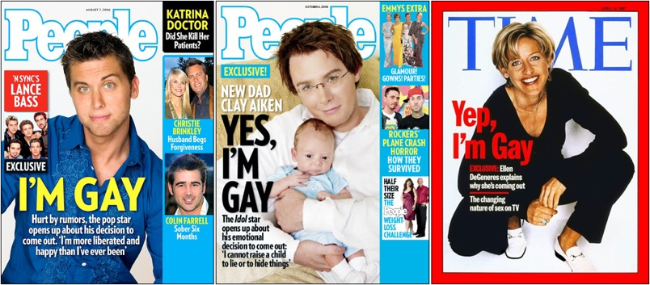

Slide 27
After the Ball
“You can forget about trying right up front to persuade folks that homosexuality is a good thing. But if you can get them to think it is just another thing – meriting no more than a shrug of the shoulders – then your battle for legal and social rights is virtually won.” (177)

Slide 28
After the Ball
“The fastest way to convince straights that homosexuality is commonplace is to get a lot of people taking about the subject in a neutral or supportive way.” (178)
“Talk about gayness until the issue becomes thoroughly tiresome.” (178)

Slide 29
After the Ball
Accuse religious people: “Gays can use talk to muddy the moral waters, that is, to undercut the rationalizations that ‘justify’ religious bigotry and to jam some of its psychic rewards.” “Portray such institutions as antiquated backwaters, badly out of step with the times and with the latest findings of psychology.” (179)

Slide 30
After the Ball: Two Messages
1. Persuade the public that gays are victims of circumstance, that they no more chose their sexual orientation than they did, say, their height, skin color, talents, or limitations.
To suggest in public that homosexuality might be chosen is to open the can of worms labeled “moral choice” and “sin” and give the religious intransigents a stick to beat us with. Straights must be taught that it is as natural for some persons to be homosexual as it is for others to be heterosexual.

Slide 31
After the Ball: Two Messages
2. Gays should be portrayed as victims of prejudice. Straights don’t fully realize the suffering they bring upon gays, and must be shown: graphic pictures of brutalized gays, dramatizations of job and housing insecurity, loss of child custody, public humiliation, etc. (184)

Slide 32
After the Ball: Rewrite History
Famous historical figures are considered especially useful to us for two reasons: first, they are invariably dead... Second… accomplishments that make these historic gay figures admirable cannot be … dismissed by the public, since high school history textbooks have already set them in incontrovertible cement

Slide 33
“Gay” Historical Figures
Famous historical figures are made out to be gay: Socrates, Eleanor Roosevelt, Abraham Lincoln, Tchaikovsky, Leonardo da Vinci…some even say that David and Jonathan were homosexuals.
Openly gay New Hampshire Episcopal Bishop Gene Robinson even stated that Jesus Christ was homosexual before later retracting the statement.

Slide 34
Role of the Media
National Lesbian and Gay Journalists Association formed in 1990
In 2000 the NLGJA met for its 10 year anniversary celebration - discussed whether mainstream journalists have a responsibility to include any viewpoints that contradict those of homosexuals.
It’s working. In 1991, 17% of teens accepted homosexuality as appropriate. In 1999, the number increased to 54%.

Slide 35
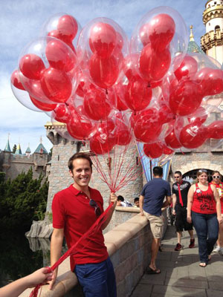
Example: Desensitization
Disney Gay Day

Slide 36
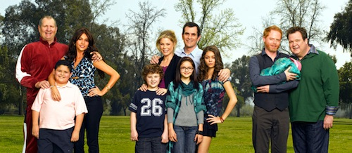
Example: Jamming
Sitcom: Modern Family

Slide 37
Example: Conversion
“The '80s saw the offensive "gays are AIDS patients" meme, while the '90s embraced the "gays are your fun and flashy best friend" idea …The new millennium largely has been about LGBT couples as parents… Now Hollywood is giving us complicated, yet truly dastardly, villains who also have a strong case of the G-A-Y.

Slide 38
Example: Conversion
Here's the twist: Unlike earlier "evil gay" stereotypes in film and TV, these villains' sexuality actually is the redeeming thing about them, not the root of their evilness. As Tim Molloy pointed out in a recent column for thewrap.com, they are humanized to the viewers using their sexuality, not portrayed as damaged or evil because of it.”
http://ohnotheydidnt.livejournal.com/73884844.html?thread=13054345900

Slide 39
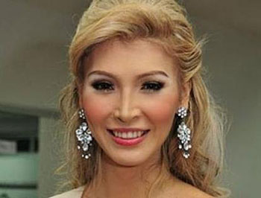
Example: Conversion
In 2013, the Miss Universe competition will allow the entry of transgender women.

Slide 40
Multiculturalism

Slide 41
Everything is Equal
Multiculturalism elevates the value of minorities over that of the majority.
Blacks, Hispanics, women, Native Americans, LGBT
All cultures and religions are considered equal
All religions are equal. Judaism, Christianity, Hinduism, and Satanism all have the same inherent value.
Why is Islam celebrated and even defended by Americans?

Slide 42
Except Christianity
“The Embassy of the United States in Cairo condemns the continuing efforts by misguided individuals to hurt the religious feelings of Muslims -- as we condemn efforts to offend believers of all religions.”
Hilary Clinton: “The United States deplores any intentional effort to denigrate the religious beliefs of others…”
Christianity, God, and Jesus Christ are ridiculed constantly in movies and TV shows.
Pastor Louis Giglio

Slide 43

All Religions Are Equal
In 2003 a US District Court Judge ruled that officials in Chesterfield County, Virginia discriminated against a witch because they barred her from opening the board of supervisor’s meeting with prayer.
The British Royal Navy allowed a satanist officer to conduct satanic rituals aboard a military vessel. He was given a satanic altar in his quarters where he would dress in black robes and worship the devil using bells and candles.

Slide 44
All Sexuality is Equal
“Intergenerational sex” – consensual sex between an adult and a child
“The continuum model of intergenerational sexual contact, to be empirically correct, must allow for all kinds of children, including informed, consenting, and initiating participants.”

Slide 45
All Life is Equal
“Animal liberationists do not separate out the human animal, so there is no rational basis for saying that a human has special rights. A rat is a pig is a dog is a boy. They’re all mammals.” - Ingrid Newkirk, founder of PETA (People for the Ethical Treatment for Animals)
“For kids that want to eat their veggies and not their friends.”

Slide 46
What About “Save the babies?”
Q: “Why don’t you focus your attention on abortion or child abuse? Why do you care about animals?”

Slide 47
What About “Save the babies?”
A: “Those we are particularly adamant on the abortion issue should also consider the issue of vegetarianism, as it requires no additional effort and lends the credibility of personal action to their statements about being ‘pro-life.’ With the issue of abortion, few of us will ever have to make the choice, and no one can make this choice for someone else, however much some people might wish to. But there is one area where the solution is simple: the issue of animal abuse on factory farms. Each and every one of us can simply choose not to be animal abusers by becoming a vegetarian. If purport to be ‘pro-life,’ yet we choose to support violence, misery, and death every time we eat, what does that say about our convictions?”

Slide 48
NYU Literature professor Carol Iannone on the 9/11 terror attacks:
“America lost its grasp of its own historic character, and embraced "diversity" as a national goal. In the name of equality and nondiscrimination we invited mass immigration from every part of the globe, and made no demands on the newcomers to become Americans. In fact, we gave up our American core, adopted multiculturalism and declared all cultures equal. We invited the new groups to celebrate themselves while we cravenly permitted libelous denigration of our own past. Like fools we prated that diversity is our strength, when common sense and all of history tell us that strength comes from unity.

Slide 49
Campaign to Destroy Marriage

Slide 50
Children are the Biggest Victim of Divorce
Malachi 2:15
But did He not make them one, Having a remnant of the Spirit? And why one? He seeks godly offspring. Therefore take heed to your spirit, And let none deal treacherously with the wife of his youth.
Divorce rate 50% in US – 75% in California
“National Studies show that children from divorced and remarried families experience more depression, have more learning difficulties, and suffer from more problems with peers than children from intact families.”

Slide 51
Statistics
“Children from divorced and remarried families are two to three times more likely to be referred for psychological help at school than their peers from intact families. More of them end up in mental health clinics and hospital settings. There is earlier sexual activity, more children born out of wedlock, less marriage, and more divorce. Numerous studies show that children of divorce have more psychological problems than those raised in intact marriages.”

Slide 52
Statistics
“Virtually every major personal and psychological pathology can be traced to fatherlessness more than to any other single factor.” – Stephen Baskerville (Professor of Political Science at Howard University)
“Fatherlessness far surpasses both poverty and race as a predictor of social deviance.”

Slide 53
Divorce is Easy Says Writer Dennis E. Powell:
I have discovered how my state – Connecticut – has done all it can to make ending a marriage easy, while making little or no provision for preserving it. In Connecticut, as in other states, “no-fault” divorce means “divorce because it suits the mood of at least one partner.”
The state has produced an official publication, the “Do-It-Yourself Divorce Guide” to make getting a divorce as simple as mounting a defense against a speeding ticket – even if your spouse has no interest in divorce. Especially if your spouse has no interest in divorce.

Slide 54
Divorce is Easy
The “Do-It-Yourself Divorce Guide” offers everything one needs to know to obtain a divorce, but no guidance as to how one who opposes a divorce might respond. There is plenty on how to battle for a bigger piece of the marital corpse and on getting court orders of alimony, child support, custody, and exclusive use of the family home. There is no mention of another pre-judgment court order … available under the law, in which the court may order two sessions with a marriage counselor or other person trained in the resolution of disputes within families …
$225-$250, 90 days, No reason required

Slide 55
Marriage Facts
There is no genuine civil marriage
Marriage contract is not a contract – no-fault divorce.
Marriage is supposed to be binding because breaking it has such a negative effect on the family/children.

Slide 56
Harvard University Press
Harvard University Press contracted with Linda J. Waite, a self-described “liberal Democrat,” along with co-author Maggie Gallagher, to write a book based on Waite’s studies about marriage.
Harvard University Press expected that the book would discredit marriage
The book however concluded that married men and women live happier, healthier, more financially secure lives, and even have “more and better sex.”

Slide 57
The Case for Marriage
It was called: “The Case for Marriage: Why Married People are Happier, Healthier and Better Off Financially”
HUP refused to publish the book, citing one reviewer not liking the “tone” of the book
HUP published other books by feminist Catherine MacKinnon that compare marriage to rape
“What in the liberal view looks like love and romance looks a lot like hatred and torture to the feminist.”
“Feminism stresses the indistinguishability of prostitution, marriage, and sexual harassment.”

Slide 58
The Case for Marriage
Book was finally published by another publisher to wide acclaim. The book gives this warning:
“For perhaps the first time in human history, marriage as an ideal is under a sustained and surprisingly successful attack. Sometimes the attack is direct and ideological, made by ‘experts’ who believe a lifelong vow of fidelity is unrealistic or oppressive, especially to women.”

Slide 59
Human Potential Movement
“Marriage and family ties regarded by the ‘human potential movement’ as threats to individual fulfillment as a man or a woman.
The highest forms of human needs were autonomy, independence, growth, and creativity, which marriage often thwarted.
Marriage referred to as “slavery,” “legalized rape,” and, “tied up with a sense of dependency.”

Slide 60
Human Potential Movement
“We have to abolish and reform the institution of marriage … By the year 2000 we will, I hope, raise our children to believe in human potential, not God … We must understand what we are attempting is a revolution, not a public relations movement.” – Gloria Steinem, quoted in the Saturday Review of Education, March 1973

Slide 61
Feminism
“Being a housewife is an illegitimate profession … the choice to serve and be protected and plan towards being a family-maker is a choice that shouldn’t be. The heart of radical feminism is to change that.” – Vivian Gornick, feminist author, a tenured professor at the University of Arizona, The Daily Illini, April 25, 1981
“We can’t destroy the inequities between men and women until we destroy marriage.” – Feminist author Robin Morgan

Slide 62
Feminism
“Like prostitution, marriage is an institution that is extremely oppressive and dangerous for women.” – Radical feminist author Andrea Dworkin in 1983
“Until all women are lesbians, there will be no true political revolution.” – Feminist author and journalist Jill Johnson, in “Lesbian Nation: The Feminist Solution,” 1973

Slide 63
History of No-Fault Divorce
Up until 30 years ago marriage was a lifetime commitment
California - A series of statewide task forces recommended that men and women seeking divorce should no longer be required to prove that their spouse was unfaithful, unfit, cruel, or incompatible.

Slide 64
History of No-Fault Divorce
Divorce would allow adults to make better choices and happier marriages by letting them undo earlier mistakes. They would arrive at an honest, mutual decision to divorce, because if one person wanted out, surely it could not be much of a marriage.

Slide 65
History of No-Fault Divorce
In 1969, Gov. Ronald Reagan signed the new law and people were happy.
It was hoped that these laws would bring freedom to men and women trapped in loveless marriages and provide a better environment for children
Within a few years, no-fault divorce laws spread like wildfire to all 50 states.

Slide 66
Reality of Marriage
Learning how to love your spouse despite their weaknesses.
Forces you to deal with your own weaknesses and failings with real visible consequence for not doing so.
Disney – “Some day your prince will come”

Slide 67
Obsessed with Sex

Slide 68
Pornography
Online pornography
12% of all website are pornographic
Revenue from pornography exceeds that of all major sports combined
68 million search requests / day
“…when one study group was exposed to as little as five hours of non-violent pornography, they began to think pornography was not offensive and that rapists deserved milder punishments.”

Slide 69
Children
2004 movie “Birth” portrayed Nicole Kidman who believes that her deceased husband has been reincarnated as a 10-year old boy. Movie contains scenes implying intimacy between the two. Received with boos at the Venice film festival.

Slide 70
Why 6-Year-Old Girls Want to Be Sexy
livescience.com article
“Most girls as young as 6 are already beginning to think of themselves as sex objects, according to a new study of elementary school-age kids in the Midwest.”

Slide 71
How Did We Reach This Point?
In the 1950s:
  Divorce was rare
  Abortion was uncommon
  Homosexuality was in the closet and not accepted

Slide 72
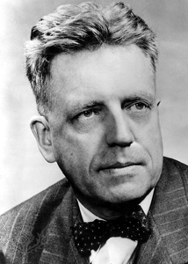
Alfred Kinsey
In 1948 a man by the name of Alfred Kinsey released his research study titled “Sexual Behavior of the Human Male.”
Today he is referred to as the “father of the sexual revolution”
The National Research Council says that the science of sex “can be divided somewhat crudely into the pre-Kinsey and post-Kinsey eras”

Slide 73
Alfred Kinsey
The first era has been attributed to the Puritans who came to the New World to protect their children from corruption and persecution in Europe.
It has been said when Kinsey revealed the results of his research, “the earth moved.”

Slide 74
Sexual Behavior in the Human Male
At the time masturbation was frowned upon, oral sex was illegal in some states, and homosexuality was considered an extremely rare, criminal deviance.
Kinsey's work set off "a true media explosion," says writer-director Bill Condon, whose movie, "Kinsey," debuted in 2004.

Slide 75
Kinsey Research “Results”
Based on thousands interviews with churchgoers, college students, prison inmates:
92% of men had masturbated
Half of married men had had extramarital affairs.
85% of males had intercourse prior to marriage
Nearly 70% had sex with prostitutes
30-45% of husbands had extramarital affairs
10-37% of men had engaged in homosexual acts

Slide 76
Kinsey Research “Results”
62% of women reported they had masturbated
50% of women said that they had engaged in premarital sex
2/3 of participants said that they had experienced overtly sexual dreams
1 in 10 human beings is homosexual – a cornerstone of the “gay rights” movement – comes directly from Kinsey’s published research (later debunked).

Slide 77
LA Times Article About Kinsey
“Overnight, millions of American men realized that they were not lone freaks for doing what they did. People felt that all their secret desires were actually normal and even healthy! People wanted to believe his message because it felt good and removed a load of guilt.”
“By bringing the sexual lives of regular American men and women out of the shadows … he opened the doors on a public discussion of sex and set a foundation for the scholarly investigation of this most intimate arena of human life.”

Slide 78
LA Times Article About Kinsey
Social scientists and sex researchers describe his contribution as one of the most significant achievements in the annals of sex research.
"His influence was tremendous -- it opened up the field," says Vern Bullough, founder of the Center for Sex Research at Cal State Northridge, and author of "Science in the Bedroom: A History of Sex Research."
Kinsey, meanwhile, has been credited with doing more than laying the groundwork for a new field. He radically altered the way society thinks of sex, and ushered in far greater sexual freedom.

Slide 79
Kinsey Research
In endless and graphic detail, Kinsey painted a picture of Americans as being amoral sexual animals seeking constant gratification.
His press coverage could not have been more extensive or enthusiastic. Time magazine, Life, Look and most of the rest of the mainstream press reported that Kinsey – whom they portrayed as a conservative Republican academic and faithful family man – had conducted the most exhaustive and scientific survey ever of Americans’ sexual habits.

Slide 80
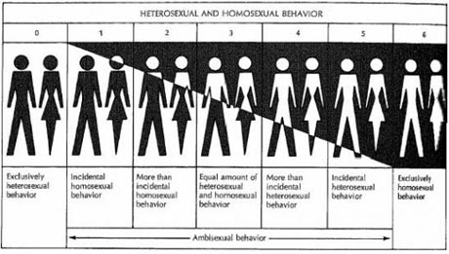
Example

Slide 81
More Research Results
Concluded that children are sexual from birth, and that youngsters as young as a few months of age have the capacity for a pleasurable and healthy sexual life.
For 30 years no one questioned Kinsey’s researched and he was considered one of the most influential and well-known men of the age
Then in 1981, a PhD researcher Judith Reisman questioned statistics in “Table 34”

Slide 82
Table 34
Recorded results of how young children as young as 5 months old responded to sexual pleasure
Reisman asked how can a man perform such research?
Answer: Kinsey solicited pedophiles to sexually violate from 317 to 2,035 infants and children for his alleged data on normal “child sexuality.”
Homosexual and pedophile movements quote his perverted research to support their chosen lifestyles.

Slide 83
Rex King and Fritz von Balluseck
In 1995, the director of the Kinsey Institute stated that Kinsey got his data from a serial pedophile named Rex King.
Kinsey wrote to King: “I rejoice at everything you send, for I am then assured that much more of your material is saved for scientific publication.”
He also gathered data from Nazi Fritz von Balluseck who was ultimately convicted of child abuse of over 200 children
Kinsey wrote to Balluseck warning him to “watch out” to avoid from being caught

Slide 84
What About the Rest?
Kinsey’s research team revealed that he:
“Forced” subjects to give the desired answers to their sex questions
Trashed three quarters of their research data
Normal male data based on a roughly 86 percent aberrant male population: 200 sexual psychopaths, 1,400 sex offenders and hundreds of prisoners, male prostitutes and promiscuous homosexuals.
So few normal women would talk to them that the Kinsey team labeled women who lived over a year with a man as “married”

Slide 85
Kinsey the Man
Although married, he was bisexual and a masochist.
Seduced his male students
Made illegal pornographic films involving his wife and colleagues
Circumcised himself without the benefit of anesthesia
He died partially as a result of diseases from his own sexual deviations

Slide 86
Why Hasn’t He Been Discredited?
Why did Hollywood make a feature movie glorifying him?
While many have joined with Riesman to expose Kinsey, when it comes to American belief’s laws and culture, his “research” has infiltrated American life.

Slide 87
Dr. E. Michael Jones on Reisman’s Research
On July 23, 1981, Reisman delivered a paper entitled, “The Scientist as a Contributing Agent to Child Sexual Abuse: A Preliminary Study,” in which she brought up for the first time in the 32 years since it had been published, the material on child sexuality in Tables 30-34 of the Kinsey Male volume and wondered how this data could have been obtained without involvement in criminal activity. Before giving her report, Reisman had written to co-author Paul Gebhard to ask about the data in Tables 30-34.

Slide 88
Dr. E. Michael Jones
Gebhard wrote back saying that the data had been obtained from parents, school teachers, and some male homosexuals, including “some of Kinsey’s men” who had used […deleted techniques…]. Virtually the entire sex industry/sex research establishment worldwide was in attendance at the meeting in Jerusalem, but the reaction to the talk was silence, stunned or sullen or otherwise, until a Swedish reporter wondered out loud why the assembled experts had nothing to say.

Slide 89
Dr. E. Michael Jones
The silence was understandable. Just about everyone in attendance had cited Kinsey as their mentor, and some even knew about the criminal activity involved in Kinsey’s research. They all knew that Kinsey’s research was the basis of their “science,” which is to say, the legitimizing basis for everything they did. Kinsey was the foundation of that house of cards. If what he had done could be discredited, it threatened the sexual empire that had been built since his death and upon which they all depended for a livelihood.”

Slide 90
Kinsey Research in Law
Riesman: “Fully 100 percent of the sex science citations in the original 1955 American Law Institute’s ‘Model Penal Code’ cite Kinsey’s bogus data on ‘normal sexuality’ – alive today in courts and legislatures.”

Slide 91
Kinsey Biography
Changing America’s sex laws was exactly what Kinsey had intended, as biographer Jones revealed in 1997:
The man I came to know bore no resemblance to the canonical Kinsey. Anything but disinterested, he approached his work with missionary fervor. … He wanted to undermine traditional morality, to soften the rules of restraint. … Kinsey was a crypto-reformer who spent his every waking hour attempting to change the sexual mores and sex offender laws of the United States. …

Slide 92
Kinsey Biography
To sum it all up, today virtually everything having to do with sex – from attitudes toward extramarital sex and homosexuality, to the nation’s sex-education curricula, to the ways medicine, psychiatry, psychology, and even the criminal justice system define and deal with sex crimes – is rooted firmly in the ludicrously fraudulent “data” of Kinsey and his cult of criminally deviant sex “researchers.”
People believed because they wanted to believe

Slide 93
Myth of Church-State Separation

Slide 94
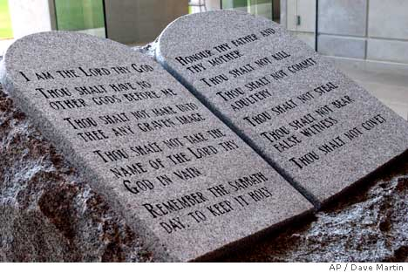
Courthouse Ten Commandments
In 2003, U.S. District Court Judge Myron Thompson ordered the removal of Ten Commandments from courthouse in Alabama.

Slide 95
First Amendment
Court ruled that the Ten Commandments violated the Establishment Clause of the First Amendment
The First Amendment has been used to remove manger scenes from public places, remove prayer from graduation commencement addresses, and prohibit children from saying, “Merry Christmas” at school.

Slide 96
First Amendment
A federal court ruled that a school teacher could not be seen with her own personal Bible at school and removed the 2 books (out of 237) from the library that spoke about Christianity.
The ACLU attacked a California public school for putting up a banner that says, “God Bless America” after the 9/11 attacks.

Slide 97
First Amendment
A federal court also ruled that a public cemetery could not have planter in the shape of a cross since its mere presence could cause “emotional distress” to a passer-by and constitute “injury-in-fact.”

Slide 98
Establishment Clause
“Congress shall make no law respecting an establishment of religion, or prohibiting the free exercise thereof”

Slide 99
History of First Amendment
6 of the original 13 states had official state-supported religion
Other states required elected officials to be Christians
Fear of national religion

Slide 100
Danbury Baptists
Thomas Jefferson wrote a letter to the Danbury Baptists of Rhode Island in 1802:
“…I contemplate with sovereign reverence that act of the whole American people which declared that their legislature should ‘make no law respecting an establishment of religion, or prohibiting the free exercise thereof,’ thus building a wall of separation between Church & State.”

Slide 101

Roger Williams in 1644
“…when they [the Church] have opened a gap in the hedge or wall of Separation between the Garden of the Church and the Wilderness of the world, God hath ever broke down the wall itself … and made his Garden a Wilderness, as at this day. And that therefore if he will ever please to restore his Garden and Paradise again, it must of necessity be walled in peculiarly unto Himself from the world, and that all that shall be saved out of the world are to be transplanted out of the Wilderness of the world, and added unto His Church or Garden.”

Slide 102
14th Amendment - 1868
14th Amendment passed after the Civil War
Ratifying the amendment was a requirement for all confederate states to be re-admitted into the union
“No State shall make or enforce any law which shall abridge the privileges or immunities of citizens of the United States; nor shall any State deprive any person of life, liberty, or property, without due process of law; nor deny to any person within its jurisdiction the equal protection of the laws.”
Slavery: Gave federal govt. power to ensure states treated citizens equally – first time federal govt. was given this much power

Slide 103
Blaine Amendment
President Ulysses S. Grant (1877) – wanted First Amendment to apply to states (not just Congress)
Proposed Blaine Amendment:
“No State shall make any law respecting an establishment of religion, or prohibiting the free exercise thereof…”

Slide 104
Senator Frelinghuysen
“The [Blaine Amendment] very properly extends the prohibition of the first amendment of the Constitution to the States. Thus the [Blaine Amendment] prohibits the States, for the first time, from the establishment of religion, from prohibiting its free exercise, and from making any religious test a qualification to office.”
It was not passed
Both opponents and proponents agreed that by this time states were not bound by the First Amendment (despite 14th Amendment)

Slide 105
Reynolds v. U.S (1878)
First time Jefferson’s concept of “separation of church and state” was related to the “Establishment” clause of the First Amendment.
Quoting Jefferson’s letter to the Danbury Baptists about separation: "coming as this does from an acknowledged leader of the advocates of the measure, it may be accepted almost as an authoritative declaration of the scope and effect of the amendment thus secured."

Slide 106
Everson v. Board of Education
Everson v. Board of Education (1947) – First case that sought to apply the Establishment clause to a state. Justified this by saying that the 14th Amendment’s due process clause caused the first amendment to apply to the states (essentially what the Blaine Amendment wanted to do).

Slide 107
Everson v. Board of Education
“The First Amendment has erected a wall between church and state. That wall must be kept high and impregnable. We could not approve the slightest breach.” Since then, this separation as been quoted so often that most people believe that it is in the constitution.
Since then the Supreme Court has ruled that the 14th Amendment requires that states abide by all federal amendments, which is why states no longer can have state-sponsored religion.

Slide 108
Is this what the Founders intended?
They had no problem with state-sponsored religion
In 1777, Congress approved the purchase of 20,000 Bibles from Holland for distribution in the states.
The Continental Congress designated days of fasting and prayer, appointed chaplains, and paid Christian missionaries to convert the Native Americans to Christianity.

Slide 109
Christianity in Government
In 1789 Rep. Elias Boudinot expressed his desire to George Washington to establish a national holiday of Thanksgiving. He told him, “[I] could not think of letting the session pass over without offering an opportunity to all citizens of the United States of joining with one voice, in returning to Almighty God their sincere thanks for the many blessings he had poured down upon them.”

Slide 110
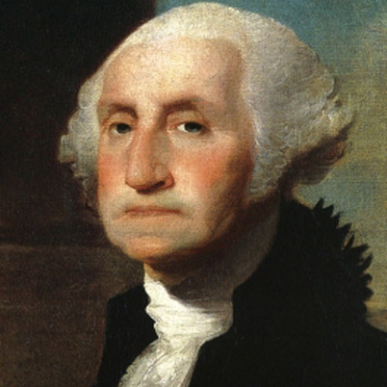
Founders were Christian
"While we are zealously performing the duties of good citizens and soldiers, we certainly ought not to be inattentive to the higher duties of religion. To the distinguished character of Patriot, it should be our highest glory to add the more distinguished character of Christian." -The Writings of Washington, pp. 342-343.

Slide 111
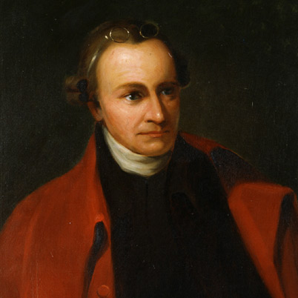
Founders were Christian
"It cannot be emphasized too strongly or too often that this great nation was founded, not by religionists, but by Christians; not on religions, but on the gospel of Jesus Christ. For this very reason peoples of other faiths have been afforded asylum, prosperity, and freedom of worship here." -The Trumpet Voice of Freedom: Patrick Henry of Virginia, p. iii.
Ratifier of the U.S. Constitution

Slide 112
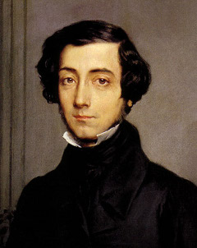
Founders were Christian
“The Americans combine the notions of Christianity and of liberty so intimately in their minds, that it is impossible to make them conceive the one without the other; and with them this conviction does not spring from that barren traditionary faith which seems to vegetate in the soul rather than to live.”
- French historian Alexis de Tocqueville

Slide 113
Chief Justice Rehnquist
“The metaphor of a ‘wall of separation’ is bad history and worse law. It has made a positive chaos out of court rulings. It should be frankly and explicitly abandoned.”

Slide 114
Chaplain in Congress
On 12/17/2012 The House Chaplain, the Reverend Patrick J. Conroy, offered the following prayer:
Loving God, we give You thanks for giving us another day. Lord, the people's House returns as a community in Connecticut begins to lay their little ones to rest. Bless the families of all whose lives were so terribly cut short with peace and consolation. Help them, and help us all, to have hope in a time of great desolation. ‘‘The souls of the just are in the hand of God, and no torment shall touch them.'‘

Slide 115
Abortion

Slide 116
Pro- “choice” Slogans
“Women must have control over their own bodies.”
“Safe and legal abortion is every woman’s right.”
“Who decides? You decide!”
“Abortion is a personal decision between a woman and her doctor.”
“Who will make this most personal decision of a woman’s life? Will women decide, or will the politicians and bureaucrats in Washington?”
“Freedom of choice – a basic American right.”

Slide 117
Abortion Movement
Since Roe v. Wade, 40 million abortions performed in the US. worldwide
1.26 billion abortions performed worldwide
Key to Success: Diverted the issue from being one of murder to one of choice. Who decides?

Slide 118
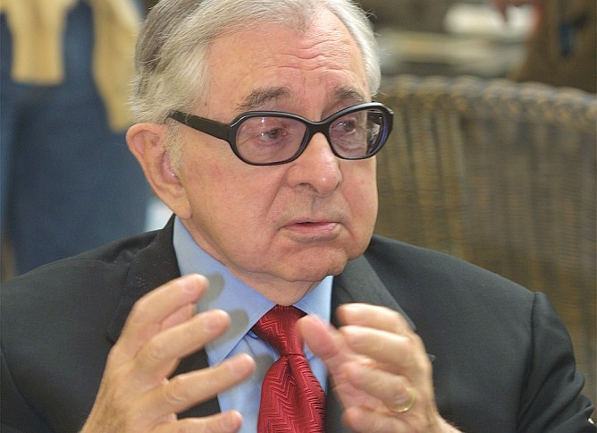
Bernard Nathanson
Principal architect of the abortion movement in the US
Cofounder of NARAL (National Association for the Repeal of Abortion Laws, and later renamed the National Abortion and Reproductive Rights Action League)

Slide 119
Nathanson’s Story
“In 1968 I met Lawrence Lader. Lader had just finished a book called ‘Abortion,’ and in it had made the audacious demand that abortion should be legalized throughout the country. I had just finished a residency in obstetrics and gynecology and was impressed with the number of women who were coming into our clinics, wards and hospitals suffering from illegal, infected, botched abortions.”

Slide 120
Nathanson’s Story
“We sat down and plotted out the organization now known as NARAL. With Betty Friedan, we set up this organization and began working on the strategy.”
“We persuaded the media that the cause of permissive abortion was a liberal, enlightened, sophisticated one. Knowing that if a true poll were taken, we would be soundly defeated, we simply fabricated the results of fictional polls. We announced to the media that we had taken polls and that 60 percent of Americans were in favor of permissive abortion.”

Slide 121
Nathanson’s Story
“This is the tactic of the self-fulfilling lie. Few people care to be in the minority. We aroused enough sympathy to sell our program of permissive abortion by fabricating the number of illegal abortions done annually in the U.S. The actual figure was approaching 100,000, but the figure we gave to the media repeatedly was 1,000,000.”

Slide 122
Nathanson’s Story
“Repeating the big lie often enough convinces the public. The number of women dying from illegal abortions was around 200-250 annually. The figure we constantly fed to the media was 10,000. These false figures took root in the consciousness of Americans, convincing many that we needed to crack the abortion law.”

Slide 123
Nathanson’s Story
“Another myth we fed to the public through the media was that legalizing abortion would only mean that the abortions taking place illegally would then be done legally. In fact, of course, abortion is now being used as a primary method of birth control in the U.S. and the annual number of abortions has increased by 1,500% since legalization.”

Slide 124
Nathanson’s Story
New York law outlawing abortion for 140 years.
“In two years of work, we at NARAL struck that law down. We lobbied the legislature, we captured the media, we spent money on public relations … Our first year’s budget was $7,500. Of that, $5,000 was allotted to a public relations firm to persuade the media of the correctness of our position. That was in 1969.”

Slide 125
Nathanson’s Story
New York immediately became the abortion capital for the eastern half of the US.
“We were inundated with applicants for abortion. To that end, I set up a clinic, the Center for Reproductive and Sexual Health (C.R.A.S.H.), which operated in the east side of Manhattan. It had 10 operating rooms, 35 doctors, 85 nurses.”

Slide 126
Nathanson’s Story
“At the end of the two years that I was the director, we had done 60,000 abortions. I myself, with my own hands, have done 5,000 abortions. I have supervised another 10,000 that residents have done under my direction. So I have 75,000 abortions in my life.”

Slide 127
Nathanson’s Story
After two years, Nathanson resigned from C.R.A.S.H.
Became chief of the obstetrical service at St. Luke’s Hospital in New York City, a major teaching center for Columbia University Medical School.
In 1973 new technologies became available, designed to give physicians a “window into the womb.”

Slide 128
Nathanson’s Conversion
“Anyway, as a result of all of this technology – looking at this baby, examining it, investigating it, watching its metabolic functions, watching it urinate, swallow, move and sleep, watching it dream, which you could see by its rapid eye movements via ultrasound, treating it, operating on it – I finally came to the conviction that this was my patient. This was a person! I was a physician, pledged to save my patients’ lives, not to destroy them. So I changed my mind on the subject of abortion.”

Slide 129
Nathanson’s Conversion
“I was immediately summoned to a kangaroo court and was discharged from the pro-abortion movement, something I do not lose sleep over.”
In 1985, Nathanson decided to put an ultrasound machine on the abdomen of a woman undergoing an abortion and videotape what happens.

Slide 130
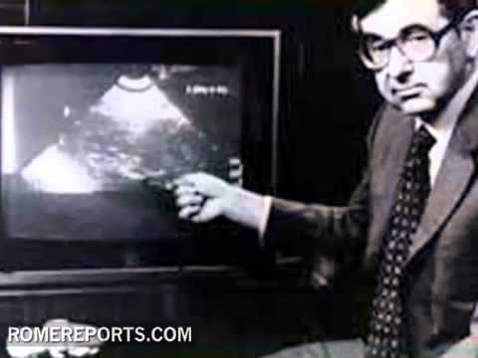
Silent Scream
“We got a film that was astonishing, shocking, frightening,” he says.

Slide 131
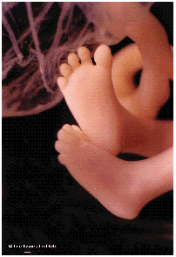
Silent Scream
“It was shattering, and the pro-abortion people panicked. Because at this point, we had moved the abortion debate away from moralizing, sermonizing, sloganeering and pamphleteering into a high-tech argument. For the first time, the pro-life movement now had all of the technology and all of the smarts, and the pro-abortion people were on the defensive.”

Slide 132
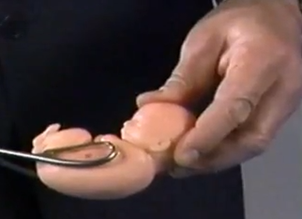
Eclipse of Reason
In 1987, Nathanson released another, even stronger film called “Eclipse of Reason,” about late-term abortions
Contrary to popular misconception, Roe v. Wade and Doe v. Bolton makes abortion permissible up to and including the ninth month of pregnancy.

Slide 133
Procedure: Dilation and Evacuation
“It involves dilating the cervix, rupturing the bag of water, taking a large crushing instrument and introducing it way high up into the uterus, grabbing a piece of the baby, pulling it off the baby, and just repeating this procedure until the baby has been pulled apart piece by piece.”
“Then the pieces are assembled on a table, put together like a jigsaw puzzle, so the abortionist can be sure that the entire baby has been removed. We photographed all this through the fetuscope. This is a shattering film.”

Slide 134
Deceptive Counseling
Carol Everett of Dallas, Texas, got involved in the abortion industry in 1973. She describes how women coming to her clinics were counseled:
“When they find out that they are pregnant, [they] may not want an abortion; they may want information. But when they call that number, which is paid for by abortion money, what kind of information do you think they’re going to get?”

Slide 135
Sell Her the Abortion
“The counselor asks, ‘How far along are you? What’s the first day of your last normal period?’”
“The counselor is paid to be this girl’s friend and authority figure. She is supposed to seduce her into a friendship of sorts – to sell her the abortion.”
Professional public relations firms train clinic personnel to sell women on the abortion option.

Slide 136
Hook the Sale
Nita Whitten worked as chief secretary at another Dallas abortion clinic:
“I was trained by a professional marketing director in how to sell abortions over the telephone. He took every one of our receptionists, nurses, and anyone else who would deal with people over the phone through an extensive training period. The object was, when the girl called, to hook the sale so she wouldn’t get an abortion somewhere else, or adopt out her baby, or change her mind … We were doing it for the money.”

Slide 137
That’s Why Abortion is Here
Kathy Sparks, who worked in a Granite City, Ill., abortion clinic, describes the manipulative counseling practices used at her clinic:
“One particular worker was very good. She could sit down with these girls during counseling and cry with them at the drop of a pin.”
“Whatever that pressure point was, she would magnify it. If the girl was afraid her parents would kill her, and didn’t know how to tell them, the counselor would proceed by saying, ‘Well, that’s why abortion is here, we want to help you; this is the answer to your problems.’”

Slide 138
Salesmanship
“If it was money, she would tell the girl how much baby items cost: ‘You know it costs $3,000 to have a baby now,’ or ‘You know, baby shoes are $28. Sleepers are $15. But you know, that’s what’s so wonderful about abortion. We can take care of this problem and you don’t have to worry about it until you are financially prepared to have a child.’”

Slide 139
No Alternatives Given
“The women were never given any type of alternatives to abortions,” says Debra Henry, who worked as an assistant and counselor for six months at an OB/GYN office in Levonia, Mich. “They were never told about adoption agencies, that there were people out there willing to help them, to give them homes to live in, to provide them with care, and even financial support.”

Slide 140
What They Were Not Told
“They were not told about the development of the baby, or about the pain that the baby would be experiencing, or about the physical or emotional effects the abortion would have on them.”

Slide 141
It’s a Blood Clot
Question #1, “Does it hurt?”
Answer: “Oh, no. Your uterus is a muscle. It’s a cramp to open it, a cramp to close it – just a slight cramping sensation.”
No. 2: “Is it a baby?”
Answer: “No,” would come the answer, “it’s a product of conception,” or “it’s a blood clot,” or “it’s a piece of tissue.” They don’t even call it a fetus, because that almost humanizes it too much, but it’s never a baby.”

Slide 142
Reactions to Abortion
“The first is: ‘I’ve killed my baby.’ It amazed me that this was the first time the patients called it a baby, and the first time they called it murder. But the second reaction is: ‘I am hungry. You kept me in here for four hours and you told me I’d only be here for two. Let me out of here.’ That woman is doing what I did when I had my abortion. She’s running from her abortion, not dealing with it.”

Slide 143
Not Allowed to See Ultrasound
What about the women having the abortions? Do they see the ultrasound?
“They are never allowed to look at the ultrasound because we knew that if they so much as heard the heartbeat, they wouldn’t want to have the abortion.”

Slide 144
Norma McCorvey
The original “Jane Roe”
McCorvey now admits Roe v. Wade was a fraud, and that she was “used” by abortion-rights attorneys in their quest to legalize the procedure.
In 2003 McCorvey filed suit in federal court to have Roe v. Wade overturned.

Slide 145
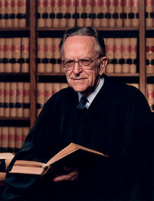
Roe v. Wade
Supreme Court Justice Harry Blackmun
“Roe was a case that Dad struggled with,” Blackmun told the feminist news service. “It was a case that he asked his daughters’ and wife’s opinion about.”

Slide 146
Blackmun’s Daughter
While a 19-year-old sophomore, Blackmun’s daughter discovered she was pregnant.
“I did what so many young women of my era did. I quit college and married my 20-year-old college boyfriend. It was a decision that I might have made differently had Roe v. Wade been around.”

Slide 147
Roe v. Wade
Blackmun lost her child to a miscarriage in the weeks following her wedding. It took six years, she noted, to complete her graduation requirements, something she questions would have occurred had her child been born. In those same six years, her hastily formed marriage collapsed. The year was 1972 – the same year her father sought her input on Roe.

Slide 148
What then should we do?
Discussion
How then should we live?

Slide 149
John 3:18-21
“He who believes in Him is not condemned; but he who does not believe is condemned already, because he has not believed in the name of the only begotten Son of God. And this is the condemnation, that the light has come into the world, and men loved darkness rather than light, because their deeds were evil. For everyone practicing evil hates the light and does not come to the light, lest his deeds should be exposed. But he who does the truth comes to the light, that his deeds may be clearly seen, that they have been done in God.”

Slide 150
Maccabees

Slide 151
1 Maccabees 1:10-15
From them came forth a sinful root, Antiochus Epiphanes, son of Antiochus the king; he had been a hostage in Rome. He began to reign in the one hundred and thirty-seventh year of the kingdom of the Greeks. In those days lawless men came forth from Israel, and misled many, saying, "Let us go and make a covenant with the Gentiles round about us, for since we separated from them many evils have come upon us."

Slide 152
1 Maccabees 1:10-15
This proposal pleased them, and some of the people eagerly went to the king. He authorized them to observe the ordinances of the Gentiles. So they built a gymnasium in Jerusalem, according to Gentile custom, and removed the marks of circumcision, and abandoned the holy covenant. They joined with the Gentiles and sold themselves to do evil.

Slide 153
1 Maccabees 1:20-28
After subduing Egypt, Antiochus returned in the one hundred and forty-third year. He went up against Israel and came to Jerusalem with a strong force. He arrogantly entered the sanctuary and took the golden altar, the lampstand for the light, and all its utensils. He took also the table for the bread of the Presence, the cups for drink offerings, the bowls, the golden censers, the curtain, the crowns, and the gold decoration on the front of the temple; he stripped it all off.

Slide 154
1 Maccabees 1:20-28
He took the silver and the gold, and the costly vessels; he took also the hidden treasures which he found. Taking them all, he departed to his own land. He committed deeds of murder, and spoke with great arrogance. Israel mourned deeply in every community, rulers and elders groaned, maidens and young men became faint, the beauty of women faded. Every bridegroom took up the lament; she who sat in the bridal chamber was mourning. Even the land shook for its inhabitants, and all the house of Jacob was clothed with shame.

Slide 155
1 Maccabees 1:41-53
Then the king wrote to his whole kingdom that all should be one people, and that each should give up his customs. All the Gentiles accepted the command of the king. Many even from Israel gladly adopted his religion; they sacrificed to idols and profaned the sabbath. And the king sent letters by messengers to Jerusalem and the cities of Judah; he directed them to follow customs strange to the land, to forbid burnt offerings and sacrifices and drink offerings in the sanctuary,

Slide 156
1 Maccabees 1:41-53
to profane sabbaths and feasts, to defile the sanctuary and the priests, to build altars and sacred precincts and shrines for idols, to sacrifice swine and unclean animals, and to leave their sons uncircumcised. They were to make themselves abominable by everything unclean and profane, so that they should forget the law and change all the ordinances.

Slide 157
1 Maccabees 1:41-53
"And whoever does not obey the command of the king shall die." In such words he wrote to his whole kingdom. And he appointed inspectors over all the people and commanded the cities of Judah to offer sacrifice, city by city. Many of the people, every one who forsook the law, joined them, and they did evil in the land; they drove Israel into hiding in every place of refuge they had.

Slide 158
1 Maccabees 2:1-14
In those days Mattathias the son of John, son of Simeon, a priest of the sons of Joarib, moved from Jerusalem and settled in Modein. He had five sons, John surnamed Gaddi, Simon called Thassi, Judas called Maccabeus, Eleazar called Avaran, and Jonathan called Apphus. He saw the blasphemies being committed in Judah and Jerusalem, and said, "Alas! Why was I born to see this, the ruin of my people, the ruin of the holy city, and to dwell there when it was given over to the enemy, the sanctuary given over to aliens?

Slide 159
1 Maccabees 2:1-14
Her temple has become like a man without honor; her glorious vessels have been carried into captivity. Her babes have been killed in her streets, her youths by the sword of the foe. What nation has not inherited her palaces and has not seized her spoils? All her adornment has been taken away; no longer free, she has become a slave. And behold, our holy place, our beauty, and our glory have been laid waste; the Gentiles have profaned it. Why should we live any longer?" And Mattathias and his sons rent their clothes, put on sackcloth, and mourned greatly.

Slide 160
1 Maccabees 2:15-22
Then the king's officers who were enforcing the apostasy came to the city of Modein to make them offer sacrifice. Many from Israel came to them; and Mattathias and his sons were assembled. Then the king's officers spoke to Mattathias as follows: "You are a leader, honored and great in this city, and supported by sons and brothers. Now be the first to come and do what the king commands, as all the Gentiles and the men of Judah and those that are left in Jerusalem have done.

Slide 161
1 Maccabees 2:15-22
Then you and your sons will be numbered among the friends of the king, and you and your sons will be honored with silver and gold and many gifts." But Mattathias answered and said in a loud voice: "Even if all the nations that live under the rule of the king obey him, and have chosen to do his commandments, departing each one from the religion of his fathers, yet I and my sons and my brothers will live by the covenant of our fathers. Far be it from us to desert the law and the ordinances. We will not obey the king's words by turning aside from our religion to the right hand or to the left."

Slide 162
1 Maccabees 2:23-30
When he had finished speaking these words, a Jew came forward in the sight of all to offer sacrifice upon the altar in Modein, according to the king's command. When Mattathias saw it, he burned with zeal and his heart was stirred. He gave vent to righteous anger; he ran and killed him upon the altar. At the same time he killed the king's officer who was forcing them to sacrifice, and he tore down the altar.

Slide 163
1 Maccabees 2:23-30
Thus he burned with zeal for the law, as Phinehas did against Zimri the son of Salu. Then Mattathias cried out in the city with a loud voice, saying: "Let every one who is zealous for the law and supports the covenant come out with me!” And he and his sons fled to the hills and left all that they had in the city. Then many who were seeking righteousness and justice went down to the wilderness to dwell there, they, their sons, their wives, and their cattle, because evils pressed heavily upon them.

Slide 164
1 Maccabees 2:31-38
And it was reported to the king's officers, and to the troops in Jerusalem the city of David, that men who had rejected the king's command had gone down to the hiding places in the wilderness. Many pursued them, and overtook them; they encamped opposite them and prepared for battle against them on the sabbath day. And they said to them, "Enough of this! Come out and do what the king commands, and you will live."

Slide 165
1 Maccabees 2:31-38
But they said, "We will not come out, nor will we do what the king commands and so profane the sabbath day." Then the enemy hastened to attack them. But they did not answer them or hurl a stone at them or block up their hiding places, for they said, "Let us all die in our innocence; heaven and earth testify for us that you are killing us unjustly." So they attacked them on the sabbath, and they died, with their wives and children and cattle, to the number of a thousand persons.

Slide 166
1 Maccabees 2:39-48
When Mattathias and his friends learned of it, they mourned for them deeply. And each said to his neighbor: "If we all do as our brethren have done and refuse to fight with the Gentiles for our lives and for our ordinances, they will quickly destroy us from the earth." So they made this decision that day: "Let us fight against every man who comes to attack us on the sabbath day; let us not all die as our brethren died in their hiding places." Then there united with them a company of Hasideans, mighty warriors of Israel, every one who offered himself willingly for the law.

Slide 167
1 Maccabees 2:39-48
And all who became fugitives to escape their troubles joined them and reinforced them. They organized an army, and struck down sinners in their anger and lawless men in their wrath; the survivors fled to the Gentiles for safety. And Mattathias and his friends went about and tore down the altars; they forcibly circumcised all the uncircumcised boys that they found within the borders of Israel. They hunted down the arrogant men, and the work prospered in their hands. They rescued the law out of the hands of the Gentiles and kings, and they never let the sinner gain the upper hand.

Slide 168
1 Maccabees 3:51-53, 59-60
Thy sanctuary is trampled down and profaned, and thy priests mourn in humiliation. And behold, the Gentiles are assembled against us to destroy us; thou knowest what they plot against us. How will we be able to withstand them, if thou dost not help us?“… It is better for us to die in battle than to see the misfortunes of our nation and of the sanctuary. But as his will in heaven may be, so he will do."

Slide 169
Discussion Questions

Slide 170
1. Maccabees presented two groups of opposition. One obeyed the Sabbath and was slaughtered. The other fought back. Which did the will of God?

Slide 171
Both groups obeyed the will of God and fulfilled their particular calling
Martyred group was a motivation to the remaining group – made the danger more real
Encouraged Mattathias to go to war (“… they will quickly destroy us from the earth.)
When we are persecuted for the truth, it mobilizes others to action.

Slide 172
2. The Maccabees forcibly circumcised the uncircumcised. Should we force others to follow Christian principles? How can America foster diversity of faiths without embracing relativism or multiculturalism?

Slide 173
People have equal value, but ideas do not
Christianity IS better than other religions
God gives each one freedom to choose
No one can be forced to be a Christian, but instead we should attract them
Corrupt Christians are to be blamed
Christ offered real healing to the broken hearted – do we do the same through our example?

Slide 174
3. Noah built an ark and waited for the rain. Many Christians similarly feel that we are in the end-times, stay on the sidelines, and are unwilling to take public steps against the immoralities in our laws and culture. As Orthodox what can/should we do to address immorality?

Slide 175
End-times attitude paralyzes us from action
Need to be more vocal in the community
Learn about what non-Orthodox need, and how they perceive our Church.
We have the true message, but need to focus on how we MARKET that message (without deception)
What can we change about our approach to attract others?

Slide 176
4. Is it our obligation as Christians to be involved in the law-making process to prevent abortion, same-sex marriage, etc. legislation from being passed?

Slide 177
Christ escaped from being an earthly king
Can’t win this battle through legislation – People disobeyed God’s perfect law
Govt is by the people. Change the people to change govt/society.
Suing for our rights will fail and defeat our witness – instead live the Gospel
Be informed
Cooperate with others with common cause (Hasideans joined Mattathias). This may include other Christian denominations or religions.

Slide 178
5. Keeping in mind that 80% of Americans still claim to be Christian, what is the best approach to motivate Americans to live by Christian principles, and what is our role as Orthodox in that process?

Slide 179
Some people call themselves Christians, but don’t want to sacrifice to live up to that label [REBUKE & WARNING]
Others have been turned off because of the bad behavior of Christians or entire churches [LOVE]
Others are ignorant of what Christianity really is [EDUCATION]
Accept scorn and persecution as Christ commanded [EXAMPLE]

Slide 180
6. How can we raise a generation of righteous Orthodox youth in such a society? Is isolation the only workable strategy?

Slide 181
Protect them from controllable sinful influences
Teach them WHY we believe
Teach them to defend their faith with reason
Teach them to love unconditionally and never hurl insults or return wrong for wrong
Teach them to expect suffering as Christ taught – not entitlement
Hope in God above all else

Slide 182
Our Message To The World
That which was from the beginning, which we have heard, which we have seen with our eyes, which we have looked upon, and our hands have handled, concerning the Word of life— the life was manifested, and we have seen, and bear witness, and declare to you that eternal life which was with the Father and was manifested to us— that which we have seen and heard we declare to you, that you also may have fellowship with us; and truly our fellowship is with the Father and with His Son Jesus Christ. (1 John 1:1-3)

