Slide 1

The Exemplary School

Slide 2
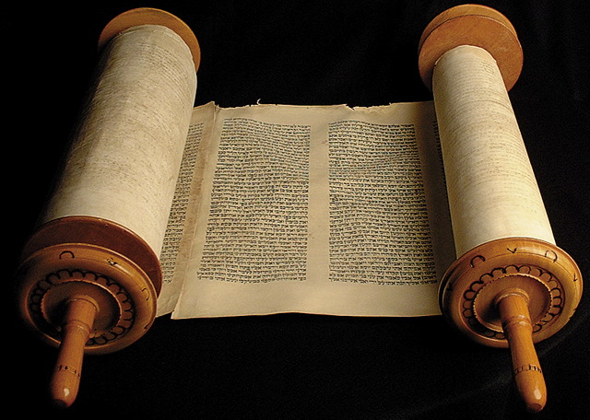
Luke 14
²⁵ Now great multitudes went with Him. And He turned and said to them, ²⁶ “If anyone comes to Me and does not hate his father and mother, wife and children, brothers and sisters, yes, and his own life also, he cannot be My disciple. ²⁷ And whoever does not bear his cross and come after Me cannot be My disciple.

Slide 3
Luke 4
¹⁴ Then Jesus returned in the power of the Spirit to Galilee, and news of Him went out through all the surrounding region. ¹⁵ And He taught in their synagogues, being glorified by all.
²⁰ …And the eyes of all who were in the synagogue were fixed on Him. ²¹ And He began to say to them, “Today
this Scripture is fulfilled in your
hearing.” ²² So all bore witness
to Him, and marveled at the
gracious words which
proceeded out of His mouth.

Slide 4
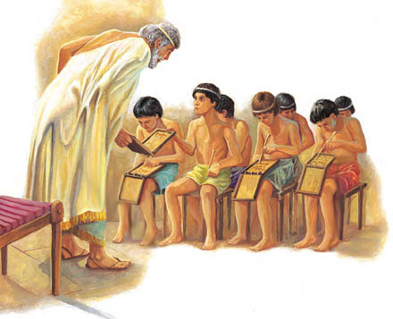
The Exemplary School
The Headmaster
  His Charisma
  His Wisdom
  His Wealth
  His Charity
Conditions of Enrollment
  Certificate of “Good Conduct”
  The Oath
The Curriculum
  Sanctification
  Consecration
The Results
  Literary Blessings
  Spiritual Blessings

Slide 5
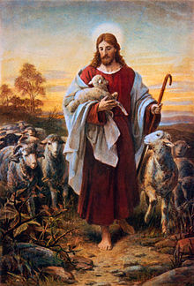
The Headmaster: Charisma
His Charisma
  Now great multitudes went with Him. (Lk 14:25)
Why?
  Good Shepherd, Successful Instructor, Profitable Merchant
  He makes me to lie down in
  green pastures;
  He leads me beside the still waters.
  (Ps 23:1)

Slide 6
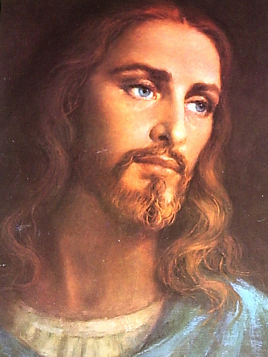
The Headmaster: Charisma
¹⁰ My beloved is white and ruddy,
Chief among ten thousand.
¹¹ His head is like the finest gold;
His locks are wavy, And black as a raven.
¹² His eyes are like doves, By the rivers of waters, Washed with milk, And fitly set.
¹³ His cheeks are like a bed of spices,
Banks of scented herbs.
His lips are lilies, Dripping liquid myrrh.
¹⁴ His hands are rods of gold, Set with beryl.
His body is carved ivory, Inlaid with sapphires.
¹⁵ His legs are pillars of marble, Set on bases of fine gold.
His countenance is like Lebanon,
Excellent as the cedars.
¹⁶ His mouth is most sweet, Yes, he is altogether lovely.

Slide 7
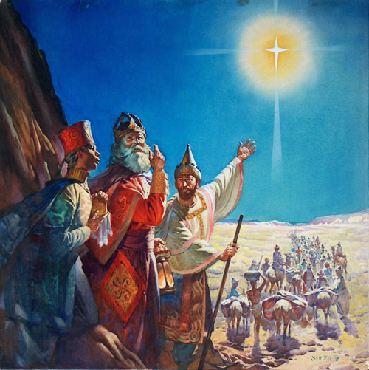
The Headmaster: Charisma
International Appeal
  After these things I looked, and behold, a great multitude which no one could number, of all nations, tribes, peoples, and tongues, standing before the throne and before the Lamb… (Rev 7)
Three wise men (legend):
  Persian elder
  Egyptian youth
  Greek lad

Slide 8

The Headmaster: Wisdom
I, wisdom, dwell with prudence, And find out knowledge and discretion. (Prov 8)
Counsel is mine, and sound wisdom;
I am understanding, I have strength. (Prov 8)
Wisdom has built her house, She has hewn out her seven pillars; (Prov 9)

Slide 9
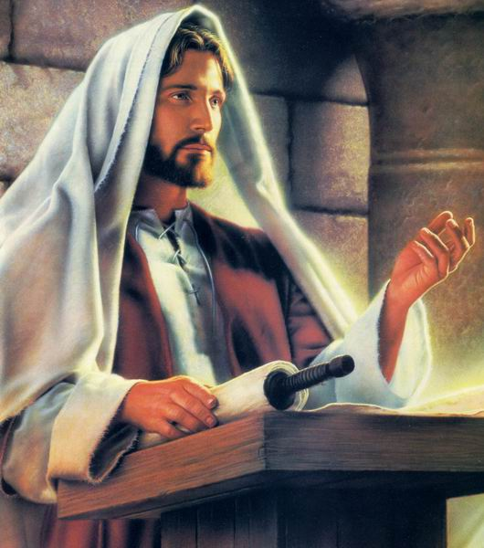
The Headmaster: Wisdom
“Great is the wisdom displayed in His instruction, and manifold the modes of His dealing in order to salvation. For the Instructor testifies to the good, and summons forth to better things those that are called; dissuades those that are hastening to do wrong from
the attempt, and exhorts
them to turn to a better life.” (Clement of Alexandria, The Paedagogus [Instructor])

Slide 10
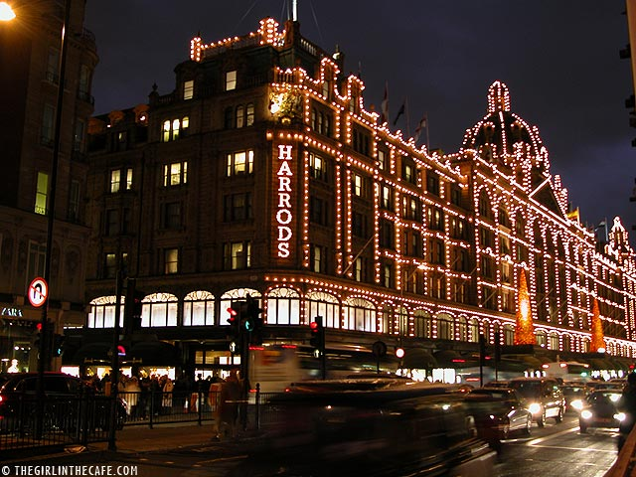
The Headmaster: Wealth
The rich Shepherd:
  The Lord is my shepherd; I shall not want.
Harrods, London:
  seven floors
  4.5 acres
  25K customers / day
  5K workers
  Nothing compared to
  our Headmaster’s storehouse
  You will show me the path of life;
  In Your presence is fullness of joy;
  At Your right hand are pleasures forevermore.
  (Ps 16:11)

Slide 11

The Headmaster: Charity
Philanthropy: altruistic (unselfish) concern for human welfare and advancement, usually manifested by donations of money, property, or work to needy persons...
American Public schools: 1840
Christ’s pubic school: 2000 years

Slide 12
The Headmaster: Charity
Motto: “Freely you have received, freely give.” (Matt 8:10)
All courses and resources:
  “…being justified freely by His grace through the redemption that is in Christ Jesus” (Rom 3:24)
  “…I preached the gospel of God to you free of charge?” (2Cor 11:7)
Free Admission:
  “I am the Alpha and the Omega, the Beginning and the End. I will give of the fountain of the water of life freely to him who thirsts.” (Rev 21)

Slide 13

The Headmaster: Charity
“Ho! Everyone who thirsts,
Come to the waters;
And you who have no money,
Come, buy and eat.
Yes, come, buy wine and milk
Without money and without price. (Isa 55:1)
Free school… just come… apply… get in…
[Wisdom] cries out from the highest places of the city, ⁴ “Whoever is simple, let him turn in here!” As for him who lacks understanding, she says to him, ⁵ “Come, eat of my bread, and drink of the wine I have mixed.
⁶ Forsake foolishness and live, And go in the way of understanding. (Prov 9)

Slide 14
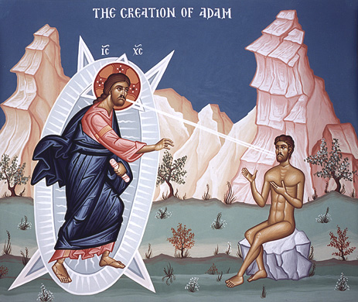
The Headmaster: Charity
The Lord ministers all good and all help, both as man and as God: as God, forgiving our sins; and as man, training us not to sin. Man is therefore justly dear to God, since he is His workmanship. The other works of creation He made by the word of command alone, but man He framed by Himself, by His own hand, and breathed into him what was peculiar to Himself.
If, then, man is an object desirable
for itself, then He who is good loved
what is good, and the love-charm is
within even in man, and is that very
thing which is called the inspiration
[or breath] of God;
(Clement of Alexandria,
The Paedagogus [Instructor])

Slide 15
The Exemplary School
The Headmaster
  His Charisma
  His Wisdom
  His Wealth
  His Charity
Conditions of Enrollment
The Curriculum
The Results

Slide 16
Enrollment:
Certificate of “Good Conduct”
Obedience, moral conduct, ethics, honor
  ²² “For if you carefully keep all these commandments which I command you to do—to love the Lord your God, to walk in all His ways, and to hold fast to Him— ²³ then the Lord will drive out all these nations from before you, and you will dispossess greater and mightier nations than yourselves… ²⁵ No man shall be able to stand against you; the Lord your God will put the dread of you and the fear of you upon all the land where you tread, just as He has said to you. (Deut 11)

Slide 17
Enrollment:
Certificate of “Good Conduct”
Jehoshaphat - had the certificate:
  ³ Now the Lord was with Jehoshaphat, because he walked in the former ways of his father David; he did not seek the Baals, ⁴ but sought the God of his father, and walked in His commandments and not according to the acts of Israel… ⁶ And his heart took delight in the ways of the Lord. (2Chr 17)
He enrolled in the school and succeeded
  ⁵ Therefore the Lord established the kingdom in his hand; and all Judah gave presents to Jeho-shaphat… ¹⁰ And the fear of the Lord fell on all the kingdoms of the lands that were around Judah, so that they did not make war against Jehoshaphat.

Slide 18
Enrollment:
Certificate of “Good Conduct”
Saul of Tarsus: zealous, although mis-guided
  Obedience -
  “Lord, what do You want me to do?” (Acts 9)
  Enrolled and succeeded: “I can do all things through Christ who strengthens me.” (Phil 4:13)
“Noah walked with God.” (Gen 6)
“Abel … obtained witness that he was righteous” (Heb 11:4)
Rechabites: “We will drink no wine, for Jonadab the son of Rechab, our father, commanded us, saying, ‘You shall drink no wine, you nor your sons, forever.” (Jer 35)

Slide 19
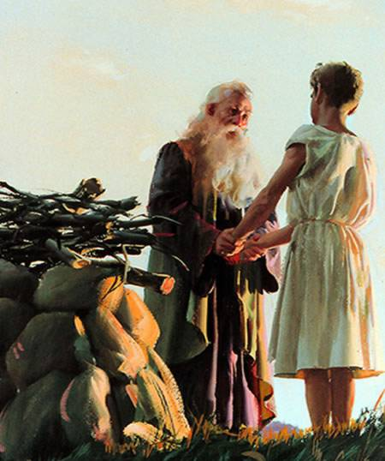
Enrollment:
Certificate of “Good Conduct”
Abram’s certificate of obedience:
  “Get out of your country, From your family
  And from your father’s house,
  To a land that I will show you.” (Gen 12)
The toughest exam question ever!
  “Take now your son, your only
  son Isaac, whom you love, and
  go to the land of Moriah, and
  offer him there as a burnt
  offering on one of the mountains
  of which I shall tell you.” (Gen 22)

Slide 20
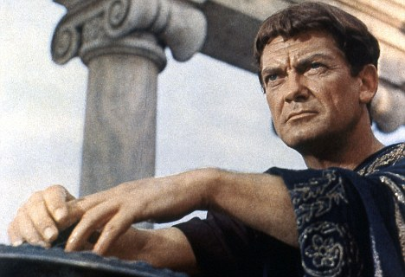
Enrollment:
Certificate of “Good Conduct”
Students who failed to secure the certificate
King Saul:
  So Samuel said: “Has the LORD as great delight in burnt offerings and sacrifices, as in obeying the voice of the LORD? Behold, to obey is better than sacrifice, And to heed than the fat of rams. (1Sam 15)
Lot’s Wife
Pontius Pilate
Story: boy in Sunday School
“My mother told me to go home right away”

Slide 21
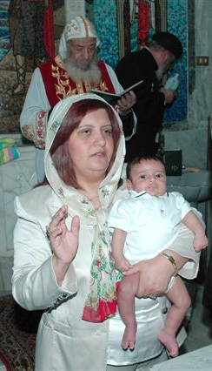
Enrollment: Oath
First Oath: Accept God
  I renounce you Satan, and all your
  unclean works, and all your wicked
  angels and all your evil demons…
  I profess You, O Christ my God, and all Your saving laws, and all Your quickening service, and all Your life giving works.
  I believe in one God, God the Father the Pantocrator, and his Only-begotten Son Jesus Christ our Lord, and the Holy, life-giving Spirit, and the resurrection of the flesh, and the one only holy catholic and apostolic Church.

Slide 22
Enrollment: Oath
Second Oath: God First
  “He who loves father or mother more than Me is not worthy of Me. And he who loves son or daughter more than Me is not worthy of Me.” (Matt 10)
  “But seek first the kingdom of God and His righteousness, and all these things shall be added to you.” (Matt 6:33)
  But from there you will seek the LORD your God, and you will find Him if you seek Him with all your heart and with all your soul. (Deut 4:29)
  “Your face, LORD, I will seek.” (Ps 27:8)
  “With my soul I have desired You in the night, Yes, by my spirit within me I will seek You early” (Isa 26:9)

Slide 23
Enrollment: Oath
Third Oath: Trust the Lord
  “In the LORD I put my trust” (Ps 11:1)
  “And those who know Your name will put their trust in You; For You, LORD, have not forsaken those who seek You.” (Ps 9:10)
  “Some trust in chariots, and some in horses;
  But we will remember the name of the Lord our God. They have bowed down and fallen;
  But we have risen and stand upright.” (Ps 20)
  “Trust in the Lord with all your heart,
  And lean not on your own understanding”
  (Prov 3)

Slide 24
Enrollment: Oath
Fourth Oath: Do Work (Free Enrollment but…)
  Dues:
    “He who does not take his cross and follow after Me is not worthy of Me.”
    “He who finds his life will lose it, and he who loses his life for My sake will find it.”
  Deeds:
    “Even a child is known by his deeds, Whether what he does is pure and right.” (Prov 20:11)
    ‘Come, you blessed of My Father…³⁵ for I was hungry and you gave Me food; I was thirsty and you gave Me drink; I was a stranger and you took Me in; ³⁶ I was naked and you clothed Me; I was sick and you visited Me; I was in prison and you came to Me.’ (Matt 25)

Slide 25
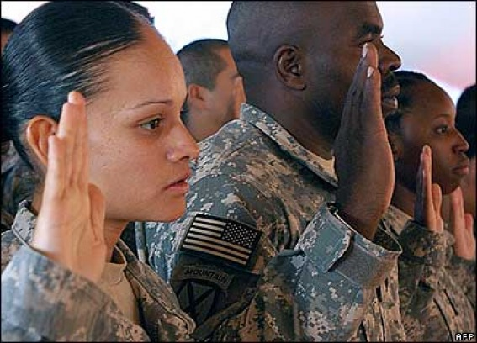
The Exemplary School
The Headmaster
  His Charisma
  His Wisdom
  His Wealth
  His Charity
Conditions of Enrollment
  Certificate of “Good Conduct”
  Take the Oath
    Accept God
    God First
    Trust God
    Do Work
The Curriculum
The Results

Slide 26
Curriculum: Sanctification
The teacher: The Most Holy
Sanctification against the self
  “If anyone comes to Me and does not hate his father and mother, wife and children, brothers and sisters, yes, and his own life also, he cannot be My disciple. (Lk 14:26)
Hating desires and ego
Curriculum of Fasting:
  Allows the Spirit to overcome the
  desires of the body

Slide 27
Curriculum: Sanctification
“For the flesh lusts against the Spirit, and the Spirit against the flesh; and these are contrary to one another” (Gal 5:17)
Therefore “Come out from among them. And be separate”, says the Lord… Therefore, having these promises, beloved, let us cleanse ourselves from all filthiness of the flesh and spirit, perfecting holiness in the fear of God. (2Cor 16)
”But as He who called you is holy, you also be holy in all your conduct, because it is written, “Be holy, for I am holy.” (1Pet 1:15-16)

Slide 28
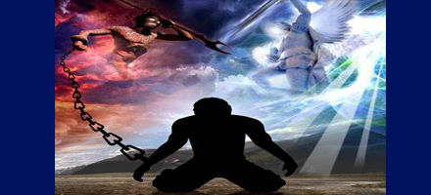
Curriculum: Sanctification
Self-Denial
  ³⁴ “Whoever desires to come after Me, let him deny himself, and take up his cross, and follow Me.
  ³⁵ For whoever desires to save his life will lose it, but whoever loses his life for My sake and the gospel’s will save it. (Mark 8)

Slide 29
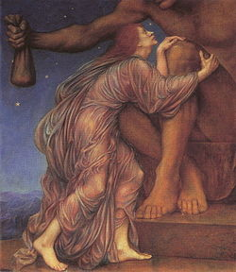
Curriculum: Sanctification
Sanctification against mammon
“whoever of you does not forsake all that he has cannot be My disciple.” (Lk 14:33)
Mammon is a god:
  “No one can serve two masters; for either he will hate the one and love the other, or else he will be loyal to the one and despise the
  other. You cannot serve
  God and mammon. (Matt 6:24)

Slide 30
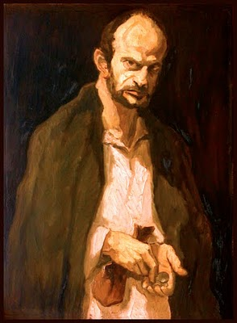
Curriculum: Sanctification
Judas’ issue is our issue
  Not lack of faith, but greediness
  Selling the Lord
  “Let Judas Iscariot be ashamed for
  his bishopric has been given to
  another. And his evil wife became blind because she counseled him
  to take the silver.”
  (Resurrection Exposition)
  “For the love of money is a root of all kinds of evil, for which some have strayed from the faith in their greediness, and pierced themselves through with many sorrows.” (1Tim 6:10)

Slide 31
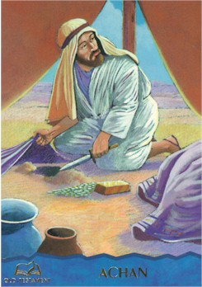
Curriculum: Sanctification
Students who failed this course:
Jacob – lies, trickery
Achan the son of Carmi - (Jos 7)
  “There is an accursed thing in your midst,
  O Israel; you cannot stand before your
  enemies until you take away the
  accursed thing from among you.”
Balaam –
  “Loved the wages of unrighteousness” (2 Pet 2:15)
Ananias and Sapphira (Acts 5)
Gehazi (2 Kings 5)
Judas Iscariot

Slide 32
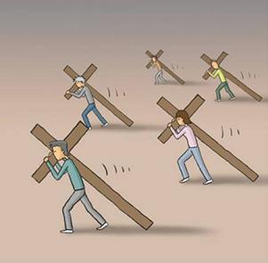
Curriculum: Consecration
Carrying the Cross – practically
  “Whoever does not bear his cross and come after Me cannot be My disciple.” (Lk 14:27)
Not denying the Lord before others
  “But he who denies Me before men will be denied before the angels of God.” (Lk 12:9)
  “¹⁴ If you are reproached for the name of Christ, blessed are you, for the Spirit of glory and of God rests upon you. On their part He is blasphemed, but on your part He is glorified…¹⁶ Yet if anyone suffers as a Christian, let him not be ashamed, but let him glorify God in this matter.” (1Pet 4)

Slide 33
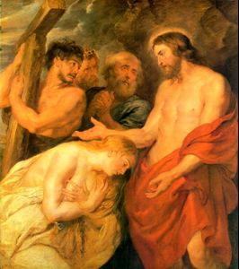
Curriculum: Consecration
Simon of Cyrene
  “Now as they led Him away, they laid hold of a certain man, Simon a Cyrenian, who was coming from the country, and on him they laid the cross that he might bear it after Jesus.” (Lk 23:26)
  Now as they came out, they found a man of Cyrene, Simon by name. Him they compelled to bear His cross. (Matt 27:32)
Carrying the Cross:
  Involuntary; compulsion, obedience
  Only a small distance left
  Inglorious task:
    He was met with jeers and boos
    Defilement, can not keep Passover

Slide 34
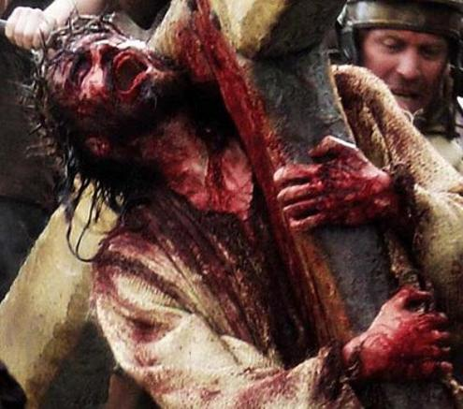
Curriculum: Consecration
Carrying the Cross – symbolically
  Cross: pain, suffering, persecution
    “…tribulation, distress, persecution, famine, nakedness, peril, sword”
    (Rom 8:35)
  A “gift”
    “For to you it has been granted on behalf of Christ, not only to believe in Him, but also to suffer for His sake”
    (Phil 1:29)

Slide 35

Curriculum: Consecration
Carrying the Cross – symbolically
  Florence Nightingale and the wounded soldier
  ''Prosperity is the blessing of the Old Testament; adversity is the blessing of the New.'' (Francis Bacon)

Slide 36
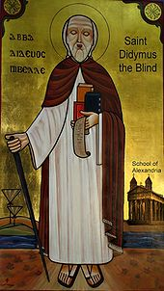
Curriculum: Consecration
St. Didymus the Blind (successful student)
  Despite his impaired vision, his memory was so powerful that he mastered dialectics and geometry.
  He wrote many works.
  Dean of Catechetical School of Alexandria
  He developed a system of carved wooden letters, akin to Braille systems.
  “The perception of the sun by an
  astronomer and by a scientist is far
  inferior to the seeing of the invisible God
  and it is inferior to the knowledge that
  comes from God.”

Slide 37
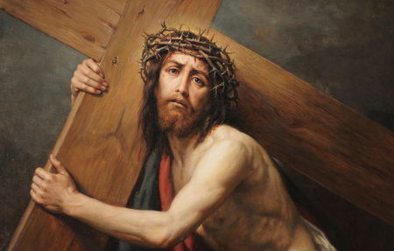
The Exemplary School
The Headmaster
Conditions of Enrollment
The Curriculum
  Sanctification
    Against Self
    Against mammon
  Consecration
    Carrying the Cross – Practically
    Carrying the Cross – symbolically
The Results

Slide 38

Results: Literary Blessings
Guaranteed success: 100%
Salt and Light (Matt 5):
  “You are the salt of the earth;”
  “You are the light of the world.”
Salt to season the world around us
  “The Lord GOD has given Me The tongue of the learned, That I should know how to speak A word in season to him who is weary.” (Isa 50:4)
Light to enlighten the darkness of the world
  “The people who walked in darkness Have seen a great light; Those who dwelt in the land of the shadow of death, Upon them a light has shined.” (Isa 9:2)

Slide 39
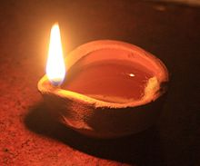
Results: Literary Blessings
Salt and Light inside the house first:
  “You may discern the hypocrite: In the
  church, he appears as an angel, he
  does not cease calling the Name of
  Christ, he soars to Heaven on Sundays, and especially during the Lord’s Supper; but at home, he is a demon. If a man is a demon at home, he is a demon everywhere!” (Thomas the Elder)
Shameful to put out our light at home
  “Nor do they light a lamp and put it under a basket, but on a lampstand, and it gives light to all who are in the house.” (Matt 5:15)

Slide 40
Results: Literary Blessings
Be Christ-like
  “I like your Christ. I do not like your Christians. Your Christians are so unlike your Christ.” (Gandhi)
  “My prayer is not be called Christian, but to be Christian.” (St. Ignatius of Antioch)
  “²Set your mind on things above, not on things on the earth. ³ For you died, and your life is hidden with Christ in God… ⁵ Therefore put to death your members which are on the earth: fornication, uncleanness, passion, evil desire, and covetousness, which is idolatry… ⁸ But now you yourselves are to put off all these: anger, wrath, malice, blasphemy, filthy language out of your mouth…(Col 3)

Slide 41
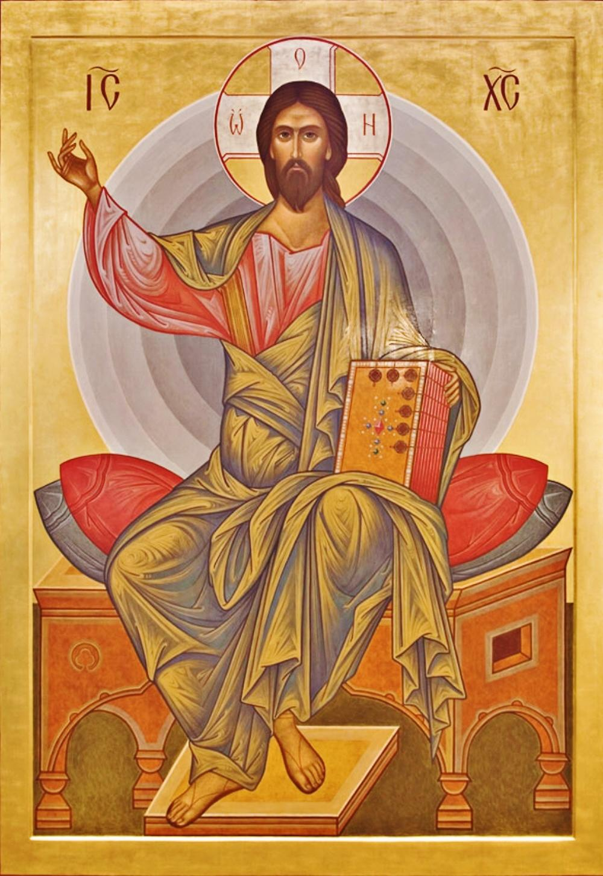
Results: Spiritual Blessings
Christ: King of our life
  “When Christ who is our life appears, then you also will appear with Him in glory.” (Col 3:4)
  “The Lord is my light and my salvation; Whom shall I fear?
  The Lord is the strength of my life;
  Of whom shall I be afraid?” (Ps 27:1)
  Story: “What if God descended to Hades?”

Slide 42

Results: Spiritual Blessings
Perpetual Blessings
  “The righteous shall inherit the land, And dwell in it forever.” (Ps 37:29)
  “I will betroth you to Me forever; Yes, I will betroth you to Me In righteousness and justice, In lovingkindness and mercy; (Hos 2:19)

Slide 43
Results: Spiritual Blessings
Graduates vs. Dropouts
Jacob: “Blessed is … Israel My inheritance.” (Isa 19:25) | Esau: “I will also stretch out My hand against Edom, cut off man and beast from it, and make it desolate…” (Eze 25:13)
Samuel: “…Samuel was among those who called upon His name; They called upon the LORD, and He answered them.” (Ps 99:6) | Eli: “…the iniquity of Eli’s house shall not be atoned for by sacrifice or offering forever.” (1Sam 3:11)
David : “The throne of David shall be established before the LORD forever.” (1Ki 2:45) | Saul: Then Samuel said [to Saul]: “So why do you ask me, seeing the LORD has departed from you and has become your enemy? (1Sam 28:16)
Peter: “… you are Peter, and on this rock I will build My church.” (Matt 16:18) | Judas: ‘Let his dwelling place be desolate, And let no one live in it’; ‘Let another take his office.’”(Act 1:20)

Slide 44
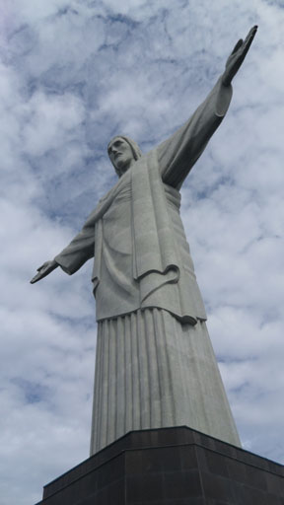
The Exemplary School
The Headmaster
Conditions of Enrollment
The Curriculum
  Sanctification
    Against Self
    Against Mammon
  Consecration
    Carrying the Cross – Practically
    Carrying the Cross – symbolically
The Results
  Literary Blessings
    Salt and Light
  Spiritual Blessings
    Christ: King of our life
    Perpetual Blessings

