Slide 1
Christ: The bright and morning star

Slide 2
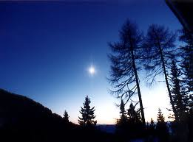
Introduction
“I, Jesus, have sent My angel to testify to you these things in the churches. I am the Root and the Offspring of David, the Bright and Morning Star.” (Rev 22:16)

Slide 3
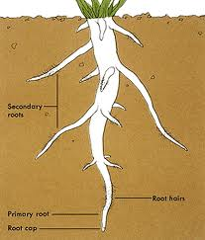
I am the Root…
He did not say, “I am the branch that has sprung from the root of David.”
Calls Himself “the Root”.
He is the cause of all things
  “How then does David in the Spirit call Him ‘Lord,’ saying: ‘The Lord said to my Lord, “Sit at My right hand, till I make Your enemies Your footstool”’? If David then calls Him ‘Lord,’ how is He his Son?”
Notes:
Calls Himself THE Root not A Root.

Slide 4
…and the Offspring of David
He is Root by Divinity
He is Offspring through Humanity
“and” refers to the perfect unity
Mia Physis Tou Theou Logou Sesarkwmene
  “One Nature of God the Incarnate Logos”
  We confess, therefore, our Lord Jesus Christ, the Only Begotten Son of God, perfect God, and perfect Man of a reasonable soul and flesh consisting; begotten before the ages of the Father according to his Divinity, and in the last days, for us and for our salvation, of Mary the Virgin according to his humanity, of the same substance with his Father according to his Divinity, and of the same substance with us according to his humanity; for there became a union of two natures. Wherefore we confess one Christ, one Son, one Lord. (St. Cyril of Alexandria)

Slide 5
The Bright One
“And you, child, will be called the prophet of the Highest; for you will go before the face of the Lord to prepare His ways, to give knowledge of salvation to His people by the remission of their sins, through the tender mercy of our God, with which the Dayspring from on high has visited us; to give light to those who sit in darkness and the shadow of death, to guide our feet into the way of peace.” (Luke 1:76-79)
We are called to reflect His light in darkness
Do I get weary when service becomes difficult or seems fruitless?

Slide 6
The Bright One
“This man came for a witness, to bear witness of the Light, that all through him might believe. He was not that Light, but was sent to bear witness of that Light. That was the true Light which gives light to every man coming into the world. (John 1:7-9)
The Lord Christ is “the Bright and Morning Star,” not “a bright morning star”
“I am the light of the world.” (John 8:12)
  Emanation or radiation?

Slide 7
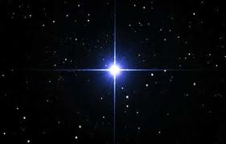
The Star
“I see Him, but not now; I behold Him, but not near; A Star shall come out of Jacob; A Scepter shall rise out of Israel…” (Num 24:17)
  Prophecy of the Lord Christ’s birth
“When they heard the king, they departed; and behold, the star which they had seen in the East went before them, till it came and stood over where the young Child was. 10 When they saw the star, they rejoiced with exceedingly great joy.” (Matt 2:9-10)
“There is one glory of the sun, another glory of the moon, and another glory of the stars; for one star differs from another star in glory.”
(1 Cor 15:41)
  St. Paul is referring to the glorified body

Slide 8
Who is the Morning Star?
Isaiah 14:12
  “How art thou fallen from heaven, O Lucifer, son of the morning! how art thou cut down to the ground, which didst weaken the nations!” (KJV)
  “How you have fallen from heaven, morning star, son of the dawn! You have been cast down to the earth, you who once laid low the nations!” (NIV)
  “How you are fallen from heaven, O Lucifer, son of the morning! How you are cut down to the ground, You who weakened the nations!” (NKJV)
  Lucifer = morning star (Hebrew)

Slide 9
Who is the Morning Star
The antichrist will claim to be Christ
“Now the beast which I saw was like a leopard, his feet were like the feet of a bear, and his mouth like the mouth of a lion. The dragon gave him his power, his throne, and great authority. And I saw one of his heads as if it had been mortally wounded, and his deadly wound was healed. And all the world marveled and followed the beast. So they worshiped the dragon who gave authority to the beast; and they worshiped the beast, saying, ‘Who is like the beast? Who is able to make war with him.’” (Rev 13:2-4)

Slide 10
Who is the Morning Star
“Then I saw another beast coming up out of the earth, and he had two horns like a lamb and spoke like a dragon. And he exercises all the authority of the first beast in his presence, and causes the earth and those who dwell in it to worship the first beast, whose deadly wound was healed. He performs great signs, so that he even makes fire come down from heaven on the earth in the sight of men. And he deceives those who dwell on the earth by those signs which he was granted to do in the sight of the beast, telling those who dwell on the earth to make an image to the beast who was wounded by the sword and lived.” (Rev 13:11-14)
Notes:
This beast ministers with propaganda

Slide 11
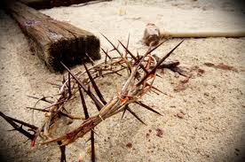
Who is the Morning Star
Satan tries to imitate the Trinity
  Dragon – Father
  Beast of the Sea – Son
  Beast of the Earth – Holy Spirit
Satan exalted himself, then humbled
The true Morning Star was humbled, then exalted
“And whoever exalts himself will be humbled, and he who humbles himself will be exalted.” (Matt 23:12)

Slide 12
Who is the Morning Star
Satan appears good at night, but goes down in flames in the morning.
The Lord Christ was in the tomb at night, but rose in the morning.
Satan was interested in immediate glory
The Lord Christ was interested in spreading the good news of salvation
Whom can I relate to my life?
  Encourage others to follow the Lord Christ
  Grab all you can now

Slide 13
Sharing the light
“And so we have the prophetic word confirmed, which you do well to heed as a light that shines in a dark place, until the day dawns and the morning star rises in your hearts…” (1 Pet 1:19)
The world is dark (temptations)
What would become without the prophetic word?
Will the word always be necessary?
  Until daylight comes
  The Lord Christ did not give them Scripture but waited until He ascended and gave them the Holy Spirit – worked through them

Slide 14
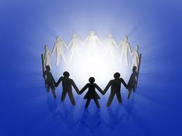
Sharing the light
“Go into all the world and preach the gospel to every creature.”
(Mark 16:15)
  We have a nightlight (the gospel)
  Is a nightlight always needed?
Compare ourselves with:
  Ungodly – we are the very daylight
    “Let your light so shine before men…”
  With what we shall be – we are still in darkness

Slide 15
Hold Fast
“ And to the angel of the church in Thyatira write, ‘These things says the Son of God, who has eyes like a flame of fire, and His feet like fine brass: “ I know your works, love, service, faith, and your patience; and as for your works, the last are more than the first. Nevertheless I have a few things against you, because you allow that woman Jezebel, who calls herself a prophetess, to teach and seduce My servants to commit sexual immorality and eat things sacrificed to idols. And I gave her time to repent of her sexual immorality, and she did not repent. Indeed I will cast her into a sickbed, and those who commit adultery with her into great tribulation, unless they repent of their deeds. I will kill her children with death, and all the churches shall know that I am He who searches the minds and hearts. And I will give to each one of you according to your works.”

Slide 16
Hold Fast
“Now to you I say, and to the rest in Thyatira, as many as do not have this doctrine, who have not known the depths of Satan, as they say, I will put on you no other burden. But hold fast what you have till I come. And he who overcomes, and keeps My works until the end, to him I will give power over the nations—’He shall rule them with a rod of iron; They shall be dashed to pieces like the potter's vessels’ — as I also have received from My Father; and I will give him the morning star.” (Rev 2:18-28)

Slide 17
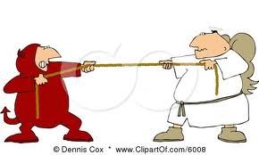
Hold Fast
We are in a tug-of-war battle with Satan
Satan often tempts us with “take a rest”
  Hold fast to Scripture and spiritual readings
  “Till I come, give attention to reading, to exhortation, to doctrine.” (1 Tim 4:13)
  [Lawyer] “What shall I do to inherit eternal life?”
  [The Lord Christ] “What is written in the law? What is your reading of it?”

Slide 18
Hold Fast
Hold fast to prayer
  What is our understanding of prayer?
  Illustration: Presidential banquet
  We are honored in prayer
  God does not get upset, but we are at a loss
  I have sinned; I can’t pray – I have sinned; I need to pray
Prayer moves the hand that moves the world

Slide 19
Questions?

