Slide 1
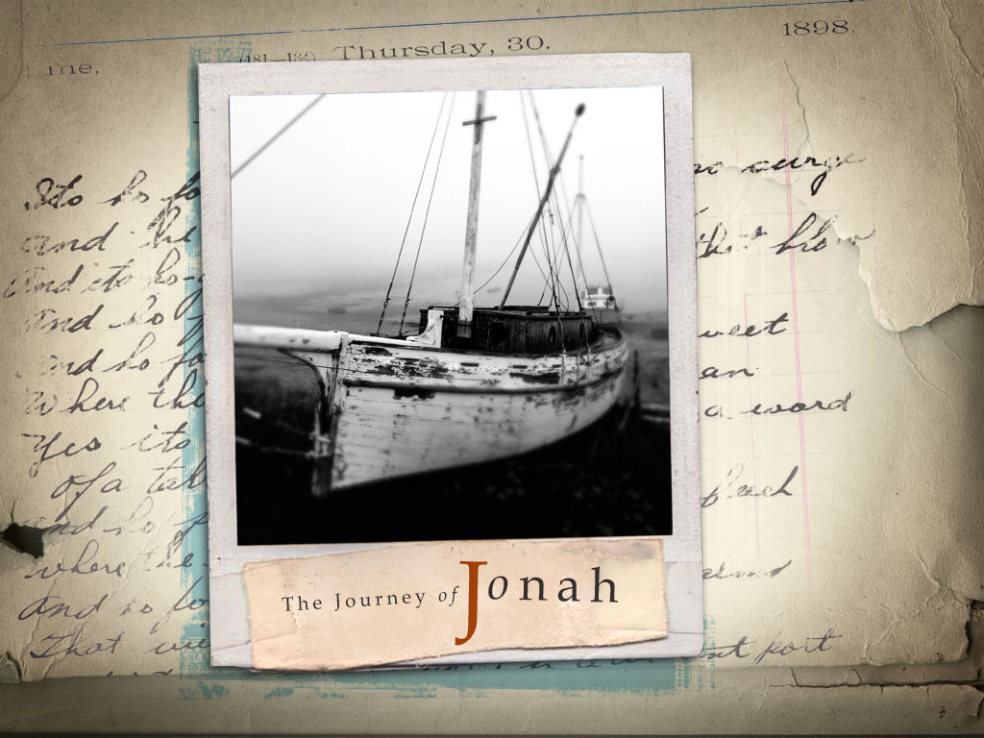

Slide 2
Lessons from Jonah
College and Beyond

Slide 3
Outline
Overview of the Story of Jonah
Lessons to Learn
  Forgiveness for All
  The trap of self-righteousness
  Abounding in Love
Conclusion

Slide 4
Background on Jonah
Jonah was a prophet during the reign of Jeroboam II in Israel. (2 Kings 14:25)
He was told to deliver a message to Nineveh, the capital of the Assyrian empire, a nation that was extorting large sums of protection money from Jonah’s country.
  - History records that the Assyrians were a brutal and wicked nation.
  - They savagely destroyed all who opposed them, not just the men, but the women and children as well.

Slide 5
The Story of Jonah
Chapter 1 – Jonah tries to escape God
  Instructions from God
  Jonah’s disobedience to God
  God’s warning to Jonah
  Jonah’s protection in the great fish (Is this punishment?)
Chapter 2 – The prayer of Jonah
  Need of Prayer
  Confidence in Prayer
  Answering of his Prayer
Chapter 3 – Repentance of the Ninevites
  Jonah preaches
  Ninevites Repent
  Result of Repentance
Chapter 4 – Jonah’s unhappiness

Slide 6
Current Events
While an evil nation may exist for a time, they are not assured of continuance. (Proverbs 14:34)
  A nation that will not serve God will be uprooted. (Isaiah 60:12)
  God will uproot any nation that does not listen to Him. (Jeremiah 12:14-17)
  No nation is so great that God cannot and will not bring low.
“Then God saw their works, that they turned from their evil way; and God relented from the disaster that He had said He would bring upon them, and He did not do it.” (Jonah 3:10)

Slide 7
Forgiveness for All – Not for ME Only
The unforgiving servant (Matthew 18:21-28)
The servant fell on his knees before him. `Be patient with me,' he begged, `and I will pay back everything.' The servant's master took pity on him, canceled the debt and let him go. But when that servant went out, he found one of his fellow servants who owed him a hundred denarii. He grabbed him and began to choke him. `Pay back what you owe me!' he demanded.
“So My heavenly Father also will do to you if each of you, from his heart, does not forgive his brother his trespasses.” (Matthew 18:34-35)
“…for I know that You are a gracious and merciful God, slow to anger and abundant in lovingkindness, One who relents from doing harm.” (Jonah 4:1)

Slide 8
The trap of self-righteousness
We stay on the straight and narrow. We know that what we do is pleasing to God.
When we see how the lost are ruining themselves, it is easy to fall in the snare of pride.
  Our focus becomes what I want, what I need, instead of looking out for the needs of others.
  Unity Through Humility (Phil 2:3-4)
The disciples fell into this trap. (Luke 9:51-54)
This is the trap Jonah fell in. Jonah was not interested in their salvation.
Then the LORD said, “Is it right for you to be angry?” (Jonah 4:4)

Slide 9
Abounding in Love
By this we become like our Father: “…and you will be sons of the Most High. For He is kind to the unthankful and evil” Luke 6:32-35
Because our reward is from Him: “But love your enemies, do good, and lend, hoping for nothing in return; and your reward will be great” Luke 6:35
Because love never fails: “Cast your bread upon the waters, For you will find it after many days.” Ecclesiastes 11:1
“My little children, let us not love in word
or in tongue, but in deed and in truth.”
1 John 3:18
“Salvation comes from the LORD.” (Jonah 2:9)

Slide 10
Conclusion
God’s Grace
Mercy: “It does not, therefore, depend on man’s desire or effort, but on God’s mercy”
(Romans 9:14-16).
Love: “I now realize how true it is that God does not show favoritism” (Acts 10:34-35; Peter after his vision in Joppa, where Jonah boarded ship).
All peoples, not just one people
Luke Chapter 11 sequence of events

Slide 11
Greater than Jonah
"A wicked and adulterous generation asks for a miraculous sign! But none will be given it except the sign of the prophet Jonah. For as Jonah was three days and three nights in the belly of a huge fish, so the Son of Man will be three days and three nights in the heart of the earth. The men of Nineveh will stand up at the judgment with this generation and condemn it; for they repented at the preaching of Jonah, and now one greater than Jonah is here
(Matthew 12:39-41).
Jonah’s confession for our repentance

