Slide 1
Jabez
Servants’ Meeting
October 2, 2011

Slide 2
Jabez
Meaning of his name and background
Dealing with difficulties and challenges
The Prayer of Jabez
“Oh that you would bless me… that Your hand would be with me”
“enlarge my territory”
“keep me from evil, that it may not grieve me”
Prosperity Theology

Slide 3
Name and Background
“he makes sorrowful” or “he makes pain”
Rising above his circumstances

Slide 4
Dealing with Difficulties and Challenges
We all have our own
“I cannot because…”
Those who overcame their challenges

Slide 5
The Prayer: 1 Chronicles 4:9-10
NIV Jabez was more honorable than his brothers. His mother had named him Jabez, saying, “I gave birth to him in pain.” Jabez cried out to the God of Israel, “Oh, that you would bless me and enlarge my territory! Let your hand be with me, and keep me from harm so that I will be free from pain.” And God granted his request. | KJV And Jabez was more honourable than his brethren: and his mother called his name Jabez, saying, Because I bare him with sorrow. And Jabez called on the God of Israel, saying, Oh that thou wouldest bless me indeed, and enlarge my coast, and that thine hand might be with me, and that thou wouldest keep me from evil, that it may not grieve me! And God granted him that which he requested. | RSV Jabez was more honorable than his brothers; and his mother called his name Jabez, saying, "Because I bore him in pain." Jabez called on the God of Israel, saying, "Oh that thou wouldst bless me and enlarge my border, and that thy hand might be with me, and that thou wouldst keep me from harm so that it might not hurt me!" And God granted what he asked. | NKJV Now Jabez was more honorable than his brothers, and his mother called his name Jabez, saying, “Because I bore him in pain.” And Jabez called on the God of Israel saying, “Oh, that You would bless me indeed, and enlarge my territory, that Your hand would be with me, and that You would keep me from evil, that I may not cause pain!” So God granted him what he requested.

Slide 6
“Oh that you would bless me… that Your hand would be with me”
Shows the quality of his character
Meekness and humility
I am not self-sufficient
Nothing can be done independent of the Lord

Slide 7
“enlarge my territory”
Two ways to understand
  “to redeem those who were under the law, that we might receive the adoption as sons. And because you are sons, God has sent forth the Spirit of His Son into your hearts, crying out, ‘Abba, Father!’” (Galatians 4:5-6)
  Comfort Zone problem
Enlarging our hearts
  “O Corinthians! We have spoken openly to you, our heart is wide open. You are not restricted by us, but you are restricted by your own affections. Now in return for the same (I speak as to children), you also be open.”
  (2 Cor 6:11-14)
  “I will run the course of Your commandments, For You shall enlarge my heart.” (Psalm 119:32)

Slide 8
“enlarge my territory”
Enlarge our vision
  “The utterance of him who hears the words of God, Who sees the vision of the Almighty, Who falls down, with eyes wide open” (Numbers 24:4)
Enlarge our scope of activity
Enlarge our influence

Slide 9
“keep me from evil, that it may not grieve me”
Similar to end of the Lord’s Prayer
  “lead us not into temptation, but deliver us from the evil one”
He was aware of the consequence of evil and sin
This, too, reveals to us the quality of his character and his desire for righteousness

Slide 10
Prosperity Theology
Claims that the Bible teaches that financial blessing is the will of God for Christians
A combination of faith, positive speech, and donations to Christian ministries will always cause an increase in material wealth for those who practice these actions

Slide 11
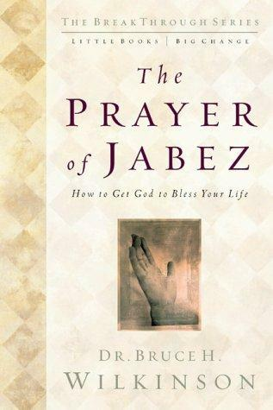
Prosperity Theology

