Slide 1
Christianity: Understanding our Faith

Slide 2
Introduction
Science and Faith
Scientific Truth in the Bible
Example: Big Bang Theory

Slide 3
Science and Faith

Slide 4
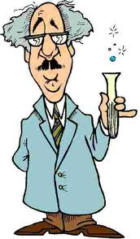
What is science?
Science is an enterprise that builds and organizes knowledge in the form of testable explanations and predictions about the world. Wikipedia
Aristotle believed scientific knowledge was a body of reliable knowledge that can be logically and rationally explained. Wikipedia

Slide 5
What is science?
Branch of knowledge or study dealing with a body of facts or truths systematically arranged and showing the operation of general laws. Dictionary.com
Systematic knowledge of the physical or material world gained through observation and experimentation. Dictionary.com

Slide 6
What is science?
Deals with observable, testable, reproducible, consistent facts that can be verified by several parties
Science vs. the study of science
Science is physical truth
The study of science is our perception of that truth
The study of science has been wrong – nature didn’t change, but our understanding of it has

Slide 7
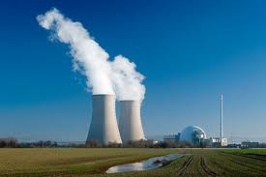
What is science?
The purpose of science is to gain more knowledge for the advancement and betterment of man.
To control nature for the purposes of man.

Slide 8

What is faith?
Hebrews 11:1,3 - Now faith is the substance of things hoped for, the evidence of things not seen…By faith we understand that the worlds were framed by the word of God, so that the things which are seen were not made of things which are visible.
Faith is the belief of something we cannot see (i.e. there is no direct evidence for)
2 Corinthians 5:7 - For we walk by faith, not by sight.

Slide 9
What is faith?
Matthew 14:28-31 - And Peter answered Him and said, “Lord, if it is You, command me to come to You on the water.” So He said, “Come.” And when Peter had come down out of the boat, he walked on the water to go to Jesus. But when he saw that the wind was boisterous, he was afraid; and beginning to sink he cried out, saying, “Lord, save me!” And immediately Jesus stretched out His hand and caught him, and said to him, “O you of little faith, why did you doubt?”
Faith allowed him to do what was impossible

Slide 10
What is faith?
Matthew 8:8-10 - The centurion answered and said, “Lord, I am not worthy that You should come under my roof. But only speak a word, and my servant will be healed. For I also am a man under authority, having soldiers under me. And I say to this one, ‘Go,’ and he goes; and to another, ‘Come,’ and he comes; and to my servant, ‘Do this,’ and he does it.” When Jesus heard it, He marveled, and said to those who followed, “Assuredly, I say to you, I have not found such great faith, not even in Israel!
Miraculous healing has no scientific explanation

Slide 11
What is faith?
What do we have faith in? God.
God is a person, not a concept.
  He has a personality and character.
  He makes decisions.
  He has thoughts.
  He is not a mathematical concept that can be predicted any more than we are
Can you predict what your friend will do 100% of the time? Why? He/she has a mind.
Can you prove a man inside a closed room?
How much more then is it difficult to predict God?

Slide 12
What is faith?
Not only does God have a mind, but it is very different than ours
Isaiah 55:9 - "For as the heavens are higher than the earth, So are My ways higher than your ways, And My thoughts than your thoughts.
1 Corinthians 2:16 - For "who has known the mind of the LORD that he may instruct Him?" But we have the mind of Christ.

Slide 13
What is faith?
Athiest’s “scientific proof” that God does not exist
We cannot assume that God will act the way that we would if we were in His place.
John 6:15 - Therefore when Jesus perceived that they were about to come and take Him by force to make Him king, He departed again to the mountain by Himself alone.

Slide 14
What is faith?
Romans 11:33 - Oh, the depth of the riches both of the wisdom and knowledge of God! How unsearchable are His judgments and His ways past finding out!
God reveals Himself to those that truly seek the truth
Jeremiah 29:13 - And you will seek Me and find Me, when you search for Me with all your heart.

Slide 15
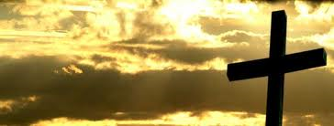
What is faith?
Faith involves a relationship with God, not just a belief in His existence
James 2:19 - You believe that there is one God. You do well. Even the demons believe—and tremble!

Slide 16
Science vs. Faith
Science | Faith
Requires proof | Trusts without proof
Based on observation | Luke 17:20-21*
Knowledge | Relationship
Predictable & repeatable | Unpredictable
Understand and control | Surrender & obey
Puffs up | Humbles
Focused on earthly life | Focused on eternal life
*Luke 17:20-21 - Now when He was asked by the Pharisees when the kingdom of God would come, He answered them and said, “The kingdom of God does not come with observation; nor will they say, ‘See here!’ or ‘See there!’ For indeed, the kingdom of God is within you.”
Conclusion: Science and faith are radically different

Slide 17
Science vs. Creation
So does science support the biblical account of creation?
If Christianity is true then nature must be inline with the biblical account
Study of science is not always an accurate picture of nature
And what if there are apparent conflicts?
  Bible has science, but is not a science book
  God spoke to a scientifically unsophisticated people
  Misunderstanding the meaning of the Bible
  Inaccurate understanding of nature

Slide 18
Scientific Truth in the Bible

Slide 19
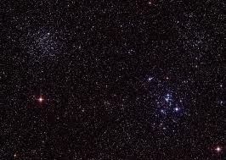
Astronomy
Jeremiah 33:22 - As the host of heaven cannot be numbered, nor the sand of the sea measured, so will I multiply the descendants of David My servant and the Levites who minister to Me."‘
There are only about 1000-3000 visible stars in the sky.

Slide 20
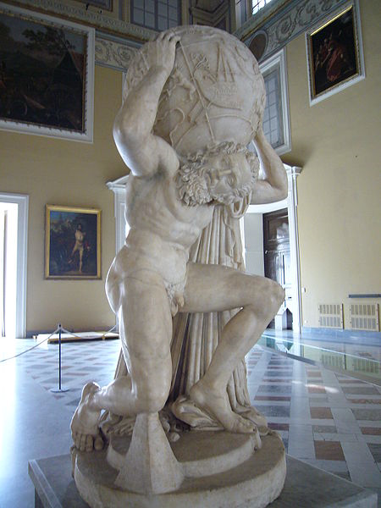
Astronomy
Job 26:7 - He stretches out the north over empty space; He hangs the earth on nothing.
The earth is floating in space.
Greek mythology believed that a Titan (Atlas) carried the earth on his back.

Slide 21
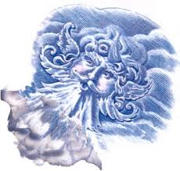
Meteorology
Ecclesiastes 1:6 - The wind goes toward the south, And turns around to the north; The wind whirls about continually, And comes again on its circuit.
How could this have been measured at the time without the elaborate wind measuring equipment that came much later?

Slide 22
Meteorology
Job 28:25 - To establish a weight for the wind, And apportion the waters by measure.
It was discovered only 300 years ago that air has weight

Slide 23

Biology
Leviticus 17:11 - For the life of the flesh is in the blood, and I have given it to you upon the altar to make atonement for your souls; for it is the blood that makes atonement for the soul.‘
In 1616, William Harvey discovered that blood circulation is the key factor in physical life

Slide 24
Hydrology
Job 36:27-29 - For He draws up drops of water, Which distill as rain from the mist, Which the clouds drop down And pour abundantly on man. Indeed, can anyone understand the spreading of clouds, The thunder from His canopy?
This describes evaporation, cloud formation, cloud movement, condensation with electrical discharges, and precipitation.
Perrault & Mariotte discovered it in the 1700s

Slide 25
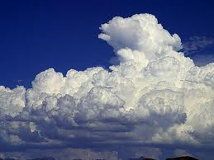
Hydrology
Job 26:8 - He binds up the water in His thick clouds, Yet the clouds are not broken under it.
Clouds are made up of moisture

Slide 26
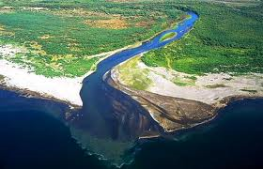
Hydrology
Ecclesiastes 1:7 - All the rivers run into the sea, Yet the sea is not full; To the place from which the rivers come, There they return again.
Accurately describes the worldwide circulation of water

Slide 27
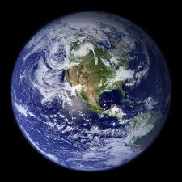
Geology
Isaiah 40:22 - It is He who sits above the circle of the earth, And its inhabitants are like grasshoppers, Who stretches out the heavens like a curtain, And spreads them out like a tent to dwell in.
This was written ~750 BC before any civilization had accepted that the earth was round

Slide 28
Example: Big Bang Theory

Slide 29
Big Bang Theory
Nothing existed
Explosion from a fixed point resulting in matter, energy, time, and space being created and expanding rapidly
Hydrogen gas gravitational attract forms large gas clouds
Clouds become dense enough to start fusion and become stars
Other debris form planets to form solar systems
Stars attract one another to become galaxies

Slide 30
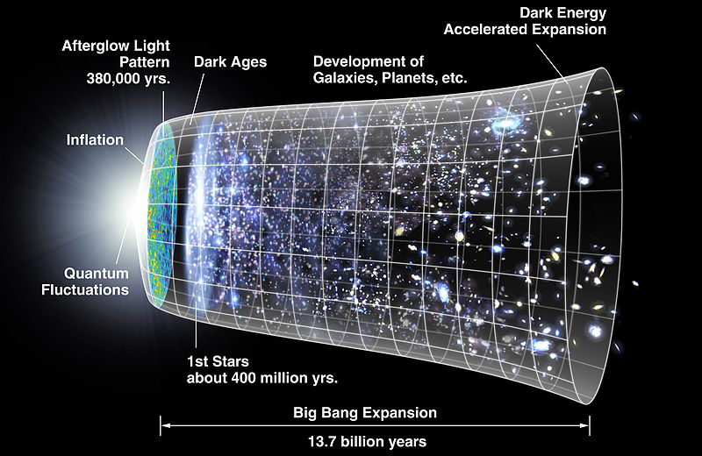
Big Bang Theory

Slide 31
Big Bang Theory
Problem: Modern scientists were shocked to find that not only are all galaxies moving apart from one another, but their speed is accelerating
This cannot be explained by the amount of physical matter in the Universe
95% of the required mass is missing
Science invented undiscovered theoretical concepts of dark energy and dark matter to give the credit to the Big Bang Theory

Slide 32
Big Bang Theory
Dark matter and energy are not measurable or observable
There is no reason to believe that they exist, except that they MUST exist for the Big Bang to be true
95% of the Universe is made up of a theoretical invisible substance
Is this science at all?

Slide 33
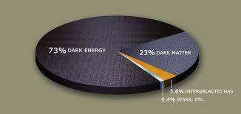

Slide 34
Conclusion
Differences between Faith and Science
Scientific Truth in the Bible
Big Bang Theory
Isaiah 29:16 - Surely you have things turned around! Shall the potter be esteemed as the clay; For shall the thing made say of him who made it, “ He did not make me”? Or shall the thing formed say of him who formed it, “He has no understanding”?

