Slide 1
Defending Our Faith
8-28-11

Slide 2
Introduction:
“But sanctify the Lord God in your hearts, and always be ready to give a defense to everyone who asks you a reason for the hope that is in you, with meekness and fear.”1Peter 3:15
Sometimes we may find ourselves in positions where we are asked to defend that which we say we believe. For example a college roommate who is an atheist, a classmate or workmate who asks us a question about God. What do we learn about ourselves in that moment?
We may learn that we have our own unanswered questions about our faith.
We may learn that we have some holes in our understanding of who God is.
We might find out that there are inconsistencies in my life (clinging to a certain lifestyle of sin that contradicts God’s word).
It may lead me to even doubt this very faith that I say I have.

Slide 3

“You better stand for something or you‟ll fall for anything!”

Slide 4
It’s ok to Doubt, it means you’re awake…..
But don’t stay there…..do something!

Slide 5
Doubting
It’s ok to doubt, it means you’re thinking. Doubt is not the opposite of faith, unbelief is the opposite of faith(willful refusal).
Indecisive over an issue (like fasting)….it’s a sign of spiritual health that we doubt—it means we’re not brain dead.
Having strong faith doesn’t disallow you to have doubt ( King David in the psalms, sharing with God our true feelings).

Slide 6
Psalm 13
Psalm 13
To the Chief Musician. A Psalm of David.
¹ How long, O LORD? Will You forget me forever?
How long will You hide Your face from me?
² How long shall I take counsel in my soul,
Having sorrow in my heart daily?
How long will my enemy be exalted over me?
³ Consider and hear me, O LORD my God;
Enlighten my eyes,
Lest I sleep the sleep of death;
⁴ Lest my enemy say,
“I have prevailed against him”;
Lest those who trouble me rejoice when I am moved.
⁵ But I have trusted in Your mercy;
My heart shall rejoice in Your salvation.
⁶ I will sing to the LORD,
Because He has dealt bountifully with me.

Slide 7
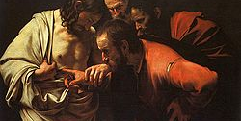
St. Thomas: Doubting Thomas
Ex of Thomas; God invites him to come closer; “come and touch” (john 20:27-28) “My Lord and my God”: he became a missionary and a martyr
Like the flu shot ( a little, gets you firmed up, immune to the full disease)
When infected, seek answers; talk to priest, attend lessons, lectures, read, pray etc.

Slide 8
I believe Lord, help my unbelief!
Mark 9:23-25

Slide 9
This is not an invitation to doubt
Don’t be scared of your doubt; it can deepen your faith. If not treated properly it can be fatal
We like not to let it in as much as possible, if it does it should be an instrument to strengthen our faith.
Doubt starts in the mind; with thought; to strengthen ourselves against doubt is to have the proper understanding of who God is.

Slide 10
Defending our Faith
Our emotions; it’s very dangerous if our faith is based on emotions. Faith is a willful decision to abide by the commands of our Lord.
Willful disobedience (clinging to a sin) can lead us to doubt in our faith…because we suffer due to our sin (that we’re holding on to) and then we wonder where’s God?
Write down your doubts, don’t leave it vague and take them to talk to spiritual father about them, so it’s not a cloud of doubt that keeps me in the dark.
Some things we just don’t have an answer for; we need to accept the fact, that we simply just don’t know.

Slide 11
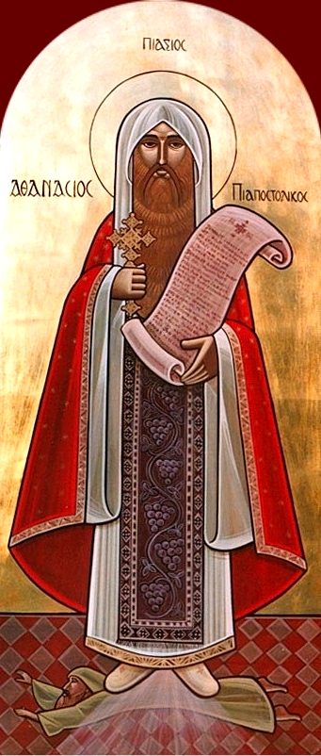
St. Athanasius as a great example for us.
St. Athanasius Contra Mundum – Against the world
St. Basil the Great said of him, “Athanasius was for the faithful what was the lighthouse was for the ship; when the night was dark and tempests raged, all eyes turned instinctively to him.”

Slide 12
St. Athanasius as a great example for us.
Born in Alexanderia, well educated,
great persecution of the church in Egypt while he was a youth.
He shadowed bishop Alexander as a deacon and also spent time with St. Antony (Brings us the life of St. Anthony)
Early 20s he wrote two essays (apologetics) “against the heathens” and “on the incarnation”

Slide 13
St. Athanasius as a great example for us.
Since St. Athanasius was a young deacon. He accompanied Pope Alexandrous to the first ecumenical council at Nicea in 325AD.
God showed in him the grace of the Holy Spirit in refuting Arius’ heresy.
He articulated the Creed which all the Christian Churches recite to this day.
In gratitude for his labors and his unique contribution, the Church conferred on him the titles of “the Defender of the Upright Faith” and “the Apostolic”.

Slide 14
St. Athanasius as a great example for us.
Except for the first 3 years and the last 5 years of his Papacy, which were the years of peace, he fought continuously and steadfastly to defend the Christian faith.
Athanasius stood up and faced emperors, powers and principalities without moving one letter from his teachings. As a consequence of his undaunted position he was exiled 5 times over 17 years.
At certain times during the fight he was alone but he certainly knew that “one with God is a majority”. When he was told that the whole world is against him, he answered, “And I am against the world”

Slide 15
St. Athanasius as a great example for us.
As Bishop Alexander's closest colleague and confidant, Athanasius accopanied him to the First Council of Nicaea where he drew a lot of attention to himself: no one expressed himself so strongly against Arianism and no one surpassed his strength of eloquence.
C.319 Arius: said Christ was created, that at one point he was not, He was created. Bishop Alexander called a council, but took time to do it, while Arius had a following ( Bishop eusibius of nicodemia backed him up).
Council of Nicea (a young deacon, was Athanasius), Consubstantial (co-essentail) (the Nicene Creed)

Slide 16
St. Athanasius as a great example for us.
Hardly a year passed when the young archdeacon was elevated to the cathedra of Alexandrian Archbishop. In spite of his young age (28 years), archbishop Athanasius took a firm hand in ruling the surrounding community under his jurisdiction: he visited churches in his vicinity, became close with bishops, ordained Thrumentius as bishop in order to strengthen the church in Abyssinia, visited monasteries scattered throughout Thebes and other regions of Egypt and visited Anthony the Great who had been his tutor during his youthful years.

Slide 17
So what’s my story?
The word “credo” is Latin for “I believe.” This is where the word “Creed” comes from; the first two words of the Nicene Creed are “We believe.”
In other words, this is our creed, our statement of what we believe about the Trinitarian God. The creeds are our confession of Faith. (Note: the word
“confess” means to own or to acknowledge. This applies both to our faith and to our awareness of our sinfulness, which is why we can “confess” our faith and “confess” our sins.)

Slide 18
So what’s my story/confession/testimonial?
Matthew 16:13-18 >>>Peter’s
When Jesus came into the region of Caesarea Philippi, He asked His disciples, saying, “Who do men say that I, the Son of Man, am?”
¹⁴ So they said, “Some say John the Baptist, some Elijah, and others Jeremiah or one of the prophets.”
¹⁵ He said to them, “But who do you say that I am?”
¹⁶ Simon Peter answered and said, “You are the Christ, the Son of the living God.”
¹⁷ Jesus answered and said to him, “Blessed are you, Simon Bar-Jonah, for flesh and blood has not revealedthis to you, but My Father who is in heaven. ¹⁸ And I also say to you that you are Peter, and on this rock I will build My church, and the gates of Hades shall not prevail against it.

Slide 19
So what’s my story/confession/testimonial?
John 1: 47-51>>>Nathanael’s
⁴⁷ Jesus saw Nathanael coming toward Him, and said of him, “Behold, an Israelite indeed, in whom is no deceit!”
⁴⁸ Nathanael said to Him, “How do You know me?”
Jesus answered and said to him, “Before Philip called you, when you were under the fig tree, I saw you.”
⁴⁹ Nathanael answered and said to Him, “Rabbi, You are the Son of God! You are the King of Israel!”
⁵⁰ Jesus answered and said to him, “Because I said to you, ‘I saw you under the fig tree,’ do you believe? You will see greater things than these.” ⁵¹ And He said to him, “Most assuredly, I say to you, hereafter you shall see heaven open, and the angels of God ascending and descending upon the Son of Man.”

Slide 20
So what’s my story/confession/testimonial?
What have I confessed about Him?
What do I believe about Him?
How does my life confess Him? (what has he redeemed?)
I believe Lord, help my unbelief!
~~Glory be to Him forever Amen~~

