Slide 1
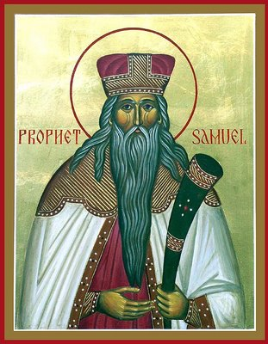
Lessons from the Life of
Samuel the Prophet II

Slide 2
Recap
Listening to the God’s calling
Speaking the unpleasant truth to Eli
Considered other people’s sin as his own
God is the King – He is our security
Praying for the people even after they reject him.

Slide 3
More Lessons
Wisdom and authority come from God alone
Give God what He wants, not what we think will please Him
Handling disappointments and unmet expectations
Focusing on the outward appearance

Slide 4
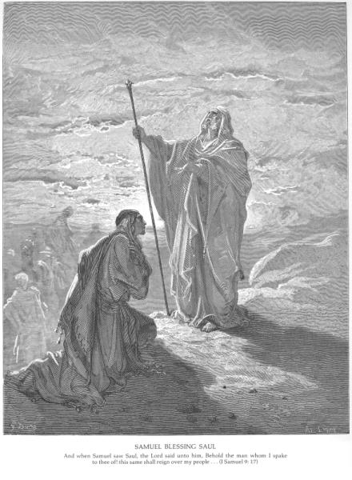
1. Wisdom and Authority come from God alone
1 Samuel 3:19
So Samuel grew, and the LORD was with him and let none of his words fall to the ground.
He spoke with authority and wisdom
Whatever he said came to pass
Elijah on Mt. Carmel

Slide 5
Earthly vs. Heavenly Wisdom
James 3:13-17
Who is wise and understanding among you? Let him show by good conduct that his works are done in the meekness of wisdom. But if you have bitter envy and self-seeking in your hearts, do not boast and lie against the truth. This wisdom does not descend from above, but is earthly, sensual, demonic. For where envy and self-seeking exist, confusion and every evil thing are there. But the wisdom that is from above is first pure, then peaceable, gentle, willing to yield, full of mercy and good fruits, without partiality and without hypocrisy.

Slide 6
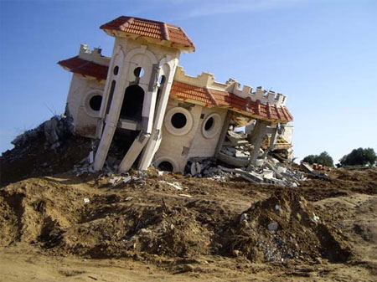
Earthly Wisdom
Bitter envy
Self-seeking
Boasting
Lying
Confusion
Priorities are wrong. Why would you buy a house that’s about to be destroyed or invest in a company that is about to go bankrupt?

Slide 7
Heavenly Wisdom
Pure – Not defiled by the world or the influences of the world. “My kingdom is not of this world”
Peaceable – Values peace between people and God more than anything else
Gentle – Patient and gentle in correcting others and dealing with other’s weaknesses
Willing to yield – Willing to yield to the desires and opinions of others, even if we disagree

Slide 8
Heavenly Wisdom
Full of mercy – Willing to forgive and have compassion on sinners and the less fortunate
Good Fruits – Evident from our behavior and the life we lead
Without partiality – Does not judge based on external appearances, but on the heart
Without hypocrisy – Sincere, not just for show

Slide 9
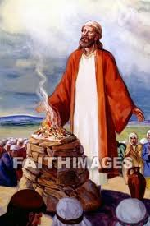
2. Give God what He wants, not what we think will please Him
1 Samuel 15:3 - God says to Saul through Samuel:
“Now go and attack Amalek, and utterly destroy all that they have, and do not spare them. But kill both man and woman, infant and nursing child, ox and sheep, camel and donkey.”

Slide 10
What does Saul do?
1 Samuel 15:7-9
And Saul attacked the Amalekites, from Havilah all the way to Shur, which is east of Egypt. He also took Agag king of the Amalekites alive, and utterly destroyed all the people with the edge of the sword. But Saul and the people spared Agag and the best of the sheep, the oxen, the fatlings, the lambs, and all that was good, and were unwilling to utterly destroy them. But everything despised and worthless, that they utterly destroyed.

Slide 11
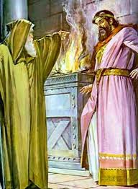
Samuel confronts Saul
1 Samuel 15:13
Then Samuel went to Saul, and Saul said to him, “Blessed are you of the LORD! I have performed the commandment of the LORD.”
Why does Saul think he obeyed God’s command?

Slide 12
Samuel confronts Saul
1 Samuel 15:14-15
But Samuel said, “What then is this bleating of the sheep in my ears, and the lowing of the oxen which I hear?” And Saul said, “They have brought them from the Amalekites; for the people spared the best of the sheep and the oxen, to sacrifice to the LORD your God; and the rest we have utterly destroyed.”

Slide 13
Samuel confronts Saul
1 Samuel 15:18-22
Now the LORD sent you on a mission, and said, ‘Go, and utterly destroy the sinners, the Amalekites, and fight against them until they are consumed.’ Why then did you not obey the voice of the LORD? Why did you swoop down on the spoil, and do evil in the sight of the LORD?” And Saul said to Samuel, “But I have obeyed the voice of the LORD, and gone on the mission on which the LORD sent me, and brought back Agag king of Amalek; I have utterly destroyed the Amalekites. But the people took of the plunder, sheep and oxen, the best of the things which should have been utterly destroyed, to sacrifice to the LORD your God in Gilgal.” So Samuel said: “Has the LORD as great delight in burnt offerings and sacrifices, As in obeying the voice of the LORD? Behold, to obey is better than sacrifice, And to heed than the fat of rams.

Slide 14
Misconceptions
Sacrifices do not add to God’s greatness but are an atonement for sin. So how can I atone for sin by disobeying God?
Placing our judgments equal with God’s – or thinking our ways are equal with His
What did Saul gain by making the sacrifices?
Hiding sin under a mask of godliness - Winning the lottery and giving to the poor
Thinking that God will overlook sins we commit because of all the “good things” we do
Obedience with humility even when what we are asked to do doesn’t make sense. Pews example.
The importance of obedience (parents, bosses, etc)

Slide 15
3. Handling disappointments
Samuel was excited about Saul being King
1 Samuel 10:23-24
So they ran and brought him from there; and when he stood among the people, he was taller than any of the people from his shoulders upward. And Samuel said to all the people, “Do you see him whom the LORD has chosen, that there is no one like him among all the people?” So all the people shouted and said, “Long live the king!”

Slide 16
Samuel disillusioned
1 Samuel 15:10
Now the word of the LORD came to Samuel, saying, “I greatly regret that I have set up Saul as king, for he has turned back from following Me, and has not performed My commandments.” And it grieved Samuel, and he cried out to the LORD all night.

Slide 17
Great expectations
Idea or plan of how we think things should be and they do not work out
We do not see things as they really are
Wrong idea that makes us think that this is in our best interest
Samuel was disappointed because he felt that his judgments were correct

Slide 18
Something better
We experience disappointment because we don’t have vision or faith to trust that God will provide something better
Examples:
  Moses after killing the Egyptian
  Moses after the people’s response to him after the workload increased (Ex 5)
  Disciples after the crucifixion

Slide 19
Something better
1 Samuel 16:1
Now the LORD said to Samuel, “How long will you mourn for Saul, seeing I have rejected him from reigning over Israel? Fill your horn with oil, and go; I am sending you to Jesse the Bethlehemite. For I have provided Myself a king among his sons.”
As though Samuel knew better than God, he mourned for what he considered a loss, but God knowing the end of the story saw it as a gain
We should realize that God’s knowledge is greater than our own
God provides hope in our times of disappointments

Slide 20
4. Focusing on the outward appearance
1 Samuel 10:23-24
So they ran and brought him from there; and when he stood among the people, he was taller than any of the people from his shoulders upward. And Samuel said to all the people, “Do you see him whom the LORD has chosen, that there is no one like him among all the people?” So all the people shouted and said, “Long live the king!”
Saul’s height qualified him to be king?

Slide 21
Outward appearances
A King from the house of Jesse
1 Samuel 16:6-7
So it was, when they came, that he looked at Eliab and said, “Surely the LORD’s anointed is before Him!” But the LORD said to Samuel, “Do not look at his appearance or at his physical stature, because I have refused him. For the LORD does not see as man sees; for man looks at the outward appearance, but the LORD looks at the heart.”
David was last of his brothers to be considered as a possible king, but God chose him

Slide 22
Outward appearances
Physical appearance
Possessions
Position
Intelligence
Achievements
Family

Slide 23

How does God consider a man?
Intentions of the heart
Willingness to obey
Humility
Penitence
Sincerity
Hatred of sin

Slide 24
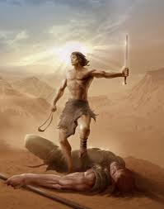
Was David the best choice?
Fearlessly slays Goliath
Obeys Saul even when Saul tries to kill him
Does not make use of an opportunity to kill Saul
Cared of Saul’s handicapped son after Saul’s death
Man after God’s own heart
Christ came from his lineage
Wrote many psalms that
prophesied the coming of Christ
and other events

Slide 25
Conclusion
Wisdom and authority come from God alone
Give God what He wants, not what we think will please Him
Handling disappointments and unmet expectations
Focusing on the outward appearance

