Slide 1
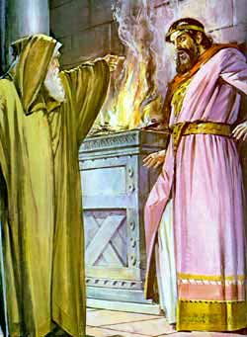
Lessons from the Life of
King Saul

Slide 2
Introduction
Sin is serious
Spiritual blindness
Spiritual problems need spiritual solutions
Dangers of envy
Spiritual decline is gradual

Slide 3
Sin is Serious
Battle against the Philistines
Samuel promised to come in 7 days
Saul was impatient and offered a sacrifice before he came

Slide 4
Sin is Serious
1 Samuel 13:11-13
And Samuel said, “What have you done?” Saul said, “When I saw that the people were scattered from me, and that you did not come within the days appointed, and that the Philistines gathered together at Michmash, then I said, ‘The Philistines will now come down on me at Gilgal, and I have not made supplication to the LORD.’ Therefore I felt compelled, and offered a burnt offering.” And Samuel said to Saul, “You have done foolishly. You have not kept the commandment of the LORD your God, which He commanded you. For now the LORD would have established your kingdom over Israel forever.
Did Saul repent? No. He numbered his army for battle.

Slide 5
Sin is Serious
God told Saul to destroy the Amalekites and all their livestock
Saul kept some livestock alive
2 Samuel 15:20-21
And Saul said to Samuel, “But I have obeyed the voice of the LORD, and gone on the mission on which the LORD sent me, and brought back Agag king of Amalek; I have utterly destroyed the Amalekites. But the people took of the plunder, sheep and oxen, the best of the things which should have been utterly destroyed, to sacrifice to the LORD your God in Gilgal.”

Slide 6
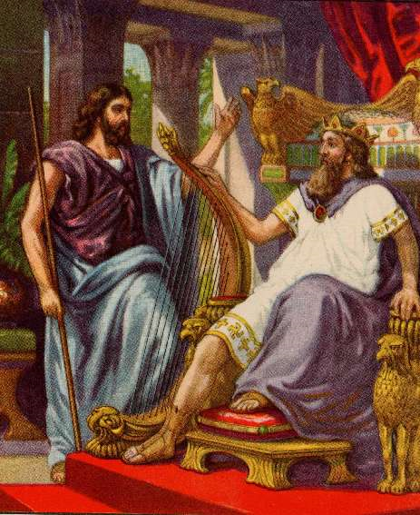
Sin is Serious
Saul did not learn his lesson
Compare to David: “I have sinned against the LORD”
Whose sin was worse, Saul or David?

Slide 7
Sin is Serious
Do we take sin lightly or make excuses for it like Saul?
“God will forgive me”
“Everyone does it”
“No one will know”

Slide 8
Sin is Serious
Matthew 5:29-30
If your right eye causes you to sin, pluck it out and cast it from you; for it is more profitable for you that one of your members perish, than for your whole body to be cast into hell. And if your right hand causes you to sin, cut it off and cast it from you; for it is more profitable for you that one of your members perish, than for your whole body to be cast into hell.

Slide 9
Sin is Serious
Cutting out a sin can be:
  Annoying
  Painful
  Cause us to lose something we value
  Embarrassing
  Sacrificial
  Heartbreaking
  Life altering

Slide 10
Spiritual Blindness
When Saul saw people eating slaughtered with the animals he said:
1 Samuel 14:34
Then Saul said, “Disperse yourselves among the people, and say to them, ‘Bring me here every man’s ox and every man’s sheep, slaughter them here, and eat; and do not sin against the LORD by eating with the blood.’”
Saul clearly saw that this was wrong, and rightly rebuked the people…but he did not see his own sin

Slide 11
Spiritual Blindness
Saul inquired of God if they should attack the Philistines during the night
1 Samuel 14:37
So Saul asked counsel of God, “Shall I go down after the Philistines? Will You deliver them into the hand of Israel?” But He did not answer him that day.
He assumed God did not answer because of the sin of the people
Instead it was because his own sin

Slide 12
Spiritual Blindness
1 Samuel 14:43-45
Then Saul said to Jonathan, “Tell me what you have done.” And Jonathan told him, and said, “I only tasted a little honey with the end of the rod that was in my hand. So now I must die!” Saul answered, “God do so and more also; for you shall surely die, Jonathan.” But the people said to Saul, “Shall Jonathan die, who has accomplished this great deliverance in Israel? Certainly not! As the LORD lives, not one hair of his head shall fall to the ground, for he has worked with God this day.” So the people rescued Jonathan, and he did not die.

Slide 13
Spiritual Blindness
How easy is it to see sins in others?
How easy is it to see the same sins in ourselves?
Matthew 7:3
And why do you look at the speck in your brother’s eye, but do not consider the plank in your own eye?
Those that suffer with a particular sin are most likely to identify that sin in another person:
  Pride
  Lust
  Lying
  Stealing
  Envy

Slide 14
Spiritual Problems Need Spiritual Solutions
1 Samuel 16:14-17
But the Spirit of the LORD departed from Saul, and a distressing spirit from the LORD troubled him. And Saul’s servants said to him, “Surely, a distressing spirit from God is troubling you. Let our master now command your servants, who are before you, to seek out a man who is a skillful player on the harp. And it shall be that he will play it with his hand when the distressing spirit from God is upon you, and you shall be well.” So Saul said to his servants, “Provide me now a man who can play well, and bring him to me.”

Slide 15
Spiritual Problems Need Spiritual Solutions
If we are far from God or depressed, what are some ways we can try to comfort ourselves:
  TV/Music/Entertainment
  Friends
  Study/Work/Ambition
  Food
  Lusts of the flesh

Slide 16
Spiritual Problems Need Spiritual Solutions
Psalm 38:6,8,15
I am troubled, I am bowed down greatly; I go mourning all the day long. I am feeble and severely broken; I groan because of the turmoil of my heart…
For in You, O LORD, I hope; You will hear, O Lord my God.
Other examples: Elijah & Job

Slide 17
Dangers of Envy
1 Samuel 18:6-9
Now it had happened as they were coming home, when David was returning from the slaughter of the Philistine, that the women had come out of all the cities of Israel, singing and dancing, to meet King Saul, with tambourines, with joy, and with musical instruments. So the women sang as they danced, and said: “Saul has slain his thousands, And David his ten thousands.” Then Saul was very angry, and the saying displeased him; and he said, “They have ascribed to David ten thousands, and to me they have ascribed only thousands. Now what more can he have but the kingdom?” So Saul eyed David from that day forward.

Slide 18
Dangers of Envy
Envy among:
  Friends
  Co-workers
  Students
  Servants
  Spouses
  Believers

Slide 19
Dangers of Envy
Each organ and part of the body has no purpose but to serve the body as a whole.
  The heart pumps blood for the whole body
  The bones support the body
  The hands hold things for the body to use
  The legs allow the body to move
Each part does not think of its own well being, but that of the body
Romans 12:5 - so we, being many, are one body in Christ, and individually members of one another.

Slide 20
Dangers of Envy
Imagine if the body were in competition with itself
Or imagine if the liver tried to pump blood better than the heart?

Slide 21
Dangers of Envy
How do we treat people that we envy?
Saul tried to kill David by sending him on a suicide mission (similar to what David did to Uriah the Hittite)

Slide 22
Spiritual Decline is Gradual
How did Saul react when Samuel first told him that he would be king?
1 Samuel 9:21
And Saul answered and said, “Am I not a Benjamite, of the smallest of the tribes of Israel, and my family the least of all the families of the tribe of Benjamin? Why then do you speak like this to me?”

Slide 23
Spiritual Decline is Gradual
When some people doubted his the could save the people from their enemies:
1 Samuel 10:27
But some rebels said, “How can this man save us?” So they despised him, and brought him no presents. But he held his peace.

Slide 24
Spiritual Decline is Gradual
After Saul led his people to victory:
1 Samuel 11:12-13
Then the people said to Samuel, “Who is he who said, ‘Shall Saul reign over us?’ Bring the men, that we may put them to death.” But Saul said, “Not a man shall be put to death this day, for today the LORD has accomplished salvation in Israel.”

Slide 25
Spiritual Decline is Gradual
Saul was humble, gracious, and wise
So what happened?
Saul misused his power and took his focus off of God and his own weakness
Started thinking himself to be a great king and a decision maker (even if those decisions contradicted God’s commands)

Slide 26
Spiritual Decline is Gradual
Dangers of pride
Feeling that we have “made it”
Not following a spiritual discipline
Not treating sin seriously

Slide 27
Summary
Sin is serious
Spiritual blindness
Spiritual problems need spiritual solutions
Dangers of envy
Spiritual decline is gradual

