Slide 1
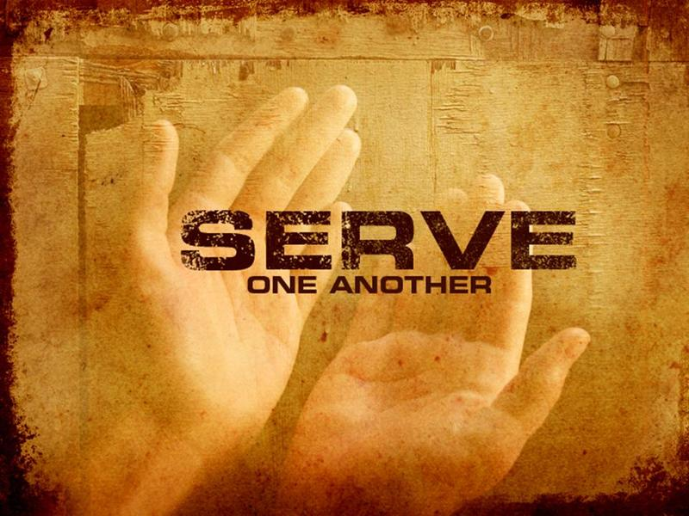
FUNDAMENTAL PRINCIPLES OF A SERVANT

Slide 2
The principle of delegation
Servants who submit to Jesus as Lord and King recognize that the Lord Himself has appointed them as servants.
This illustrates the principle of delegation. Jesus Delegates His authority to servants so that His work and His mission can be carried out throughout the world.

Slide 3
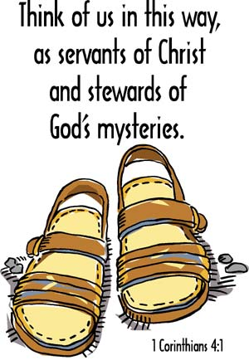
The principle of stewardship
Servant quickly learns the importance of stewardship (or, management). “Let a man so consider us, as servants of Christ and stewards of the mysteries of God” 1Corinthians 4-1.
The Almighty Lord God owns all things – no servant can claim the right of ownership. Even our position of leadership is a gift to us.
The Lord gives gifts and assigns places of service where each servant may guide God’s people to accomplish God’s purposes

Slide 4
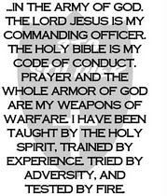
The principle of sacrifice
Servants who follow the Messiah cannot hide from their kingdom responsibilities.
Servant must understand how to sacrifice self to the kingdom.
Servant must be next in line behind the Commander of the army of God. He must be in the front of their people in all spiritual battles. He cannot lag behind, or seek refuge in the rear.

Slide 5
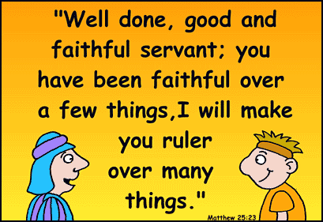
The principle of faithfulness
Wise Servants soon discover the importance of faithfulness in their service. “Moreover it is required in stewards that one be found faithful” 1 Corinthians 4-2.
Faithfulness is essential for servants. As the Apostle said, the Messiah was totally faithful to the One who appointed Him. He set the example for all of us.

Slide 6
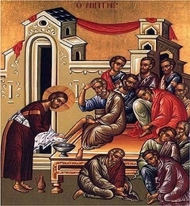
The principle that servant is spiritual
True spiritual servant, with a spirit of humility and service, will cause people to follow God because they want to, not because they have to.
Genuine humility and spiritual leadership is attractive. People want to follow a person who serves alongside them and sets an example for them. Perhaps the Apostle Paul sums it up best, "Follow my example, as I follow the example of Christ" (1 Corinthians 11:1).

Slide 7
The principle of coordination
Servant who understand Jesus’ role as the Head of the Body (the Head of the Church) will also understand the importance of organization, order, and coordination.
As the Head, Jesus determines the direction of the Body and expects its leaders and members to follow.
The church is to function together, as a unified body. A body cannot be “separated” and still be useful. Therefore, the coordination between the servant and the people is of great importance. When there is harmony and the church is in God’s will, then many wonderful blessings will come upon the people

Slide 8
The principle of oversight
Church servant who recognizes the Lord Jesus as the Overseer will understand the principle of oversight.
Oversight of a flock means giving watchful and tender and responsible care to the flock, they are to watch over the welfare, the work and the fruit of the church. They will give an account to God for their oversight (Hebrews 13:17).

Slide 9
The principle of submission
Servant who crown Jesus the Messiah as the King of Kings and Lord of Lords, the Most High God, will live out their lives according to the principle of submission.
Servants are never to seek first place. That position of honor and glory belongs to the Lord Jesus only. Servants are to have the same attitude as John the Baptist, who said, “He must Increase ; I must decrease” (John 3:30).

Slide 10
Why Do We Serve?
For……
Prestige
Power
Popularity
Fun
Social activity
Showing off
Self satisfaction

Slide 11
While it should be,
For……
We love God.
We love His children.
We want to save others.
We want to help others to:
A. Grow spiritually.
B. Have a relationship with God.
C. Live a life of repentance.
D. Live a life of righteousness.

Slide 12
The main aim is to lead God’s people to the path of eternal life.
“Who desires all men to be saved and to come to the knowledge of the truth”.
(1 Tim 2:4)
Glory be to God forever.

