Slide 1
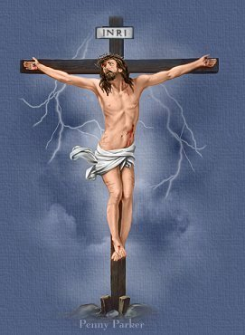
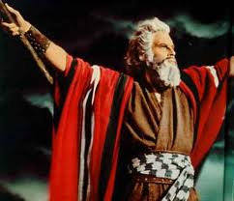
Christ is greater than Moses
h e b r e w s 3 : 1 - 6

Slide 2
Introduction
From the opening lines of the Epistle to the Hebrews, the greatness of Christ is established. He is the greatest and the ultimate prophet through whom God had revealed Himself
1) God, who at various times and in various ways spoke in time past to the fathers by the prophets
2) Has in these last days spoken to us by His Son, whom He has appointed heir of all things, through whom also He made the worlds;.(Hebrews 1:1-2)

Slide 3

Introduction
This greatness of Christ over the prophets is repeated in Hebrews chapter 3 where Christ is proven to be greater than the prophet Moses.
But why was Moses considered for comparison ?

Slide 4
Introduction
Moses grew up to be appointed by God to deliver Israel out of Egypt, where they had lived as slaves for 430 years
It is written of Moses ( So the LORD spoke to Moses face to face, as a man speaks to his friend) (Exodus 33:11).
Moses saw the glory of God; and the glow of the divine glory reflected from his face . (So when Aaron and all the children of Israel saw Moses, behold, the skin of his face shone, and they were afraid to come near him.)( Exodus 34:30).

Slide 5
Introduction
The greatest significance to the Jewish people was the fact that the law (Torah) came through Moses. In fact, the law became so identified with Moses that it was commonly referred to as the “law of Moses”.
Moses had not only given them the Ten Commandments; the priesthood and sacrifices were instituted through him.
Finally, when he died, God Himself dug his grave .So Moses the servant of the LORD died there in the land of Moab, according to the word of the LORD. 6 And He buried him in a valley in the land of Moab, opposite Beth Peor; but no one knows his grave to this day. (Deuteronomy 34:5-6).

Slide 6
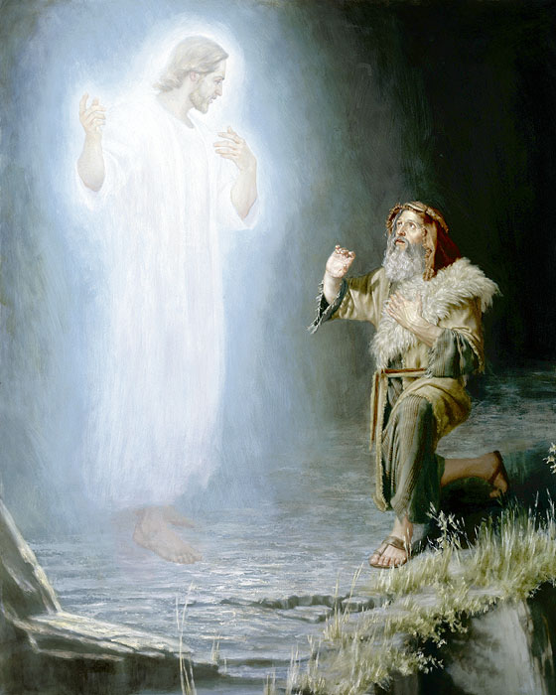
Introduction
The high honor that the Jews had rendered to Moses is not without basis as the Old Testament Scriptures has this testimony concerning him: “But since then there has not arisen in Israel a prophet like Moses, whom the LORD knew face to face,” (Deuteronomy 34:10).

Slide 7
Christ was no less faithful than Moses
Hebrews 3:1-2
1) Therefore, holy brethren, partakers of the heavenly calling, consider the Apostle and High Priest of our confession, Christ Jesus,
2) who was faithful to Him who appointed Him, as Moses also was faithful in all His house. .

Slide 8
Christ was no less faithful than Moses
The book of Hebrews presents Jesus as an equal, even a greater prophet than Moses was. (why?)
Moses had lapses in his faithfulness but Jesus was absolutely and perfectly faithful to the Father who sent Him to the world. He always did the Father's will.
Jesus said, “And He who sent Me is with Me. The Father has not left Me alone, for I always do those things that please Him.” (John 8:29).

Slide 9
Introduction
St. Ambrose comments on this apostolic phrase by saying,
[Here we see that the Apostle said, Jesus was appointed, He took a flesh from the seed of Abraham, obviously emphasizing the point of start of the body, for how could he make propitiation for the sins of the people except in His flesh? Because He suffered according to the flesh, as it was said . Moreover He is the High Priest, who shared His

Slide 10
Christ is more glorious than Moses
Hebrews 3:3
3) For this One has been counted worthy of more glory than Moses, inasmuch as He who built the house has more honor than the house.

Slide 11
Christ is more glorious than Moses
Here, the Spirit of God asserts that Christ is more excellent than Moses the greatest of Jewish prophets!
Moses’ face once shone with the glory of God, but it was only a reflection – a transitory glory.
On the other hand, Christ’s glory is a “ the glory that excels.” (2 Corinthians 3:10).

Slide 12
Christ is the builder of the house which Moses is a part of
Hebrews 3:4
4 For every house is built by someone, but He who built all things is God.

Slide 13
Christ is the builder of the house which Moses is a part of
Moses was a great leader in the house of Israel, but only by appointment of the One who built it
In other words, Moses was called to be a servant of the house which Christ built.
As an added emphasis to Christ’s superiority over Moses, it is said in verse 4: Christ has not only built “the house” but also “all things”. He created all things ( Hebrews 1:2; John 1:3), including Israel. That is evidence of His divinity. Thus how much greater glory than Moses is He justly entitled to

Slide 14
Christ is the builder of the house which Moses is a part of
As an added emphasis to Christ’s superiority over Moses, it is said in verse 4: Christ has not only built “the house” but also “all things”. He created all things ( Hebrews 1:2; John 1:3), including Israel. That is evidence of His divinity. Thus how much greater glory than Moses is He justly entitled to

Slide 15
Christ is the Son, but Moses a servant
Hebrews 3:5-6
And Moses indeed was faithful in all His house as a servant, for a testimony of those things which would be spoken afterward,
But Christ as a Son over His own house, whose house we are if we hold fast the confidence and the rejoicing of the hope firm to the end.

Slide 16
Christ is the Son, but Moses a servant
There was a special purpose for Moses’ role as a faithful servant in the house of Israel which Christ built to be a witness of the things that would be revealed in the future. Moses served as a prototype of Jesus the Messiah that was to come (15 “The LORD your God will raise up for you a Prophet like me from your midst, from your brethren. Him you shall hear,). (18 I will raise up for them a Prophet like you from among their brethren, and will put My words in His mouth, and He shall speak to them all that I command Him.(Deuteronomy 18:15, 18).

Slide 17
Christ is the Son, but Moses a servant
Unlike Moses, Christ was not a servant. Christ is the son over his own house; whose house are we”
(Jesus said, “And a slave does not abide in the house forever, but a son abides forever. (John 8:35,)
St. John Chrysostom comments by saying, [Moses cared for others' possessions, but the Lord Jesus cares for His private possessions.] This means, He cares for us, His house, His holy temple and the subject of His kingdom

Slide 18
Christ is the Son but Moses a servant
Moses had an important role in God’s plan, but he was only a part of the house. Christ is the founder of the household. The house of Christ is made up of believers whether Jews or Gentiles.

Slide 19
Conclusion
Christ was no less faithful than Moses, even greater
Christ is more glorious than Moses
Christ is the builder of the house which Moses is a part of
Christ is the Son, but Moses a servant

Slide 20
GLORY BE TO GOD FOREVER

