Slide 1
Day of Opposition
Pascha Tuesday

Slide 2
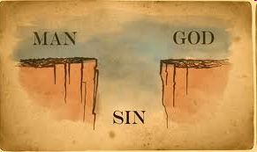
Theme: God’s opposition
Separating the good from evil
God’s rejection and punishment

Slide 3
1st Hour
God’s holiness vs. people’s wickedness
  Gospel - John 8:23-24
  And He said to them, “You are from beneath; I am from above. You are of this world; I am not of this world. Therefore I said to you that you will die in your sins; for if you do not believe that I am He, you will die in your sins.”
Separation between God and his people
  John 8:42,44
  Jesus said to them, “If God were your Father, you would love Me, for I proceeded forth and came from God…You are of your father the devil, and the desires of your father you want to do…
  James 4:4
  Do you not know that friendship with the world is enmity with God?
Unbelievers will perish

Slide 4
3rd Hour
The punishment for idolaters and the disobedient
  Prophecy - Deuteronomy 8:19-20
  Then it shall be, if you by any means forget the LORD your God, and follow other gods, and serve them and worship them, I testify against you this day that you shall surely perish. As the nations which the LORD destroys before you, so you shall perish, because you would not be obedient to the voice of the LORD your God.
  Those that forget God will perish
  God will treat His people like the other heathen nations
God’s people oppose Him
  Gospel - Matthew 23:37
  “O Jerusalem, Jerusalem, the one who kills the prophets and stones those who are sent to her! How often I wanted to gather your children together, as a hen gathers her chicks under her wings, but you were not willing!

Slide 5
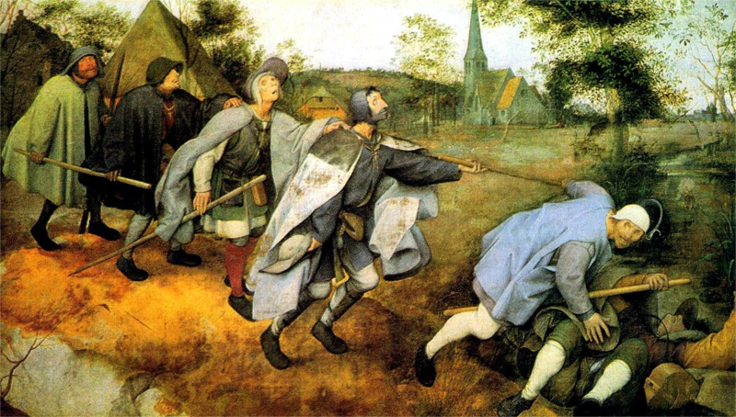
6th Hour
Christ is the light
  Gospel - John 8:12
  Then Jesus spoke to them again, saying, “I am the light of the world. He who follows Me shall not walk in darkness, but have the light of life.”
Pharisees are darkness leading others to perdition
  Matthew 15:14
  Let them alone. They are blind leaders of the blind. And if the blind leads the blind, both will fall into a ditch.”

Slide 6
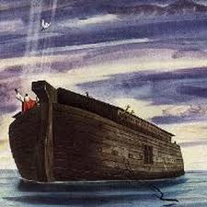
9th Hour
The people have become completely corrupted
  Prophecy - Genesis 6:5
  Then the LORD saw that the wickedness of man was great in the earth, and that every intent of the thoughts of his heart was only evil continually.
God’s people do not repent and will be destroyed
  Prophecy - Genesis 6:7
  So the LORD said, “I will destroy man whom I have created from the face of the earth, both man and beast, creeping thing and birds of the air, for I am sorry that I have made them.”

Slide 7
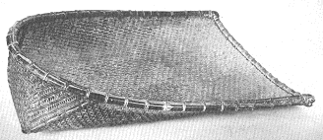
11th Hour
God’s punishment against Assyria
  Prophecy - Isaiah 30:27
  Behold, the name of the LORD comes from afar, Burning with His anger, And His burden is heavy; His lips are full of indignation, And His tongue like a devouring fire.
  Prophecy - Isaiah 30:28
  His breath is like an overflowing stream, Which reaches up to the neck, To sift the nations with the sieve of futility;

Slide 8
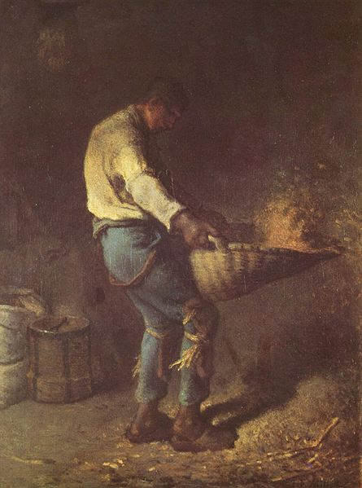
11th Hour
God will sift the nations and find nothing (futility)
  Luke 3:17
  His winnowing fan is in His hand, and He will thoroughly clean out His threshing floor, and gather the wheat into His barn; but the chaff He will burn with unquenchable fire.”
Separate the good from the evil
  Gospel - Matthew 25:31-33
  “When the Son of Man comes in His glory, and all the holy angels with Him, then He will sit on the throne of His glory. All the nations will be gathered before Him, and He will separate them one from another, as a shepherd divides his sheep from the goats. And He will set the sheep on His right hand, but the goats on the left.

Slide 9
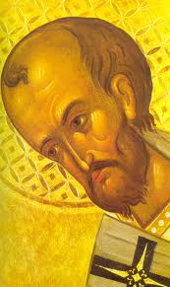
11th Hour
Punishment for those that misuse God’s sacrament
  Homily by St. John Chrysostom -“I want to remind you – with what I repeatedly reiterated to you concerning our communion with the Holy Sacraments, which is of Christ. I see you in a state of extreme looseness, permissiveness, and an alarming audacity and lamentable recklessness…Do these people really know for whom do they stand for. Or do these people realize the power of this sacrament…I dread the thought that God’s wrath may be inflicted upon you because of your disregard of this great sacrament. Do you really know who is He you want to partake of. This is the Holy Body of God the Word. And His blood that he offered for our salvation. Anyone who partakes in it undeservingly will suffer abominable punishment”

Slide 10
Hosea 4 – 1st Hour of Tuesday
Hosea 4:1
Hear the word of the LORD, You children of Israel, For the LORD brings a charge against the inhabitants of the land: “There is no truth or mercy Or knowledge of God in the land.
No truth
  Truth has been diluted and no longer has meaning
  Varies from person to person, and religion to religion
No mercy
  Quick to cast judgment
  Pointing fingers and casting blame
No knowledge of God
  Science has replaced God
  God is whoever people want Him to be

Slide 11
Sins of the People
Hosea 4:2
By swearing and lying, Killing and stealing and committing adultery, They break all restraint, With bloodshed upon bloodshed.
1 Timothy 3:1-5
But know this, that in the last days perilous times will come: For men will be lovers of themselves, lovers of money, boasters, proud, blasphemers, disobedient to parents, unthankful, unholy, unloving, unforgiving, slanderers, without self-control, brutal, despisers of good, traitors, headstrong, haughty, lovers of pleasure rather than lovers of God, having a form of godliness but denying its power.

Slide 12
The Land Will Mourn
Hosea 4:3
Therefore the land will mourn; And everyone who dwells there will waste away With the beasts of the field And the birds of the air; Even the fish of the sea will be taken away.
The people will mourn
  Sadness & despair
The people will waste away
  Neglected & forgotten
Desolation & decline
  Even natural resources diminish
Leviticus 26:32
I will bring the land to desolation, and your enemies who dwell in it shall be astonished at it.

Slide 13
Reject Rebuke
Hosea 4:4
Now let no man contend, or rebuke another; For your people are like those who contend with the priest.
The people reject rebuke
  No one is willing to bear rebuke
  Each one will defend himself and not consider his sin
  They reject instruction from the church
The people place blame on each other
  Pointing fingers instead of admitting fault

Slide 14
Stumble
Hosea 4:5
Therefore you shall stumble in the day; The prophet also shall stumble with you in the night;
False prophets that lead the people astray
Blind leading the blind - Pharisees
Day and night are the same to the blind

Slide 15
Lack of Knowledge
Hosea 4:6
My people are destroyed for lack of knowledge. Because you have rejected knowledge, I also will reject you from being priest for Me; Because you have forgotten the law of your God, I also will forget your children.
Lack of knowledge
  No understanding of the truth
  Content to live life aimlessly focused on worldly pleasures
  No serious commitment to God
God’s rejection of false priests and leaders
  Purpose changed from salvation of the people to keeping their authority intact
  Modern day false teachers – preach what people want to hear

Slide 16
Pride
Hosea 4:7
“The more they increased, The more they sinned against Me; I will change their glory into shame.
Pride
  The more the prideful gain, the further they stray from God
  The more the humble gain, the more they praise Him
God will cause those that think they stand on their own to fall
  1 Corinthians 10:12
  Therefore let him who thinks he stands take heed lest he fall.
  Acts 12:22-23
  And the people kept shouting, “The voice of a god and not of a man!” Then immediately an angel of the Lord struck him, because he did not give glory to God. And he was eaten by worms and died.

Slide 17
Eat up the Sin
Hosea 4:8
They eat up the sin of My people; They set their heart on their iniquity.
The false priests shared the sins of the people
They even caused them to sin
  Matthew 23:13
  “But woe to you, scribes and Pharisees, hypocrites! For you shut up the kingdom of heaven against men; for you neither go in yourselves, nor do you allow those who are entering to go in.
  Matthew 23:15
  “Woe to you, scribes and Pharisees, hypocrites! For you travel land and sea to win one proselyte, and when he is won, you make him twice as much a son of hell as yourselves.

Slide 18
Conclusion
Day of Opposition
God separates the good from the evil
God rejects the wicked
  No truth or mercy
  The land will mourn
  Reject correction
  Pride
  Lack of knowledge
  False teachers that lead the people to sin
Hope for the righteous
  9th Hour Prophesy - Genesis 7:1
  Then the LORD said to Noah, “Come into the ark, you and all your household, because I have seen that you are righteous before Me in this generation.

