Slide 1
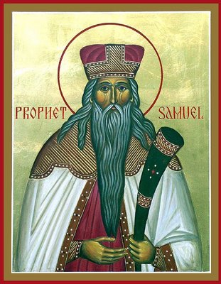
Lessons from the Life of
Samuel the Prophet I

Slide 2
Introduction
Background
Listening to God’s calling
Speaking the unpleasant truth
Considering other’s sins as his own
Trusting in God more than man
Praying for those that reject us

Slide 3
Background
Born to Elkanah and Hannah
His mother Hannah was barren
God granted her a son
Hannah dedicated Samuel for service in the temple
Lived under the care of Eli the priest
Eli’s sons (Hophni and Phinehas) were corrupt priests

Slide 4
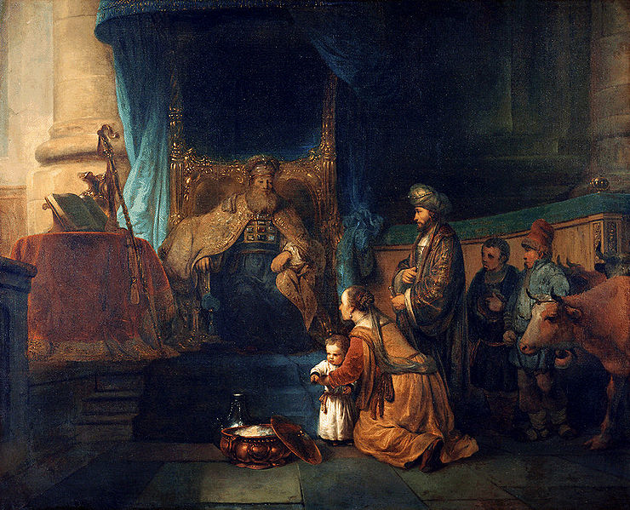

Slide 5
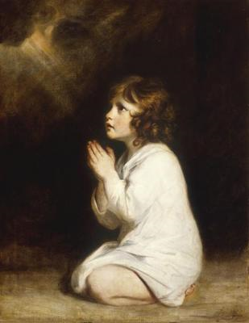
Listening to God’s calling ⁽¹⁾
1 Samuel 3:1-10
Now the boy Samuel ministered to the LORD before Eli. And the word of the LORD was rare in those days; there was no widespread revelation. And it came to pass at that time, while Eli was lying down in his place, and when his eyes had begun to grow so dim that he could not see, and before the lamp of God went out in the tabernacle of the LORD where the ark of God was, and while Samuel was lying down, that the LORD called Samuel. And he answered, “Here I am!” So he ran to Eli and said, "Here I am, for you called me.” Then the LORD called yet again, "Samuel!“ (Now Samuel did not yet know the LORD, nor was the word of the LORD yet revealed to him.) And the LORD called Samuel again the third time. So he arose and went to Eli, and said, "Here I am, for you did call me.“ Therefore Eli said to Samuel, "Go, lie down; and it shall be, if He calls you, that you must say, "Speak, LORD, for Your servant hears."' So Samuel went and lay down in his place. Now the LORD came and stood and called as at other times, “Samuel! Samuel!” And Samuel answered, “Speak, for Your servant hears.”

Slide 6
Listening to God’s calling ⁽²⁾
Samuel was very quick to respond to the Lord’s calling
Abram
  Now the LORD had said to Abram: Get out of your country…So Abram departed as the LORD had spoken…
  “Take now your son, your only son Isaac, whom you love…and offer him there as a burnt offering…” So Abraham rose early in the morning and saddled his donkey…and arose and went to the place of which God had told him.

Slide 7
Listening to God’s calling ⁽³⁾
Do we delay or ignore when we hear God speaking?
  Put it off to tomorrow
  It’s too difficult or unpleasant
  He must be addressing someone else
Do we misunderstand who is really speaking? God or Eli?

Slide 8
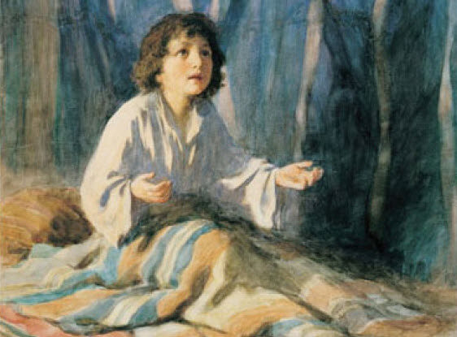
Listening to God’s calling ⁽⁴⁾
At the time Samuel “did not yet know the LORD, nor was the word of the LORD yet revealed to him”
God can call us before we even know Him yet or feel equipped for the calling
Moses, Jeremiah

Slide 9
Listening to God’s calling ⁽⁵⁾
Persistence in listening – Samuel responded to God’s call 4 times before God actually spoke to Him
How quick are we to dismiss the Word of God?
Samuel saw himself as a servant and was receptive to the Word of God

Slide 10
Speaking the unpleasant truth ⁽¹⁾
1 Samuel 3:12-14
In that day I will perform against Eli all that I have spoken concerning his house, from beginning to end. For I have told him that I will judge his house forever for the iniquity which he knows, because his sons made themselves vile, and he did not restrain them. And therefore I have sworn to the house of Eli that the iniquity of Eli’s house shall not be atoned for by sacrifice or offering forever.”

Slide 11
Speaking the unpleasant truth ⁽²⁾
So Samuel lay down until morning, and opened the doors of the house of the LORD. And Samuel was afraid to tell Eli the vision. Then Eli called Samuel and said, “Samuel, my son!” He answered, “Here I am.” And he said, “What is the word that the LORD spoke to you? Please do not hide it from me. God do so to you, and more also, if you hide anything from me of all the things that He said to you.” Then Samuel told him everything, and hid nothing from him.

Slide 12
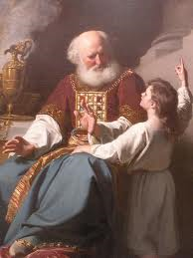
Speaking the unpleasant truth ⁽³⁾
Samuel spoke honestly to Eli, the words that God told him to speak
  Honesty
  Without interpretation
  Without judgment
  Without fear of punishment

Slide 13
Speaking the unpleasant truth ⁽⁴⁾
1 Kings 22:8 – ‘So the king of Israel [Ahab] said to Jehoshaphat, “There is still one man, Micaiah the son of Imlah, by whom we may inquire of the LORD; but I hate him, because he does not prophesy good concerning me, but evil.”’
King Ahab hated Micaiah, because he spoke the honest truth

Slide 14
Speaking the unpleasant truth ⁽⁵⁾
We are often placed in similar situations, how do we respond?
Worried about offending the feelings of the other?
How will people think about us?
One person standing against hundreds?

Slide 15
Considering other’s sins as his own ⁽¹⁾
1 Samuel 7:3-6
Then Samuel spoke to all the house of Israel, saying, "If you return to the LORD with all your hearts, then put away the foreign gods and the Ashtoreths from among you, and prepare your hearts for the LORD, and serve Him only; and He will deliver you from the hand of the Philistines.” So the children of Israel put away the Baals and the Ashtoreths, and served the LORD only. And Samuel said, "Gather all Israel to Mizpah, and I will pray to the LORD for you.“ So they gathered together at Mizpah, drew water, and poured it out before the LORD. And they fasted that day, and said there, "We have sinned against the LORD." And Samuel judged the children of Israel at Mizpah.

Slide 16
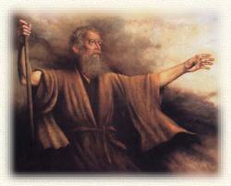
Considering other’s sins as his own ⁽²⁾
Samuel acted as though he were to blame along with the people
Moses example
Instead do we blame our sin on others?

Slide 17
Considering other’s sins as his own ⁽³⁾
Anger - I wouldn’t lose my temper if my co-workers were easier to get along with, or if my kids behaved better, or if my spouse were more considerate.
Impatience - I would be a very patient person if it weren’t for traffic jams and long lines in the grocery store. If I didn’t have so many things to do, and if the people around me weren’t so slow, I would never become impatient!
Lust - I would have a pure mind if there weren’t so many sensual images in our culture.
Anxiety - I wouldn’t worry about the future if my life were just a little more secure—if I had more money, and no health problems.
Spiritual Apathy - My spiritual life would be so much more vibrant and I would struggle with sin less if my friends were more encouraging, or if Sunday school were more engaging, or if my church were more lively, or if the sermons were better.
Insubordination - If my parents/bosses/elders were godly leaders, then I would joyfully follow them.

Slide 18
Considering other’s sins as his own ⁽⁴⁾
A Critical Spirit - It’s not my fault that the people around me are ignorant and inexperienced.
Bitterness - If you knew what that person did to me, you would understand my bitterness. How could I forgive something like that?
Gluttony - My wife/husband/roommate/friend is a wonderful cook! The things they make are impossible to resist.
Gossip - It’s the people around me who start the conversations. There’s no way to avoid hearing what others happen to say. And when others ask me questions, I can’t avoid sharing what I know.
Self-Pity - I’ll never be happy, because my marriage/family/job is so difficult.
Selfishness - I would be more generous if we had more money.

Slide 19
Considering other’s sins as his own ⁽⁵⁾
Instead, like Samuel, we need to not only take responsibility for our sins, but also help our fellow neighbor with theirs
Galatians 6:1
Brethren, if a man is overtaken in any trespass, you who are spiritual restore such a one in a spirit of gentleness, considering yourself lest you also be tempted.

Slide 20
Trust in God more than man ⁽¹⁾
1 Samuel 8:4-9
Then all the elders of Israel gathered together and came to Samuel at Ramah, and said to him, "Look, you are old, and your sons do not walk in your ways. Now make us a king to judge us like all the nations.” But the thing displeased Samuel when they said, "Give us a king to judge us." So Samuel prayed to the LORD. And the LORD said to Samuel, "Heed the voice of the people in all that they say to you; for they have not rejected you, but they have rejected Me, that I should not reign over them. According to all the works which they have done since the day that I brought them up out of Egypt, even to this day--with which they have forsaken Me and served other gods--so they are doing to you also. Now therefore, heed their voice. However, you shall solemnly forewarn them, and show them the behavior of the king who will reign over them."

Slide 21
Trust in God more than man ⁽²⁾
The people wanted a physical King, but this was against God’s command
Samuel didn’t want to be like all the other nations. God was their King.
His security was in God.
Where is our security?

Slide 22
Trust in God more than man ⁽³⁾
Money
Health
Family/Friends
Work
Social Status
Ask: What do I feel I cannot live without?
Do we feel that God is our King?

Slide 23
Praying for those that reject us ⁽¹⁾
1 Samuel 12:23-24
Moreover, as for me, far be it from me that I should sin against the LORD in ceasing to pray for you; but I will teach you the good and the right way. Only fear the LORD, and serve Him in truth with all your heart; for consider what great things He has done for you.

Slide 24
Praying for those that reject us ⁽²⁾
Samuel was rejected by the people as their leader
He did not take this personally nor hate them as a result
How do we respond in similar situations?

Slide 25
Praying for those that reject us ⁽³⁾
We get offended when rejected because our identities are not completely built on God
Low self-esteem
Constant desire for validation from others
Always wanting to prove we are right or good

Slide 26
Praying for those that reject us ⁽⁴⁾
Trust in God’s judgment in allowing us to be rejected
Sincere love for those that reject us
Joy in the success of those that reject us
Always considering that we might not have had the best solution or been the best choice

Slide 27
Praying for those that reject us ⁽⁵⁾
Learning to deal with losing and failure
Avoiding self-pity
Joseph example – never turned to hatred or feeling sorry for himself
He always felt that he was in God’s hand
Ultimately he had to be rejected so that he could be honored and be a savior for his people

Slide 28
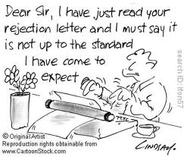
Praying for those that reject us ⁽⁶⁾

Slide 29
Conclusion
Listening to God’s calling
Speaking the unpleasant truth
Considering other’s sins as his own
Trust in God more than man
Praying for those that reject us

