Slide 1
Sanctifying Our Thoughts
Sunday January 16th, 2011

Slide 2
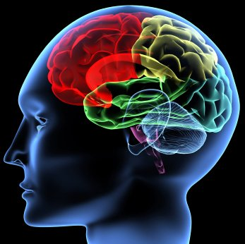
Introduction
“‘Love the Lord your God with all your heart and with all your soul and with all your strength and with all your mind’^{[a]}; and, ‘Love your neighbor as yourself.’^{[b]}” Luke 10:27

Slide 3
Why sanctify our minds?
Every action starts with an idea.
To Keep from sinning: and sinful behavior
To Give Glory to God
To guard against anxiety and depression.
To live intently and with compassion.

Slide 4

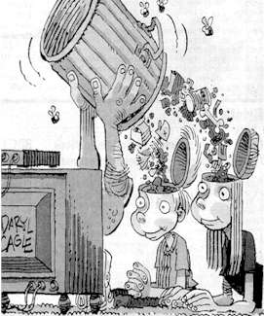
How do we sanctify our minds?
Take out what is bad: GIGO (Garbage In: Garbage Out)
Be vigilant to guard our minds.
Feed it with what is good.

Slide 5

What am I consuming?
What am I reading?
Watching?
Who am I spending time with? And what is the conversation entail?
Simply FLEE!

Slide 6
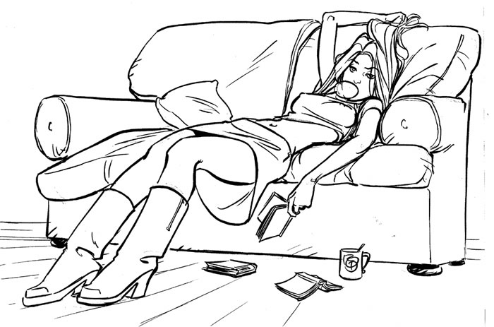
Maybe I just got nothing going on!
"The mind of an idle person is a convenient place of work for the devil.”
A person who spends his time in idleness will have his mind exposed to evil thoughts; he does not control his thoughts but the thoughts direct him.

Slide 7
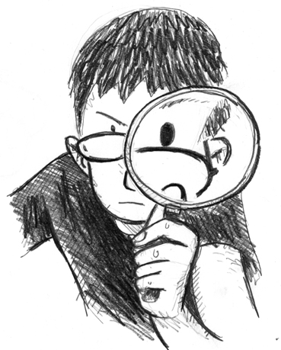
Ask yourself…
Let us be keen to examine our thoughts, what are we dwelling on? What belief systems do we carry with us about ourselves, about who God is, and about others?

Slide 8

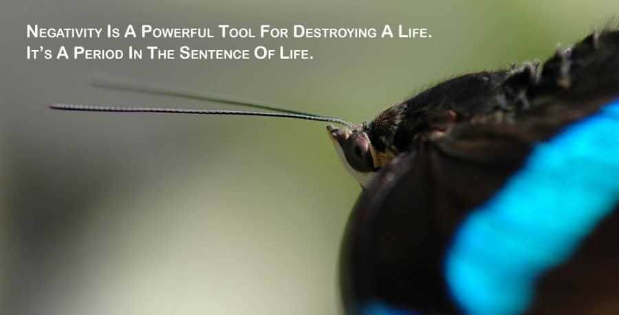
What might I find?
Worry?
Negativity?
Discontent?
Hopelessness?

Slide 9
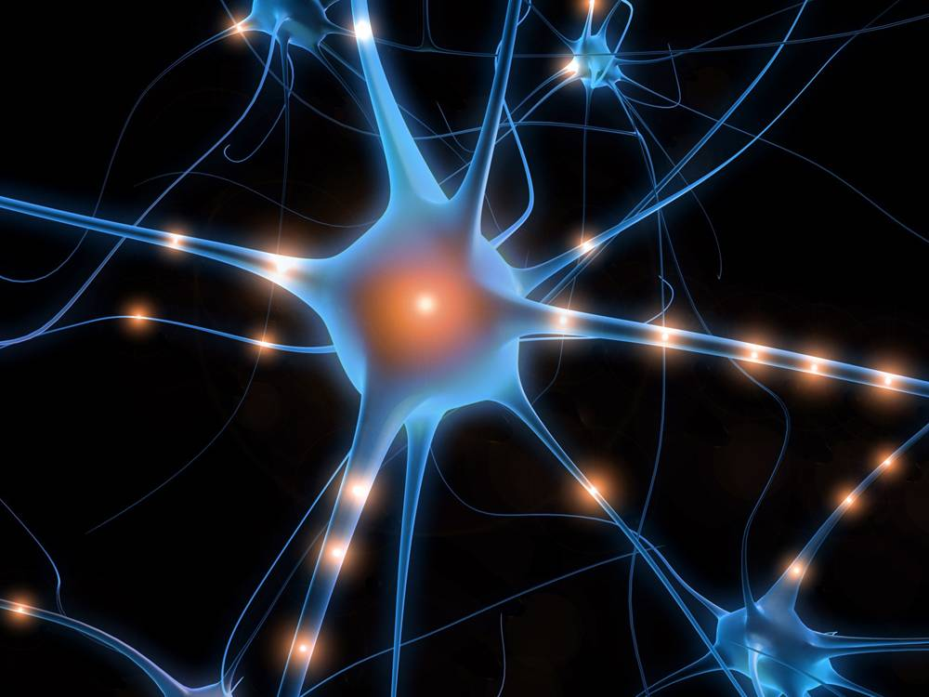
Neural Plasticity
The good news!
Our minds are flexible
Neural pathways
are like malleable
play dough .
We can teach our brains to create pathways of gratitude and compassion, instead of discontent and anxiety!

Slide 10
THIS TAKES WORK!
Awareness.
Intent.
Practice.

Slide 11
Awareness
What preoccupies my thinking?
Am I constantly wishing I had more and more
Am I comparing my life with others?
What am I fearful of?
Do I always feel sorry for myself? Feel that I am being victimized?

Slide 12

Intent
Separate Myself:
What we see/taste/touch/listen to(music has message)/ say will all affect what we think so Ps 101:3 I will set nothing wicked before my eyes; I hate the work of those who fall away; It shall not cling to me. Ps. 119:63 I am a companion of all who fear You, And of those who keep Your precepts.

Slide 13
Intent
Luke 11:34
The lamp of the body is the eye. Therefore, when your eye is good, your whole body also is full of light. But when your eye is bad, your body also is full of darkness.
What our eyes look at and our ears hear have a direct impact on us.
Over the course of time, what we experience does have a dramatic and profound effect on our spiritual lives.
Today the media plays a huge role in our view of the world, the people in it, and what is important.

Slide 14
Be intentional about what I am consuming!
Replace with good thoughts. Not enough to just stop bad thoughts need to put something in their place.
Phil 4:8 Finally, brethren, whatever things are true, whatever things are noble, whatever things are just, whatever things are pure, whatever things are lovely, whatever things are of good report, if there is any virtue and if there is anything praiseworthy—meditate on these things.

Slide 15
Keep things in perspective to thwart Negativity
Sometimes we blow things up in our minds, we make them bigger than they should be.
Chances are a year from now you are not going to care or even remember the details of the problematic situation.
Laugh at yourself when you take things far too seriously.
Instead of using that energy to be upset and hold angry grudges drop that feeling of being overwhelmed, get past the obstacle of your unhappiness and spend time in prayer and meditation.

Slide 16
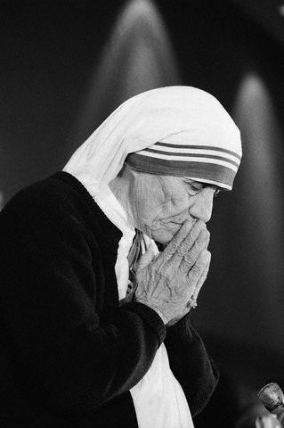
Harboring compassion as a way to thwart negativism:
When life is not fair we should be encouraged to do our best to improve our own lives or the world as a whole. But, to feel self-pity is wrong. Pity is a self defeating emotion. Replace it with compassion. Compassion for others and for your situation will move you to action.
Compassion is something you develop over time and with concentrated, conscious effort. It is a call to action and change in thinking. When practiced over time, other people will matter more. The value of what you can do lies not in its material price but in the act of your doing it.
Mother Teresa, renowned for her philanthropic work and her great compassion, said; "We cannot do great things on this earth. We can only do small things with great love."
With compassion we will feel positively about our service and our worth as children of promise. We sow seeds of compassion that grow and beget more seeds of compassion.

Slide 17
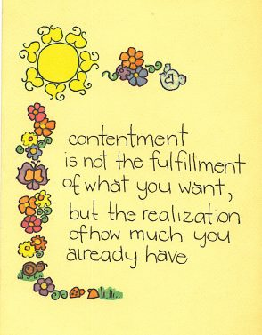

Slide 18
Practice Contentment
1 Timothy 6:6-8 – we own nothing in this world and we aren’t taking it with us. We must daily remind ourselves of that and live it.
The Perfect Example of Contentment is the Shunamite woman: 2 kings 4: 8-18

Slide 19
Practicing Contentment
Spend time with God in His Word and prayer. Not only does that remind us of the futility of life, but it also reminds us of the promises of a loving God, and it makes us realize that all we need in life is really God. The saints realized that and forsook everything just to acquire a relationship with God. St. Augustine said that he had conquered the world when he achieved a state where he neither feared anything nor desired anything from the world. That should be our attitude as well.
Believe that EVERYTHING you have is a gift from God for you personally and it is suited for your purpose in life. He has gifted you with the abilities, talents, husband, children, home, life, that is perfectly and uniquely suited to your purpose, and calling. They are gifts that you could not acquire with your own efforts.
Contentment is a learned thought process – St. Paul states this clearly – Phillipians 4:11 ”Not that I speak in regard to need, for I have learned in whatever state I am, to be content.” We must work on changing our attitudes – for most of us this doesn’t come naturally. We need to start by always having a thankful attitude especially in our prayers.

Slide 20

Sanctifying our Thoughts takes practice
Like the analogy missy used in a previous lesson.
We need to identify our negative thought patterns, confess them, stop them and do it over and over again until that rope breaks.

Slide 21
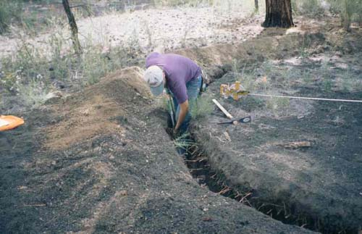
Sanctifying our thoughts takes practice!
Once you stop the negative, You then teach your brain the positive.
It is like digging a trench: teaching our thoughts the way.
It’s hard work at first, but once the trail is made: that neural pathway will be achieved and your brain will learn to do it on its own.

Slide 22

Glory be to God Forever Amen!

