Slide 1
Faith & Temptations
James 1

Slide 2
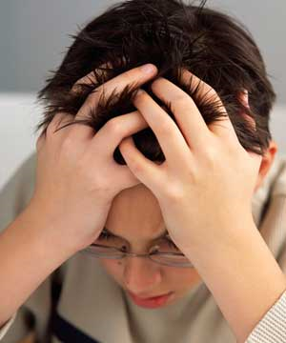
Trials

Slide 3
Joy during trials
James 1:2-3 - My brethren, count it all joy when you fall into various trials, knowing that the testing of your faith produces patience.
From God or by His permissive will
Should be a source of joy
Intended to strengthen our character and produce patience
Focus on my growth instead of my pain

Slide 4
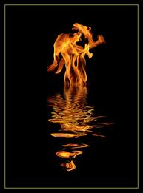
Testing our faith
1 Peter 1:7 - that the genuineness of your faith, being much more precious than gold that perishes, though it is tested by fire, may be found to praise, honor, and glory at the revelation of Jesus Christ,
Genuine faith is more precious and rarer than gold
God knows us without needing a test
But we do not know ourselves

Slide 5
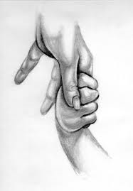
An act of love
John 15:2 - Every branch in Me that does not bear fruit He takes away; and every branch that bears fruit He prunes, that it may bear more fruit.
God wants us to grow in Him as a loving parent wants to see his children grow and be fruitful

Slide 6
Should be expected
1 Peter 4:12-13 - Beloved, do not think it strange concerning the fiery trial which is to try you, as though some strange thing happened to you; but rejoice to the extent that you partake of Christ's sufferings, that when His glory is revealed, you may also be glad with exceeding joy.
If we suffer with Him, we will also be glorified with Him

Slide 7
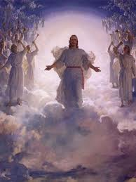
Required to enter the Kingdom
Acts 14:22 - We must through many tribulations enter the kingdom of God.
“He who runs from tribulations runs from God” – St. Paul the Hermit

Slide 8
To reach spiritual maturity
James 1:4-5 - But let patience have its perfect work, that you may be perfect and complete, lacking nothing.
We cannot attain virtue unless we endure trials to develop patience.
Working out is painful but develops muscles

Slide 9
Endurance requires wisdom
James 1:5 - If any of you lacks wisdom, let him ask of God, who gives to all liberally and without reproach, and it will be given to him.
Wisdom to focus on God, not the trial
Joy comes by trusting God during the trial, not just waiting for the trial to end
The time of trial is a time of prayer, not idleness and despair

Slide 10
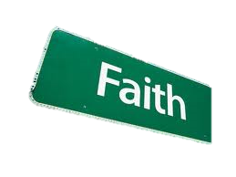
Ask in faith
James 1:6-8 - But let him ask in faith, with no doubting, for he who doubts is like a wave of the sea driven and tossed by the wind. For let not that man suppose that he will receive anything from the Lord; he is a double-minded man, unstable in all his ways.
Why do we ask if we do not expect to receive?
God will certainly grant comfort and peace, but perhaps not the resolution we seek immediately

Slide 11
Do not doubt
“Put away doubting and do not hesitate to ask of the Lord. Do not say to yourself. ‘How can I ask of the Lord and receive from Him, seeing that I have sinned so much against Him?’ Do not reason with yourself like this, but turn to the Lord with all your heart and ask of Him without doubting, and you will know the multitude of His tender mercies, that He will never leave you but fulfill the request of your soul.” - Hermas

Slide 12
Results in reward
James 1:12 - Blessed is the man who endures temptation; for when he has been approved, he will receive the crown of life which the Lord has promised to those who love Him.
“How beneficial are these sufferings and temptations for your life! Some may think that they are evil, but the saints do not avoid them but seek them with all their power, enduring them courageously, becoming beloved of God and receiving the crown of eternal life. The apostle says, ‘Therefore, I take pleasure in infirmities, in reproaches, in needs, in persecutions, in distresses, for Christ’s sake, for when I am weak, then I am strong.’” - Father Theodore

Slide 13
Temptations

Slide 14
Temptations are not from God
Temptations are from the devil or from our evil desires
Purpose is to cause us to sin.
James 1:13-14 - Let no one say when he is tempted, "I am tempted by God"; for God cannot be tempted by evil, nor does He Himself tempt anyone. But each one is tempted when he is drawn away by his own desires and enticed.
Matthew 4:1 - Then Jesus was led up by the Spirit into the wilderness to be tempted by the devil.

Slide 15
Desire → Sin → Death
James 1:15 - Then, when desire has conceived, it gives birth to sin; and sin, when it is full-grown, brings forth death.
Excitement (Drawn to it) – memory or senses: seeing, hearing, smelling, tasting, or touching
To enjoy it (Desire conceived) – “If we are fasting, then when we see food, lust of tasting the food is stirred in us, that in turn produces enjoyment. Then we should not please it, but control it.” – St. Augustine
To please it (To give birth) – “However, if we please it, then sin will be completed in the heart and God will know about it, even if no man knows.” – St. Augustine
Repeated unrepented sin leads to death

Slide 16
Lay aside filthiness
James 1:21 - Therefore lay aside all filthiness and overflow of wickedness, and receive with meekness the implanted word, which is able to save your souls.
To overcome temptations we must do 2 things:
  Lay aside all filthiness – Purge sinful influences. TV, movies, media, and what we allow our eyes to see. What we allow ourselves to listen to. The people that we associate with, etc.
  Receive the word with meekness. We should be like the good ground.
Matthew 13:23 - But he who received seed on the good ground is he who hears the word and understands it, who indeed bears fruit and produces: some a hundredfold, some sixty, some thirty.”

Slide 17
Be doers of the Word
James 1:22-24 - But be doers of the word, and not hearers only, deceiving yourselves. For if anyone is a hearer of the word and not a doer, he is like a man observing his natural face in a mirror; for he observes himself, goes away, and immediately forgets what kind of man he was.
Puffed up with knowledge and judging others
Hypocrisy
Blind to our own sins and shortcomings

Slide 18
Examine the heart
“Neither I nor any other preacher can see into your hearts... but God is looking, for nothing can be hidden from Him. Do not deceive yourselves by coming eagerly to hear the Word and then failing to do it. If it is a good thing to hear, it is a much better thing to do. If you do not hear, you cannot do, and therefore you will build nothing. But if you hear and do not do, then what you are building will be a ruin.” – St. Augustine
Outward acts (service) vs. inward acts (repentance and prayer)

Slide 19
Knowledge without works
James 3:1 - My brethren, let not many of you become teachers, knowing that we shall receive a stricter judgment.
James 1:27 - Pure and undefiled religion before God and the Father is this: to visit orphans and widows in their trouble, and to keep oneself unspotted from the world.
Judged based on our works, not our knowledge

Slide 20
I am a “good” person
Looks but does not see
We do not want to see the ugly things in our character
Easier to defend ourselves rather to admit the depth of our sin
King David: “Wash me thoroughly from my iniquity, and cleanse me from my sin. For I am conscious of my iniquity; and my sin is at all times before me.”
Instead do we say: “For I am conscious of my accomplishments; and my strengths are at all times before me”?

Slide 21
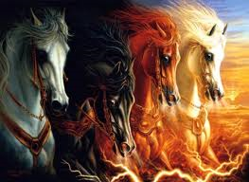
Judgment Day
We will be judged for what we did with each word of truth we received
Matthew 12:41 - The men of Nineveh will rise up in the judgment with this generation and condemn it, because they repented at the preaching of Jonah; and indeed a greater than Jonah is here.
Why are people interested in the apocalypse?

Slide 22
Perseverance
James 1:25 - But he who looks into the perfect law of liberty and continues in it, and is not a forgetful hearer but a doer of the work, this one will be blessed in what he does.
The spiritual life requires lifelong commitment, seriousness, and consistency, not spurts of emotional passion

Slide 23
Perseverance
“This is the mark of Christianity--however much a man toils, and however much righteousness he performs, to feel that he has done nothing, and in fasting to say, ‘This is not fasting,’ and in praying, ‘This is not prayer,’ and in perseverance at prayer, ‘I have shown no perseverance; I am only just beginning to practice and to take pains’; and even if he is righteous before God, he should say, ‘I am not righteous, not I; I do not take pains, but only make a beginning every day.’” - St. Macarius the Great

Slide 24
Sins of the tongue
James 1:19-20,26 - So then, my beloved brethren, let every man be swift to hear, slow to speak, slow to wrath; for the wrath of man does not produce the righteousness of God…If anyone among you thinks he is religious, and does not bridle his tongue but deceives his own heart, this one's religion is useless.
One mirror to see if we are doers or hearers is our speech
Wrath, gossip, excessive talking, cursing, etc

Slide 25
Summary
Trials
  Joy
  Testing our faith
  An act of love
  To be expected
  Required to enter the Kingdom of God
  Result in spiritual maturity
  Asking for wisdom in faith during trials
  Heavenly reward
Temptations
  Desires + Devil
  Lay aside filthiness
  Be doers of the Word
  Examine the heart
  Knowledge without works
  Blindness to our sin
  Judged by what we hear
  Perseverance
  Sins of the tongue

