Slide 1
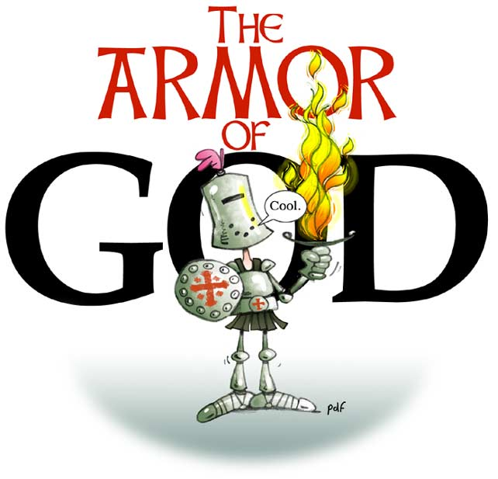

Slide 2
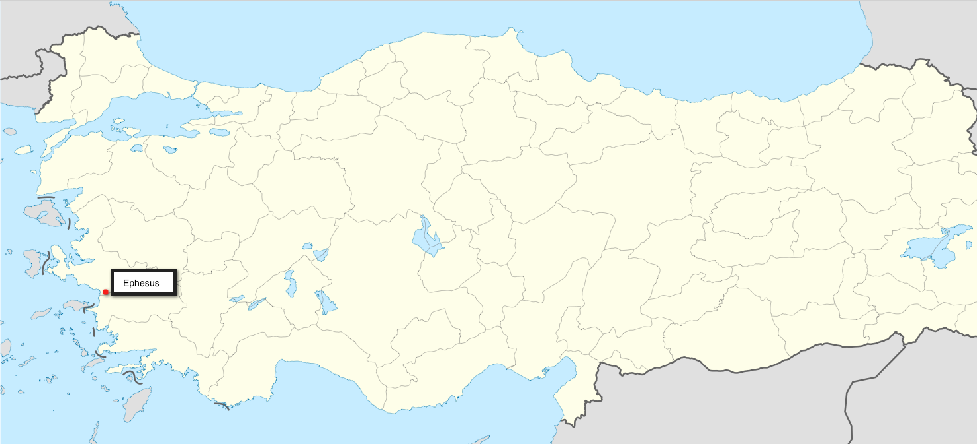
Ephesians Ch 6:10-20
Belt of Truth
Breastplate of righteousness
Shod your feet with preparation of Gospel of Peace
Shield of Faith
Helmet of Salvation
Sword of the Spirit

Slide 3
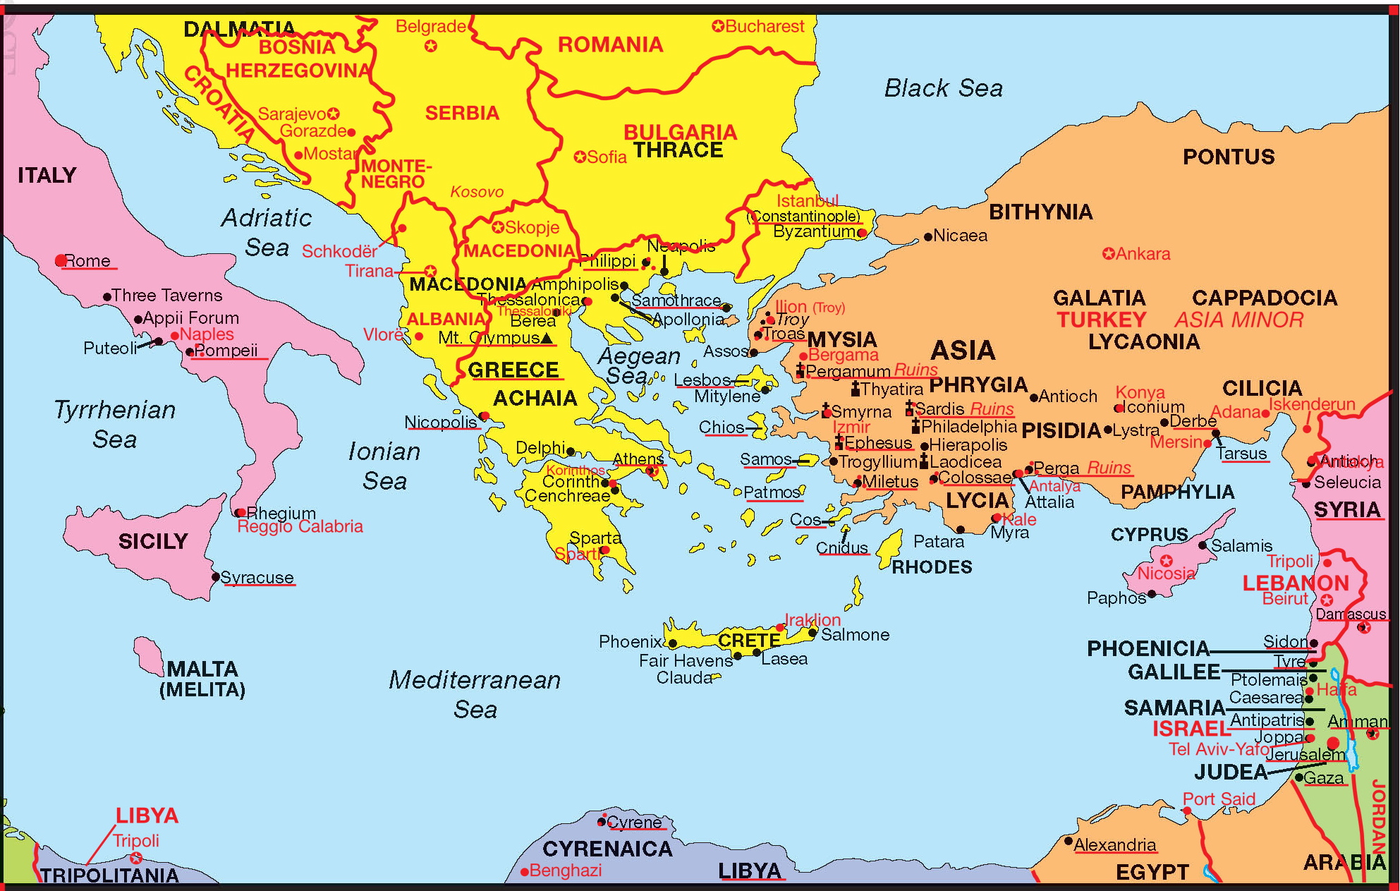
Ephesians Chapter 6:10-20

Slide 4
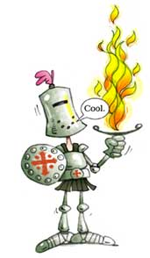
The Armor of God
(Eph 6:10) Finally my brethren, be strong in the Lord and in the power of His might
Who are these brethren?
Husbands
Wives
Fathers
Mothers
Sons
Daughters
Masters
Slaves

Slide 5
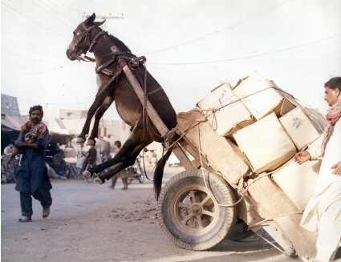
The Armor of God
(Eph 6:10) Finally my brethren, be strong in the Lord and in the power of His might
We need to learn to be strong.
Why? We are His sons and daughters.
We carry our worries above our shoulders.
(Gen 5:1) In the day that God created man, He made him in the likeness of God.
No comment ;…

Slide 6
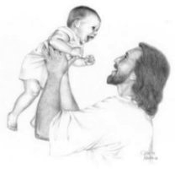
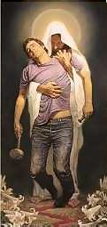
The Armor of God
Who asked us to take the whole load on our shoulders?
I thought I can do it;…
(Math 11:28) “Come to Me all you who labor and are heavy laden and I will give you rest.”

Slide 7
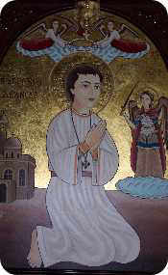
The Armor of God
(Eph 6:11) Put on the whole armor of God, that you may be able to stand against the wiles of the devil.
He wants us to be strong for who?
Others
Ourselves
Why?
Education?
Success in Career?
Physical well being?
Spiritual well being?
St. Abanoub
(Matthew 18:20) For where two or three are gathered together in My name, I am there in the midst of them.”

Slide 8
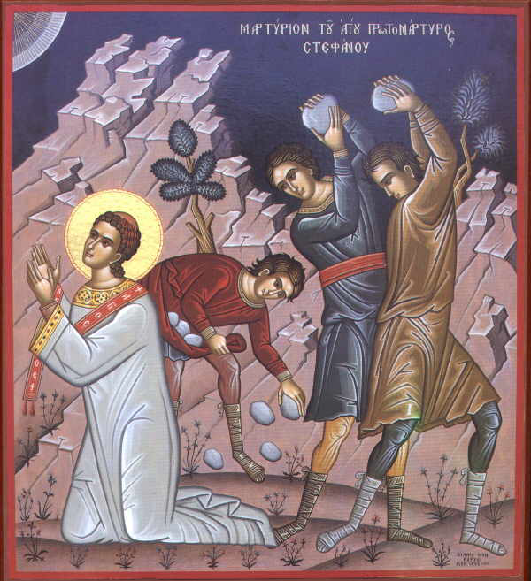
The Armor of God
(Eph 6:12) For we do not wrestle against flesh and blood, but against principalities against powers against the rulers of the darkness of this age against spiritual hosts of wickedness in the heavenly places.
Our war is not against people.
St Stephen while he was being stoned said:
(Acts 7:60) “Lord, do not charge them with this sin.”
St Paul is asking us to remember:
  Who is steering the war against us (our enemy).
  When a husband and a wife are fighting.
  The enemy of good may try to put a thought in our minds and then we keep dwelling on it.
We need to have a spiritual guide (Abuna).

Slide 9
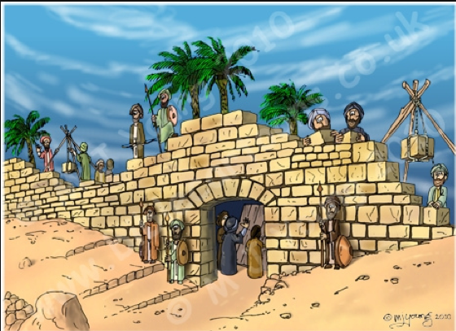
The Armor of God
(Eph 6:13) Therefore take up the whole armor of God, that you may be able to withstand in the evil day, and having done all, to stand, stand therefore
God here is like a good Father repeating the advise.
If you are a soldier in a war you will not sleep.
Remember how Nehemiah organized his men when danger was nearby.

Slide 10
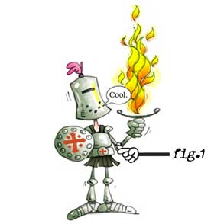
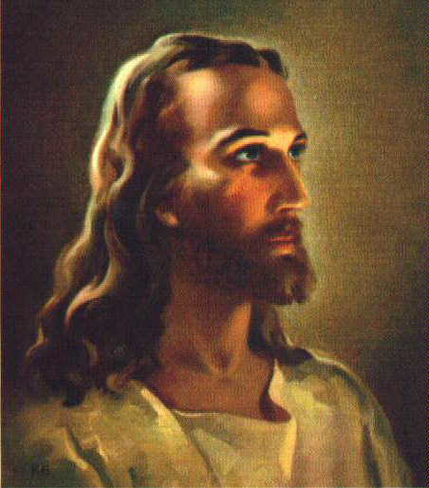
1. Belt of Truth (Self Control)
(Eph 6:14) “Stand therefore, having girded your waist with truth”
(John 14:6) “I am the way, the truth and the life”
The truth helps us in controlling our lusts, our bodies, our senses.
How does the truth help us in self control?
(Math 4:4) “Man shall not live by bread alone’ teaches us to fast.
kingdom of heaven teaches us that living on earth is not the end and it helps us in controlling our lusts.
(1 Peter 5:8) Our enemy walks about like a roaring lion seeking whom he may devour makes us more careful and vigilant.

Slide 11
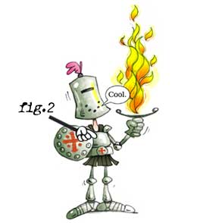
2. Breastplate of Righteousness
(Eph 6:14) “Stand therefore, … having put on the breastplate of righteousness;”
Any virtue we have in our life on earth like patience, humbleness, meekness, love, wisdom;… is coming from who? From Jesus Christ because He alone is perfect.
The devil keeps bombarding us with missiles of lies and accusations in the forms of thoughts or reminders of past sins, the same sins that God has removed.
Sometimes we tend to accuse ourselves that we are not perfect.
Or worse we don’t forgive ourselves even after Jesus has forgiven us (feelings of guilt and relation to - ).

Slide 12
2. Breastplate of Righteousness
How can we live in virtue all the time?
Ha I know the answer…
Are we really wearing the breastplate all the time?
Activity Duration
Wake up, get ready - 1/2 hr
Give the kids lift to school, and go to work - 1/2 hr
Work - 8 hrs
Drive back to home - 1 hr
Have dinner, get some rest or do some errands. - 1 hr
Watch TV, news, a movie, sports - 2 hrs
Oh I didn't check my personal emails - 1 hr
Oh I received messages on Facebook, and it is rude not to reply - 2 hrs
Sleep - 8 hrs
Can we do it?
(Phil 4:13) “I can do all things in Christ who strengthens me”
Read in the Bible or the Agpeya - 15 minutes

Slide 13
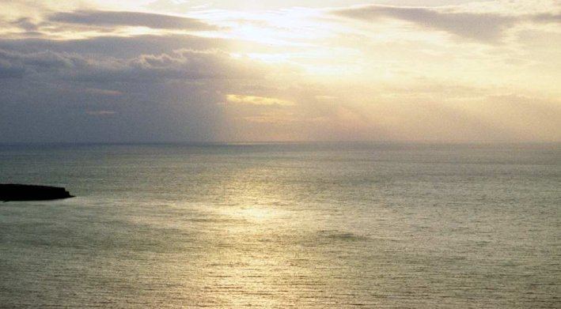
Ephesians Theme … In Jesus Christ … in the Lord

Slide 14
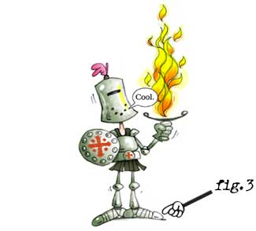
3. The shoes of the Gospel of Peace
(Eph 6:15) “Stand therefore, … having … shod your feet with the preparation of the gospel of peace;
Can you imagine a soldier going to war bare footed. It is the Bible which guides our feet.
Gospel of peace, although we are in war, we are in enmity with the bad but this is a message of peace because we are in peace with all other people.

Slide 15
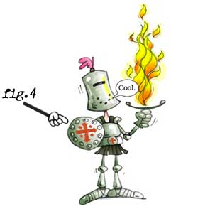

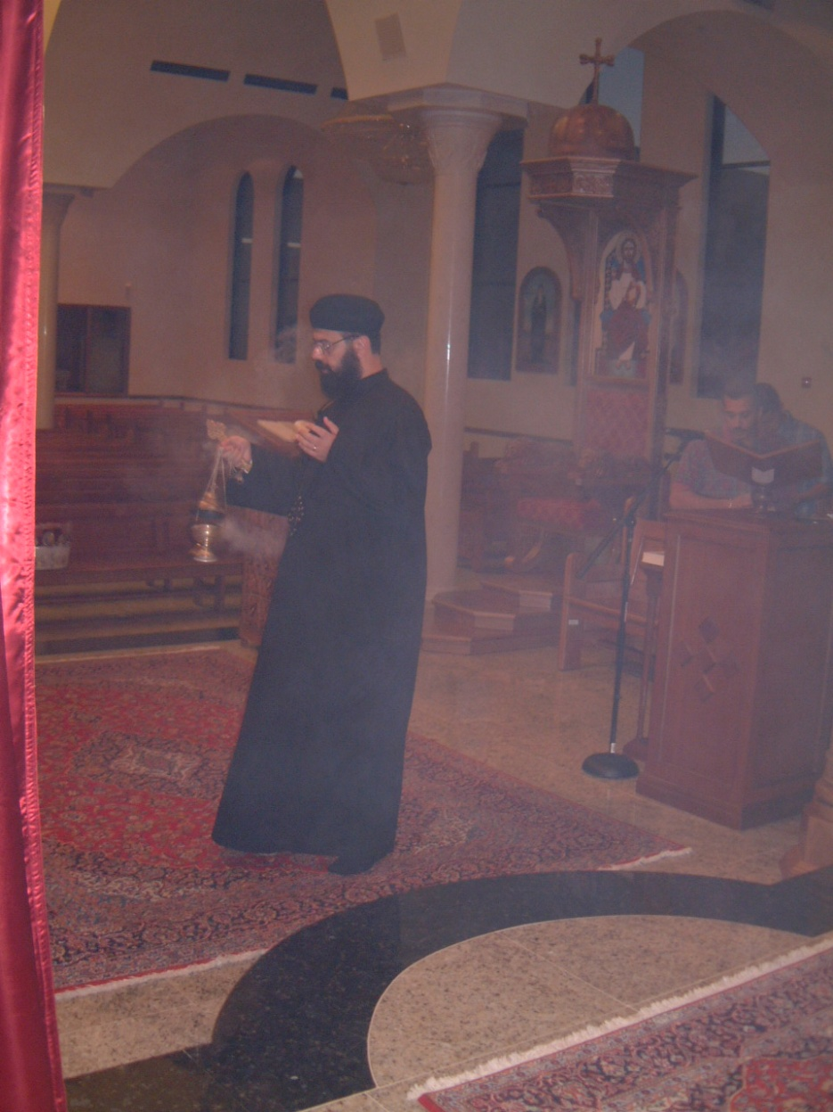
4. Shield of Faith
(Eph 6:16) “Above all taking the shield of faith, with which you will be able to quench all the fiery darts of the wicked one.”
The enemy of good is throwing darts and arrows.
Do we have our shield on?
If yes we’re shielded.
What if one of them gets through.
The enemy throws arrows of doubt, was Jesus Christ really a human being and God at the same time?
Your shield starts working remembering Abuna from the Liturgy when he says:
[Truly I believe that his divinity parted not from his humanity for a single moment nor a twinkling of an eye.]

Slide 16
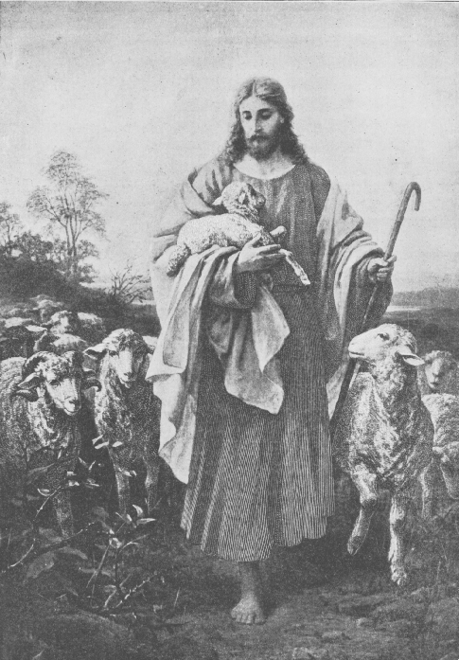
4. Shield of Faith
(Eph 6:16) “Above all taking the shield of faith, with which you will be able to quench all the fiery darts of the wicked one.”
There are arrows about money, e.g. easy money through illegal methods.
(1 Timothy 6:10) For the love of money is a root of all kinds of evil;
One of the strongest shields you can put on is to absorb:
(Psalm 23) ¹The LORD is my shepherd, I shall not want;… ⁴Yes, though I walk through the valley of the shadow of death, I will fear no evil; For You are with me;…

Slide 17
4. Shield of Faith
(Eph 6:16) “Above all taking the shield of faith, with which you will be able to quench all the fiery darts of the wicked one.”
When arrows of desperation come to your way because there are a lot of evil around you.
(John 16:33) In the world you will have tribulation; but be of good cheer, I have overcome the world.”

Slide 18
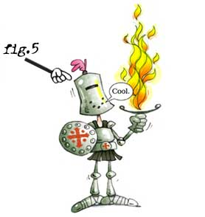
5. Helmet of Salvation
(Eph 6:17) And take the helmet of salvation;...
Our church is beautiful, it always reminds us by the helmet of Salvation.
How is that?
Reading in the Agpeya:
Morning prayers: reminds us by the Lord’s resurrection. Atheists say so what? We say how? without His resurrection we would have been still waiting in Hades.
Sixth hour: reminds us by Jesus Christ being crucified, this is a salvation thought, because it reminds us that He loves us so much that he went through all this pain for us.
Compline and Vespers: this is the end of the day did you get ready to meet with Him.
In the Liturgy we say: Jesus Christ my good Savior

Slide 19
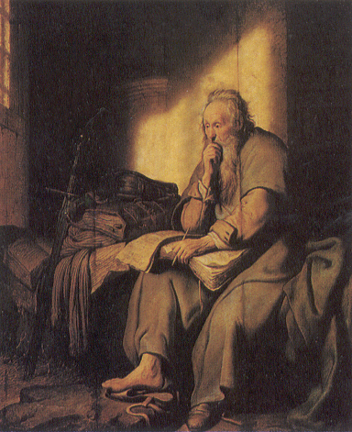
5. Helmet of Salvation
(Eph 6:17) And take the helmet of salvation;...
How would we react if we go out of this meeting to prison?
Some of us will:
Start weeping and wining.
Start praying to God
Start using the time to preach the word of God to the rest of the prisoners.
St. Paul in Prison (by Rembrandt - 1627)

Slide 20
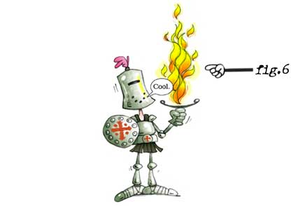
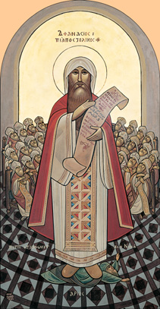
6. The Sword of the Spirit
(first one to defend and respond)
(Eph 6:17) And take …, and the sword of the Spirit, which is the word of God;…
We need the sword of spirit, not only to shield us but to protect and respond.
The enemy of good found that killing the disciples and the apostles was causing more Christians to be brought into the faith.
So he decided to fight the church with thoughts (heresies).
Heretics like Arius;… were more dangerous than killing the Christians.
The Lord blessed the church with people who have the sword of spirit. Like who?
St Athanasius, St Peter the seal of Martyrs, St Cyril;…

Slide 21
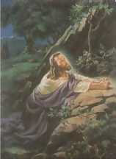
Praying all the time:
(Eph 6:18) praying always with all prayer and supplication in the Spirit.
(Philippians 4:6) Be anxious for nothing, but in everything by prayer and supplication, with thanksgiving.

Slide 22
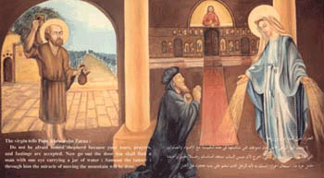
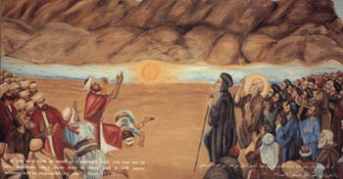
The Whole Armor of God
Remember we need to put the whole armor of God to be strong, then we can move mountains (worries;…).
Right?
(Matthew 17:20) “if you have faith as a mustard seed, you will say to this mountain, Move from here to there and it will move and nothing will be impossible for you.”

