Slide 1
Suffering and the Life of Holiness: 1 Peter 4
Servants’ Meeting
October 9, 2010

Slide 2
1 Peter 4
1 Therefore, since Christ suffered for us in the flesh, arm yourselves also with the same mind, for he who has suffered in the flesh has ceased from sin,
2 that he no longer should live the rest of his time in the flesh for the lusts of men, but for the will of God.
3 For we have spent enough of our past lifetime in doing the will of the Gentiles --- when we walked in lewdness, lusts, drunkenness, revelries, drinking parties, and abominable idolatries.
4 In regard to these, they think it strange that you do not run with them in the same flood of dissipation, speaking evil of you.
5 They will give an account to Him who is ready to judge the living and the dead.

Slide 3
1 Peter 4
Serving for God’s Glory
6 For this reason the gospel was preached also to those who are dead, that they might be judged according to men in the flesh, but live according to God in the spirit.
7 But the end of all things is at hand; therefore be serious and watchful in your prayers.
8 And above all things have fervent love for one another, for “love will cover a multitude of sins.”
9 Be hospitable to one another without grumbling.
10 As each one has received a gift, minister it to one another, as good stewards of the manifold grace of God.

Slide 4
1 Peter 4
Suffering for God’s Glory
11 If anyone speaks, let him speak as the oracles of God. If anyone ministers, let him do it as with the ability which God supplies, that in all things God may be glorified through Jesus Christ, to whom belong the glory and the dominion forever and ever. Amen.
12 Beloved, do not think it strange concerning the fiery trial which is to try you, as though some strange thing happened to you;
13 but rejoice to the extent that you partake of Christ’s sufferings, that when His glory is revealed, you may also be glad with exceeding joy.
14 If you are reproached for the name of Christ, blessed are you, for the Spirit of glory and of God rests upon you. On their part He is blasphemed, but on your part He is glorified.

Slide 5
1 Peter 4
15 But let none of you suffer as a murderer, a thief, an evildoer, or as a busybody in other people’s matters.
16 Yet if anyone suffers as a Christian, let him not be ashamed, but let him glorify God in this matter.
17 For the time has come for judgment to begin at the house of God; and if it begins with us first, what will be the end of those who do not obey the gospel of God?
18 Now “If the righteous one is scarcely saved, Where will the ungodly and the sinner appear?”
19 Therefore let those who suffer according to the will of God commit their souls to Him in doing good, as to a faithful Creator.

Slide 6
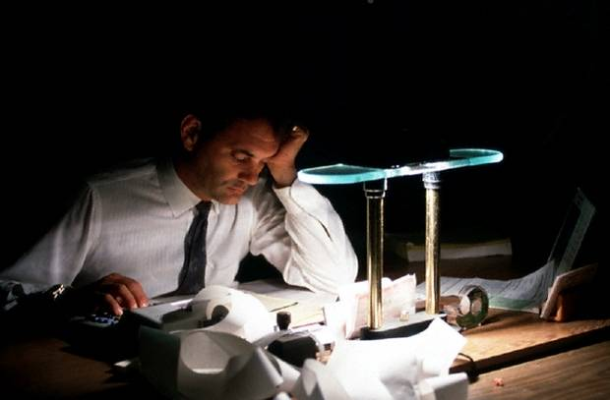
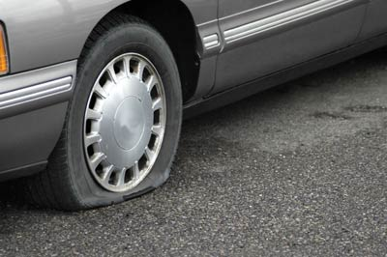
Types of Suffering
Day-to-day trials and tribulations
  Responsibilities at the home and office
  Difficulties that face us day in and day out
    Flat tire, car trouble
    Getting no sleep due to a sick child
    Working late and through the weekend to finish a project

Slide 7
Types of Suffering
Suffering due to my sins
  Laziness and carelessness at work causes me to miss a deadline
    Rebuked by manager
    Written up
    Pay cut
    “Laziness casts one into a deep sleep, And an idle person will suffer hunger.” (Prov 19:15)
  Lack of serious study leads to troubles in class
    Low grade on exam, extra tutoring
  Drinking, smoking, drugs, etc.
    Destroys my liver and lungs
    Bronchitis

Slide 8
Types of Suffering
  Lack of attention in raising my child
    Disobedience and rebellion
    Lacks the fear of God
    Lacks wisdom and becomes a source of pain in later years
  My sensitivities and weaknesses
    Interpret intentions of others in an evil way
    Offended easily by every comment, rebuke, action, look, etc.
    Never at peace with those around me, but have made myself a victim in my own mind
    Because I do not have a simple eye, I suffer due to the successes and blessings of others

Slide 9
Types of Suffering
Sufferings out of my control
  Emerging or sudden illness
    Cancer
    Heart attack
    Terminal disease
  The loss of a loved one
    Whether sudden or expected

Slide 10
Types of Suffering
Suffering for the sake of godliness
  Enduring weaknesses of others
    “with all lowliness and gentleness, with longsuffering, bearing with one another in love” (Eph 4:2)
  Loving enemies; blessing those who curse us
    “But I say to you, love your enemies, bless those who curse you, do good to those who hate you, and pray for those who spitefully use you and persecute you” (Matt 5:44)
  Suffering shame for the sake of the Lord Christ
    “So they departed from the presence of the council, rejoicing that they were counted worthy to suffer shame for His name.” (Acts 5:41)

Slide 11
Types of Suffering
  Being considered a fool
    “We are fools for Christ's sake” (1 Cor 4:10)
    “Let no one deceive himself. If anyone among you seems to be wise in this age, let him become a fool that he may become wise.” (1 Cor 3:18)
    “But the natural man does not receive the things of the Spirit of God, for they are foolishness to him; nor can he know them, because they are spiritually discerned.”
    (1 Cor 2:14)
  Turning the other cheek
    “But I tell you not to resist an evil person. But whoever slaps you on your right cheek, turn the other to him also.”
    (Matt 5:39)

Slide 12
Types of Suffering
  For the sake of love and unity, accepting the group’s opinion, even if I am not convinced
    “fulfill my joy by being like-minded, having the same love, being of one accord, of one mind.” (Phil 2:2)
  Being considered “different” than those around me
    “In regard to these, they think it strange that you do not run with them in the same flood of dissipation, speaking evil of you.”
    (1 Peter 4:4)
  Freely seeking suffering for the sake of the comfort of others
    The churches of Macedonia: “that in a great trial of affliction the abundance of their joy and their deep poverty abounded in the riches of their liberality.” (2 Cor 8:2)

Slide 13
How do we Understand Suffering?
The world views suffering as evil, but what about us?
It is only a negative that can be of no good whatsoever?
Happens as a punishment?
Leads us to blame others, blame the church, and to eventually blame the Lord God Himself

Slide 14
What Scripture Says
“My brethren, count it all joy when you fall into various trials” (James 1:2)
“For what credit is it if, when you are beaten for your faults, you take it patiently? But when you do good and suffer, if you take it patiently, this is commendable before God.” (1 Peter 2:20)
“But even if you should suffer for righteousness' sake, you are blessed.” (1 Peter 3:14)
“For it is better, if it is the will of God, to suffer for doing good than for doing evil.” (1 Peter 3:17)

Slide 15
Benefits of Suffering
Leads me to seek the Lord
  Heartfelt prayer
  Provides an opportunity for a new level of intimacy with God
  Increases my experiences with the Lord
  Those who suffer the most are those who typically are very close to the Lord

Slide 16
Benefits of Suffering
Is a test of my faith
  All the spiritual activity I do prepares me for the moments of suffering
Provides me a mirror into my heart
  At moments of weakness, I can see the true condition of my heart
  Identify my weaknesses and I seek to address them
Allows me an opportunity for purification
  This is the real goal: a step further in the life of holiness

Slide 17
Benefits of Suffering
Suffering causes me to cease from sins of the flesh
  “Therefore, since Christ suffered for us in the flesh, arm yourselves also with the same mind, for he who has suffered in the flesh has ceased from sin” (1 Peter 4:1)
My own suffering makes me more aware of the suffering of others
  When I compare my suffering to that of others, I am comforted knowing that my pain is nowhere near as great.

Slide 18
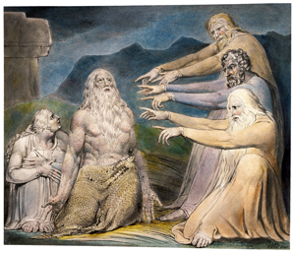
Examples of Suffering: Job
See how Job reacted to his suffering
  Never blamed the Lord
  Blessed the Lord:
    “Naked I came from my mother's womb,
    And naked shall I return there. The LORD gave, and the LORD has taken away; Blessed be the name of the LORD.” (Job 1:21)
  “The patience of Job”
  Suffering was necessary
    Helped him see the error of his ways: self-righteousness
    Helped him to grow in the life of holiness

Slide 19
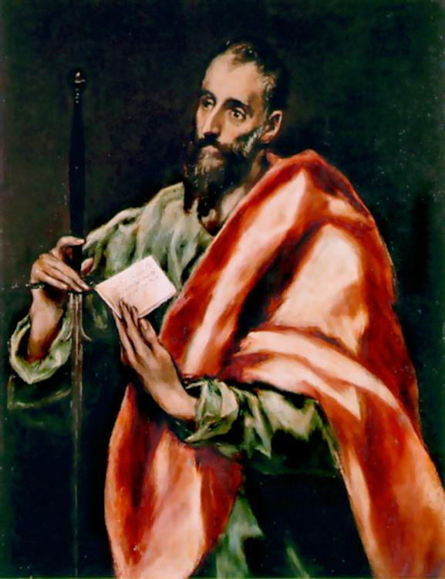
Examples of Suffering: St. Paul
He labored more than all the apostles
  “but I labored more abundantly than they all, yet not I, but the grace of God which was with me.”
  (1 Cor 15:10)
He suffered greatly for the sake of the Gospel of the Lord Christ, yet he did so patiently and joyfully
  23 “Are they ministers of Christ? --- I speak as a fool --- I am more: in labors more abundant, in stripes above measure, in prisons more frequently, in deaths often.
  24 From the Jews five times I received forty stripes minus one.

Slide 20
Examples of Suffering: St. Paul
  25 Three times I was beaten with rods; once I was stoned; three times I was shipwrecked; a night and a day I have been in the deep;
  26 in journeys often, in perils of waters, in perils of robbers, in perils of my own countrymen, in perils of the Gentiles, in perils in the city, in perils in the wilderness, in perils in the sea, in perils among false brethren;
  27 in weariness and toil, in sleeplessness often, in hunger and thirst, in fastings often, in cold and nakedness ---
  28 besides the other things, what comes upon me daily: my deep concern for all the churches.”
  (2 Cor 11:23-28)

Slide 21
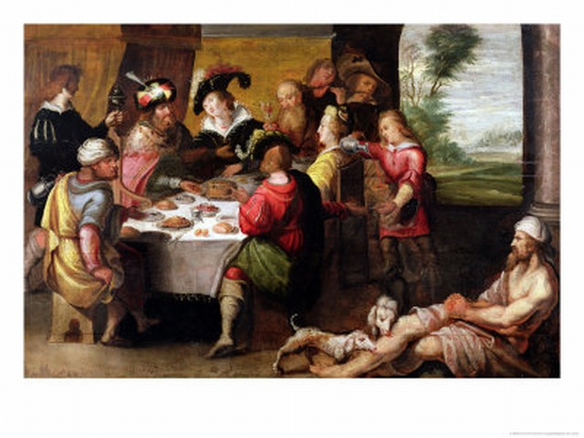
Examples of Suffering: Lazarus
Never enjoyed any of the pleasures of the world
Suffered during every waking moment
Was consistently neglected by the rich man
But through his patient enduring of his sufferings, he was cleansed of his sins and won a place in Paradise

Slide 22
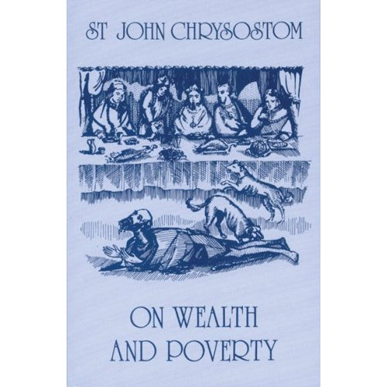
Examples of Suffering: Lazarus

Slide 23
Examples of Suffering: Lazarus
“For when our good actions are small and slight, but the weight of our sins is unspeakably great, if in this life we enjoy prosperity and do not suffer any misfortune, we will certainly depart bare and naked from the exchange of good things, since we will have received all our due in this life. Likewise when our good actions are many and great, but our sins small and slight, if we suffer any misfortune, we put away even those small sins in this life, and in the next life we receive as our due a pure reward ready for our good deeds.”

Slide 24
Examples of Suffering: Lazarus
“Therefore when you see anyone living in wickedness but suffering no misfortune in this life, do not call him lucky, but weep and mourn for him, because he will have to endure all the misfortunes in the next life, just like this rich man. Again, when you see anyone cultivating virtue, but enduring a multitude of trials, call him lucky, envy him, because all his sins are being dissolved in this life, and a great reward for his endurance is being prepared in the next life; just as it happened for this man Lazarus.”
--St. John Chrysostom

Slide 25
Examples of Suffering: Lazarus
“…For he who pays some penalty here will experience a lighter punishment hereafter; but he who is forced to endure all his punishment hereafter will have an unmerciful judgment, just as this rich man, because he had not washed away any of his sins here, was so severely punished that he could not get even the smallest drop of water.”
--St. John Chrysostom

Slide 26
A New Attitude
We should learn to welcome sufferings and to expect them
We should learn that they are actually a source of blessing to us and not a curse at all
We should learn that sufferings cleanse me from my sins and bring me closer to the life of holiness that the Lord expects of us

Slide 27
Review
Types of Suffering
How do we Understand Suffering?
What Scripture Says
Benefits of Suffering
Examples of suffering: Job, St. Paul, Lazarus
A New Attitude

Slide 28

Another Good Resource

