Slide 1
Humility, The service of washing the feet;
John 13 1-17

Slide 2
The lesson of Christ washing the disciples’ feet
The meditation of the church fathers.
What we know about this service
What is Humility?
How to Become Humble?
Father’s sayings’ about Humility

Slide 3
The meditation of the church fathers
He rose from supper (v4)
He laid aside His garments (v4)
He girded Himself with a towel (v4)
He began to wash the disciples' feet (v5)
He took His garments again (v12)
He sat down (v12)
He rose from His heavenly throne and communion with the Father.
He laid aside His glory
He took the form of a servant and became Man
He began His present ministry of cleansing us from sin. (1 John 1:9)
He is now glorified
He is now seated at the right hand of the Father. (Hebrews 1:3)

Slide 4
What we know about this service
Washing the feet is an act of a servant
A service of humility
The Lord used His Mighty hands to serve the disciples who would soon desert Him
God Loved His Disciples “To the End” This great love for His own was demonstrated in the act of foot-washing
His washing of feet to be symbolic of another washing--the cleansing from sin.
A teaching of how to follow Christ instructions “ For I have given you an example, that you should do as I have done to you” John 13:15
Bathing represents salvation and the foot-washing represents restoration
Notes:
Love to the end (Let those go first), Covenant Thursday

Slide 5
What is Humility?
A great Virtue
"...and learn from Me, for I am gentle and lowly in heart" (Matt. 11:29).
“Humility is the foundation upon which all virtues are built up. Humility is the rampart that guards all virtues and all gifts” (Pope Shenouda)
Not thinking too highly of oneself, opposite of pride
(James 4:6) God resists the proud”
(Proverbs 11:2) “When pride comes, then comes shame; But with the humble is wisdom”
Notes:
A great Virtue, The Story of ST Mcarouis, Saint Antony Traps, Saint Antony Satan

Slide 6
What is Humility?
A quality of being courteously respectful of others
Matthew 23-11,12“But he who is greatest among you shall be your servant. And whoever exalts himself will be humbled, and he who humbles himself will be exalted”.
Is exactly what is needed to live in peace
Proverbs 16:7: “When a man’s ways please the LORD, He makes even his enemies to be at peace with him”
Notes:
The Story of Saint Moses in the night

Slide 7
What is Humility?
Dissipates anger and heals old wounds
Proverbs 16:32 “He who is slow to anger is better than the mighty, And he who rules his spirit than he who takes a city,
Distinguishes the wise leader from the arrogant power-seeker
Proverbs 29:11, 12 “A fool vents all his feelings, but a wise man holds them back. If a ruler pays attention to lies, all his servants become wicked
Notes:
Covering the sin by saint Macarouis

Slide 8
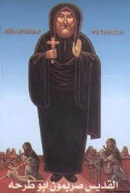
What is Humility?
Will gain us much more than we sacrifice
The Widow’s mites she was acknowledged and praised by the Lord Himself
“Then one poor widow came and threw in two mites, which make a quadrans. So He called His disciples to Himself and said to them, “Assuredly, I say to you that this poor widow has put in more than all those who have given to the treasury; (Mark 12:41)
Act of Love
Saint Sarapamoun The Bishop Of Minoufia
Notes:
The story of the brother, and the story of the monk next to saint arsanouis

Slide 9
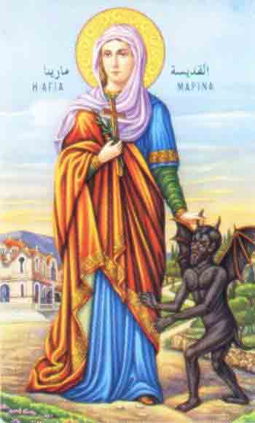
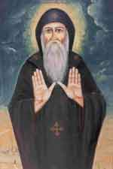
What is Humility?
The fear of God
Proverb 22:4 “By humility and the fear of the LORD Are riches and honor and life
Leaning and relying on the power of God
Saint Macarius
Saint Marina

Slide 10
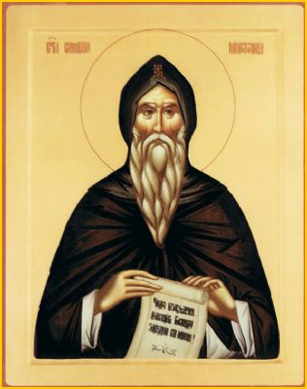
How to Become Humble?
Pray to become humble (Saint Arseny, Saint Bishoy)
Exodus 20:24-26 ”An altar of earth you shall make for Me, and you shall sacrifice on it”
Sacrifice what you cannot live without (The most attached sin)
Meditate on the gifts and honors that God gave you
Meditate on the multitude of sins which God covers for you. (saint Antony saying)
Do the dirty services.
Notes:
Saint Arsanouis Praying from the sunset to sunrise

Slide 11
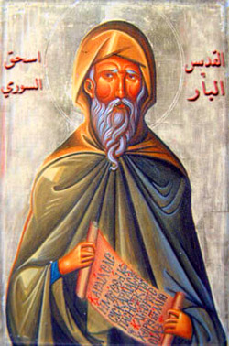
Some of the father’s Says about Humility
Saint Isaac the Syrian said:
"I want to speak about humility, but I am afraid, as one who wants to speak about God...this is because humility is the garment that divinity wore when He appeared among us...for this reason, when the devils see a humble person, they are afraid, because they see in him the image of their Creator who has subdued them."

Slide 12
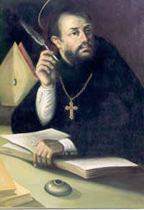
Some of the father’s Says about Humility
“Saint Augustine” Let us then follow Christ’s paths which he has revealed to us, above all the path of humility, which He Himself became for us. He showed us that path by his precepts, and he himself followed it by his suffering on our behalf

Slide 13
Some of the father’s Says about Humility
St. Augustine: the path of humility trod by Christ which we too must tread, admitting that we are saved not by our own virtue or good works, by but God's merciful grace, which we receive before we do anything to deserve it, as a free gift of the Father's love.

Slide 14
Glory Be to God

