Slide 1

Song of Songs - Chapter 5
Matrimonial Life

Slide 2
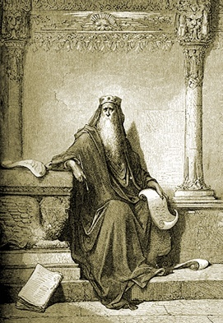
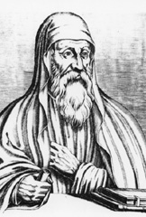
Song of Songs - Chapter 5
Matrimonial Life
Author:
King Solomon
Origen

Slide 3

References
Origen on Song of Songs as the spirit of Scriptures.
By J. Chirstopher King
Abuna Tadros Malaty
Sermons of Fr. Anthony Messeh
Sermons of Anba Youannes Bishop of Gharbya

Slide 4
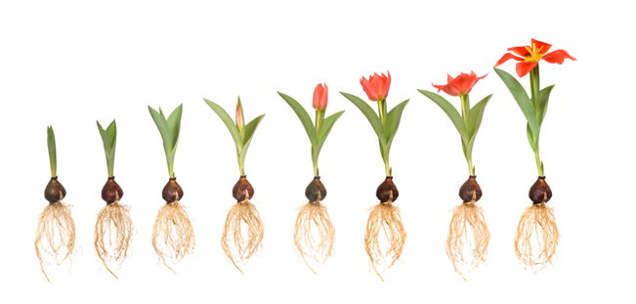
Matrimonial Life - Ch 5
Imagine this plant represents our spiritual life cycle
Are we there spiritually?
Song of Songs wants us to be here

Slide 5
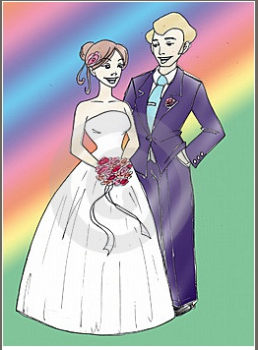
Worldly
Matrimonial means:
A bride and her groom who will get married or already married.

Slide 6
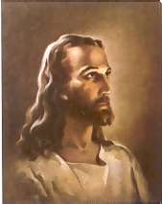
Spiritually
What is the theme of the
book of Song of Songs?
Abiding in Christ.
^{(John 6:56)} “He who eats My flesh and drinks My blood abides in Me and I in him”
Attaining union of faith and the knowledge of His infinite glory.
^{(Mat 19:6)} “So then they are no longer two but one flesh”

Slide 7
Do you remember Ch 1-3 ?
Ch 1: The bride expresses her desire for the groom.
Ch 2/3: Union broken and restored.
She got what she wanted but she quickly lost it because she went after the world desires.
After repentance we always go back to our Father in heaven.

Slide 8
Do you remember Ch 4 ?
Ch 4: Joy of unbroken union, the Beloved accepted her back and kept talking about her beauty.
She said that you do whatever you like from the north or from the south like martyrs surrendering their lives to the Lord without even hesitation

Slide 9

^{(Song of Songs 5:1)} I have come to my garden,
my sister, my spouse.
My garden?
Her heart or the heart of each one of us.

Slide 10

^{(Song of Songs 5:2)} I sleep but my heart is awake, it is
the voice of my beloved.
I sleep:
Something Catastrophic happened here between verse 1 and verse 2
What Happened? In our spiritual lives after approaching God we may have set backs due to running after worldly lusts even during service.

Slide 11
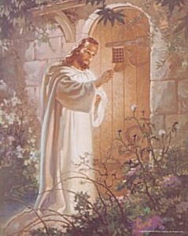
^{(Song of Songs 5:2)} He knocks saying open for me
my sister, my love, my dove, my perfect one.
He knocks:
My sister, my love,
my dove.
My perfect one
^{(Revelation 3:20)} Behold I stand at the door and knock.
If anyone hears My voice and opens the door, I Will come in to him and dine with him and he with Me.

Slide 12
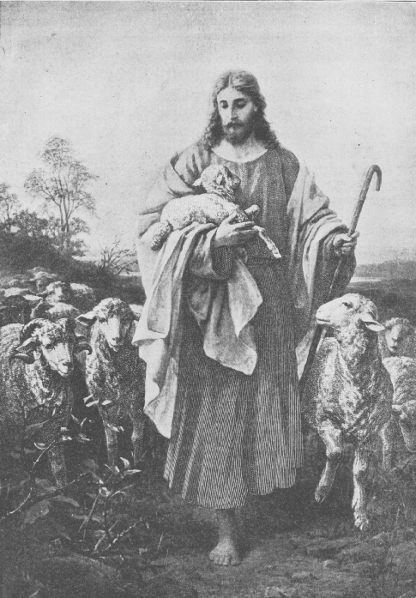
The Shulamite’s troubled evening
^{(Song of Songs 5:2)} For my head is covered with dew, my locks with the drops of the night
Why his head is covered with dew, and his locks (hair) with drops of the night?
In the previous chapter He said He is on the mountains searching for the lost and working to save all mankind.
^{(John 10:11)} “I am the good shepherd. The good shepherd gives His life for the sheep”
^{(John 5:17)} “My Father has been working until now and I am working”

Slide 13

^{(Song of Songs 5:3)} I have taken off my robe, how can I put it again?
My service is over today.
Who told you to take off your robe?
Here our fathers stress on servants along with married people.
^{(John 10:11)} “when you have done all those things which you are commanded say, we are unprofitable servants. We have done what was our duty to do”

Slide 14
^{(Song of Songs 5:6)} I opened for my beloved but my beloved had turned away and was gone. I sought him but I could not find him, I called him but he gave me no answer.
She took Him for granted.
What after He knocks?
This is worse than the first time when she lost him and found him.

Slide 15

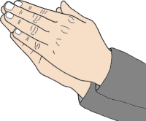
^{(Song of Songs 5:7)} The watchmen who went about the city found me they struck me, they wounded me, the keepers of the walls took my veil away from me.
Who are the watchmen?
The priests and clergy watchmen of the house of the God.
Why struck her?
To realize the gravity or seriousness of the situation.
Took my veil?
Humiliation, despair, worst possible situation
May be she is now ready or close to find Him.
^{(John 10:11)} “The sacrifices of God are a broken spirit, a broken and a contrite heart. These O God You will not despise”

Slide 16
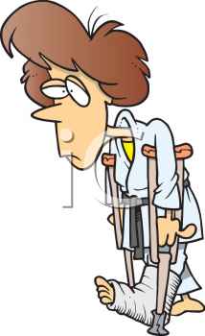
^{(Song of Songs 5:8)} I charge you O daughters of Jerusalem, if you find my beloved that you tell him I am lovesick.
Tone of who?
A broken woman
or a broken man.

Slide 17
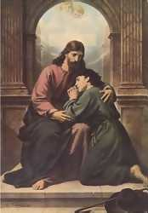
^{(Song of Songs 5:9)} What is your beloved more than another beloved, O fairest among women? What is your beloved more than another beloved, that you so charge us?
Public humiliation!
She is the bride of the King.
Who are you?

Slide 18
^{(Song of Songs 5:10-16)} 10 My beloved is white and ruddy, Chief among ten thousand. 11 His head is like the finest gold; His locks are wavy, And black as a raven. 12 His eyes are like doves By the rivers of waters, Washed with milk, And fitly set. 13 His cheeks are like a bed of spices, Banks of scented herbs. His lips are lilies, Dripping liquid myrrh. 14 His hands are rods of gold Set with beryl. His body is carved ivory Inlaid with sapphires. 15 His legs are pillars of marble Set on bases of fine gold. His countenance is like Lebanon, Excellent as the cedars. 16 His mouth is most sweet, Yes, he is altogether lovely. This is my beloved, And this is my friend, O daughters of Jerusalem!
Who’s speaking?
The Shulamite - beautiful words from the depth of her heart.
So full of passion that made the daughters of Jerusalem change their tone.

Slide 19
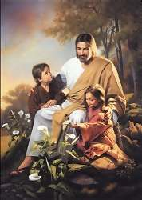
^{(Song of Songs 6:1)} Where has your beloved gone, O fairest among women? Where has your beloved turned aside that we may seek him with you?
They were moved with her words.
Wow you have a great beloved how can we help you?

Slide 20
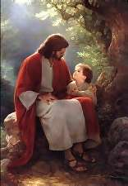
Restored once more
^{(Song of Songs 6:2)} My beloved has gone to his garden, to the beds of spices, to feed his flock in the gardens and to gather lilies.
I am my beloved’s, and my beloved is mine. He feeds his flock among the lilies.
^{(Song of Songs 2:16)} My beloved is mine and I am his. He feeds his flock among the lilies.

