Slide 1
Heaven
¹³But in keeping with his promise we are looking forward to a new heaven and a new earth, the home of righteousness. 2Peter 3:13
Notes:
Introduction:
We are sojourners on this earth, travelers in this temporary world on our way to a final destination which the Lord has prepared for us. A place prepared for those who have abided in His love to continue to live with Him forever in perfect peace without any struggling or pain.
We are created for Heaven, we are made to be heavenly creatures. In order to understand this topic we need to open our hearts and realize that we can’t understand our faith by intellect a lone but by belief, by our spirit.

Slide 2
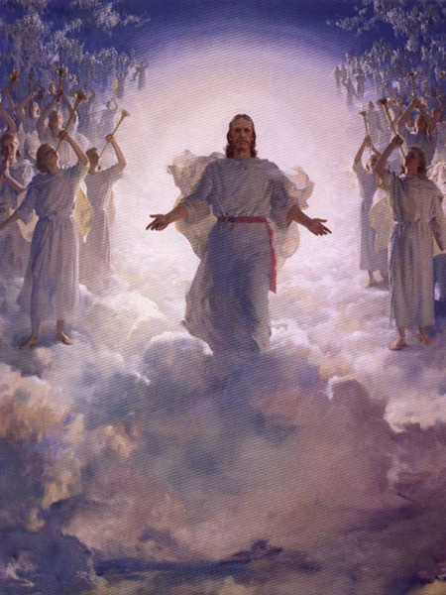
What is Heaven?
Heaven is the place from which we were created (our long awaited home land) for which we were created and through our Lord Christ, it was opened to us once again. The door of heaven was shut to us after the fall but was made available to us again after Christ came.

Slide 3
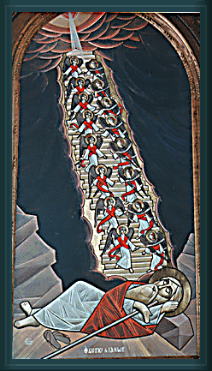
Heaven was opened through Christ, and that’s the revelation that Jacob saw:
Genesis 28:12-13
¹² Then he dreamed, and behold, a ladder was set up on the earth, and its top reached to heaven; and there the angels of God were ascending and descending on it.
¹³ And behold, the LORD stood above it and said: “I am the LORD God of Abraham your father and the God of Isaac; the land on which you lie I will give to you and your descendants.

Slide 4
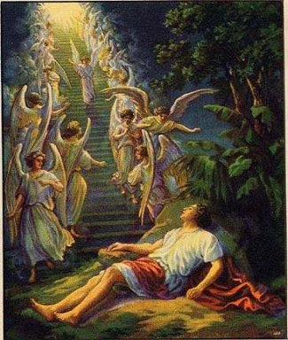
Spiritual eyes opened.
Jesus said to Nathaniel: John 1:51
⁵¹ And He said to him, “Most assuredly, I say to you, hereafter^{[a]} you shall see heaven open, and the angels of God ascending and descending upon the Son of Man.”
In the saints we see examples of those who lived in and for the promise of Heaven to come. They lived by faith in the spirit.
Hebrews 11:13
The Heavenly Hope
¹³ These all died in faith, not having received the promises, but having seen them afar off were assured of them,^{[a]} embraced them and confessed that they were strangers and pilgrims on the earth.”

Slide 5
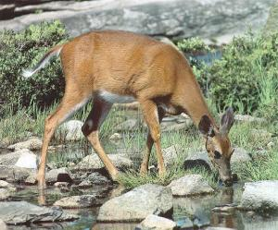
We have a God Shaped Hole in our Hearts:
Psalm 42
¹
^{[b]} As the deer pants for streams of water,
so my soul pants for you, O God.
² My soul thirsts for God, for the living God.
When can I go and meet with God?
Notes:
2 Corinthians 5:6-8
⁶ So we are always confident, knowing that while we are at home in the body we are absent from the Lord. ⁷ For we walk by faith, not by sight. ⁸ We are confident, yes, well pleased rather to be absent from the body and to be present with the Lord.
“The saints lived in the flesh on earth as if they had no bodies, as spirits in heaven.” P. 19 of Heaven
We have a natural eagerness for heaven and this is evidenced by our prayers, offerings (service, laying up treasures in heaven) and intercessions of the angels and saints and for the departed, especially in the Holy liturgy.

Slide 6
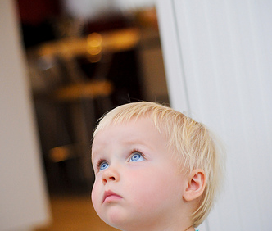
Prayers: Expression for our longing for and love for God: Psalm 123:1
Unto You I lift up my eyes,
O You who dwell in the heavens

Slide 7
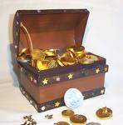
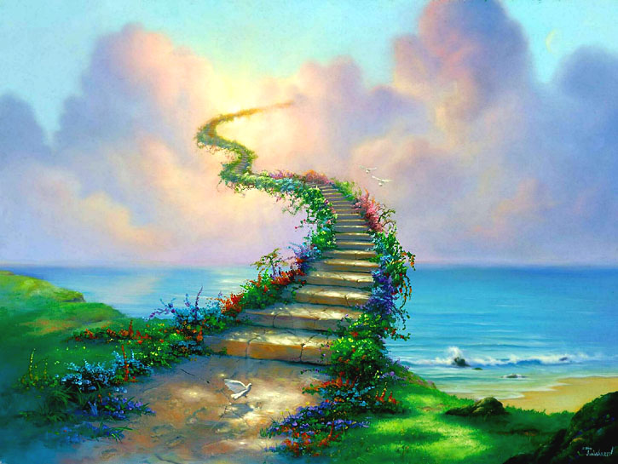
Charity and Offerings: Investing in our future: Matthew 6:19-20
Lay Up Treasures in Heaven
¹⁹ “Do not lay up for yourselves treasures on earth, where moth and rust destroy and where thieves break in and steal; ²⁰ but lay up for yourselves treasures in heaven, where neither moth nor rust destroys and where thieves do not break in and steal.”
“Anyone who gives charity to someone in need is someone who touches heaven with his hand while he is still on earth.” P. 23 of Heaven

Slide 8
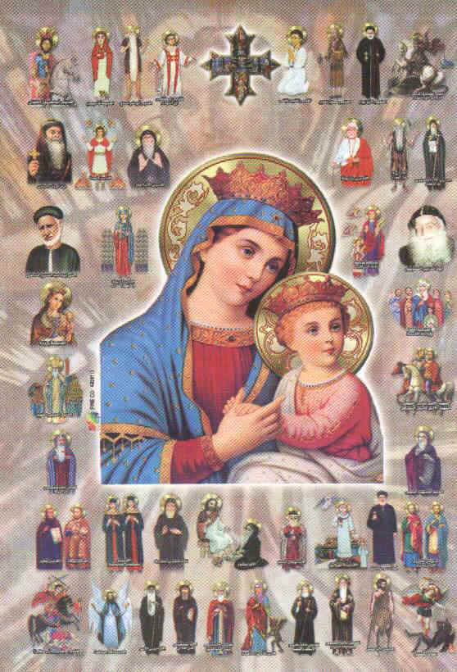
Intercession of the Angels and Saints and Prayer for the Departed
Intercessions of the Saints is having a telephone (a network) that connects heaven directly!
“Contacting heaven and its inhabitants is very easy and possible. You just have to call the siat, “O Virgin Mary, Mother of Light; O Archangel Michael; O Saint George; “ Saint Mina, etc..” Immediately, our call reaches their ears, and they quickly come to our rescue.” P. 24 of Heaven
Notes:
In the Matins Doxology we offer incense to each of the saints as if we are telling each of them good morning by name. We are constantly living with those in heaven this way.

Slide 9
Proof that man is made for Heaven (we are heavenly creatures):
^{Mathew 6:19} And I will give you the keys of the kingdom of heaven, and whatever you bind on earth will be bound in heaven, and whatever you loose on earth will be loosed^{[d]}in heaven.”

Slide 10
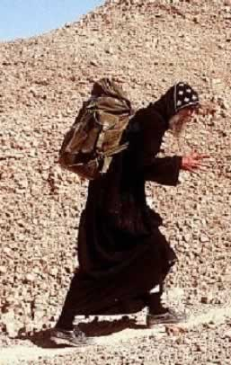
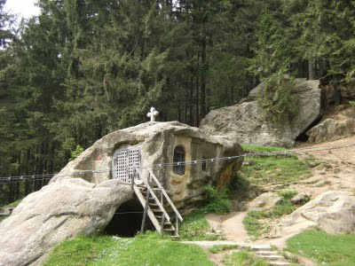
Heaven is our final dwelling place, it is our country of citizenship from which we have been traveling away from all our lives and eager to return to:
Notes:
Matthew 5
The Beatitudes
¹ And seeing the multitudes, He went up on a mountain, and when He was seated His disciples came to Him. ² Then He opened His mouth and taught them, saying:
³ “ Blessed are the poor in spirit,
For theirs is the kingdom of heaven.
⁴ Blessed are those who mourn,
For they shall be comforted.
⁵ Blessed are the meek,
For they shall inherit the earth.
⁶ Blessed are those who hunger and thirst for righteousness,
For they shall be filled.
⁷ Blessed are the merciful,
For they shall obtain mercy.
⁸ Blessed are the pure in heart,
For they shall see God.
⁹ Blessed are the peacemakers,
For they shall be called sons of God.
¹⁰ Blessed are those who are persecuted for righteousness’ sake,
For theirs is the kingdom of heaven.
¹¹ “Blessed are you when they revile and persecute you, and say all kinds of evil against you falsely for My sake.¹² Rejoice and be exceedingly glad, for great is your reward in heaven, for so they persecuted the prophets who were before you.
And

Slide 11

2 Corinthians 5:1-2
¹ For we know that if our earthly house, this tent, is destroyed, we have a building from God, a house not made with hands, eternal in the heavens. ² For in this we groan, earnestly desiring to be clothed with our habitation which is from heaven

Slide 12
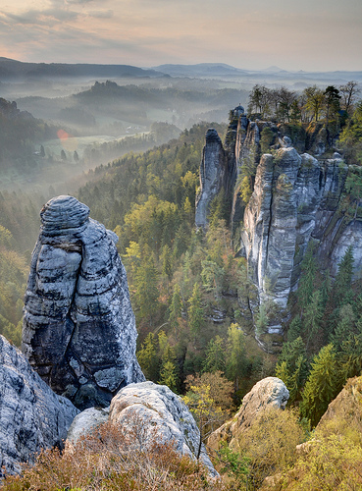
Our Citizenship is in Heaven
St. Gregory the Theologian says; “When I witness the overwhelming joy that man gains by dying and the triviality of what he loses by departing form life, I can not bear any eagerness so intense to go up to heaven. I cry out to God saying, ‘When, O God, will You deliver me from this life and make me dwell in my dear country?”
Notes:
St. Paul described how the those faithful in the Old Testament looked to heaven: Hebrews 11:16 ¹⁶ But now they desire a better, that is, a heavenly country.Therefore God is not ashamed to be called their God, for He has prepared a city for them.
When St. Paul was nearing his death he said; 2 Tim 4:18: And the Lord will deliver me from every evil work and preserve me for His heavenly kingdom.

Slide 13
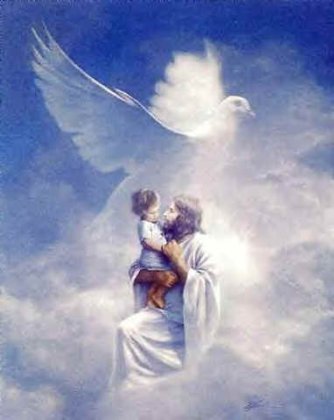
“Our Father who art in heaven…”---In Christ we discovered our true value, our true identity as Christians, we are heavenly creatures.
“
Galatians 4:7
⁷ Therefore you are no longer a slave but a son, and if a son, then an heir of^{[a]} God through Christ.

Slide 14
Where is this Heaven?
1st heaven: St. Basil the Great said is the sky, “the birds heaven.”
2nd heaven is Space
3rd heaven: Paradise, where the saints wait upon their death for the final judgment
Where St. Paul was a witness; 2 Corinthians 12:2-4
² I know a man in Christ who fourteen years ago—whether in the body I do not know, or whether out of the body I do not know, God knows—such a one was caught up to the third heaven. ³ And I know such a man—whether in the body or out of the body I do not know, God knows— ⁴ how he was caught up into Paradise and heard inexpressible words, which it is not lawful for a man to utter.

Slide 15
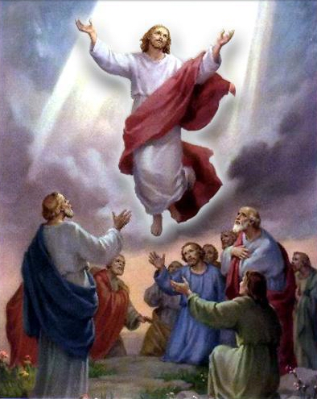
The Heaven where God dwells:
--Gen 17:22 ²² Then He finished talking with him, and God went up from Abraham.
-- On the day of the inauguration of the temple built by Solomon (the house of God, which His place on earth) Solomon prayed; 1 Kings 8:22-23
²² Then Solomon stood before the altar of the LORD in the presence of all the assembly of Israel, and spread out his hands toward heaven; ²³ and he said: “LORD God of Israel, there is no God in heaven above or on earth below like You, who keep Your covenant and mercy with Your servants who walk before You with all their hearts 1 Kings 8:30 And may You hear the supplication of Your servant and of Your people Israel, when they pray toward this place. Hear in heaven Your dwelling place; and when You hear, forgive.
Notes:
--Gen 17:22 ²² Then He finished talking with him, and God went up from Abraham.
-- On the day of the inauguration of the temple built by Solomon (the house of God, which His place on earth) Solomon prayed; 1 Kings 8:22-23
Solomon’s Prayer of Dedication
²² Then Solomon stood before the altar of the LORD in the presence of all the assembly of Israel, and spread out his hands toward heaven; ²³ and he said: “LORD God of Israel, there is no God in heaven above or on earth below like You, who keep Your covenant and mercy with Your servants who walk before You with all their hearts 1 Kings 8:30 And may You hear the supplication of Your servant and of Your people Israel, when they pray toward this place. Hear in heaven Your dwelling place; and when You hear, forgive.
More evidence form scripture that Heaven is His dwelling place;
When the Lord spoke to Nicodemus: John 3:13 (New King James Version)
¹³ No one has ascended to heaven but He who came down from heaven, that is, the Son of Man who is in heaven.^{[a]}
-- ^{John 6:38} For I have come down from heaven, not to do My own will, but the will of Him who sent Me. ³⁹ This is the will of the Father who sent Me, that of all He has given Me I should lose nothing, but should raise it up at the last day. ⁴⁰ And this is the will of Him who sent Me, that everyone who sees the Son and believes in Him may have everlasting life; and I will raise him up at the last day.”
John 20:17
¹⁷ Jesus said to her, “Do not cling to Me, for I have not yet ascended to My Father; but go to My brethren and say to them, ‘I am ascending to My Father and your Father, and to My God and your God.’”

Slide 16
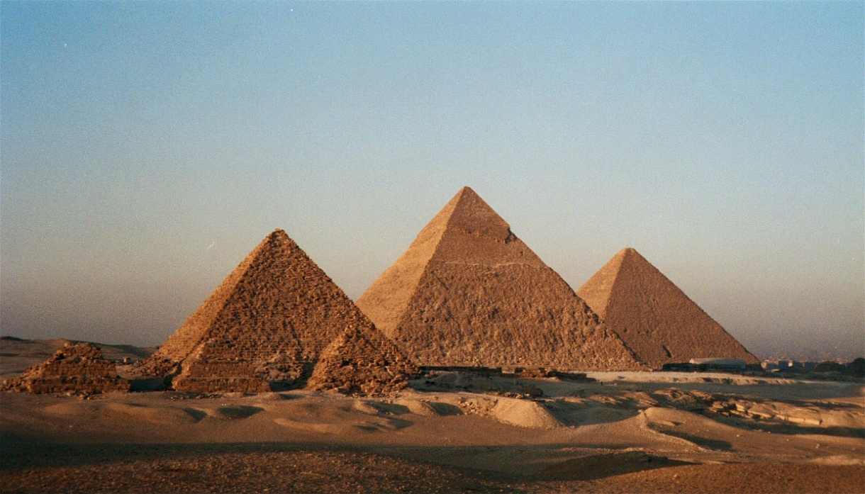
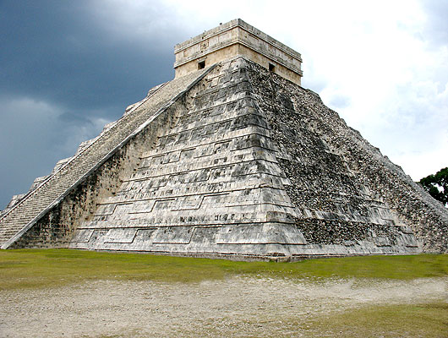
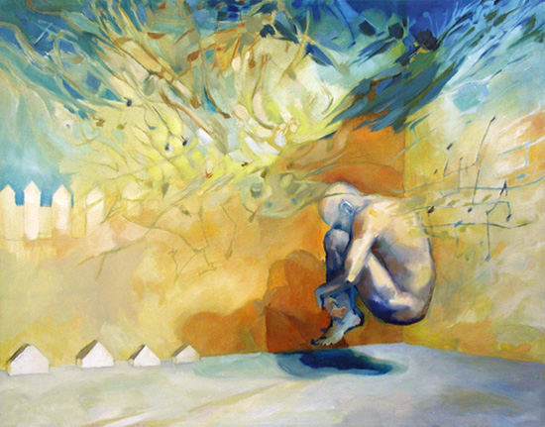
Death and the After Life
Notes:
Man instinctively throughout the ages, of different cultures and races and class, have hypothesized about the after life, for example the Ancient Egyptians (among so many, the Aztecs, for example the ancient Greeks; in their burial rituals, they called on the one who was deceased by shouting their name three times, wishing him three times to be happy and healthy and “may the burial be easy on you.”
The shapes of the Pyramids are directed towards heaven.
Beni salam tombs (very early tombs found dead buried in a fetal position) –for rebirth.

Slide 17
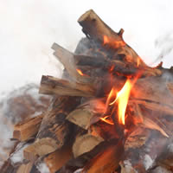
Behold I tell you a Mystery: We shall all be changed
Everything on this earth (through the heavenly/spiritual lens can prove the existence of heaven) for example in Physics; matter can never be destroyed, it always exists in different forms; When you burn wood it is transformed into ashes and carbon but doesn’t disappear—doesn’t cease to exist. Wouldn’t it be the same of God’s most magnificent creature when we die, we change.
Notes:
Phil 3:20-21
²⁰ For our citizenship is in heaven, from which we also eagerly wait for the Savior, the Lord Jesus Christ, ²¹ who will transform our lowly body that it may be conformed to His glorious body, according to the working by which He is able even to subdue all things to Himself.
1 Corinthians 15:51-52
⁵¹ Behold, I tell you a mystery: We shall not all sleep, but we shall all be changed— ⁵² in a moment, in the twinkling of an eye, at the last trumpet. For the trumpet will sound, and the dead will be raised incorruptible, and we shall be changed.

Slide 18
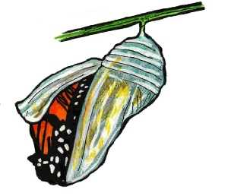
Nature itself gives us proof of the Resurrection:
Caterpillar/Cacoon
Plants:
John 12:23-24 ²³ But Jesus answered them, saying, “The hour has come that the Son of Man should be glorified. ²⁴ Most assuredly, I say to you, unless a grain of wheat falls into the ground and dies, it remains alone; but if it dies, it produces much grain. ²⁵ He who loves his life will lose it, and he who hates his life in this world will keep it for eternal life.

Slide 19
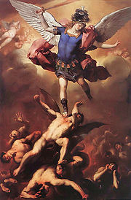
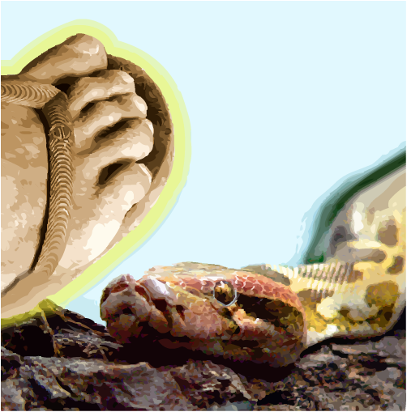
Death is actually a transitional stage, an end and a beginning because the Lord Christ tasted death and transformed it to Life.
Notes:
1 Corinthians 15:57
⁵⁷ But thanks be to God, who gives us the victory through our Lord Jesus Christ

Slide 20
The spirit leaves the body at Death:
Our spirit is the mystery behind our bodies, that which gives us life, intellect, Acts 17:28
'For in him we live and move and have our being.' As some of your own poets have said, 'We are his offspring.'
Notes:
We are made in His image, because God is Spirit John 4:24
²⁴ God is Spirit, and those who worship Him must worship in spirit and truth.
And 2 Corinthians 3:17
¹⁷ Now the Lord is the Spirit;
Therefore our spirit in the image of God is immortal, pure, sanctified and has dominion over nature>>notice these are characteristics of the saints (whenever we hear of a saint’s story, they weaken their bodies to strengthen their spirits and are able to do the things of the spirit).
The body dies (Job 34:15)
¹⁵ All flesh would perish together,
And man would return to dust
And the Spirit is separated from the body: Acts 7:59: ⁵⁹ And they stoned Stephen as he was calling on God and saying, “Lord Jesus, receive my spirit.” ⁶⁰ Then he knelt down and cried out with a loud voice, “Lord, do not charge them with this sin.” And when he had said this, he fell asleep. And Psalm 31:5
⁵ Into Your hand I commit my spirit;
You have redeemed me, O LORD God of truth.
And the Lord Himself said on the cross;
Luke 23:46
⁴⁶ And when Jesus had cried out with a loud voice, He said, “Father, ‘into Your hands I commit My spirit.’”^{[a]} Having said this, He breathed His last.”

Slide 21
Qualifications for entering Heaven
2 Peter 3:9
⁹ The Lord is not slack concerning His promise, as some count slackness, but is longsuffering toward us,^{[a]} not willing that any should perish but that all should come to repentance.
1 Timothy 2:4-6 who desires all men to be saved and to come to the knowledge of the truth. ⁵For there is one God and one Mediator between God and men, the Man Christ Jesus, ⁶ who gave Himself a ransom for all, to be testified in due time,

Slide 22
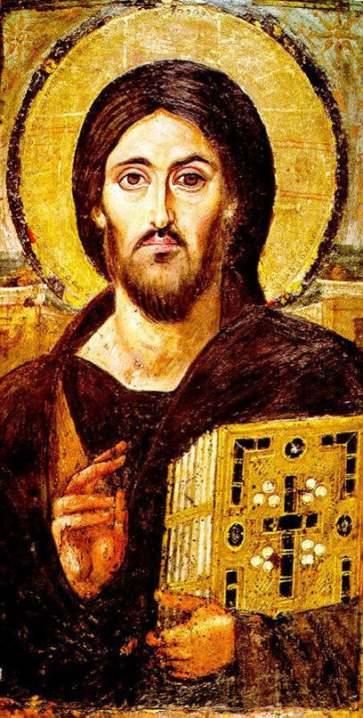
Qualifications for entering Heaven
Faith in Christ’s Salvation: A practical and actual faith with the correct understanding of His mercy and justice.
Ps 85:10 Mercy and truth have met together;
Righteousness and peace have kissed.
Notes:
John 3:18-19 “He who believes in Him is not condemned; but he who does not believe is condemned already, because he has not believed in the name of the only begotten Son of God. ¹⁹ And this is the condemnation, that the light has come into the world, and men loved darkness rather than light, because their deeds were evil.

Slide 23
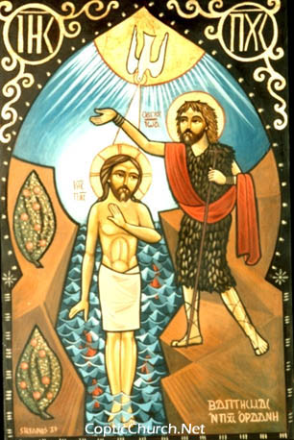
Qualifications for Entering Heaven
The Second Birth: Holy Baptism
Notes:
Holy Baptism is the birth into which we enter our spiritual life and hence heaven, without it we are dead. Just as we are born naturally into this world by a father and mother, we need to born spiritually into the spiritual domain which is Heaven through a Father (God the Lord) and a spiritual Mother (which is the church) with this second birth we enter heaven.
John 3
The New Birth
¹ There was a man of the Pharisees named Nicodemus, a ruler of the Jews. ² This man came to Jesus by night and said to Him, “Rabbi, we know that You are a teacher come from God; for no one can do these signs that You do unless God is with him.”
³ Jesus answered and said to him, “Most assuredly, I say to you, unless one is born again, he cannot see the kingdom of God.”
⁴ Nicodemus said to Him, “How can a man be born when he is old? Can he enter a second time into his mother’s womb and be born?”
⁵ Jesus answered, “Most assuredly, I say to you, unless one is born of water and the Spirit, he cannot enter the kingdom of God. ⁶ That which is born of the flesh is flesh, and that which is born of the Spirit is spirit. ⁷ Do not marvel that I said to you, ‘You must be born again.

Slide 24
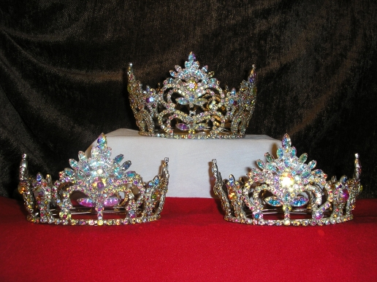
Qualifications for Entering Heaven
Christian Virtues
Notes:
-Meekness and Humility
-The fruit of the Spirit
-- Ephesians 5:9
⁹(for the fruit of the light consists in all goodness, righteousness and truth)
--“The holies for the holy”
Hebrews 12:14
¹⁴Make every effort to live in peace with all men and to be holy; without holiness no one will see the Lord.
Ephesians 1:4
⁴For he chose us in him before the creation of the world to be holy and blameless in his sight. In love
Glory be to God forever Amen.

