Slide 1
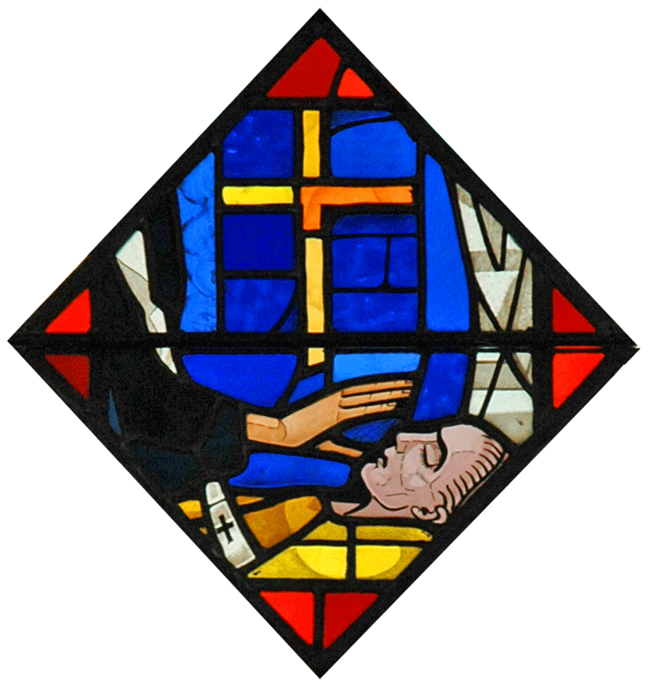
Church Sacraments
The Unction of the Sick

Slide 2
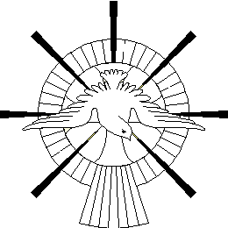
Introduction:
The seven Sacraments of the Church are the channels by which we receive the graces and blessings of the Holy Spirit. The Holy Spirit works in the church through the Sacraments, giving us His gifts, blessings and comfort, and teaches us and guides us to the way of truth.

Slide 3
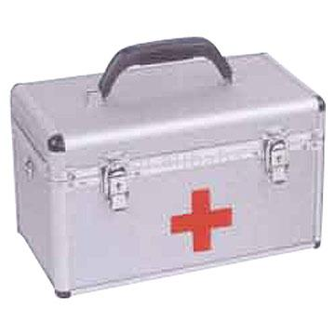
The Significance of the Sacraments for our Lives
There are three classes
of medicine for our health
Preventative
Curative
Supplemental
Notes:
Preventive Medicine: like vaccination given to children against smallpox, paralysis and others, to protect them against these diseases.
Curative Medicine: prescribed for a person after having had the doctor diagnose the reason for illness.
Supplementary Medicine: various vitamins, prescribed by the doctor to strengthen the human body, giving energy and immunity against a disease once more.
The same applies to the soul in that resembles the body; it is prone to spiritual diseases like sin, satanic warfare’s and others.
Our great physician, the Lord Jesus made the church our spiritual hospital, and the priest as its spiritual physician, as St. John Chrysostom once said, “Are you a sinner? Go to the Church which is a hospital not a court”. In the church you will find the spiritual physician who is the priest. Tell him your sins, as he accurately examines everything and prescribes the appropriate cure.
The spiritual medicines are the Seven Sacraments of the Church, which are preventive, curative and supplementary.

Slide 4
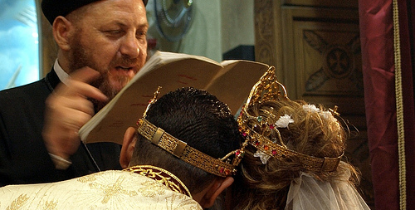

PREVENTIVE
Sacrament of Myron: by which the Holy Spirit dwells to fortify against sin and evil, helps to overcome sin and provides victory in spiritual struggle.
Sacrament of Matrimony: protects the couple from falling into the sin of adultery.

Slide 5
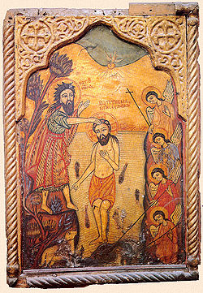
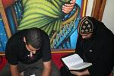
CURATIVE
Sacrament of Baptism: provides the cure from the original sin for children, and from the committed sins of those older.
Sacrament of Confession and Repentance: for those who repent and confess, this sacrament provides the cure and forgiveness of their sins.
Sacrament of Unction of the Sick: provides cure for those who are physically and psychologically ill, caused by sin.

Slide 6
The Unction of the Sick
Instituted by the Lord Jesus when He said to His disciples,
“Heal the sick, cleanse the lepers” (Matthew 10:8), and, “Whatever city you enter … heal the sick who are there” (Luke 10:8).
The Apostles then put the Lord’s words into practice: “They anointed with oil many who were sick and healed them” (Mark 6:13).
Our teacher St. James the Apostle advised believers to practice it, by saying, “Is anyone among you sick? Let him call for the elders of the Church, and let them pray over him, anointing him with oil in the name of the Lord. And the prayer of faith will save the sick, and the Lord will raise him up, and if he has committed sins, he will be forgiven” (James 5:14-15).

Slide 7
Origin of the Sacrament
It is called the ‘Sacrament of Lamps’, for the early Christians used to place oil in a lamp, from which hung seven other lamps. Each lamp was lit at the beginning of every prayer. This rite still exists, however, the seven lamps were replaced by seven wicks, made from cotton wool, which sit in a plate of oil. The Spirit of God dwells and sanctifies the oil in order to heal those anointed by it. The wicks are placed in the sign of the cross, in the plate of oil.

Slide 8
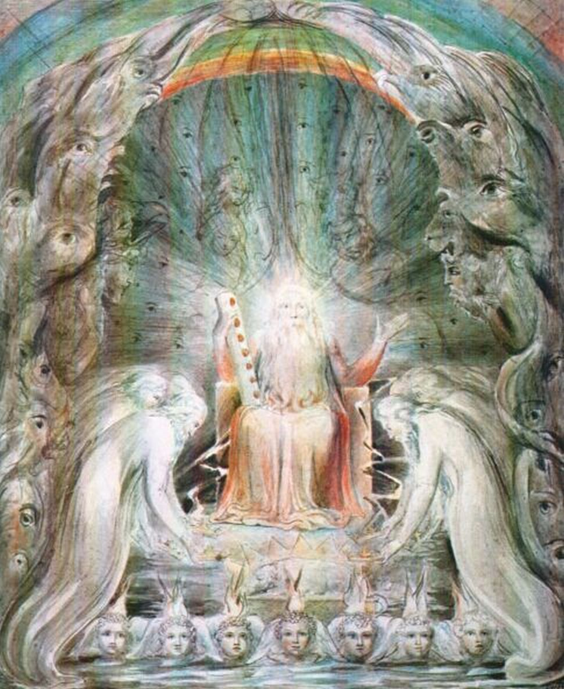
The Origin of the Sacrament:
The number seven signifies the seven spirits of God, which are mentioned in the Book of Revelation (Revelation 3:1).-Symbolically the number is seven is a sign of perfection or completion.
Notes:
God was described in Rev. 3:1 as ; “And to the angel of the church in Sardis write,
‘These things says He who has the seven Spirits of God and the seven stars: “I know your works, that you have a name that you are alive, but you are dead.

Slide 9

The Necessity of Confessing before partaking of the Sacrament of the Unction of the Sick:
“Jesus went about doing good and healing all those who were oppressed by the devil” (Acts 1:38), as Malachi prophesied about Him saying, “But to you who fear My Name, the Son of Righteousness shall rise with healing in His wings” (Malachi 4:2).
Our fathers the Apostles practiced it according to the orders of their Master, as the Bible says, “So they went out and preached that people should repent. And they cast out many demons, and anointed with oil many who were sick and healed them” (Mark 6:12,13).

Slide 10

Mind/Body Connection
Some Biblical and Scientific Research Examples
Notes:
the lame man at Bethsaida, who had been sick for 38 years, He said to him: “Sin no more, lest a worse thing come upon you” (John 5:14).
when the people lowered the paralytic man down from the roof top on a stretcher, the first words the Lord said to him was: “Your sins are forgiven”, then, “Arise, take up your bed and walk” (Matthew 9:2-6).
This doesn’t mean don’t seek Medical care—but simply that it would be only doing half the necessary work:
A patient who relies only on medicine, denies himself the ability of God to heal him, just like King Asa, of Judah:“Asa became diseased and his malady was very severe, yet in his disease he did not seek the Lord, but the physicians” (2 Chronicles 16:12-13), who was contrary to the good King Hezekiah who was close to death, and prayed to the Lord, weeping bitterly until the Lord sent Isaiah the prophet to him saying: “Thus says the Lord, the God of David your father, I have heard your prayer, I have seen your tears, surely I will heal you. On the third day you shall go up to the house of the Lord. And I will add to your days fifteen years”(2 Kings 20:1-6)
Sickness is both physical and spiritual; The physician may advise the patient to rest, in order for them to have a quick recovery, just as Joshua advised:“Severe sickness is gone by sleep” (Joshua 31:2), but most of all, it is necessary to plead to God in order for them to receive healing and the regaining of health (Joshua 38:14)
This is why this sacrament is performed regularly in people’s homes during Holy Lent, although there may not be a specific sick person there, but for true repentance and healing of our souls.
Usually sickness in old age and Alzheimer’s is more common for those who are inclined to depression and anxiety and anger, all symptoms of the soul that confession can get rid of: Science today is discovering that there is a mind-body connection:
Increased physical activity and exercise would maintain cognition by reducing risk of diseases associated with cognitive decline.
In a study published in 2006 psychologist Stanley J. Colcombe of the University of Illinois and his colleagues examined the influence of fitness training on potential changes in brain structure. The six-month trial included 59 healthy but sedentary community-dwelling volunteers, age 60 to 79. Brain scans after fitness training showed that even relatively short exercise interventions can begin to restore some of the losses in brain volume associated with normal aging.
And just as maintaining some activity patterns in old age may reduce risk of cognitive decline, the persistence of other patterns of behavior may actually increase the risk. Chronic psychological distress—resulting from depression, anxiety and negative emotions such as anger and shame—is associated with a variety of negative outcomes in adulthood, including cognitive decline. The tendency to experience psychological distress is often called neuroticism. Studies have consistently found a higher level of neuroticism to be linked to an increased incidence of Alzheimer’s disease and mild cognitive impairment in old age.

Slide 11
General Unction of the Sick or “Andeel” on the last Friday of Lent
once a year the Church performs this Sacrament in the Church, and it takes place on the last Friday of the holy Lent (that is, the Friday before Passion Week). It is called the ‘General Andeel’.
Notes:
General Unction of the Sick or “Andeel” on the last Friday of Lent
It is a known fact that all sacraments are accomplished in the Church, with the exception of the Sacrament of Unction of the Sick as the sick may be too weak to come to church so the priest officiates it in the home. However, once a year the Church performs this Sacrament in the Church, and it takes place on the last Friday of the holy Lent (that is, the Friday before Passion Week). It is called the ‘General Andeel’.
The General Andeel serves the purpose of :
Reminding people of the importance and significance of the Sacrament of Unction of the Sick, for the healing of every believer.
Serving all those believers who have not called the priest privately at home.

Slide 12
Format and Proceedures of the Sacrament:
There are Seven prayers coinciding with the seven lamps or cotton wicks;
Notes:
The order of the prayers of the Unction of the Sick are very old and traditional. Church history mentions that St. Epifanius, Bishop of Cyprus, wrote and organized these prayers. In addition, St basil confirms that the ‘Andeel Prayers’ were well known in the Church from the early days (Canon 91).
Done early in the morning to ensure everyone participating is fasting.
As the Andeel oil is holy oil, upon which the Holy Spirit came, it is important not to leave it sitting in the dish in case it is accidentally spilled. The priest should ensure that the oil, after prayers, is placed in a small bottle, and that the dish is wiped with cotton wool and burnt together with the cotton wicks which were used during the Andeel prayers, before he leaves the house.
We notice in the Rite of the Sacrament of Unction of the Sick, that there are a great quantity of readings from the Holy Bible (7 Pauline, 7 Psalms, and 7 Gospels, apart from all the prayers and supplications). If the sick person is attentive to the prayers, these readings and prayers are a great source of consolation, patience, endurance, peace, and comfort, as well as providing the gift of healing that is accomplished in God’s time. The sick person then feels he can surrender himself to God, and so his feelings of worry and anxiety are replaced with peace and calm, for “Whatever things were written before were written for our learning, that we through the patience and comfort of the Scriptures might have hope” (Romans 15:4).

Slide 13
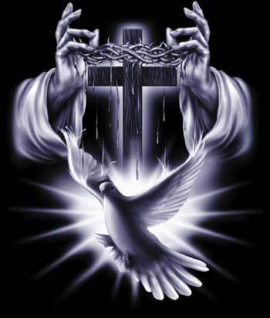

Format and Proceedures of the Sacrament:
The priest says the Blessing and concludes with the Lord’s Prayer. First he anoints the sick person with oil with a cross on his forehead, chest and hands ...
Notes:
1. The forehead is anointed because being the head, it is the center of the senses and thoughts.
2. The chest is anointed because it contains the heart, for King Solomon said, “Keep your heart with all diligence, for out of it spring the issues of life” (Proverbs 4:23).
3. The hands are anointed because they are the instruments of work and deeds.
The priest anoints the person with signs of the cross, in the name of the Holy Trinity, who sanctifies and blesses all things.
The attendants are anointed by oil in the same manner, under one condition - that they are fasting. The woman who is menstruating should not be anointed by oil.
The sick person must receive Holy Communion as soon as possible, after partaking in the Sacrament of Unction of the Sick, for Holy Communion is the essence of life.
The sick person must endeavor to anoint himself with the oil for seven consecutive days, believing in the power of God, and the power of prayer. This perseverance shows his faith in the effectiveness of the Sacrament, and his obedience to the church rite. Faith and obedience are essential ingredients for recovery. Just as the sick preserve in taking medicine for their recovery, so too must they be diligent in anointing themselves with oil.

Slide 14

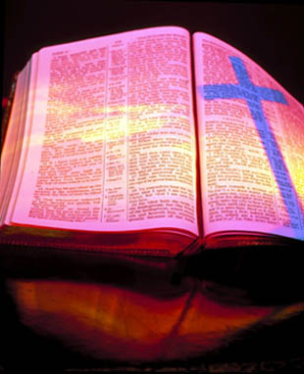
The importance of Faith for the participants in this sacrament:
Notes:
The sick person and his relatives must have strong faith in the work of God in this sacrament, just like the two blind men who had strong faith that Christ would heal them (Matthew 9:28), and the faith of Jairus (Luke 8:50), and the faith of the father who had an epileptic son (Mark 9:23), and the faith of the friends of the paralytic man (Matthew 9:2), and the faith of the bleeding woman (Luke 8:48).
The sick must have faith and confidence in the priest, just as he has trust in his doctor.
At times the sick person may not recover quickly after the Sacrament or may take a long time to heal, and at times the sick person may even die. There are many reasons for this, of which some are ...
Lack of faith of the sick person, just like the people of Nazareth: “The Lord Jesus did not do many mighty works there because of their unbelief” (Matthew 13:58). “Without faith it is impossible to please Him” (Hebrews 11:6). Faith is important for our healing as the Lord Jesus said to Jairus who’s daughter Christ healed, “Do not be afraid, only believe, and she will be made well” (Luke 8:50). Also, the Lord said to the two blind men who asked Him to open their eyes: “Do you believe that I am able to do this?...then He touched their eyes” (Matthew 9:28), and to the father who asked Christ to heal his sick son, the Lord said, “If you can believe, all things are possible to him who believes” (Mark 9:23).
He may not be worthy of being healed due to his evil doings and reluctance to repent and return to God, who says, “Return, you backsliding children, and I will heal your backsliding” (Jeremiah 3:22).
Death of the person is not necessarily an indication that they are not faithful and redeemed. It may be just the next step of His will for them and the perfect ending of pain.
Sickness may be for chastisement and God may abolish it when its purpose is accomplished, just like Job who was sick for seven years. Likewise, Moses’ sister Miriam, was struck by leprosy when she spoke badly against Moses. Then Moses prayed for her saying: “‘Please, heal her, O God, I pray!’ and the Lord said to him, ‘Let her be shut out of the camp seven days, and after that she may be received again’” (Numbers 12), that is, healed from leprosy.

